Slide 1
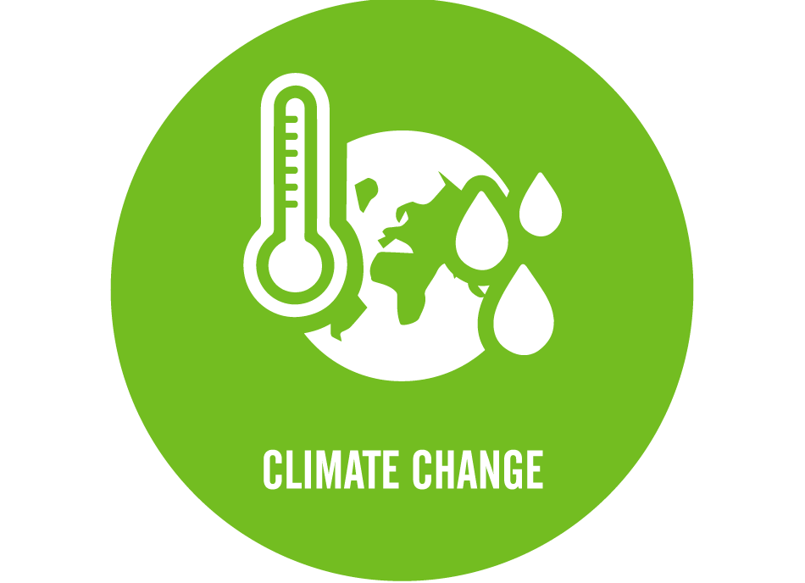
Wexford County Council Climate Action Event 1st June 2023 Theme 1: Agriculture

Slide 2
European Innovation Partnerships (EIP) ‘A completely new way of responding to local challenges’
EU funding granted for Duncannon EIP through DAFM
€721,197 (4.5 years)
Locally Led Section (Johnstown Castle)
Opportunity to design an innovative locally-led scheme for the catchment which improves water quality , protects farm incomes and
Notes:
EIP was a new source of EU funding
This project was one of the 12 successful projects to receive funding

Slide 3
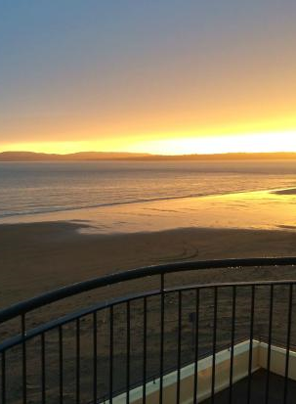
Duncannon Blue Flag Farming & Communities Scheme
Sustainably restore, protect & enhance water quality
Climate Action Co-Benefits
Develop an effective model for the future catchments
Foster positive relations between farmers and households
Notes:
The aims of the project were to
Improve & restore water Quality
Include C0-Benefits for Climate Action
Develop a model to be used in other catchments
Develop good positive relations with farmers householders businesses and communities

Slide 4
Notes:
An operational working group was established to include all representatives from all stakeholders

Slide 5
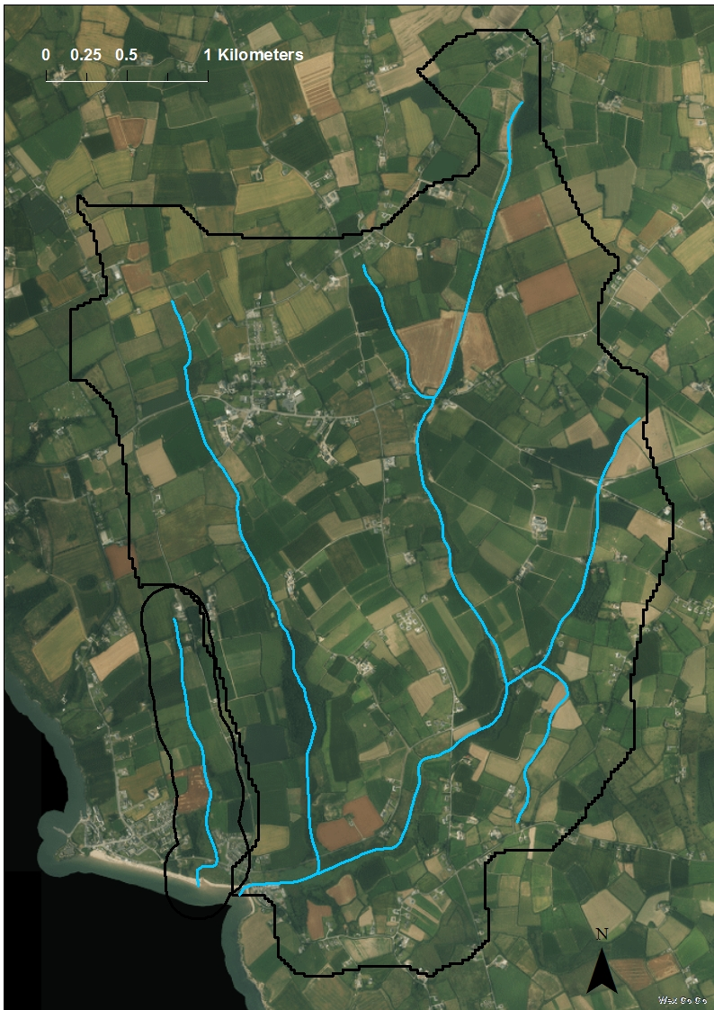
Catchment Area
1400 ha (<3500 acres)
16km watercourse
Curraghmore stream
Small stream
Farmers
Several Business’s
Two schools & creche
Ramsgrange village
Ramsgrange Village
Duncannon
Curraghmore Stream
Small Stream
Notes:
This is a map of the catchment area.
It is Intensive agricultural land.
A mixture of beef, dairy and tillage.
The village of Ramsgrange is also in the catchment
There around 200 houses.
Detailed sampling carried out initially showed issues with elevated nitrates and phosphates in the streams aswell and the ecology is impacted.

Slide 6
To date...
35 farmers
4 dairy
8 tillage
23 drystock
>975ha
70% - GLAS
Notes:
To date we have the buy in from 35 farmers

Slide 7
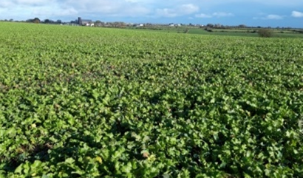
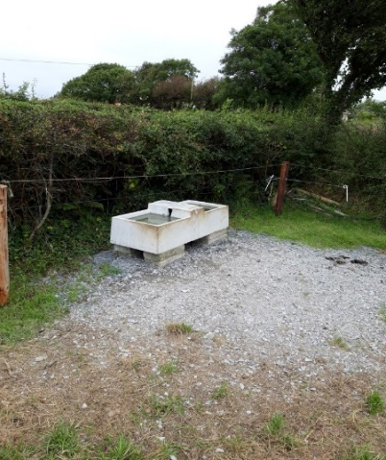
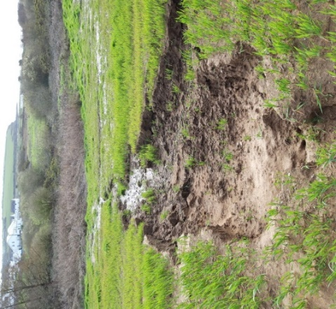
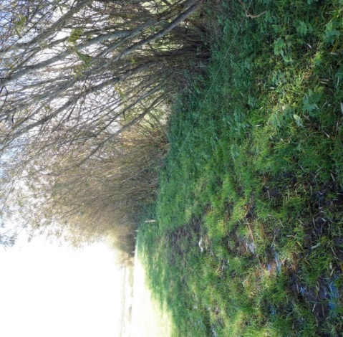
Water Protection Improvement works & Climate Action
Watercourses (16km)
Drinking points
Water troughs (20m)
Soil sampling & NMP (100%)
Buffer zones (10m)
Sediment traps
Farm roadways
Low Emission Slurry Spreading
Riparian zones (native)
Hedgerow planting
Arable Grass margins (1.2km)
Winter cover crops
Notes:
Water quality improved
Protect & restore ecology in stream and Biodiversity
Co-Benefit of Climate Action
Improved Efficiencies on farms

Slide 8
Community engagement
Local Schools
Tidy towns
Village renewal
Coastwatch
LAWPRO
IFI
EPA
Seal Rescue Ireland
Ramsgrange Tidy Towns
National Inspection Plan
Notes:
A number of ‘Citizen Science’ courses in Duncannon for farming/wider community over the time of project
Participants shown how to monitor the water quality of local streams
Huge interest and enthusiasm, particularly for their own farms

Slide 9
Results, return and performance
Reduction in Bacteria in stream
Improvement in Ecological quality & Biodiversity
Compliance above Nitrates Directive
Improved Efficiencies on catchment farms
Reduction in septic tank failures
Local ownership, responsibility and appreciation for local environment
Co-Benefits for Climate Action
Notes:
Results indicate
Reduction in bacteria
Climate action measures undertqaken
Improvement in ecology & Biodiversity
Compliance with Nitrates
Improved Efficiencies on farms
Local Ownership and Appreciation of local environment

Slide 10
Thank You

