Slide 1
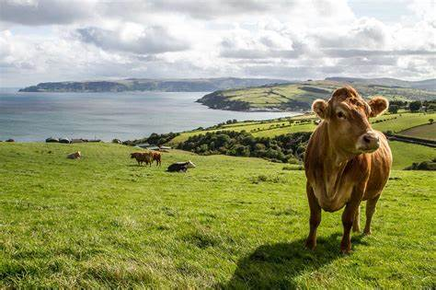
“A changing landscape for Agriculture”
Eoin Kinsella
Agricultural Scientist
Environment Section

Slide 2
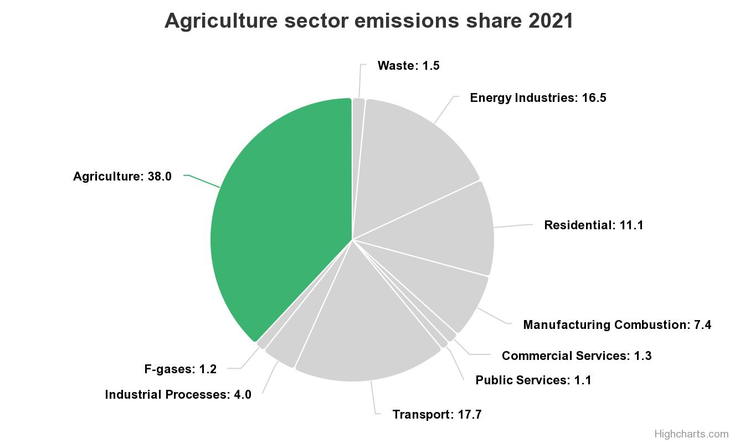

Slide 3
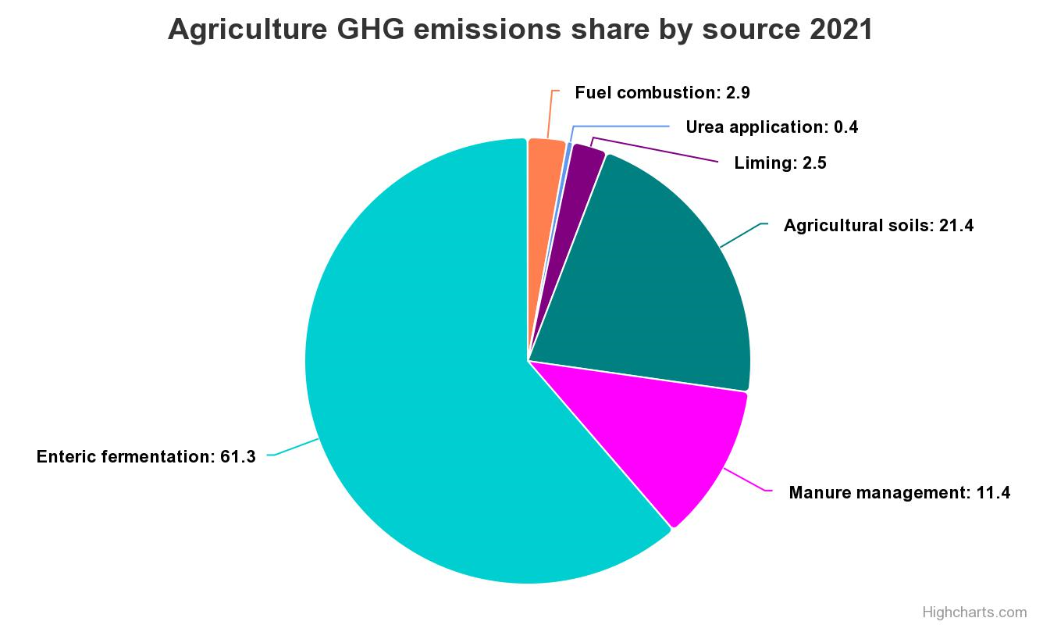

Slide 4
Highlights
Current trends
Greenhouse gas emissions increased 3.6% in 2021
Emissions up 20.6% in last ten years (2011-2021)
Outlook
Emissions projected to increase with expansion of animal numbers.
Technologies to reduce emissions available:
Low Emission Slurry Spreading
"Stabilised urea" fertilisers
Cause
In 2021, we saw an increase in nitrogen fertilizer use (+5.2%) and liming (+49.5%)
Dairy cow numbers up 2.8%
Milk production up 5.5%

Slide 6
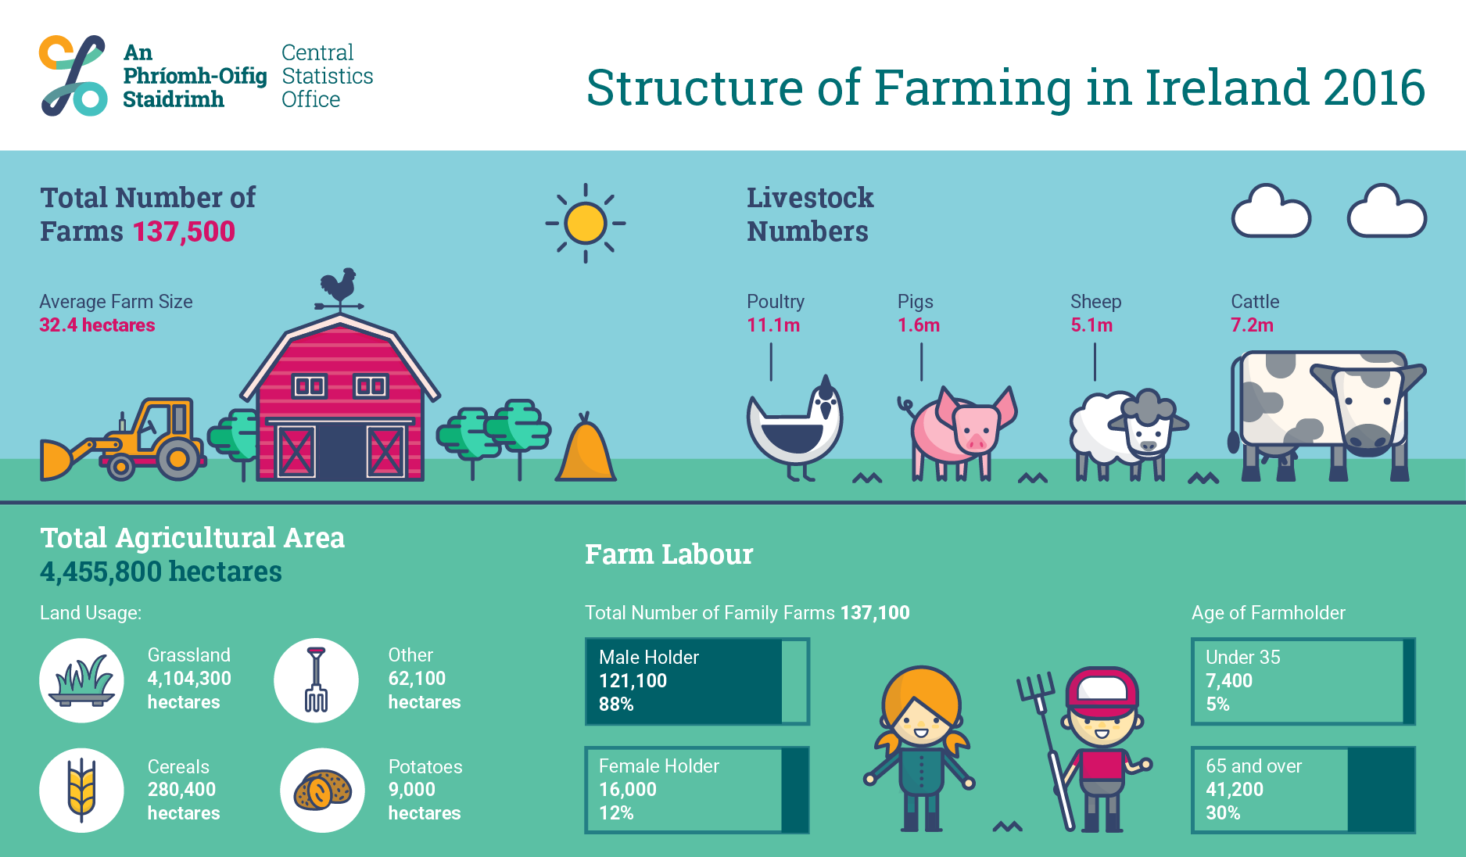
An Roinn Talmhaíochta, Bia agus Mara │ Department of Agriculture, Food and the Marine

Slide 7
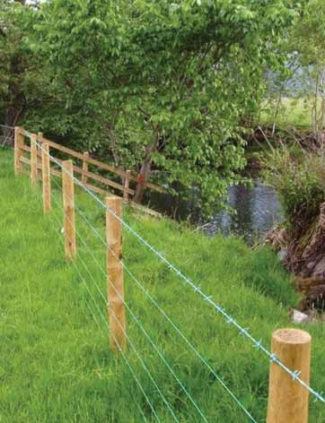
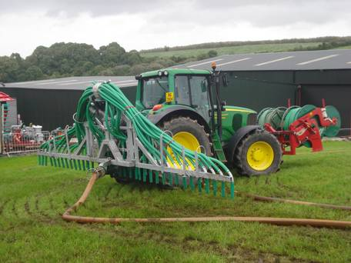
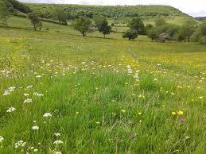
Rural Development Programme (RDP 2014 – 2020)
Green Low-carbon Agri-environment Scheme (GLAS)
16,600 km watercourses protected from bovines
4,900 using low emission slurry spreading
24,800 ha wild bird cover
281,600 ha low input permanent pasture
Maximum payment €5,000/year
Participation – approx 50,000 farmers
Total RDP Funding
€4bn
GLAS Funding
€1.3bn

Slide 8
Agri-Climate Rural Environment Scheme (ACRES)
What’s on offer?
€1.5 billion
50,000 farmers
CAP strategic plan 2023-2027
Range of measures
Biodiversity
Water quality
Climate change
€7,311 (€10,500)

Slide 9
Suckler Carbon Efficiency Programme
Improve the environmental sustainability of the national beef herd
€260 million funding
Action 1 – Eligible Bull/Eligible AI
Action 2 - Female Replacement Strategy
Action 3 – Genotyping
Action 4 - Weighing and Submission of Weights to ICBF
Action 5 – Calving Details and Surveys
€225/ha up to 15 ha (€180/ha)

Slide 10
Agro-Forestry
€1.318 billion
12 categories
Native- €6,744/ha (€1,103/ha)
Broadleaf- €4,314/ha (€1,037/ha)
Agro-forestry- €8,555/ha (€975/ha)
15 to 20 years

Slide 11
Min-Till
Non-plough system
Reducing carbon & humus depletion by 50%
TAMS approved
Consider cover crops
Additional 50,000ha - competition

Slide 12
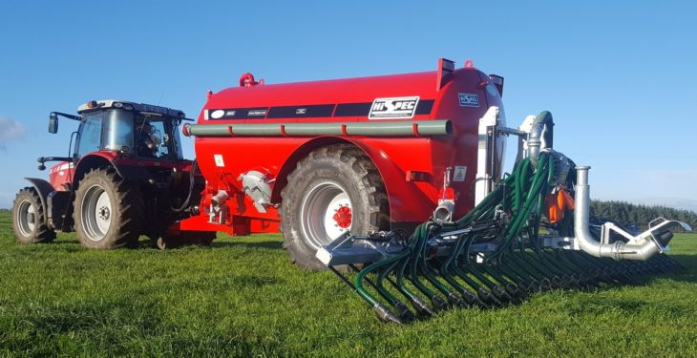
Low Emission Slurry Spreading
€92 million funding available from DAFM
GLAS uptake at 4,900 farmers
TAMS funding for shallow injection and trailing shoe
Increased N availability
EPA (2021) – 1% increase in Ammonia
- 3% rise in cattle numbers
Rise of 48% in use

Slide 13
Multi-species swards/Red Clover/White clover
Red clover replacing perennial in silage ground
White clover incorporation – 50% cut in fertiliser
Multi-species swards
- Plantain
Chicory
Red/white clovers
€300/ha
DLF based in Waterford

Slide 14
Organic Farming Scheme
4100 organic farmers (target of 10% by 2030)
200,000ha
Organic processing investment grant scheme – €1.7 million
Regulated by DAFM
Irish Organic Association
60ha to 70ha
40% (60%) grants available

Slide 15
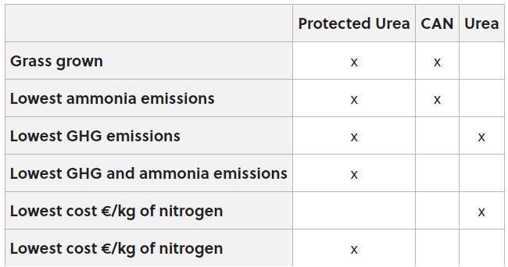
Urea vs CAN
More focus on organic manures
CAN – 27% N
Urea
Protected Urea
Protected Urea – 30% less cost
Same growth rates achieved
January – September

Slide 16
Knowledge transfer/ Collaboration groups
CAP 2023-2027
Highly effective option
Forestry, Dairy, Beef, Sheep, Horticulture
More diverse groups
Incentive!!!
Duncannon Blue Flag Farming & Communities Scheme EIP

Slide 17
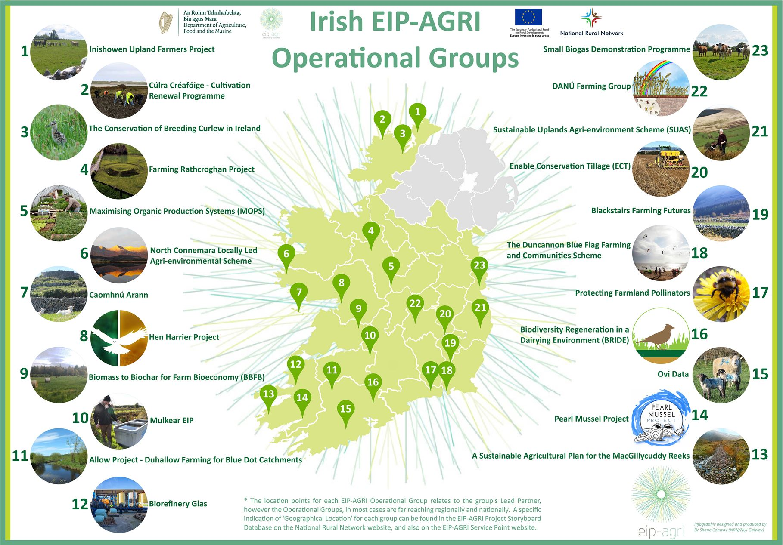
An Roinn Talmhaíochta, Bia agus Mara │ Department of Agriculture, Food and the Marine
Notes:
There is a wide selection
5 Peat uplands
3 soils
Pollinators
Farming in a archaeological landscape
Water quality and Flood management
Biodiversity
Bio-energy
Organic Production
Ovine data.
And of course the Hen Harrier and Pearl Mussel projects

Slide 18
Ireland’s farmers
Land use changes needed globally are massive: increased afforestation & bioenergy crops & decreased pasture & cropland - maintaining food security
Irish farmers are world-class and make an extraordinary contribution to the Irish economy, to rural communities and to employment. They supply world class food and raw materials to people all over the globe.
The €8.2bn in farm gate output, the €14.2bn in agri-food exports to over 180 countries, and the 163,000 agri-food jobs in rural Ireland, demonstrate all of that. And, uniquely, farmers can provide a range of ecosystem services that can contribute positively to addressing environmental challenges (DAFM, 2023)
2050 – 2 billion more people
Demand for food will be 56% greater than 2010
Agriculture will need to become more productive and greener!
Vital to see an incentive for all actions/ measures for farmers as we know farmers are great adapters and adopters
Highly efficient and innovation inside the gate
Knowledge transfer incentive

Slide 19
“It’s hard for donkeys to win the race if they are going to carry the elephants on their backs” (Jim Hightower)
“We must, indeed all hang together or, most assuredly, we shall hang separately” Benjamin Franklin

