Slide 1


Wexford County Council
Climate Action Event
1st June 2023
Theme 2: Biodiversity & Food
Notes:
I am delighted as chair of the Climate Change Biodiversity & Environment SPC to open this session of the climate Action Event which Focuses on the theme of Biodiversity and Food.

Slide 2
Impact of Climate Change on Biodiversity in Ireland
Changes in the timing of life-cycle events (phenology) of plants, birds, and insects
Changes in the geographic range of some bird species
Changes in the suitable climatic zones of key habitats and species

Slide 3
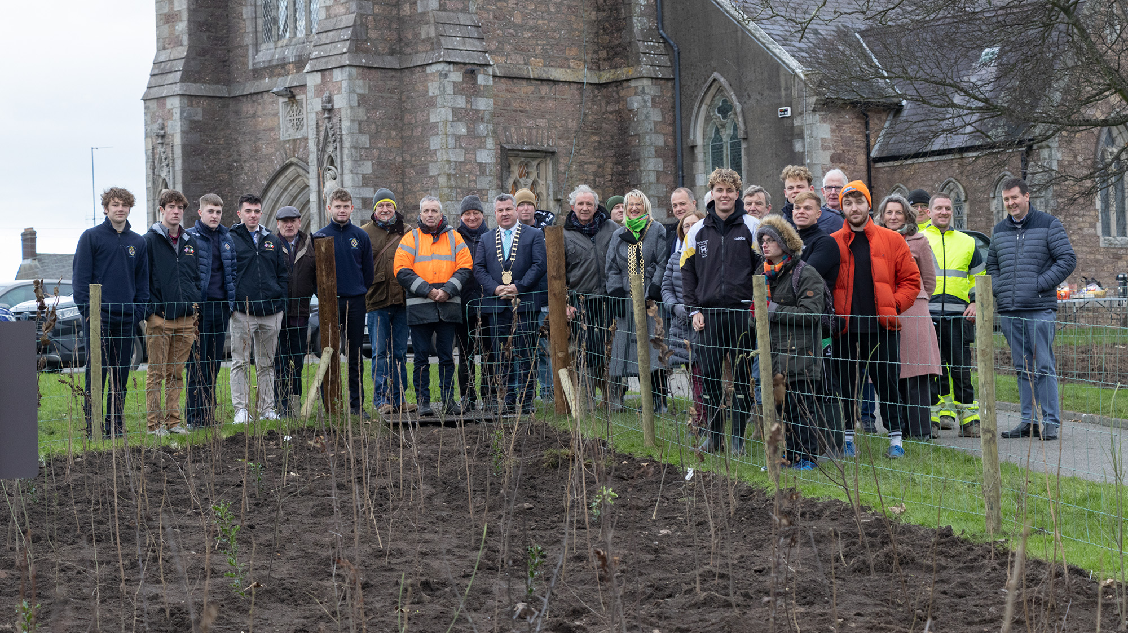
100 Million trees Project
Notes:
National Community- driven Initiative
Developed By brothers Richard & David Mulcahy
A number of pocket forests have been planted around co. Wexford
We are delighted to have Richard here today to give an overview of the project in Wexford and the merits of this initiative

Slide 4
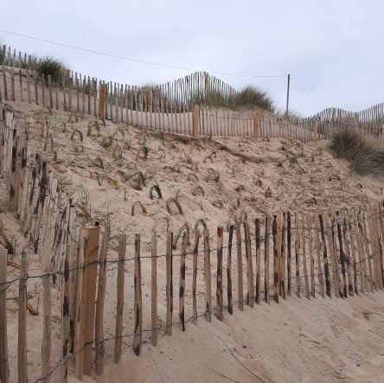
Biodiversity Dune Restoration Project
Community event
Clean Coast , WCC Environment Education Team & Kilmuckridge Tidy Towns
Planting of Marram Grass to protect Dunes at Morriscastle
Notes:
Sand Dunes play a big part in our fight against Climate Change
Sand dunes provide natural coastal protection against storm surge and high waves and help prevent or reduce coastal flooding and structural damage to properties behind them
The strength of the dunes comes from the plants that traps & bind the sand together
Maram grass is most common in Ireland
Fencing erected to keep people off the planted areas.

Slide 5
Notes:
Reimagining Enniscorthy is a Public Art & Community decarbonisation project
It’s a collaborative and place based response to the climate and Biodiversity crisis between Wexford county council Arts department, the Climate action team and local voluntary groups in Enniscorthy
This project is jointly funded through the Wexford County Council’s Per Cent for Art Scheme and Creative Ireland Programme.

Slide 6
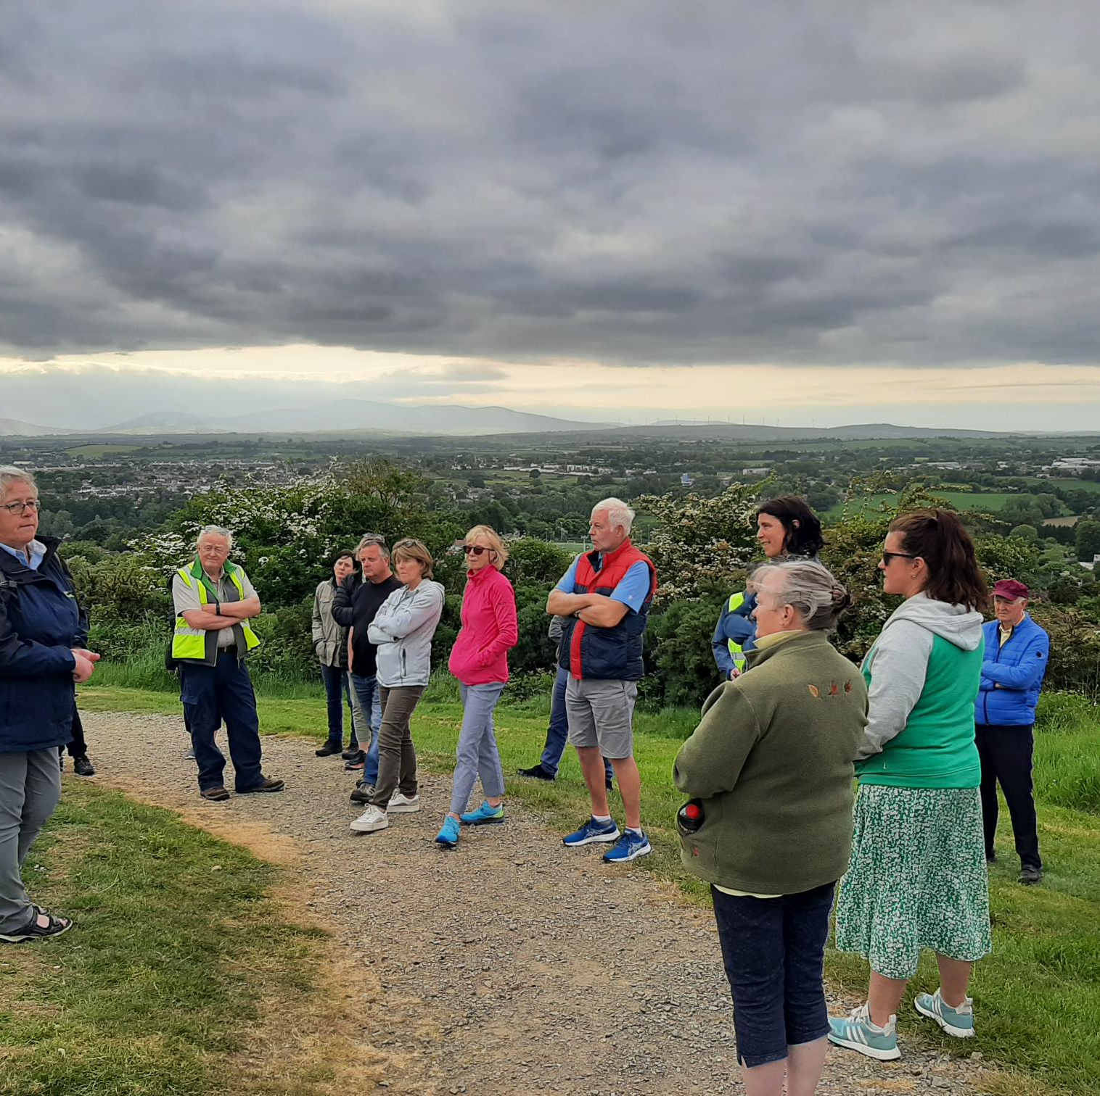
Reimagining Enniscorthy
Biodiversity Hedgerow walk
Free Seed Hub banks
Climate Cafe
Notes:
The project is a way of helping to create a local ecology network for people-led climate action, connecting neighbours and community groups in Enniscorthy with each other, and with local food producers, environmental groups, artists and craftspeople, so a conversation can be started about food - where it comes from, how we grow it, and the environmental impact

Slide 7
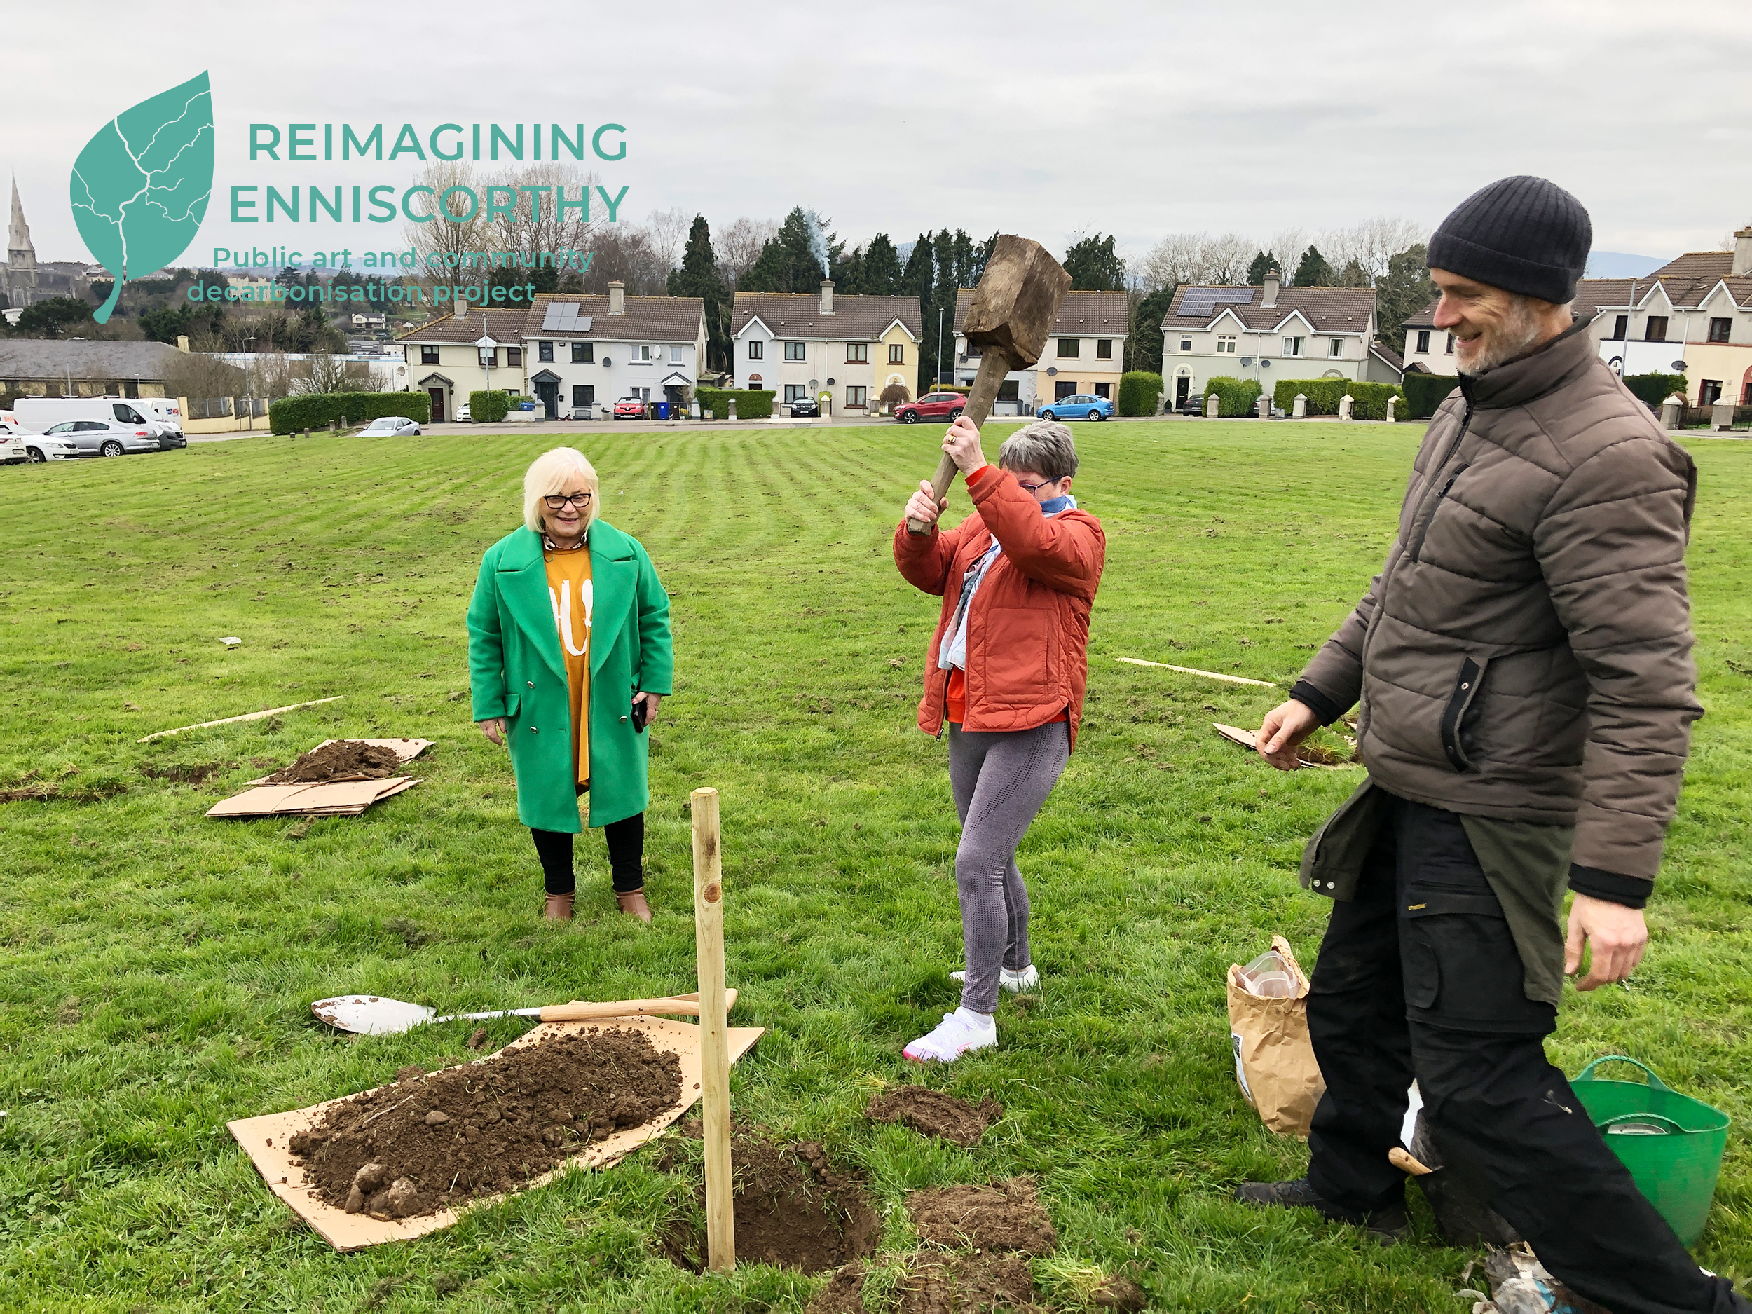
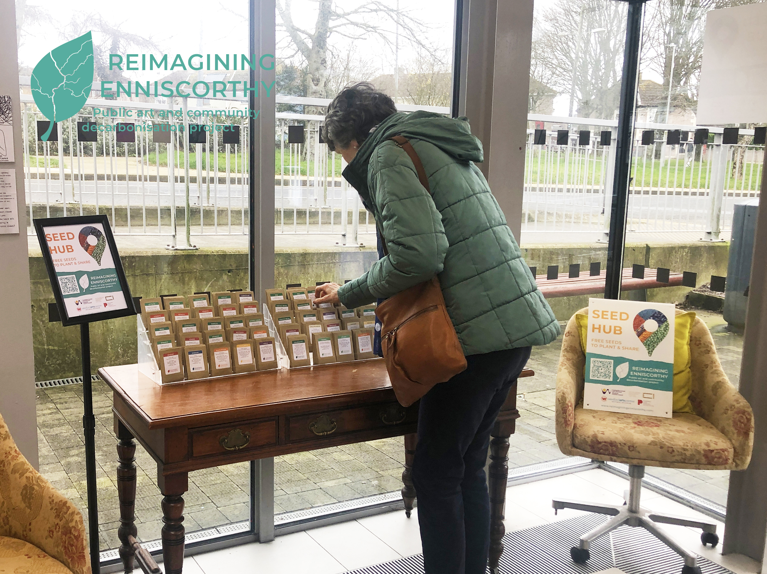
Community orchard Week
Seed Hub
Final Exhibition 17th June
Presentation Centre 3pm
Notes:
.
This public art project is jointly funded through the Wexford County Council’s Per Cent for Art Scheme and Creative Ireland Programme.
Helping to create a local ecology network for people-led climate action, connecting neighbours and community groups in Enniscorthy with each other, and with local food producers, environmental groups, artists and craftspeople, so a conversation can be started about food - where it comes from, how we grow it, and the environmental impact.
morning talks and afternoon planting
Final Exhibition / Showcase – Saturday 17th June 2023 @ 3pm in the Presentation Art Centre Enniscorthy. Running until 30 June 2023

Slide 8
Notes:
National Food Waste Recycling Week will take place from June 5th – 11th June
Separating food waste is a positive climate action
Just to make you aware of the free food waste recycling pack available in the recycling centres around the county next week

Slide 9
Thank you

