Slide 1
Colm O Mahony
Energy Engineer
Domestic Retrofit/Grant Funding
01/05/2023
www.southeastenergy.ie

Slide 2
Introduction
Irelands retrofitting targets
Energy and Heat loss in homes
Benefits of retrofitting your home
Homeowner Journey “Roadmap”
Traditional Heating systems & Heat pumps.

Slide 3
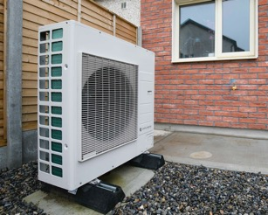
National Housing Targets
40% of Ireland’s energy-related carbon emissions from buildings. Housing/Residential sector responsible for approx. 25%.
Committed to retrofitting 500,000 homes to a B2/Cost Optimal Equivalent BER standard by 2030.
600,000 heat pump installations, with 400,000 to be installed in existing homes
50% of houses in Ireland have a BER rating of D or lower and require significant energy upgrades
Significant upscaling - from a ‘shallow’ to ‘deeper retrofit’ - also providing a “Roadmap”.
Needs to be “Cost Optimal” and “Affordable to all”.
www.southeastenergy.ie

Slide 4
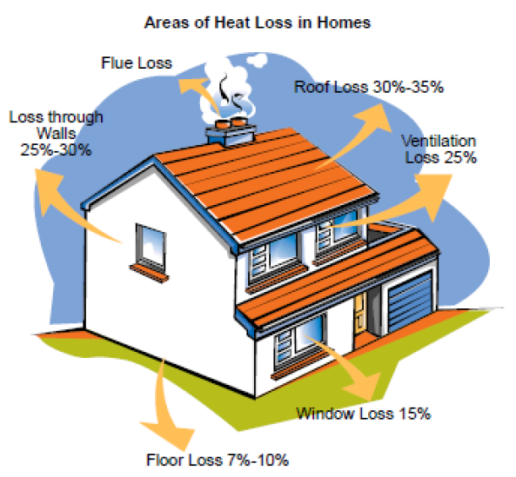
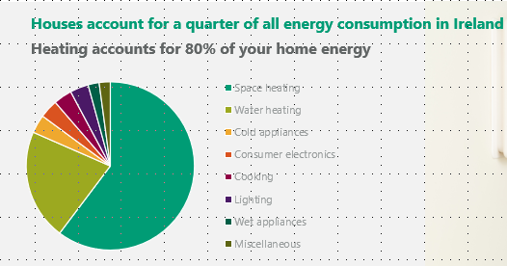
Energy Loss & Energy use in your home

Slide 5
Example/Est Costs - (Based on DEAP software analysis)

Slide 6
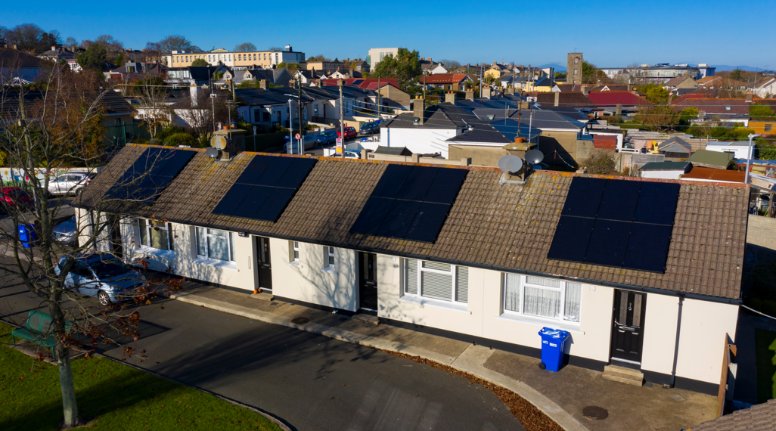
Benefits of a Home Energy Upgrade
Savings – Reduce your energy bills (<demand)
Environment – Reduce your emissions and your carbon footprint.
Asset Value – Increase the value of your property.
Thermal Comfort - Warmer, cosier and healthier home. > IAQ. > quality of living.

Slide 7
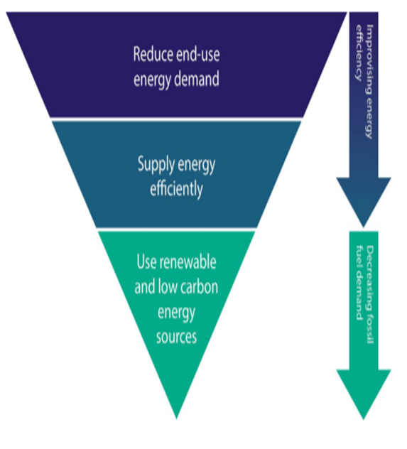
Retrofit Principles/Fabric First Approach
Insulate/upgrade building envelope
Limit thermal bridging
Improve Air tightness
Building Ventilation (DCV/MVHR)
Building is “Heat Pump Ready” (Heat loss indicator <2 W/m.K)
Heating system – Heat Pump and fully integrated controls upgrade.
Renewables (Solar PV)

Slide 8
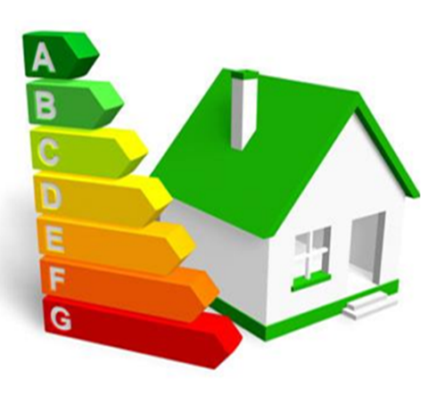
Homeowner journey – Where to Start
BER Assessment/Advisory Report - Baseline and highlights EE measures to improve the energy efficiency of your home.
Energy Audit Report - “Roadmap” – Specific measures for your home.

Slide 9
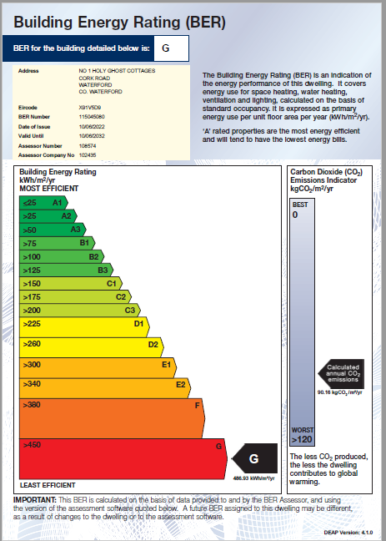
Homeowner journey – Where to Start

Slide 10
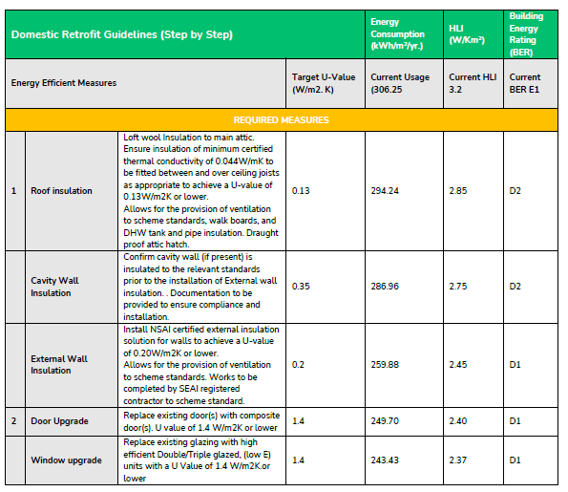
Energy Audit Report - Roadmap

Slide 11
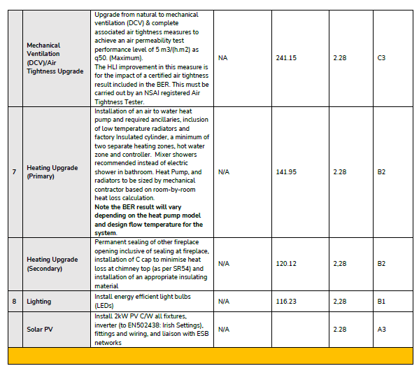
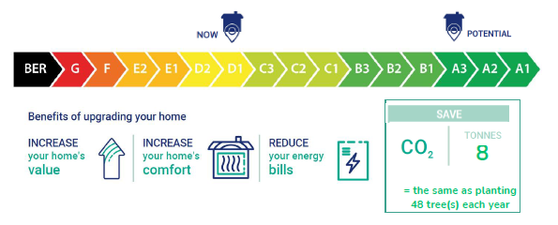
Energy Audit Report - Roadmap

Slide 12
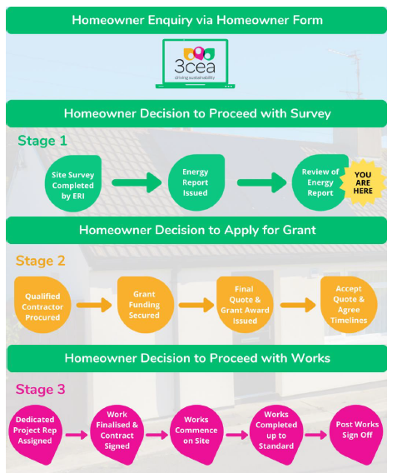
Energy Audit Report - Roadmap

Slide 13
Heating Systems - How do we Heat our Homes?
How everyone heats their home varies from house to house with one or more of the following being used:
Oil Boiler – traditional central heating system that runs on oil
Gas Boiler – traditional central heating system that runs on gas
Stove – runs on solid fuel (some with back boiler for heating / hot water)
Open Fire – runs on solid fuel (some with back boiler for heating / hot water)
Storage Heaters – runs on electricity
Electric Heaters – runs on electricity
Heat Pump – renewable heating system runs on electricity

Slide 14
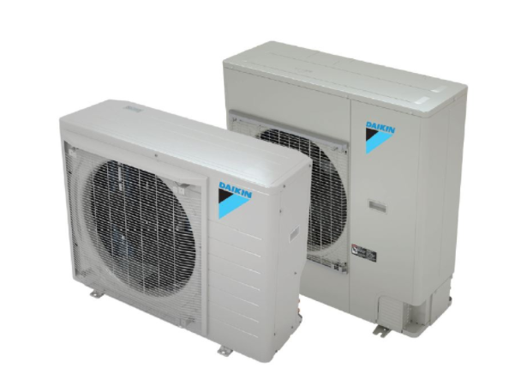
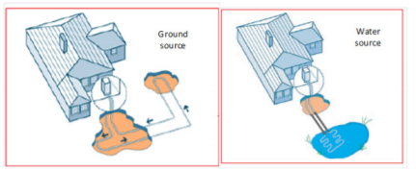
Heat Pumps
Extracts heat from one place (Exterior) and transfers it to another (Interior)
Types
Air Source Heat pumps
Ground/Water Source Heat Pump
Exhaust Air Heat Pumps

Slide 15
What are Heat Pumps?

Slide 16
Thank You
www.southeastenergy.ie

