Slide 1


Beneficiary Information
Community Energy Grants 2023

Slide 2

Agenda
Introduction – who we are and our experience
Application Process
Timelines
Technical Workbooks
Deadlines
Quality assurance & Inspections
Payments & Grant claims
Measurement & Verification
Energy Credits
Key Points

Slide 3
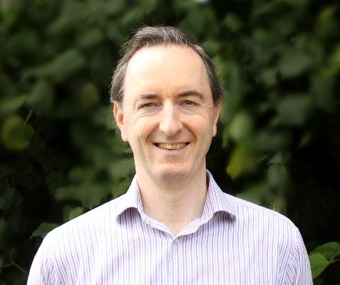

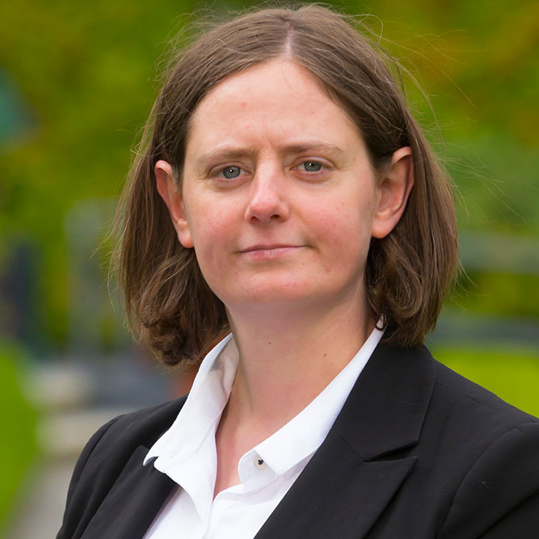


South East Energy Team
    Alex Hamilton – Senior Engineer
    Bill Lowe – Office Manager
    Onyedikachi Onwusor, Michael Kinchella & Mark Treacy – Delivery Engineers

Slide 4
Projects Delivered 2013 -2021
Notes:
To give you some idea of avoided energy spend, grant drawdown and kilowatt-hour savings since 2015, this slide summarises all these aspects. Through the BEC grant process we have reduced energy consumption by 39 GigaWatt-hours, avoided 4.2 million euro in energy spend, drawn down 8.2 million in grant, retrofitted 644 homes and improved efficiencies in 235 businesses and SMEs.

Slide 5
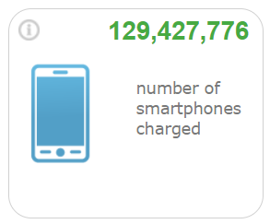
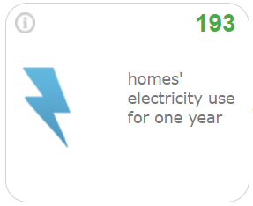
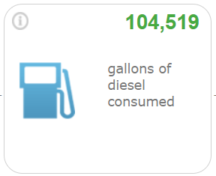
Communities Energy Grant Overview - 2021
5 SEAI Grant Applications
47 non-domestic Projects
60 Houses
Total Investment Costs = €4.5million
Total grant funding = €2.2 million
Energy Savings = 3.6 GWh
Carbon Savings = 1064 Tonnes CO₂

Slide 6

Communities Energy Grant Overview - 2023
Regional Partnership across the South East
  Waterford
  Wexford
  Carlow
  Kilkenny

Slide 7
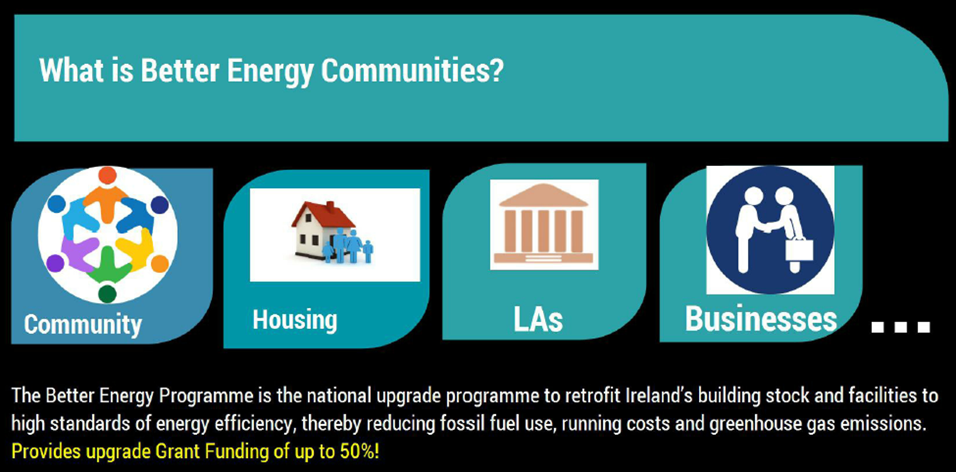
What is Community Energy Grants?
Notes:
The Communities Energy Grant is part of the Governments National Retrofit Programme aimed at upgrading building stock and facilities to high standards of energy efficiency and renewable energy usage, thereby reducing fossil fuel usage, energy costs and greenhouse gas emissions.
As part of this initiative, the Communities Energy Grant supports new approaches to achieving high quality improvements in energy efficiency within Irish communities. By bringing together groups of buildings under the same retrofit programme, communities projects facilitate community-wide energy improvements more efficiently and cost effectively than might otherwise be possible. The Communities Energy Grant is designed to engage all members of SEAI’s Sustainable Energy Community (SEC) network who wish to participate in delivery of energy efficiency works, as well as those Project Coordinators who have previously participated in SEAI Community Energy Grant projects.

Slide 8
Parties Involved
SEAI
  Award grant funding
Local Authority – Waterford City & County Council
  Lead Applicants
  Responsible for ensuring that all of the Beneficiaries comply with the T&C’s
South East Energy Agency
  Project co-ordinator
  Quality Assurance
  Payment Claims
Communities/SME’s/Public Sector Bodies
  Beneficiary

Slide 9

Who is it for?
Notes:
The grant is designed to Support cross-sectoral, partnership approaches that deliver energy savings to a range of building types including public, commercial and community buildings with a particular focus on using the projects to deliver home retrofits along with supporting the SEC network members in advance on their Learn-Plan – Do process.
Projects are required to demonstrate a building fabric first approach in line with the SEAI definition in the following order of priority to:
• Be as energy efficient as possible (fabric first approach)
• Decarbonise heat considering and utilising renewables where feasible
• Improve ventilation
• Adopt smart technologies as appropriate

Slide 10
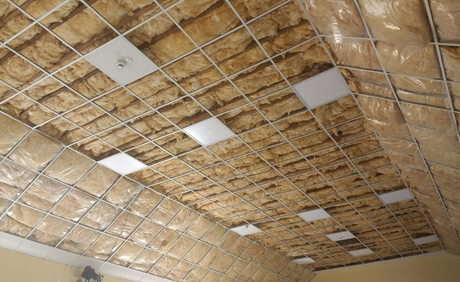
Eligible measures or upgrades
Building Fabric upgrades
  Wall Insulation
  Attic Insulation
  Windows & Doors
Heating upgrades – NON Fossil Fuels
Renewables (PV – 20%)
HVAC
Pumps
Controls/BMS
Smart metering
EV chargers
Monageer Parish Hall, Wexford

Slide 11

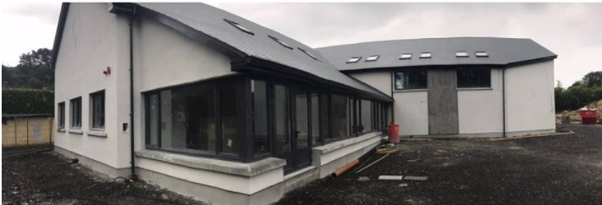
What is the % grant available?
30% up to 50% funding to community facilities – community halls, charity facilities, GAA clubs etc. (subject to state aid rules and SEAI approval in advance)
Up to 30% funding for private sector – hotels, large commercial buildings, private nursing homes, SMEs
Windgap Community Hall
Notes:
What is the percentage grant available? Different from previous years there is now default 30% in the Technical Workbook. 50% can be available for community subject to certain T&Cs by SEAI. Before we submit an application on line the community projects must be pre-approved for the 50% funding level. This approval is subject to state aid rules as well.
There is 30% funding available for SME’s, commercials and non-domestics.
Here is a lovely example of some of the work Windgap community completed as part of the BEC-2018 application.

Slide 12

Partnership
Partnership
  Public
  Private
  Community
  Domestic
  Participating Energy Supplier (PES)
Group Application
  Lead Applicant
  Project Coordinator
  Beneficiary
Notes:
This is a group application. There is a Lead applicant which in our case is generally the local authorities or the county councils. They support communities and businesses in their regions and allow the grant payments to go through their payment systems so you can get your grant money. 3CEA are the project coordinators, so we aggregated all the projects from the various sectors and bring them into a single application. Any entity seeking funding under the scheme will be known the beneficiary.
We have to show partnership in the application – partnerships are created by all or some of the sectors coming together. The more partnerships on an application the better it scores.

Slide 13
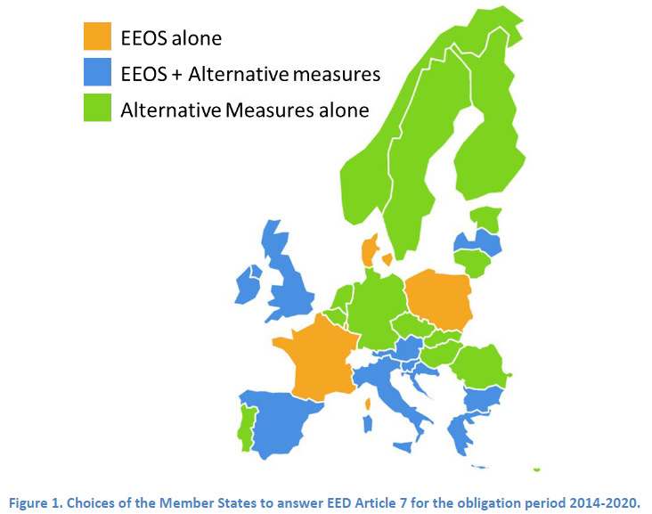
Energy Credits
Energy Credits
Every Project creates Energy Savings
Energy Efficiency Obligation Scheme - EEOS
These kWh Savings are traded with a Participating Energy Supplier
Additional payment for community & domestic projects
SME’s within the South East Region
Measurement & Verification 12-months after completion

Slide 14
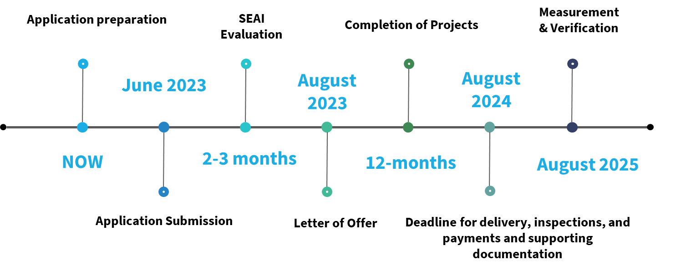
Timeframes

Slide 15
Documents Required
Energy Audit / Technical Report
VAT letter from Revenue – to confirm VAT status
Declaration of financial resources
Bank statement – over €50k
Tax Clearance Certificate – TCC & Access number
Confirmation of Community / not-for-profit / Charity Status
  Default to 30%
Letter of Support if you are part of an SEC
Participation letter from SEC
Notes:
• Confirmation of Community/Not-for-Profit Organisation /Charity status
This year SEAI have decided to default all beneficiaries to 30% funding. Pre-approval must be sought from SEAI to increase funding for community groups, charities and Not-for-Profit organisations from the default 30% to the standard 50%. SEAI have requested proof from all community groups confirming that they have little or no economic activity. To comply with this requirement can you please provide a letter confirming the name and address of the organisation, and whether there is any additional income apart from donations to help support the running of the centre.
Sustainable Energy Community Member (SEC)
SEC’s must be registered on the Register of SEC Network Communities at the date of the BEC application to be consider a registered SEC. SEAI will require evidence that any SEC included in an application is aware of their participation. This will be done by way of the SEC completing a SEC participation form at application.
To include a SEC in the application they must also include letters of support from the SECs in the application setting out what their role was and how they participate in the project and what tangible benefits they expected from participation for the community

Slide 16
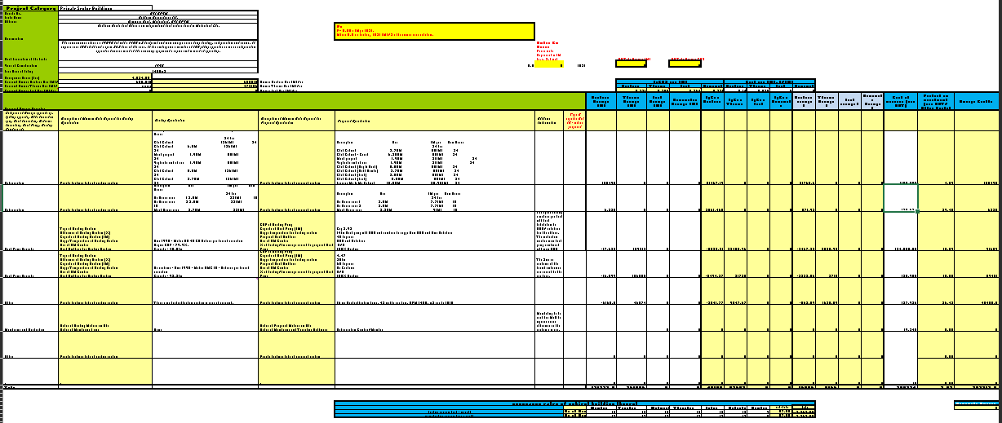
Technical Workbook

Slide 17
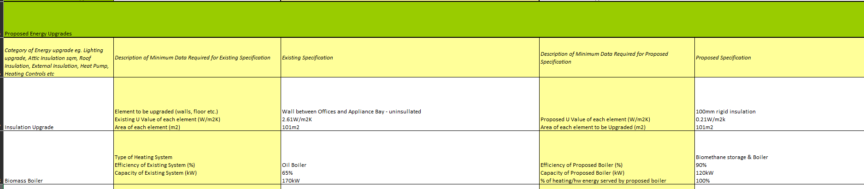
Technical Workbook

Slide 18
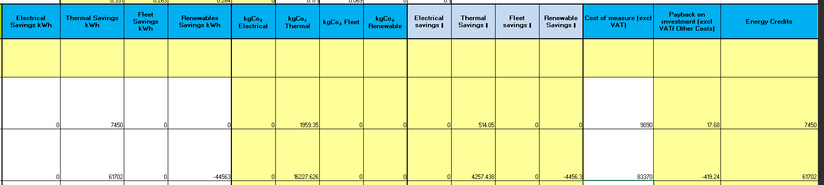
Technical Workbook

Slide 19
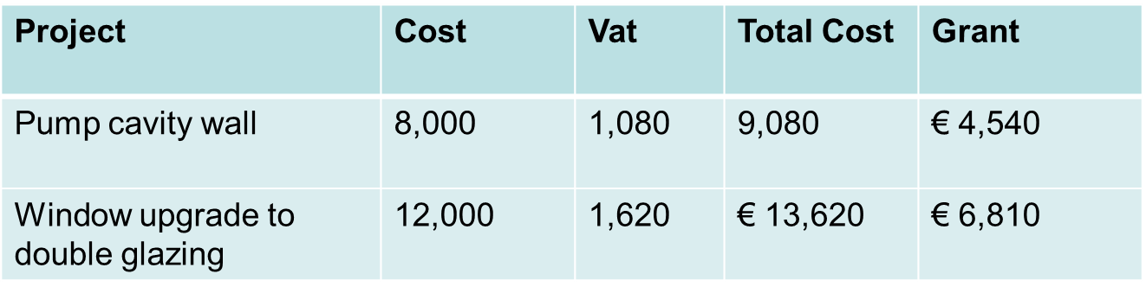
Technical Workbook
DO NOT DEVIATE FROM THE WORKBOOK
No grant for work outside of what has been applied for
e.g.
If you do attic insulation upgrade – NOT ELIGABLE, NO GRANT

Slide 20
Technical Workbook
Specifications must be as per the Technical Workbook
Grant not given for anything that differs
e.g.
  u-value = 1.4W/m2k
  If u-value = 1.5W/m2K – NO GRANT
e.g.
  28kW Heat Pump
  26kW Heat Pump – NO GRANT

Slide 21
Letter of Offer
Letter of Offer has been issued or will be issued shortly
Between 30% & 50% funding
Maximum grant pay-out not exceeded
e.g.
If cavity wall = €10,000, maximum claim = €4,540

Slide 22
Letter of Offer
Individual details have been sent to you
Breakdown of costs
SEAI Workbook calculates amounts
South East Energy Agency fees are set and agreed with each Beneficiary – as per our PM Contract
Name of Beneficiary | Project Cost (Ex VAT) | VAT | Sub Total | Project Mgmt. (7.5%) | VAT | Total Project Cost (Ex VAT) | TOTAL VAT | SEAI Funding
SME 1 | €20,000 | 13.5% | €22,700 | €1,500 | 23% | €21,500 | €2,045 | €7,063

Slide 23
Deadlines
Milestones & Deadlines
Each project has individual Deadlines – based on your own programme of works
  Delivery Team working with you and your contractor to get projects finished on time
Absolute Deadline for delivery of works is 12 months from letter of offer
Takes minimum 4-weeks to get all documents to South East Energy Agency
  South East Energy final inspection
  Reworks if needed
  Invoice & payment to contractor
Errors in paperwork leads to delay in grant

Slide 24
Scope Changes & Drop-outs
Milestones & Deadlines
NO SCOPE CHANGES
  Deliver what is in the TWB or notify us immediately if project is not going ahead.
Please notify South East Energy Agency IMMEDIATELY if there are any changes in projects
Technical workbook submitted is FINAL –
e.g.
  28kW heat pump
  Put in a 32kW heat pump – NO GRANT

Slide 25
Progress Reports
Milestones & Deadlines
Progress Reports
  Works completed
  Works Procured
  Works yet to be started
Fortnightly calls from the Energy Agency to check progress
Can make payment claim for any works completed at Milestone

Slide 26
Procurement
Procurement: Recipients of grant support must ensure that compliance is achieved with the relevant principles of Irish and EC law regarding the expenditure of this funding and, where applicable, the laws and guidelines concerning state aid and public procurement
Value for money
3 quotes – in writing and/or use of the South East Energy Agency DPS
Internal Procurement Policy
E.g. Public Procurement Rules
Notes:
Use of DPS only for Local Authorities

Slide 27
The Works
South East Energy Agency engineer will be assigned to your project
Assistance with procurement, specifications, contractor management, quality assurance & any technical issues
To ensure that works are completed in line with the scheme & to the best standards
To gather all inspection documentation
Notes:
Copy of design document provided to beneficiary

Slide 28
Completion Reports
List of required documents has been provided
Get all guarantees, certificates & commissioning reports from the contractor
e.g.
  28kW heat pump
  O&M manual is for a 26kW heat pump – NO GRANT
Get proof of contractor qualifications
  e.g RECI certified
Notes:
Copy of design document provided to beneficiary

Slide 29
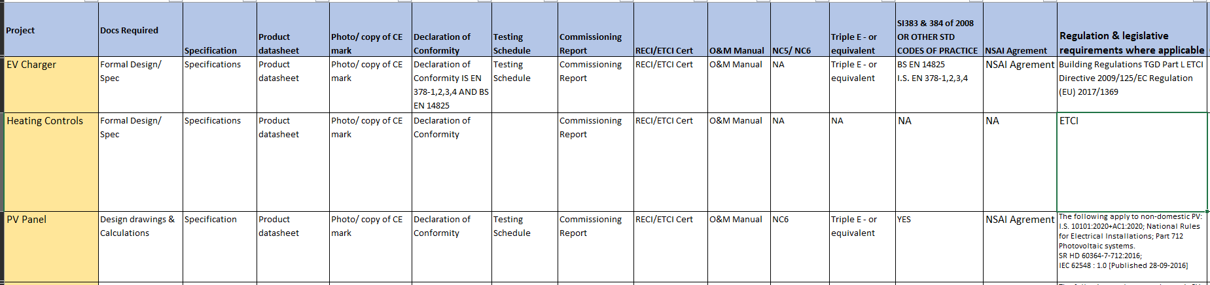
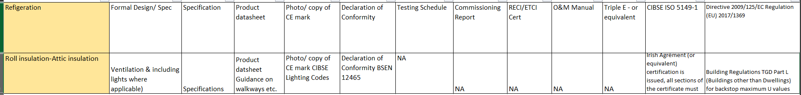
Completion Reports

Slide 30
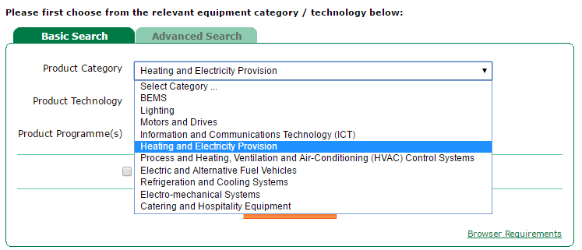
Triple E Products
Purchase of plant, machinery or equipment
  Use ‘Triple E’ register http://www.seai.ie/Your_Business/Triple_E_Product_Register/
Public bodies MUST purchase from Triple E register
Other beneficiaries are ADVISED to purchase from this register
Notes:
Local authority only

Slide 31
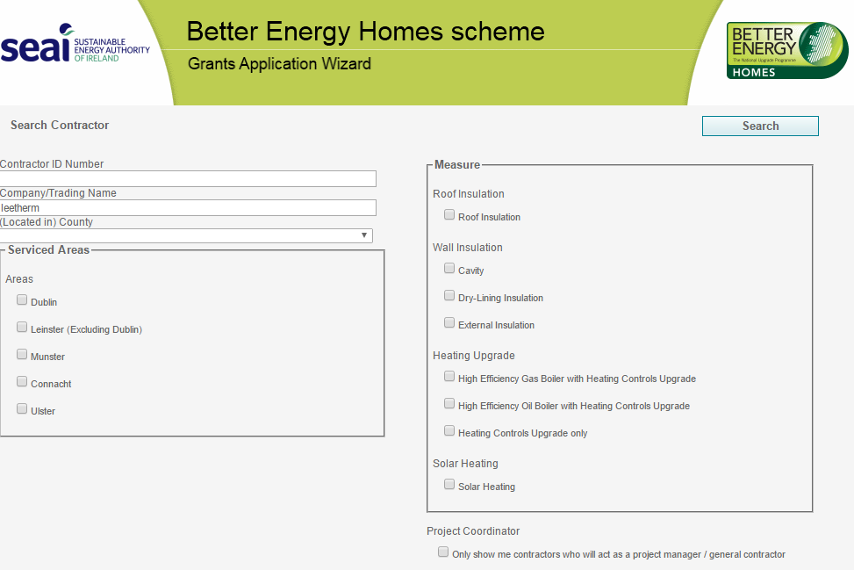
Quality Assurance
Use Registered Contractor
  SEAI Registered List - https://hes.seai.ie/GrantProcess/ContractorSearch.aspx
Ensure Codes of Practice adhered to
Notified of changes to Codes

Slide 32
Quality Assurance
DO NOT pay contractor until South East Energy Agency Inspection completed
Please provide Contractor details to South East Energy Agency as soon as possible

Slide 33
Payment Claims
Milestones & Deadlines
The following documents must be submitted at each Payment Claim:
You
Invoices
Bank Statements
Tax Clearance Certificate
Receipts
South East Energy Agency
Payment Request Form
Grant Claim Workbook
Certified statement of expenditure

Slide 34
Required Documents from you
Payment Procedure – REQUIRED DOCUMENTS
Valid Tax Clearance Certificate
VAT status confirmation dated in 2023 from the Revenue Commissioners

Slide 35
Measurement & Verification
Estimated savings (kWh) were submitted as part of application
All projects must verify savings after completion
South East Energy Agency will require 12-months Electricity/Heating bills
Before project
After project
If savings not achieved, may require explanation
SEAI could ask for grant to be returned
10% Retention

Slide 36
Key Points
Summary
Have you got an energy audit?
Have you got contractor quotes?
Have you signed the South East Energy Agency contract?
Do Not Deviate from the Technical Workbook
Procure correctly – minimum of 3 quotes in writing or use South East Energy Agency DPS
Use Triple E register or equivalent & SEAI Registered contractors where possible
Work with South East Energy Agency to ensure QUALITY & TIMELINES ARE ADHERED TO
WHO IS GOING AHEAD?

Slide 37
FURTHER INFORMATION
South East Energy Agency
Burrell Hall, St Kieran’s College, College Rd, Kilkenny
T: 056 779 0856
E: bec@southeastenergy.ie
W: www.southeastenergy.ie

