Slide 1
Let’s talk Climate Action!
LocalEnterprise.ie
#MakingItHappen

Slide 2
Today’s sustainable businesses are likely to become tomorrow’s industry leaders. Let us help you to become one of them.
Sustainability has 3 pillars: Economic, environmental, and social – commonly referred to as People, Plant and Profit. Any sustainability plan needs to assess the impacts of a business under all three P’s

Slide 3
Key Focus for Business
Decarbonisation
Digitalisation
Innovation
Competitiveness
Market Diversification
Each of these need to be seen as a call to arms at all levels of your business!

Slide 4
Companies that develop sound sustainability practices now will be more prepared for future changes which are coming. They will be more attractive to consumers, as an employer, and to potential investors

Slide 5
How will this benefit the company:
Increase cost savings (avoid waste, reuse and repurpose)
Improved resources efficiency (less energy, water and materials)
Reduced environmental impacts and greenhouse gas emissions
Opportunities for providing additional value-add ‘GREEN’ products and services
Increase access to new customers and better, more efficient suppliers
Improved Corporate image and better brand loyalty
Increase Business resilience to climate change impacts as they arise
Improved employee engagement

Slide 6
LEO is leading the way in terms of Local Enterprise Engagement
Our mandate is growing - 10+ employees
Enterprise White Paper - places decarbonisation at the centre of enterprise policy
Reengineering our businesses & local economies
Local Innovation & Entrepreneurialism
Micro Enterprise Green Strategy which is Embedded in our strategy with key metrics

Slide 7
Content Overview
LEO Grant Supports which assist SME’s:
Green for Micro
Greenstart
Lean Consultancy Support
Digital Start
New Energy Efficiency Grant
Visit www.localenterprise.ie/Wexford and let’s talk Business!
#localenterprise

Slide 8
Green for Micro - Small Changes. Big Impact!
FREE programme which will help understand the growing importance of sustainability
Understand the significant benefits that it can have for your company, on everything from efficiencies to cost savings.
Access to a green consultant who’ll show you the small changes that can have a big impact
Visit www.localenterprise.ie/Wexford and let’s talk Business!
#localenterprise

Slide 9
Visit www.localenterprise.ie/Wexford and let’s talk Business!
#localenterprise

Slide 10
Key Outcomes for Business’s
Developing a ‘greener’ policy can:
• Increased cost savings • Improved resource efficiency (for example: using less energy, water, and materials) • Reduced environmental footprint and greenhouse gas emissions • Opportunities for higher and additional value on products and services • Increased access to customers, improved corporate image and reputation. • Increased resilience to climate change impacts
Visit www.localenterprise.ie/Wexford and let’s talk Business!
#localenterprise

Slide 11
Case Study Example
PARK 100 – Based in Wexford
Visit www.localenterprise.ie/Wexford and let’s talk Business!
#localenterprise

Slide 12
GreenStart
Training/consultancy/advisory project of up to 7 days carried out by an external Green Service Provider
Micro-enterprises (between 1 and 9) in the manufacturing and internationally traded services sectors who have undertaken a Green For Micro, and for whom an additional need for support has been identified
Small enterprises (employing between 10 and 50) who are operating in the manufacturing and internationally traded services sectors
Where the turnover is in excess of €30,000 annually in either 2020 or 2021 and the business is trading in excess of 6 months.
Visit www.localenterprise.ie/Wexford and let’s talk Business!
#localenterprise

Slide 13
Lean for Micro Lean into working smarter, not harder!
Lean is about doing things quicker, better and saving costs. Lean strives to remove waste and to continually improve a company.
Productivity increases 20%
Sales increases 40%
Delivery adherence improvements 43%
Product & Service quality improvements 30%
Employment increases 11%
Visit www.localenterprise.ie/Wexford and let’s talk Business!
#localenterprise

Slide 14
Introducing Lean
Work Smarter
Visit www.localenterprise.ie/Wexford and let’s talk Business!
#localenterprise

Slide 15
Digital Start Maximise every advantage!
A digital strategy can give businesses a real edge.
Optimising processes to delivering a seamless digital customer experience, the aim is to help businesses prepare and implement a plan for the adoption of digital tools and techniques across the business.
Digital adaptation plan based on your identified need and assisting you to implement your digital plan
Visit www.localenterprise.ie/Wexford and let’s talk Business!
#localenterprise

Slide 16
Case Study
Dessert First
Visit www.localenterprise.ie/Wexford and let’s talk Business!
#localenterprise

Slide 17
New Energy Efficiency Grant Building Better Business!
Supports the investment in technologies and equipment identified in a Green for Micro Report, GreenStart Report or a SEAI Energy Audit with 50% of eligible costs up to a maximum grant of €5,000.
Eligible for Energy Grant:
Employing between 1 and 50
Undertaken a Green for Micro, GreenStart or recent energy audit by a SEAI registered energy auditor
turnover is in excess of €30,000 annually and the business is trading in excess of 6 months
Visit www.localenterprise.ie/Wexford and let’s talk Business!
#localenterprise

Slide 18
Other Green Business Support
Includes a number of training, mentoring and financial supports
SEAI Energy Audits
Climate Ready - Skillnet
Failte Ireland
Local Business Chambers
Visit www.localenterprise.ie/Wexford and let’s talk Business!
#localenterprise

Slide 19
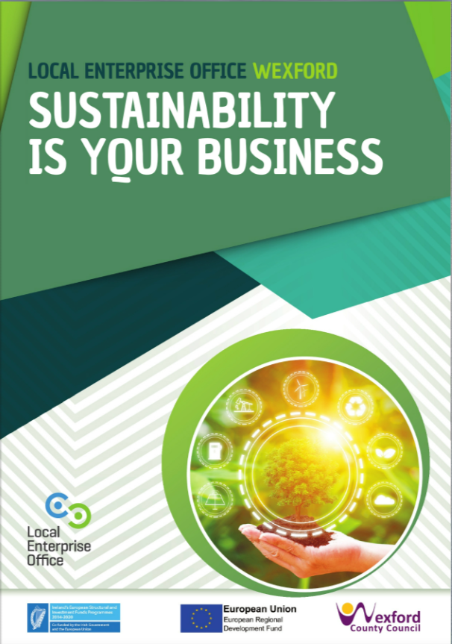
Sustainability is YOUR Business
Easy steps to follow
Save Money
New Green income streams
Supports available

Slide 20
Thank you!
Jill Kelleher
Business Advisor|Local Enterprise Office
Jill.Kelleher@wexfordcoco.ie
Visit www.localenterprise.ie/Wexford and let’s talk Business!
#localenterprise

