Slide 1

Business Energy Seminar
Loch Garman Arms
Gorey
Wednesday 15th October 2025

Slide 2

Agenda
6.30 Welcome: Climate Action Team
Frank Burke & Clare Kelly
6.40 LEO Grants: Local Enterprise Office
Annette Rowsome & Fiona Bennett
7.00 SEAI Business Grants: South East Energy Agency
Michael Kinchella
7.20 Next Steps

Slide 3

5 Year plan 2024-2029
133 actions
Mitigation e.g. reduction in carbon emissions / improvements to biodiversity
Adaptation e.g. building resilience to extreme weather events
Co-benefits e.g. air quality (inside & outside the home)
Notes:
Wexford County Council adopted its Climate Action Plan in February of this year. The plan runs for 5 years and has 133 actions across 5 action areas.
The Plan includes Mitigation and Adaptation measures. There is also a focus on Co-Benefits across the actions including Air and Water Quality and improved quality of life for the citizens of County Wexford.
3

Slide 4

Goals of the Plan
51% Reduction in Greenhouse Gas Emissions by 2030
50% Reduction in Energy Consumption
Support, influence & facilitate the public, communities and businesses to reduce their own emissions
Notes:
The goals of the plan are to
Reduce Greenhouse Gas Emissions by 51% by 2030
Reduce Energy Consumption by 50% by 2030
To Support, Influence & Facilitate communities and Business’ and individuals to reduce their own emissions
4

Slide 5
Overview
Climate Action Team – Advocacy
Aim: Get as many SME's to consider an Energy Roadmap as possible
Increase awareness of the supports available
Start the journey
Step 1: Provide pertinent information to SME's
Energy options to facilitate Carbon Reduction
Benefits for Business
Paths to eligibility
Eligible expenditure
Step 2: Voucher for energy audits!!

Slide 6




Energy Efficiency Grant:
Empowering Sustainable Business Growth
-
Annette Rowsome & Fiona Bennett
Local Enterprise Office Wexford

Slide 7


Energy Efficiency Grant
The Energy Efficiency Grant is designed to support businesses in implementing sustainable practices.
Today’s Sustainable Businesses are likely to become tomorrow’s industry leaders. Let us help you to become one of them!
75% of eligible costs, up to a maximum of €10,000 (minimum spend €750)
Open to all Businesses
- Trading over 6 months

Slide 8

Path to Eligibility
To qualify for the Energy Efficiency Grant, businesses must:
Complete one of the following:
Green for Business Report
GreenStart Report
SEAI Energy Audit
Ensure their technology or equipment is at least 5 years old.
Provide documentation such as planning permissions and technical assessments when necessary.

Slide 9
Eligible Expenditures
Measurement Tools:
Lighting Upgrades:
System Upgrades:
Meters for electricity, gas, diesel, oil, water, steam, etc.
Smart energy controls for heating, cooling, and lighting.
LED lighting, as part of a broader energy efficiency package.
Heat pumps (air, water, or ground source).
Heat recovery systems.
Replacement of refrigeration units and electric boilers (must be over 5 years old).

Slide 10
Samples Case studies – approved funding
Engineering Company. Lighting upgrade, Smart controls for heating
Retailer
Upgrade of lighting and replacement of display fridges
Public House
Upgrade of cooling equipment
Tourist attraction
Upgrade of lighting, Upgrade of refrigeration & oven in Coffee shop
Sport facility with Trading Income
Smart Controls for
Water / light /Heat
LED Lighting upgrade
Restaurant
Upgrade of Lighting, Cooker & Extraction Hood

Slide 11




Contact Your LEO Green Supports Advisor
Path to Funding
Complete Green for Business (FREE)
Apply for Energy Efficient Grant
Enjoy a Greener more efficient future

Slide 12
Completed
SEAI Energy Audit
1. Email or phone
Local Enterprise office fiona.bennett@wexfordcoco.ie
3. Consultant Appointed by LEO Leadtime for
completion
c. 3-4 weeks
4
2. In person Meeting
HATCH LAB with Fiona / Annette
17th October & 14th November
Assistance to complete the Consultancy (audit) Application
form. Booking link will be sent after this meeting
Or remote discussions with Fiona
4. Apply for Energy Efficient Grant – connect with LEO office
(In-person event February)
Docs needed
Financial Accounts & no of employees
Complete works and
Pay suppliers
Submit claim and get refund of approved funding

Slide 13


Any Questions
Annette Rowsome
annette.rowsome@wexfordcoco.ie
Fiona Bennett
fiona.bennett@wexfordcoco.ie
053 9196620
Local Enterprise Office Wexford

Slide 14


GRANTS & SUPPORTS
Businesses & SME’s
Michael Kinchella - Project Delivery Engineer

Slide 15
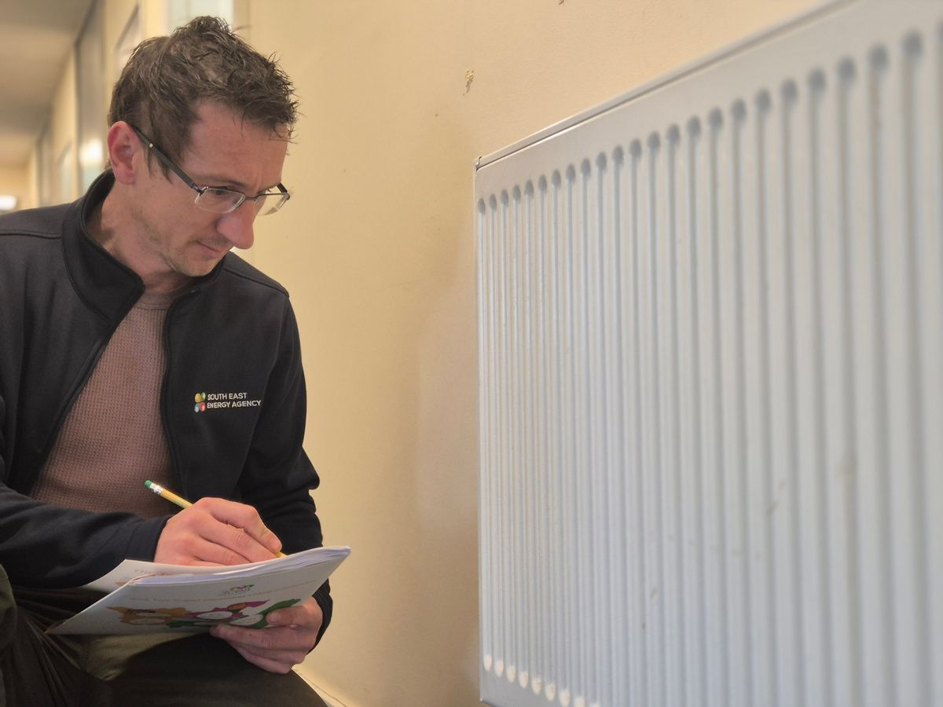
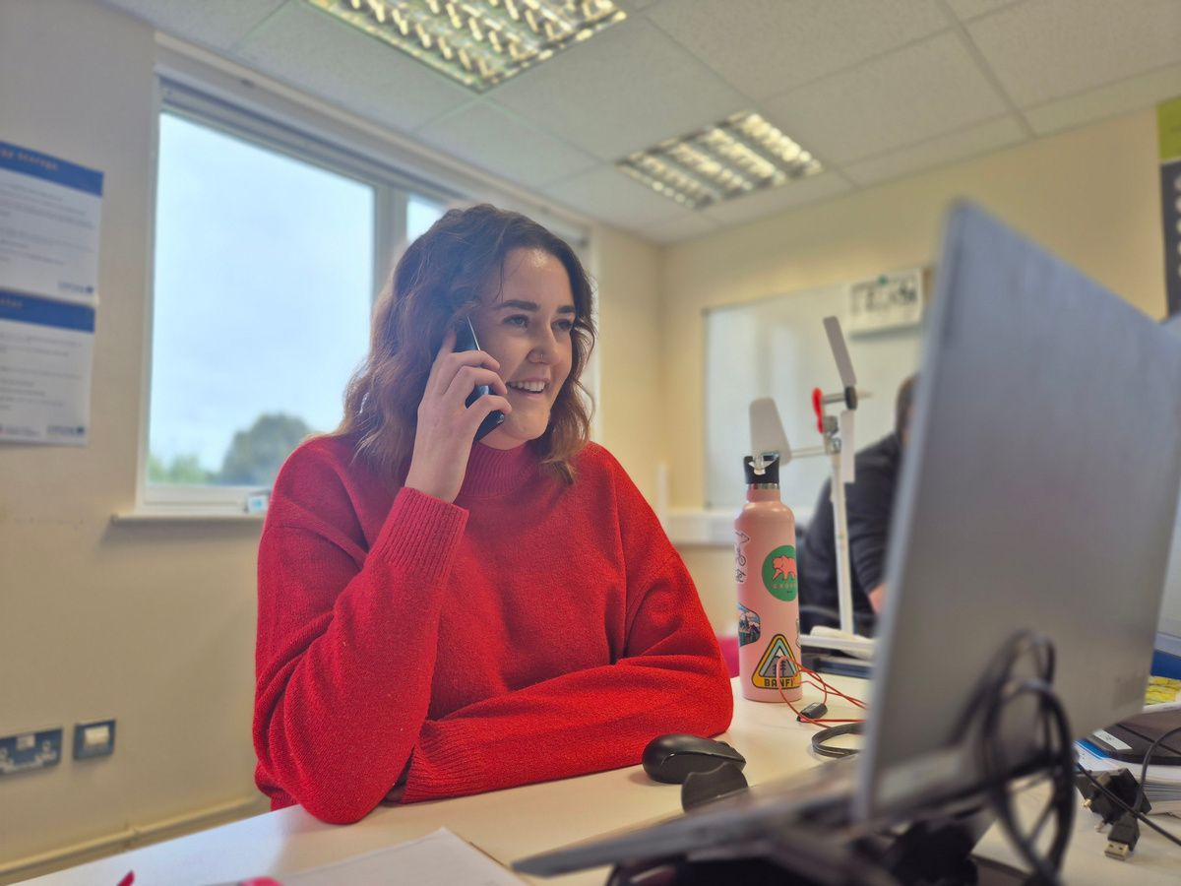
WHO WE ARE
  Not for profit, supplier independent​
  Trusted Intermediary​
  Work with all sectors including​
  Every energy user – that’s you and me!​
  Support everyone to deliver energy & climate transition across the South East
  Public sector​
  Communities​
  Residential​
  Commercial/SME’s​
  Farmers ​

Slide 16

PROJECT MANAGEMENT SUPPORTS
  Audit / Delivery Package
  Discounted Audit and PM based on 5% of capital costs.
  Tendering and Procurement through our DPS.
  Access to Database of experienced contractors.
  Upload of all relevant Q&A docs to SEAI.
  Upload of all Financial Docs for payment claim

Slide 17
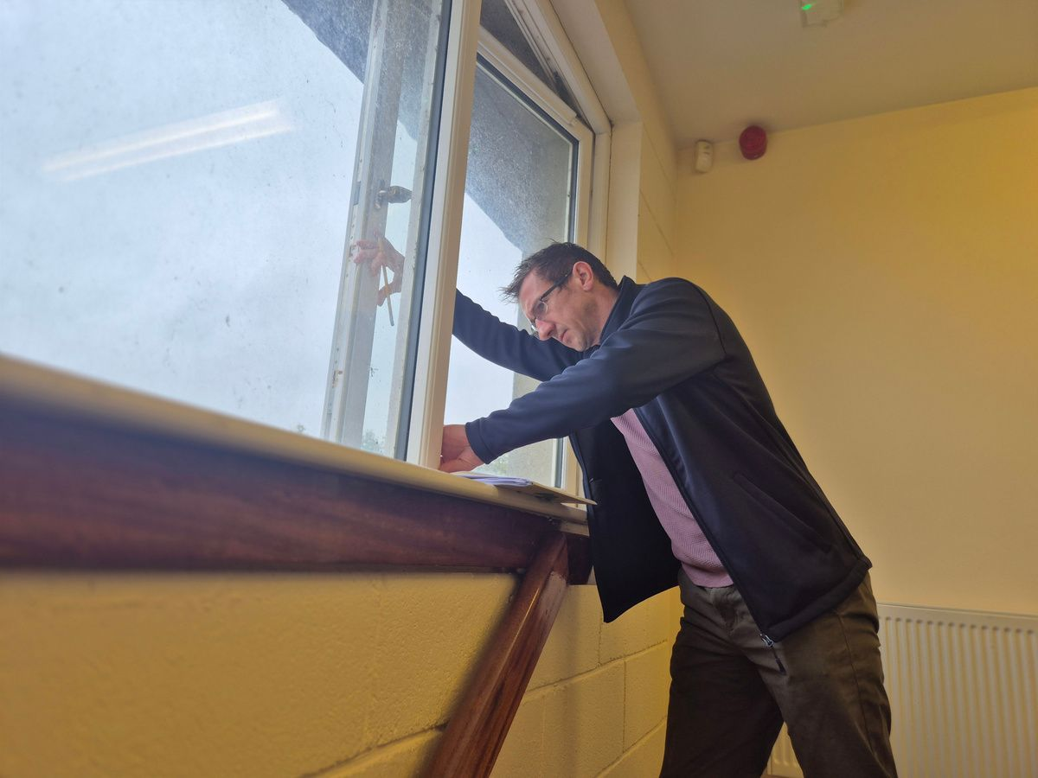


SUPPORT SCHEME FOR ENERGY AUDITS
SEAI's support scheme for energy audits (SSEA) offers SMEs a €2,000 voucher towards the cost of a high quality energy audit. In most cases, this will cover the total cost of the audit. Application to the scheme is easy, with automatic approval for eligible businesses.
Eligibility
Businesses applying to the scheme must be:
  non-obligated entities
  tax compliant
  registered in the Republic of Ireland
  spend at least €10,000 on energy (exclusive of transport energy costs) per year at the site being audited
  There is a limit of 1 audit voucher per Applicant/Company
  Choose an Energy Auditor from the list of registered Auditors from the SEAI website
Scan the QR code
to learn more
*Registration Number EA10100 Alexandra Hamilton 3Counties Energy Agency

Slide 18
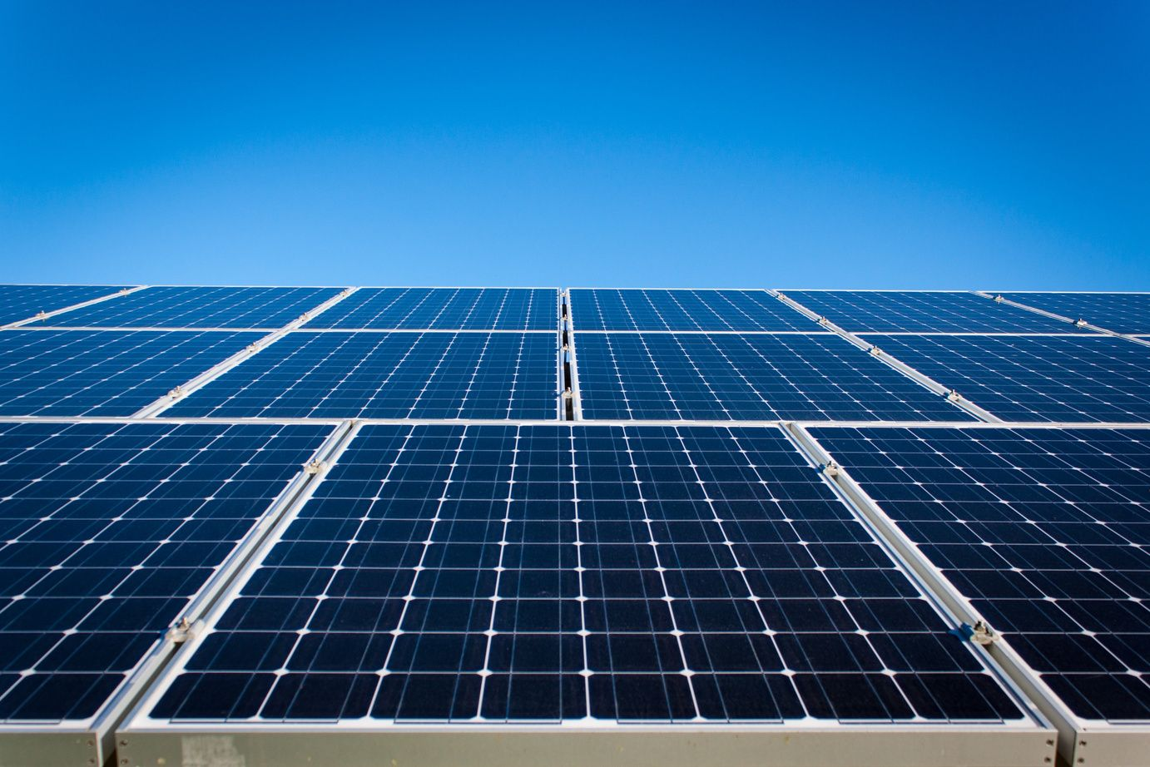
MICRO-GENERATION
SUPPORT SCHEME
The Non-Domestic Microgen Grant (NDMG) provides financial assistance to help businesses and other sectors to install solar PV panels to generate electricity on site.
This technology reduces commercial electricity costs and increases security of supply, while enhancing a positive sustainability image.
Grant funding is available for systems up to a maximum 1000kWp.
Solar PV System
Grant Value
1kWp
€900
2kWp
€1,800
3kWp
€2,100
4kWp
€2,400
5kWp
€2,400
6kWp
€2,400
7 - 20kWp
€300/kWp
21 - 200kWp
€200/kWp
201 - 1000kWp
€150/kWp

Slide 19


MICRO-GENERATION
SUPPORT SCHEME
  Tariff for extra electricity generated and not used on site​
  Export the electricity to the grid and get paid for it​
  Need to have a grid connection agreement with ESB Networks
  NC6 Form to be completed by the installer & submitted to ESB
  Rates of payment differ by supplier – contract your supplier to find out tariffs
Scan the QR code
to learn more
  Rates as per October 2023 – these will change dependant on the market
  Domestic & Non-Domestic buildings are eligible
  average €350/year income based on 4kWp Domestic system​
  Amounts will differ depending on how much you use in the building
Rates of payment by supplier
Supplier
SSE Airtricity
Pinergy
Energia
Electric Ireland
Community Power
Bord Gáis
Energy
Yuno Energy
Prepay Power
Price paid
per Kwh
34 cent*
25 cent
24 cent
21 cent
20 cent
18.5 cent
15.89 cent
15.89 cent
*If panels installed by Active8, otherwise 24 cent

Slide 20
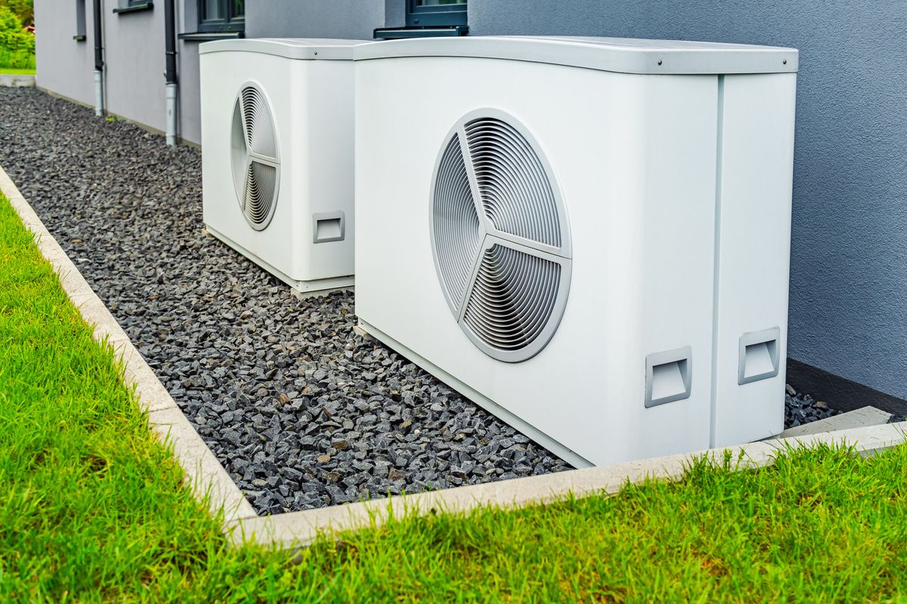


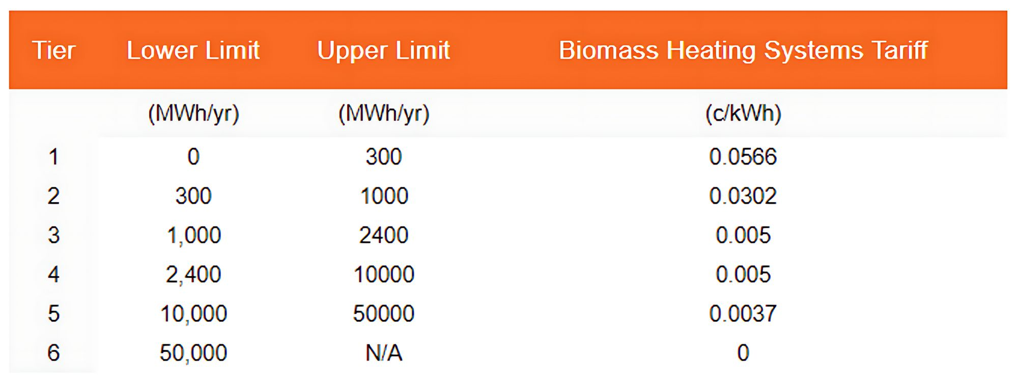
(SSRH ) SUPPORT SCHEME FOR RENEWABLE HEATING
  Government funded initiative designed to increase the energy generated from renewable sources in the heat sector​
  REMOVE FOSSIL FUELS​
  Open to commercial, industrial, agricultural, public sector and other non-domestic heat users
  The Scheme will support
  An installation grant – 30% of capex of Heat pumps​
  On-going operational support – Tariff for heat generated by Biomass/biogas boilers for 15-years
Tier
Lower Limit
Upper Limit
Biomass Heating Systems Tariff
Scan the QR code
to learn more

Slide 21
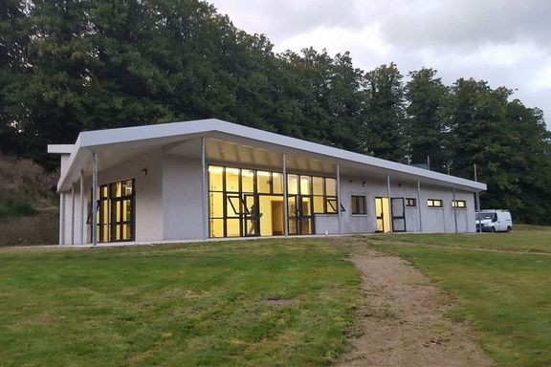
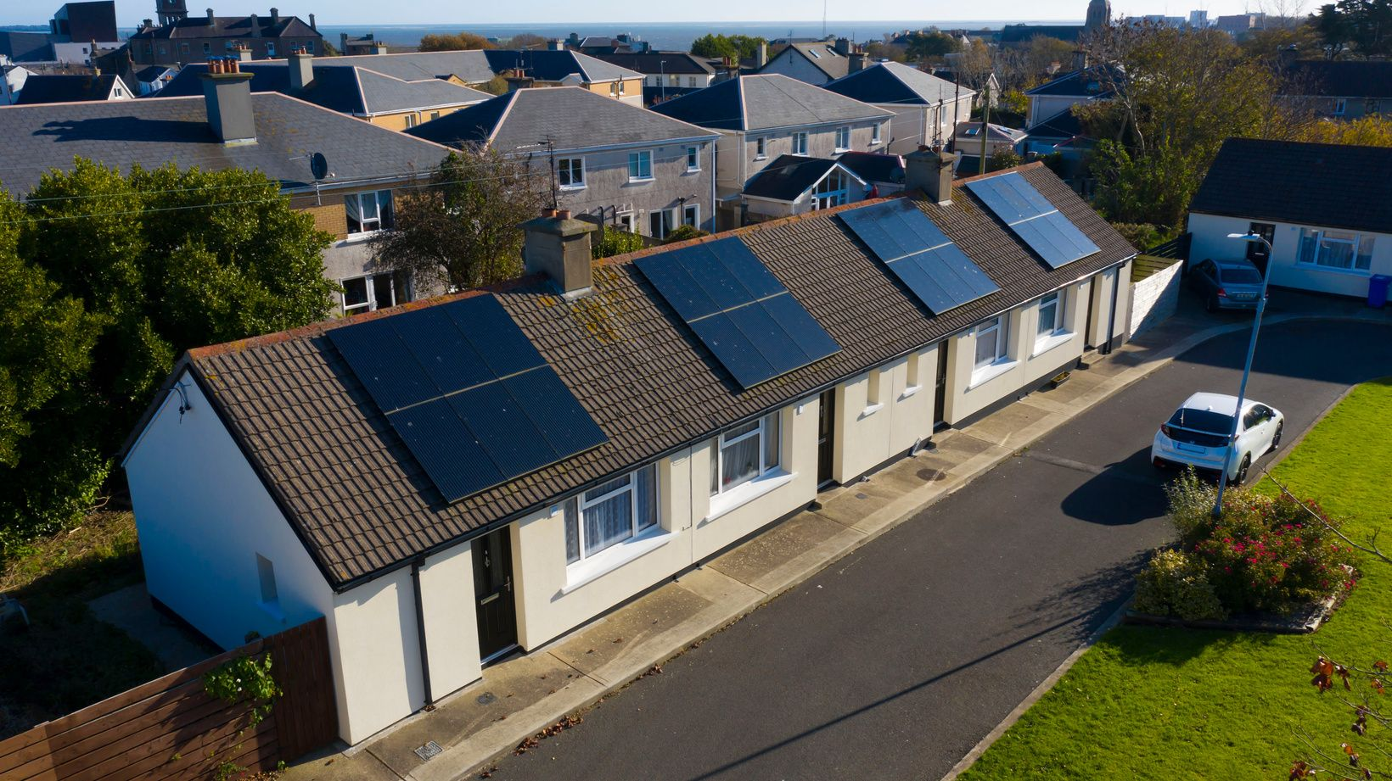
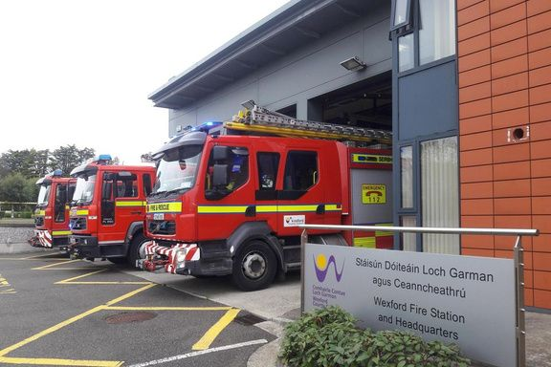
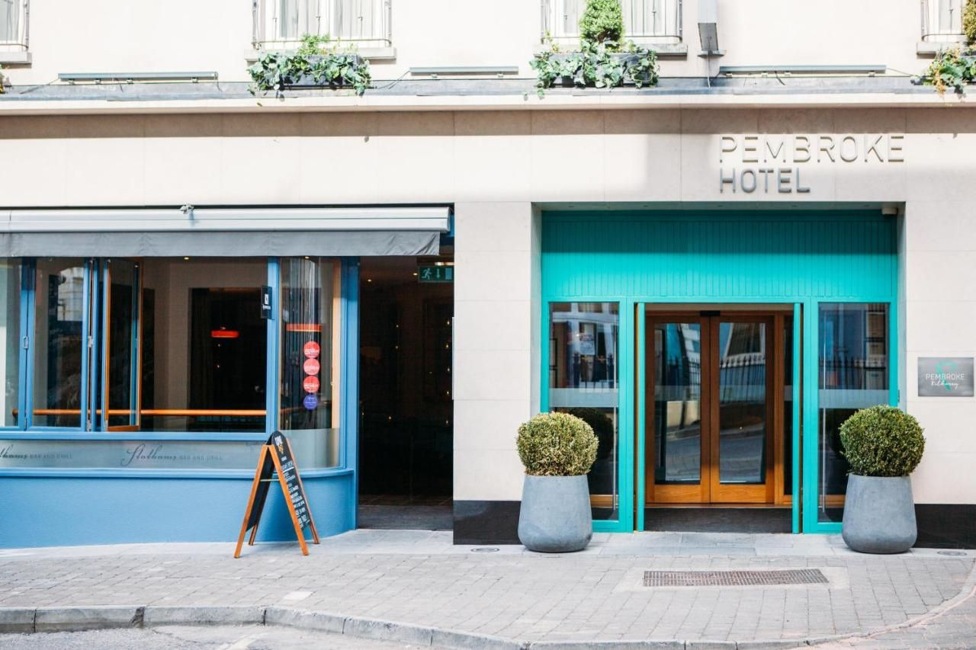
COMMUNITY ENERGY
GRANT (CEG)
Supporting the upgrade of homes, community buildings and businesses right across Ireland to become more energy efficient and reduce energy costs.
Community
Housing
Local Authority
Businesses

Slide 22
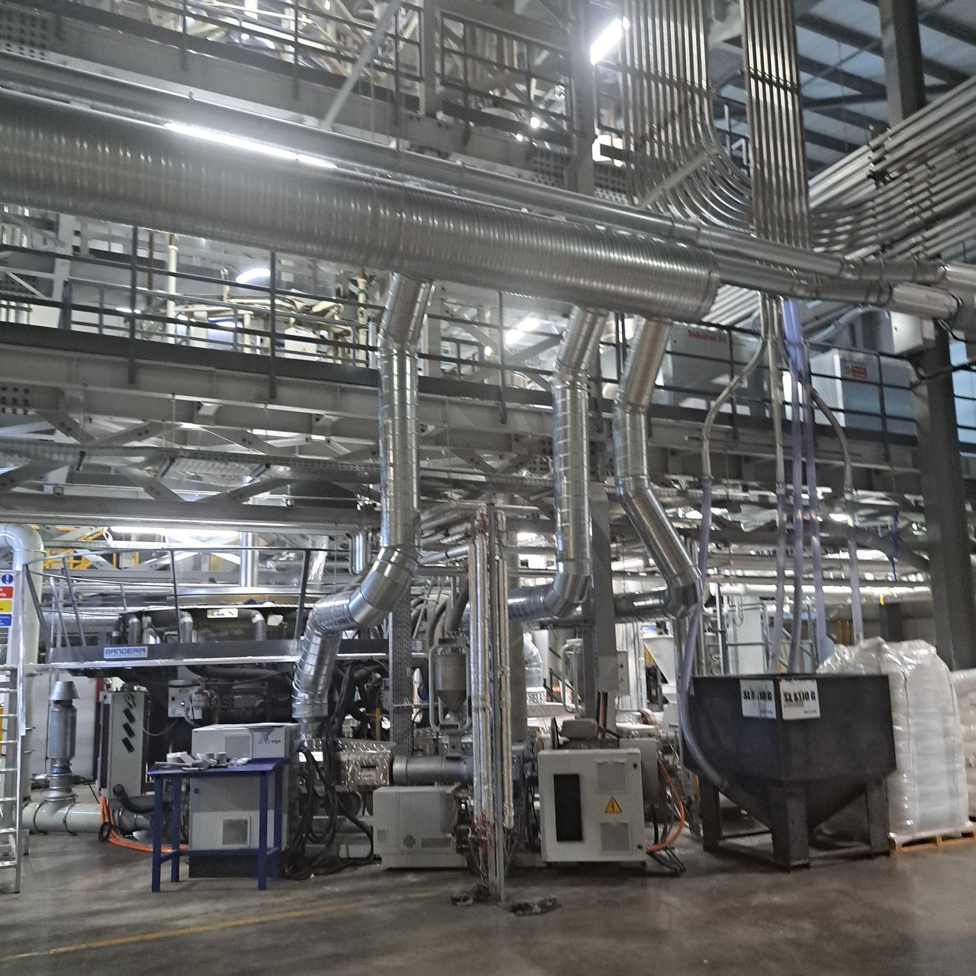
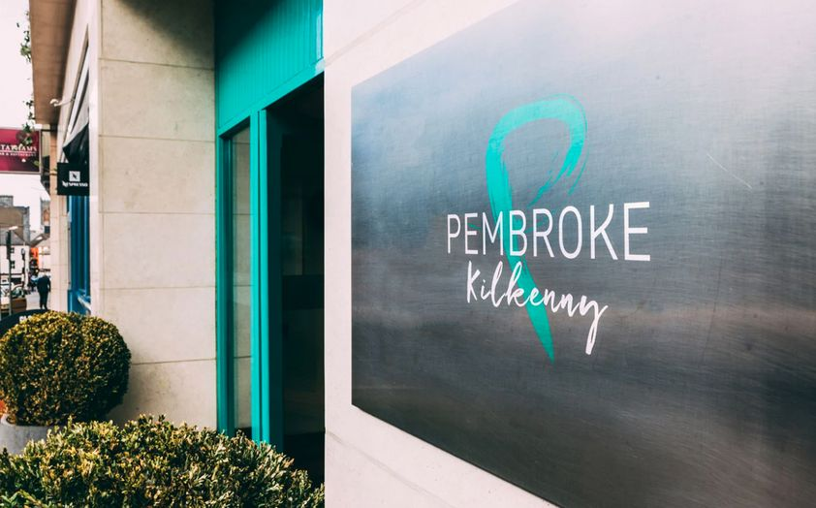

COMMUNITY ENERGY
GRANT (CEG)
  Up to 30% funding
  Public Sector
  SME’s /Commercial Sector
  Up to 50% funding
  Community Groups
  Not for profits / Charities
  Housing Associations
Scan the QR code to register your interest in the CEG
  Upgrade measures that SEAI support
  Fabric upgrades
  Heating
  Windows/doors
  Floodlighting
  Technology & system upgrades

Slide 23







GRANT PROCESS
CEG, SSRH, BEUS & MICROGEN
Expression
of Interest
Energy
Audit
Energy Audit
Report
SEAI Grant
Application Submission

Slide 24

BUSINESS ENERGY
UPGRADE SCHEME
Eligible Measures
  Solar Thermal
  Solar PV
  Wall and roof Fabric
  Heating and Cooling upgrades , Pumps , Air handling units, BMS Optimisation , BMS system controls.
  Design Assistance
  24 hour grant approval, 8 months to complete works
Scan the QR code
to learn more

Slide 25

Eligible Measures Grant Table
CEG
BEUS
SSRH
MICROGEN
WALL INSULATION
ROOF INSULATION
FLOOR INSULATION
AHU
BMS
WINDOWS/DOORS
SOLAR PV
BMS OPTIMISATION
DESIGN ASSISTANCE
SOLAR THERMAL
REFRIGERATION
TECHNOLOGY & SYSTEM UPGRADE
PITCH LIGHTING
EV CHARGER
BIOMASS
BIOMETHANE
HEAT PUMP
PUMP
CEG: Community Energy Grant
BEUS: Business Energy Upgrades Scheme
SSRH: Support Scheme for Renewable Heat
Microgen: Non-Domestic Microgen Grant

Slide 26

Case Study

Slide 27



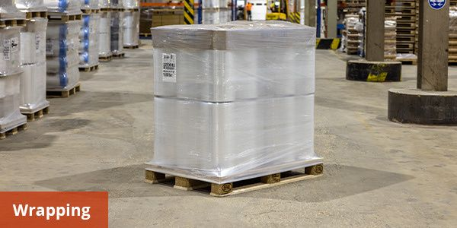



Result
€140,000
Signode Packaging are a leading innovator in the commercial packaging industry. Signode were facing increasing energy bills due to the large amounts of energy for heating and cooling required for their manufacturing processes.
Total Project Cost
€42,000
Grant Amount
€42,714
Project actions: Installation of ducting allowing the redirection of air overspill from manufacturing process, heat transfer system.
Annual Savings
€1,067,850
25 Year Savings
3.3 Years
Payback Time
371,424 kWh
Energy Saved Annually
123
Tonnes of CO
2
Reduced Annually

Slide 28
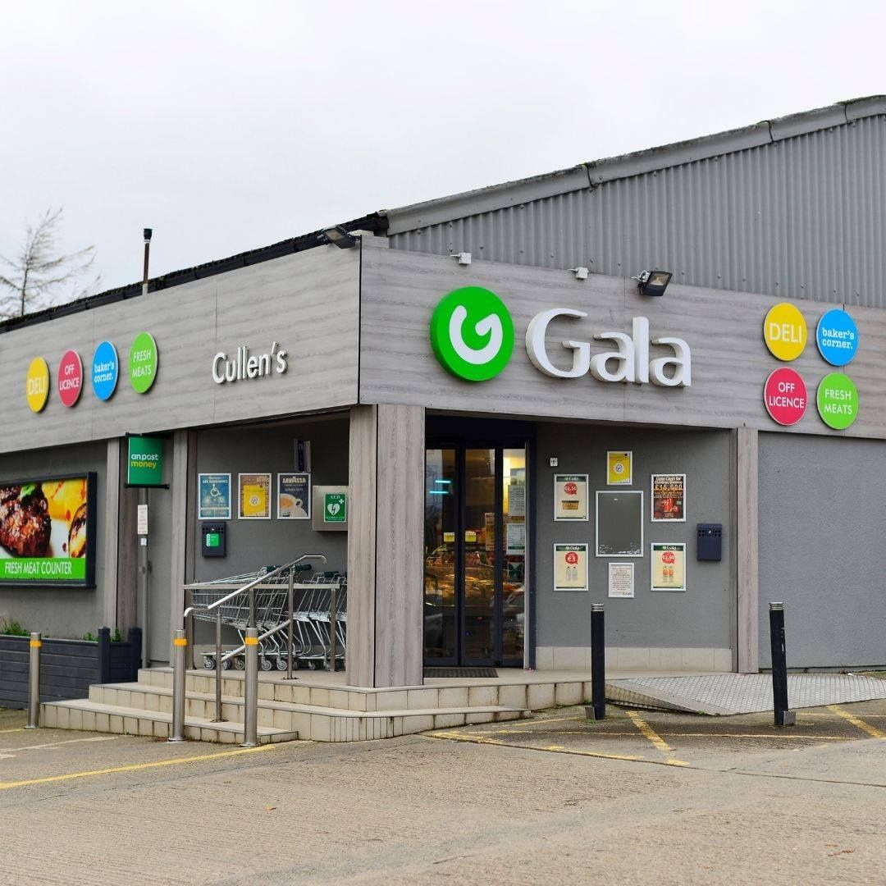
Case Study
Cullen’s Gala
Adamstown
CO. Wexford

Slide 29

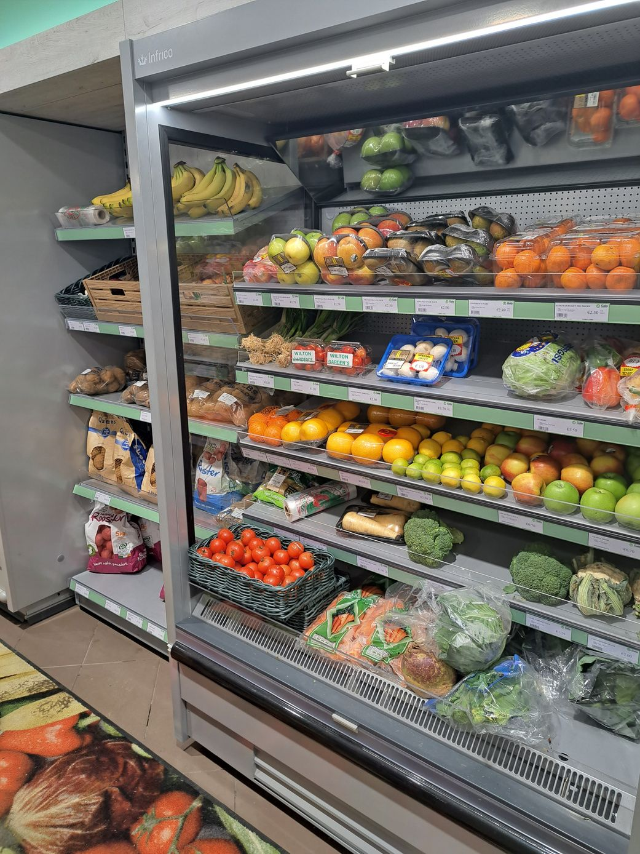
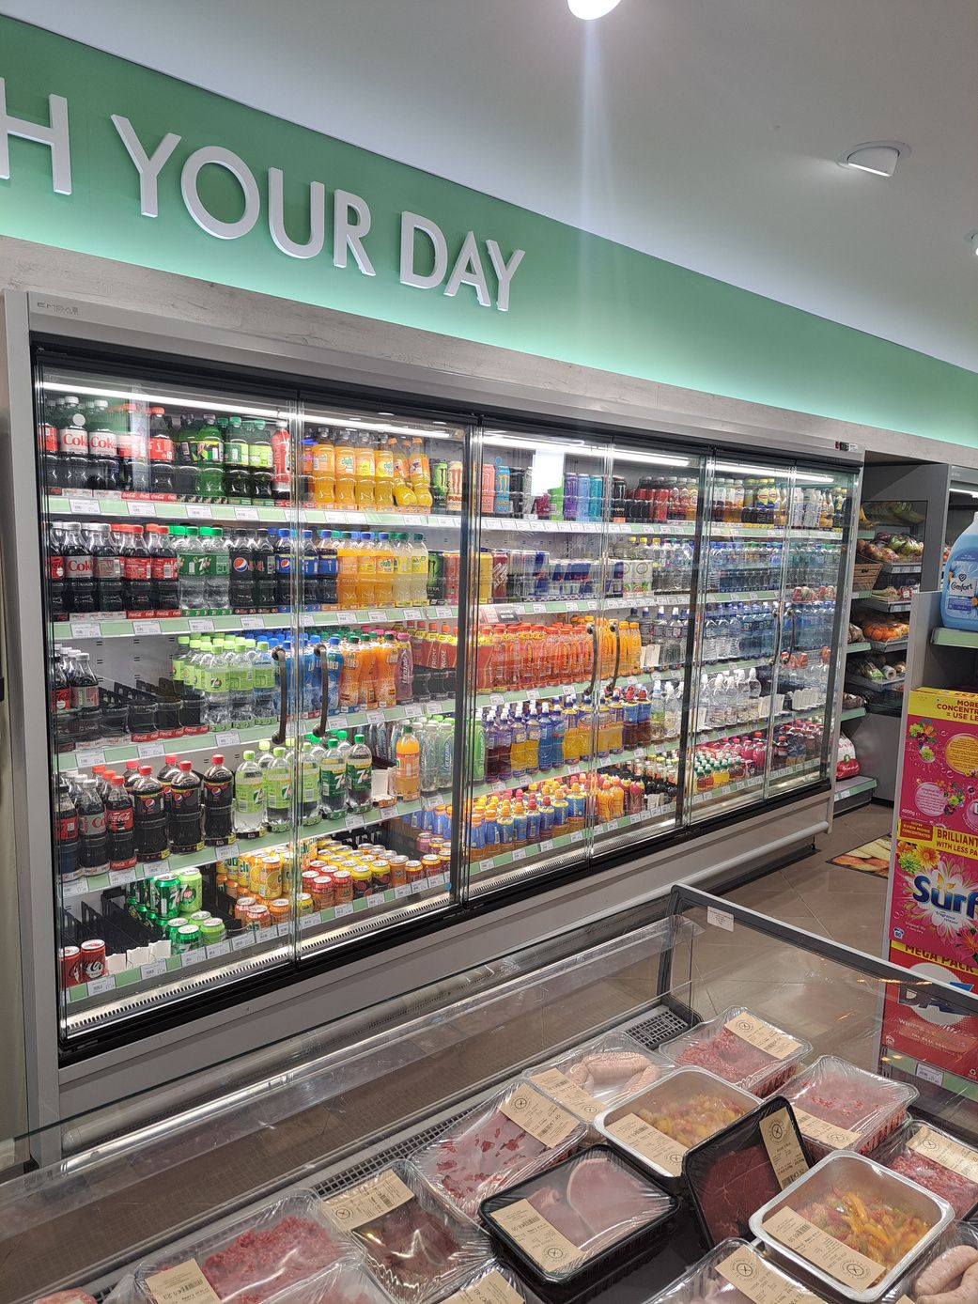
Result
Cullens Gala is a family-run convenience store located in the heart of Adamstown, Co. Wexford. One of the key challenges for Cullens Gala was the outdated refrigeration and freezer units, many of which dated back to the store’s early years of operation. These older units consumed significant amounts of electricity and lacked modern energy-efficient features.
€27,863
Total Project Cost
€8,359
Grant Amount
Project actions: Installation of several modern refrigeration & freezer cabinets. Providing improved energy efficiency.
No longer covered under CEG
€2,633
Annual Savings
€65,825
25 Year Savings
10.58 Years
Payback Time
13,858 kWh
Energy Saved Annually
4.5
Tonnes of CO
2
Reduced Annually

Slide 30

Case Study

Slide 31

Case Study
The Pembroke Hotel is a 4-star boutique hotel located in the heart of Kilkenny City. Opened in 2004 by owner and managing director John Ryan, the hotel is now recognised as one of the best places to stay in Kilkenny.
The hotel has the ambition of becoming carbon neutral, and with the help of South East Energy Agency has availed of two previous CEG’s with a third in the process. The energy upgrades have transformed the hotel, increasing the comfort for its guests and dramatically lowering operational costs.

Slide 32



2019
Annual
Savings/
Reduction
Completed
  Air handling unit upgrade
  Inefficient gas hobs replaced with induction hobs.
€4,996
Saved
32.4
Tonnes CO
Reduced
173,034 kWh
Energy saved
Total Project Cost: € 118,983 (30% Funded)
2
2022
Annual
Savings/
Reduction
Completed
  Windows upgrade
  Controls Upgrade (BMS/Smart control)
  Air Handling Unit
  Water pump upgrade
€21,857
Saved
37.4
Tonnes CO
Reduced
116,999 kWh
Energy saved
2
Total Project Cost: € 137,222 (30% Funded)
2024
Annual
Savings/
Reduction
Completed
  Electric air curtains
  Heat Pump upgrade
  Kitchen extract fan system
(Estimated)
€9,237
Saved
37.5
Tonnes CO
Reduced
187,283 kWh
Energy saved
Total Project Cost: € 268,217 (30% Funded)
2

Slide 33
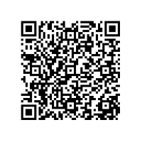
One to one 30 minute appointments available
November 5th
Go through the Energy Audit Grant process and next steps for grant applications.

Slide 34


GRANTS & SUPPORTS
Businesses & SME’s
Michael Kinchella - Project Delivery Engineer
Scan the QR code to register your interest in the CEG or visit southeastenergy.ie to learn more
https://southeastenergy.ie/contact/
+353 (0)56 7790856

Slide 35
Further Case Studies
John Lee's Bar and Venue, Tullamore, Offaly
https://www.youtube.com/watch?v=9d1CcVIYLWc
Mahon Point Shopping Centre, Cork
https://www.youtube.com/watch?v=npzK83hMze4
Ballyliffen Lodge and Spa, Donegal
https://www.youtube.com/watch?v=_g67O16lUio

Slide 36
Climate Action Team – Next Steps
Steps 1 and 2 completed in this Session (session 1)
Step 3: Provide guidance on the completion of application for energy audit voucher!!
Session 2
LEO follow-up - Gorey Hatch Lab – October 17th and November 14th
SEEA follow-up – Meeting room in Foyer of Gorey Library - November 5th
Step 4: Aid with completion of applications for energy grants, post audit.
February, 2026

