Slide 1
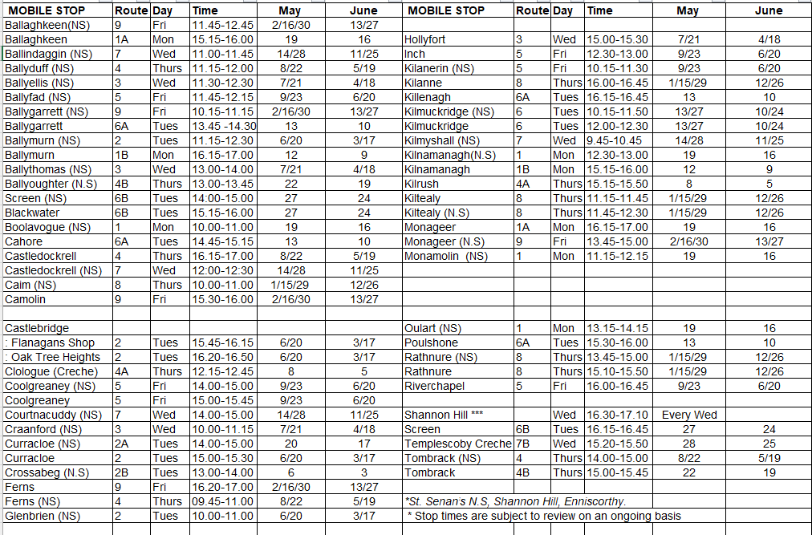
May-June 2025

Slide 2
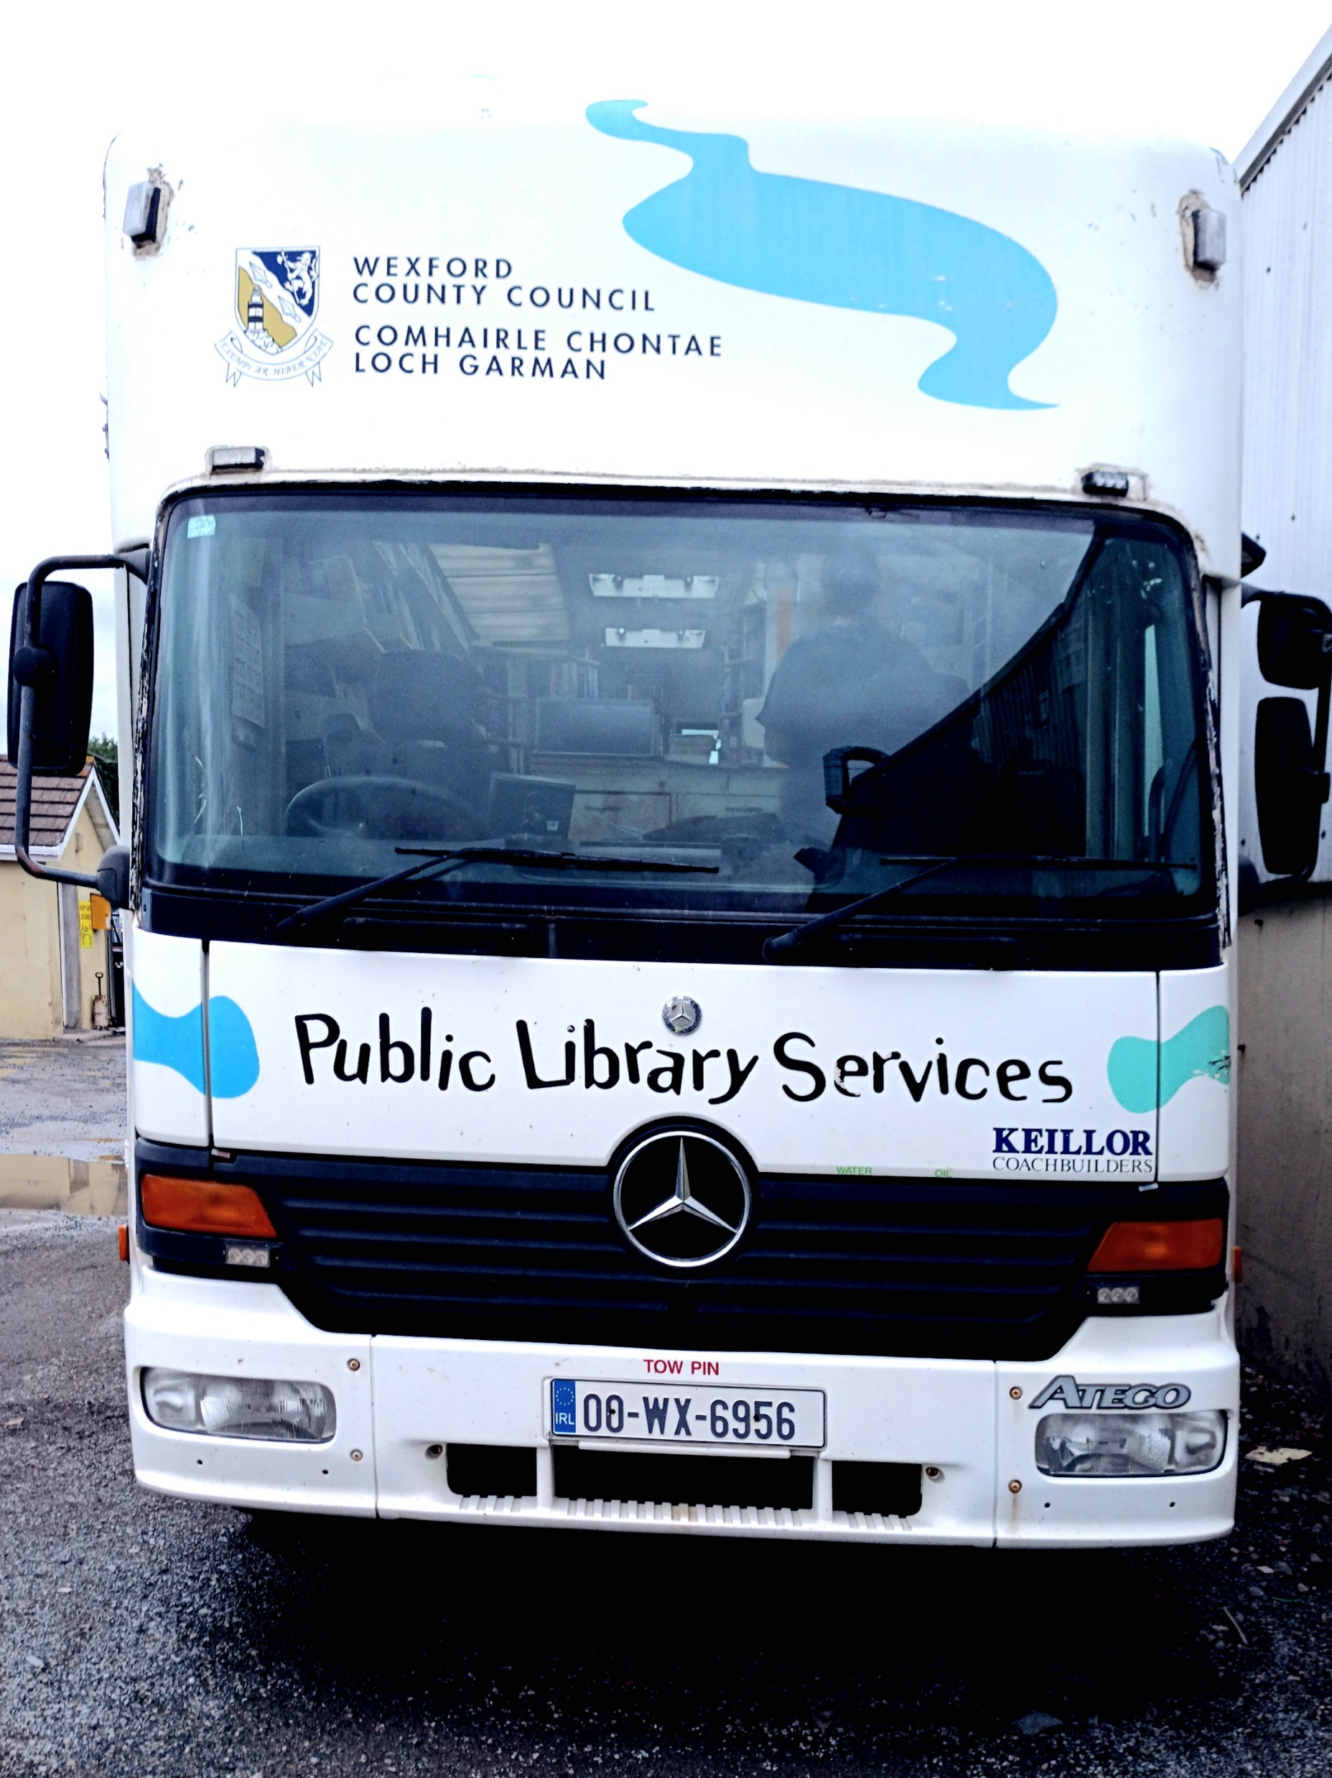
Class Novel sets and Project
boxes
Wexford County Council Public Library Service Library App
Public Library Services
Libby eMagazines
Mobile Library Schedule
North County
May-June 2025
Please ask about our literacy Apps
Transparent Languages
Learn a language
Freegal access to over 30 million songs
Sensory Toys & Assistive Resources
Press Reader access newspapers
BorrowBox eBooks eAudio Books
Storytime available for
junior classes on request
Follow this link https://www.wexfordcoco.ie/libraries/ebooks-and-eresources to find out more about our apps
Contact Numbers
Bunclody Library 053 9375466
Enniscorthy Library 053 9236055
Gorey Library 053 9483820
New Ross Library 051 421877
Wexford Library 053 9196760
Storytime
Comhairle Chontae
Loch Garman
Leabharlann Taistil
For Further information contact Joanne
mobilelibnorth@wexfordcoco.ie
Mobile north 087 4175810
www.wexfordcoco.ie

