Slide 1
Presentation for Transportation and Water Services Strategic Policy Committee
Thursday 4 ^{th} July, 2023

Slide 2
Policies in the Transport Sector - Project Ireland 2040 NSOs

Slide 4
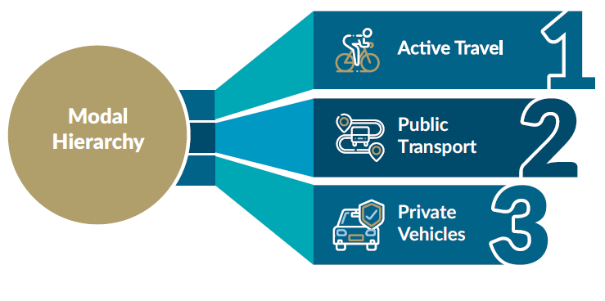
Policies in the Transport Sector – NIFTI Modal Hierarchy
Sets out a hierarchy of travel modes to be accommodated and encouraged when investments are made.

Slide 5
What is Active Travel?
Active Travel is travelling with a purpose - using your own energy. Generally this means walking or cycling as part of a purposeful journey.
Walking as part of a commute to work, cycling to the shop or scooting to school are all considered Active Travel, whereas walking or cycling for purely leisure purposes is not.
“According to Association for the study of Obesity in Ireland (ASOI) if the current trend continues by 2025, 33% of adults will be overweight, costing €2.1 billion to treat obesity related disease”.
Encouraging walking and cycling and public transport use over private car usage will improve health and will also improve local air quality.
The Climate Action Plan will also ask the public to consider their choices and to choose the sustainable mobility option first such as cycling or walking.

Slide 6
Who are we designing infrastructure for? ………………………..
We are designing for everyone!

Slide 7
When we design good infrastructure for cyclists it must be for people of all ages and all abilities.
Full segregation from vehicular traffic is the goal where possible
If people feel safe and comfortable cycling, then more people will choose this option for travel

Slide 8
Active Travel Team Wexford
A dedicated Active Travel Team of 4 staff is now in place to actively progress National Transport Authority (NTA) approved Active Travel Infrastructure.
The team is currently project progressing 3 large schemes in Wexford Town; Roxborough R730; Beechlawn/ Clonard Avenue Cycle scheme which is at Preliminary design stage, Newtown Road Cycle Scheme which is at Tender Procurement Stage (Planning is in Place) and will proceed to construction in Sept 2023.
When completed 10.5 km of enhanced walking and cycling infrastructure will have been created. Future schemes will build linkages across these main axis points creating connections across town.
Safe routes to school – We are currently working with six schools as part of the Safe Routes to Schools scheme. This is a scheme to make the front of school environment and routes to school safe to encourage children and parents to walk or cycle to school.
Development of Wexford County Cycle Network – The Active Travel team is currently reviewing the proposed cycling routes prepared by Aecom Consultants.

Slide 9
Wexford County Cycle Connects Network
CycleConnects: Ireland’s Cycle Network aims to improve sustainable travel by providing the potential for more trips on a safe, accessible and convenient cycling network, connecting more people to more places.

Slide 10
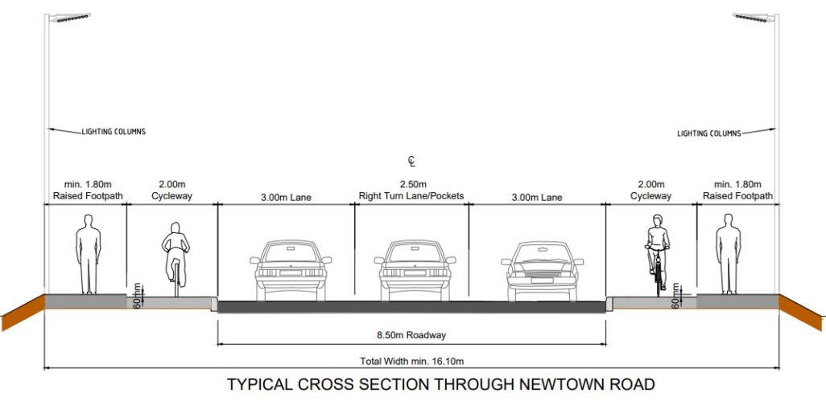
Typical Cross Section of Segregated Cycle Scheme proposed for Newtown Rd Wexford 2023.

Slide 11
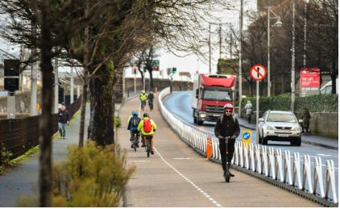
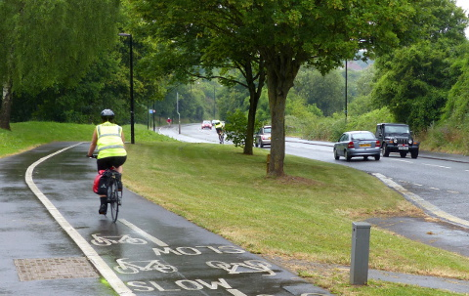
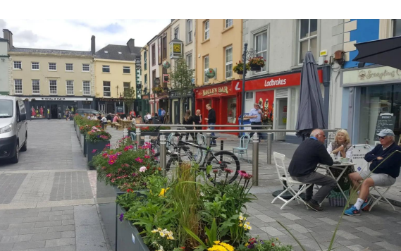
Opportunities for Improvements to Public Realm Places for people

Slide 12
Enniscorthy traffic congestion
As our towns become more populated and busier it is becoming more and more difficult to squeeze cars into the town centre.
This takes precious town centre space from other activities

Slide 13
Wexford Town
Traffic congestion at Grogan's Road

Slide 14
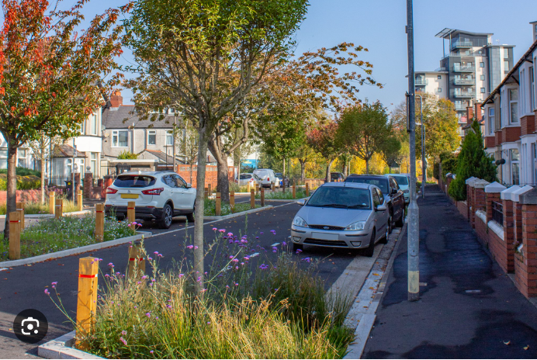
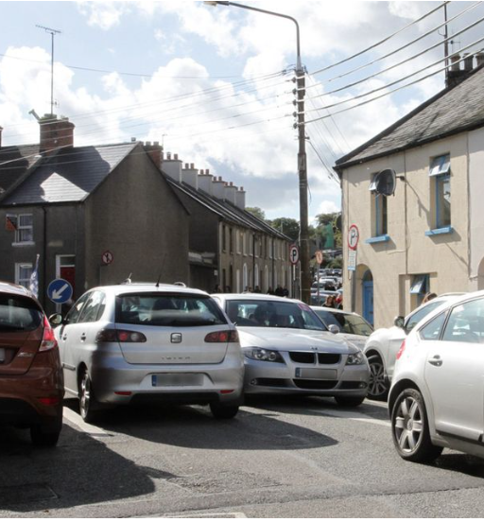
What kind of environment and streetscape would you like?

Slide 15
Active Travel street designs with SUDS
Road narrowing achieved through thoughtful planting plans. Lane width reduction reduces vehicular speeds and creates a nicer environment for everyone.

Slide 16
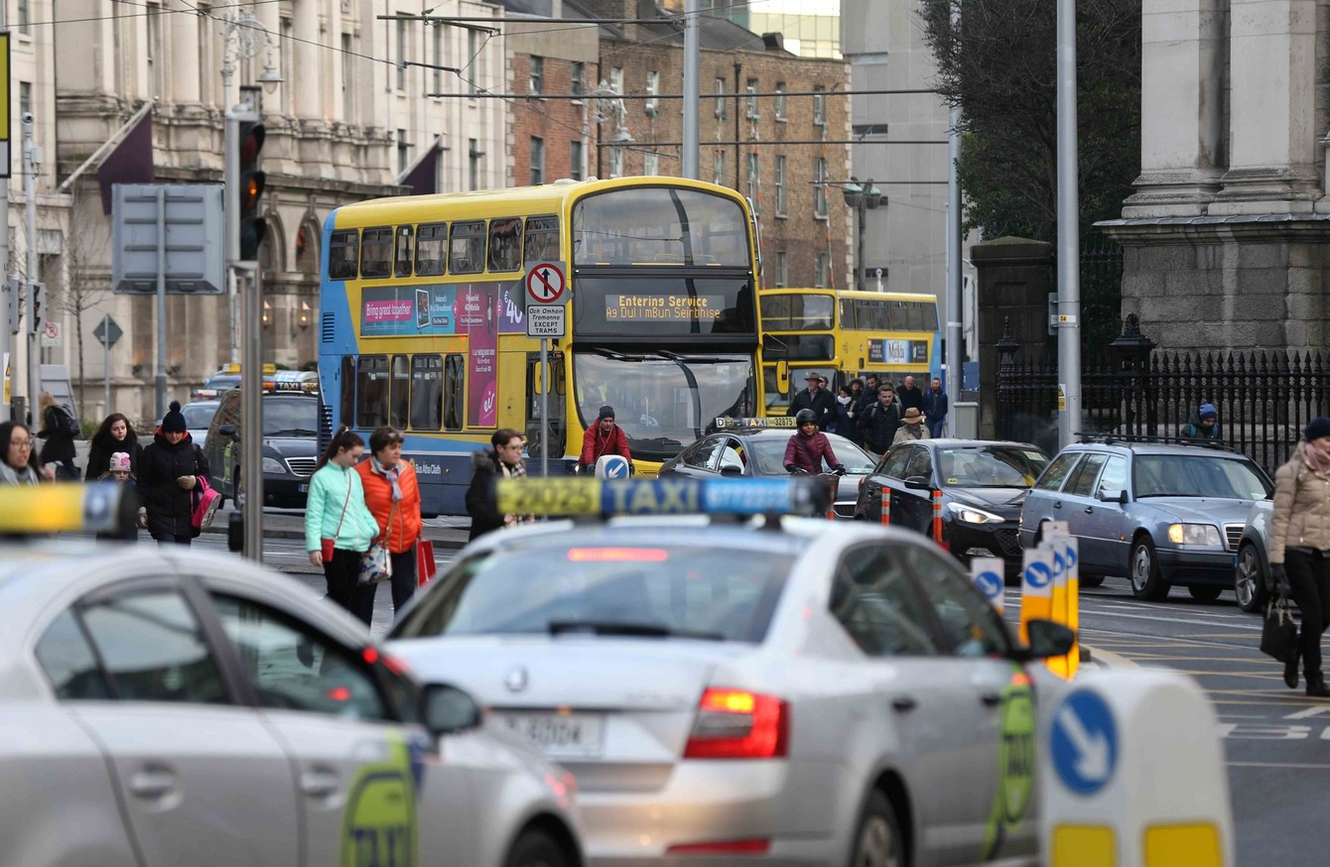
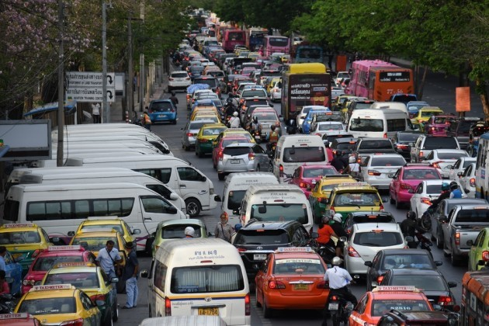
Space for people
Quality of Life
Physical Activity
Meeting people
Being healthy
Social coherence
Space for social interaction when we are not in cars

Slide 17
Safe Routes to School (SRTS)Programme
To improve infrastructure outside and on the routes to school in order to improve safety for cyclists and pedestrians on key access routes to schools
Develop Safe Routes to School Programme in consultation with An Taisce and the Schools’ Board of Management.
Accelerate delivery of accessibility improvements in order to increase the number of children who walk, cycle or scoot to school.
27 Wexford schools applied. 6 of which are currently at design stage.
Improve safety at the school gate by providing ‘front of school’ intervention measures to improve safety, alleviate congestion and improve access.

Slide 18
SRTS Typical ‘Front of School’ Improvements

Slide 19
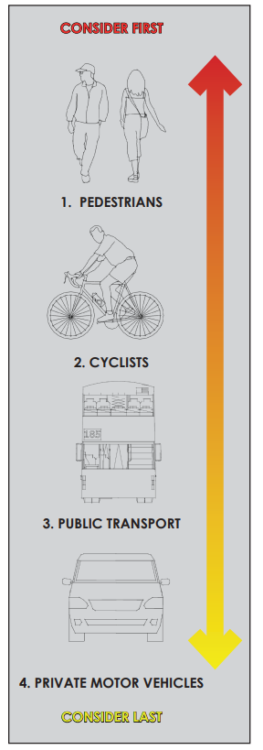
The Design Manual for Urban Roads and Streets (DMURS) proposes pedestrians be given the highest design consideration on urban roads and streets (Ref. DMURS 2.2.2):
As junctions are a critical link on any pedestrian route, and represent a significant conflict risk between pedestrians/other vulnerable road users and vehicular traffic, it is important that they are designed and constructed to improve the safety of pedestrians, and facilitate their priority. Many junctions have been designed with the intention of facilitating ease of movement for turning vehicular traffic, at the expense of pedestrian convenience. These legacy junctions often feature:
1. large corner radii, facilitating swift vehicular turning movements and,
2. poor pedestrian crossing facilities including:
large distances across the mouth of the junction,
pedestrian crossings located away from desire lines, and
inadequate/non-existent dropped kerbs or tactile paving.
As a result Designers must place pedestrians at the top of the user hierarchy (Extract DMURS Figure 2.21).

Slide 20
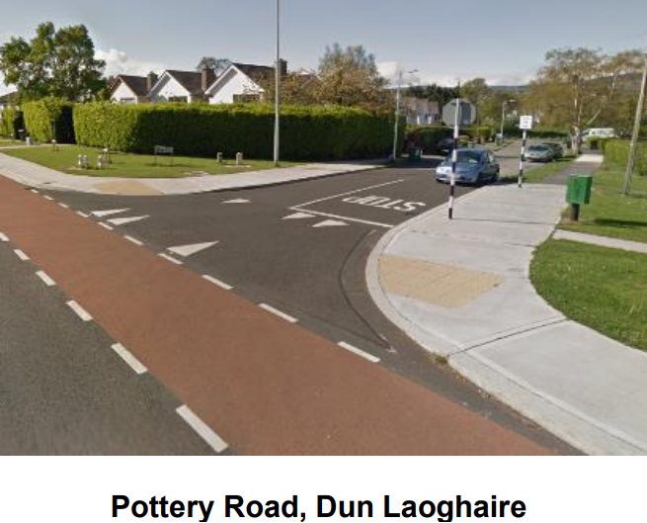
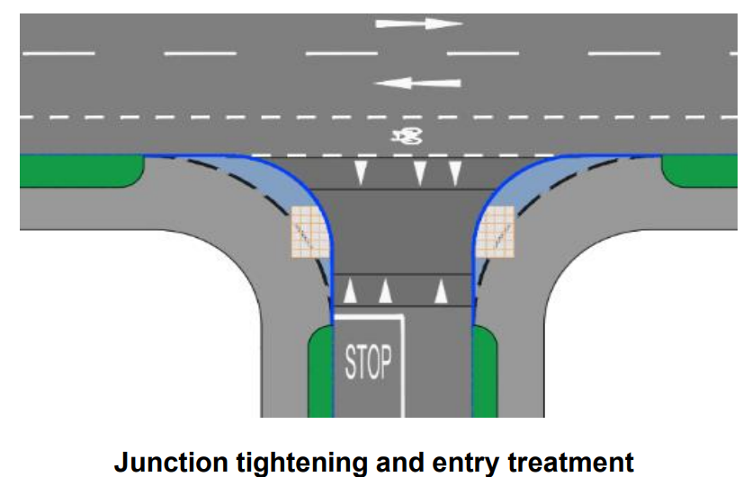
Junction Tightening/Pedestrian Crossing Schemes”.
The purpose of junction tightening is to improve the safety and comfort of vulnerable road users at existing priority junctions and pedestrian crossings.
In recent decades the growth in residential development has been centered primarily on access by road.

Slide 21
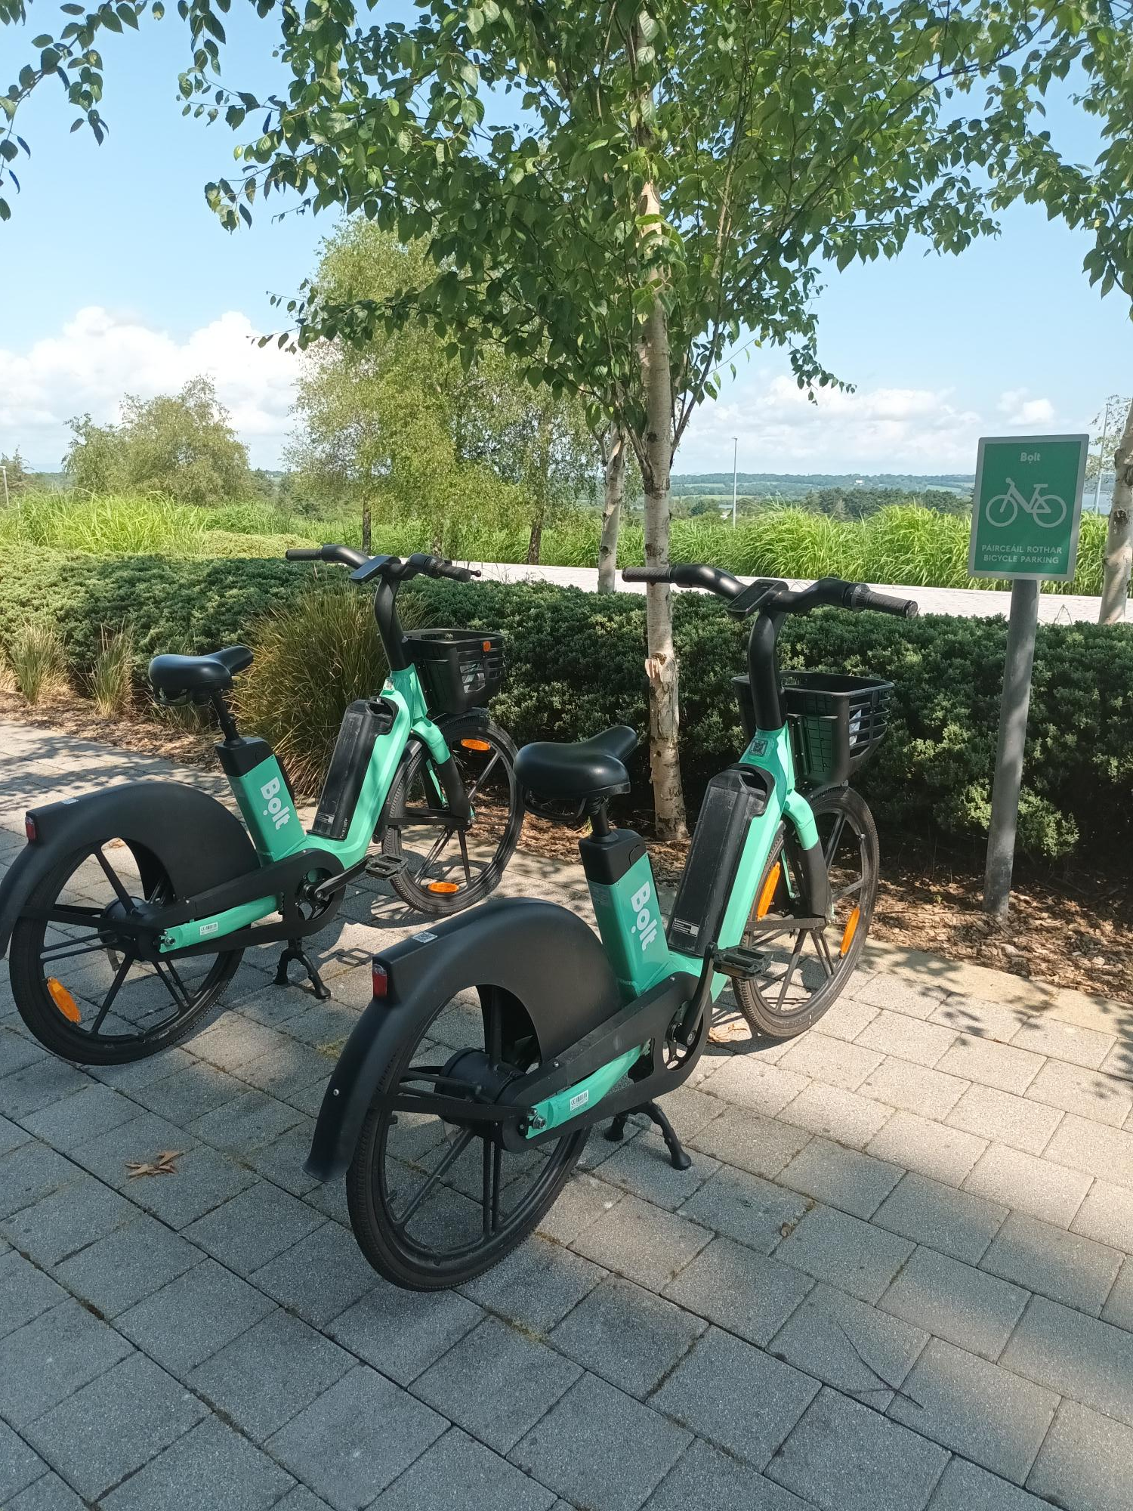
Public eBike Sharing Scheme launched in Wexford Town

Slide 22
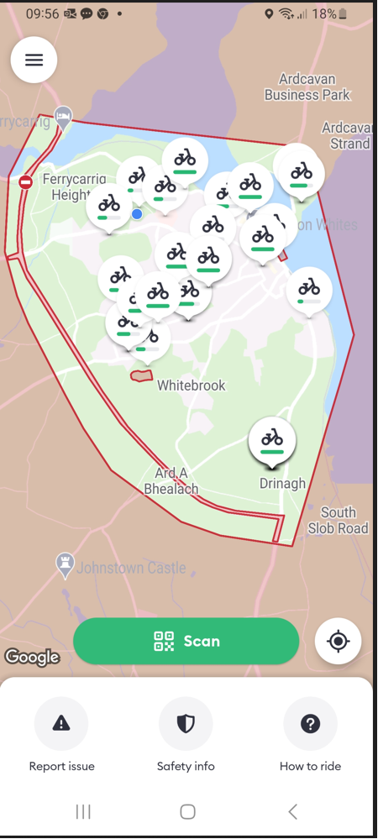
eBike Sharing Scheme
This is a trial eBike sharing scheme which commenced in May in association with Bolt. It will be monitored over the coming year until summer 2024 to see if it is a good fit for Wexford town
It is a ‘hop on, hop off’ type scheme particularly aimed at commuters and those undertaking short journeys in the town.
Since the 17th of May 2023 there have been 2,956 journeys undertaken
8,041 km were travelled within the Wexford Urban area (inside Ring Road and across the bridge as far as Ely hospital)
The hotels – Whites, The Talbot, Whitford and Maldron have all expressed an interest in having bike parking at their premises and these should be in place soon
There is a good spread of bikes being hired across town -see below - the busiest locations recently appear to be at Summerhill, Aldi, Hill Street and Waters Technology
Early indications are that the scheme is proving popular. Bolt may look at increasing the number of bikes in the near future to satisfy the demand
Prices is .18c per minute to cycle and lower rate when ‘locked and reserved’ for short periods is .5c per minute
-Launched: 17th May 2023 -Fleet: 50 e-bikes
-Unique users to date: 1,030 -Rides: 2,956
-Average Duration: 16 min -Average Distance: 2.8 KM
-Total Distance: 8,041 KM
-Parking Locations: Will be increasing in number as we see where demand is

Slide 23
Intelligent app –
Bolt app – available from the Play store tells users where the bikes are spread across town and the current state of the battery and distance available
The empty batteries are swapped out for recharged ones out on the ground by a local operator
Regular maintenance checks carried out by local operator
Beginners or those a bit less confident in cycling can opt for ‘beginner’ mode which controls the speed of the bike down to 15km/hr. Max speed is 25km/per hr
Certain areas of the town are excluded from being cycled in for safety reasons – such as The Quay and Main Street – where the bikes intelligent on board system will slow the speed right down to walking speed so there can be no conflict with pedestrians in these areas
The parking locations are controlled by GPS fencing , bikes must be returned to these locations to be considered fully ‘off hire’.

Slide 24
Thank you

