Slide 1
Wexford County Council
Climate Change & Biodiversity
Clare Kelly
Executive Scientist
Climate Action

Slide 2
Summary of Observed Climate Changes in Ireland
Irelands climate is changing in line with global patterns;
Temperatures are rising across all seasons
The timing and spatial distribution of precipitation (rain, sleet and snow) is changing
Sea levels are rising
The frequency and intensity of extreme weather events are changing

Slide 3
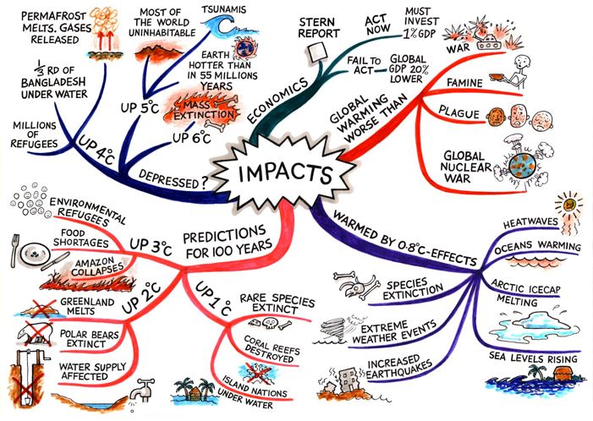
Impacts of Climate Change
Climate change will have diverse and wide ranging impacts on Ireland’s environment, society, and economic and natural resources and Biodiversity
Impacts are predicted to include
Coastal Flooding
More intense storms and rainfall events;
Increased likelihood and magnitude of river and coastal flooding;
Water shortages in summer;
Increased risk of new pests and diseases;
Adverse impacts on water quality;
Changes in distribution and phenology (the timing of lifecycle events) of plant and animal species on land and in the oceans.

Slide 4
Climate Change Actions
Mitigation
Seeks to prevent Climate Change
Adaptation
Seeks to respond to the impacts of climate change
Climate Action
Adaptation refers to efforts to manage the risks and impacts associated with existing or anticipated impacts of climate change.
Mitigation refers to the efforts to reduce the emission of greenhouse gases and reduces the severity of future climate change impacts.

Slide 5
Impact of Climate Change on Biodiversity in Ireland
Changes in the timing of life-cycle events (phenology) of plants, birds, and insects
Changes in the geographic range of some bird species
Changes in the suitable climatic zones of key habitats and species

Slide 6
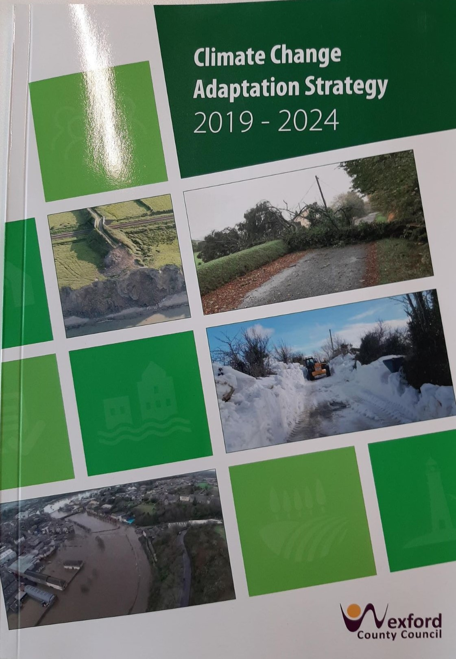
Wexford County Council Climate Adaptation Strategy
Adopted by members in 2019

Slide 7
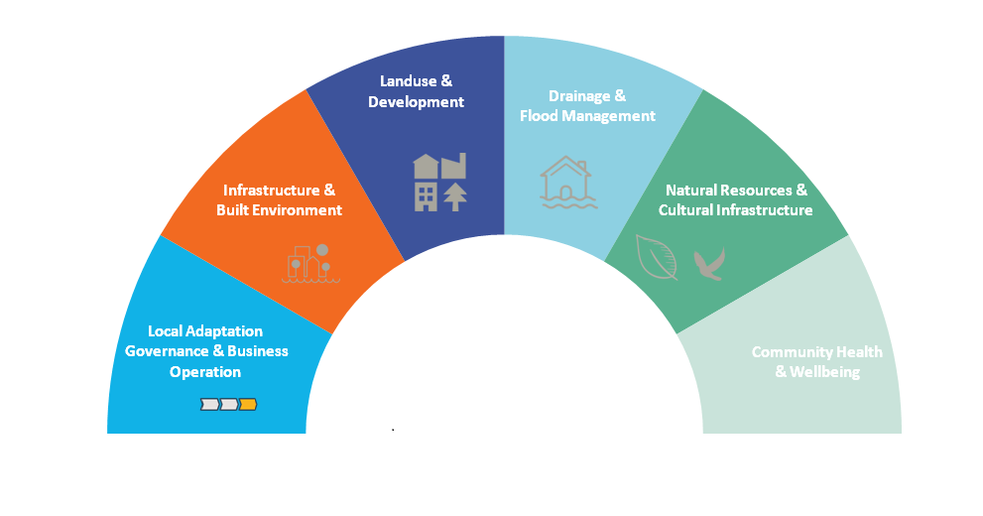
Adaptation Goals, objectives & Actions
6 Thematic Areas
13 Objectives
85 Actions

Slide 8
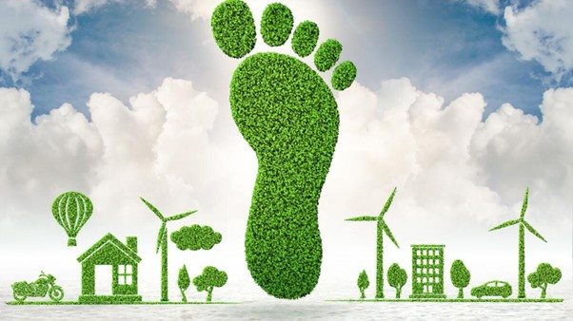
CCAS Actions
Climate Change an integral component of Co. Development Plan 2022
Build expertise within WCC through training on
Climate Change
Invasive Species Awareness
Pollinator Awareness
Promote the Incorporation of green infrastructure – embedded in CDP

Slide 9
CCAS Actions
Integration of natural borders/Buffers for design of amenity areas/trails/Public realm
Review of WCC Biodiversity Plan to incorporate Climate Change
Support all National and Regional initiatives to explore the consequences of climate change impacts on heritage and cultural sites
Provide Information Awareness of the impact of Climate Change on the Heritage and Cultural Assets of the County.

Slide 10
Sustainable Urban Drainage Systems
Incorporate the requirement for SUDS in LA projects and Private Sites
Water Framework Directive
Raingardens
Permeable pavement
Grassed basins
Shallow grassed channels

Slide 12
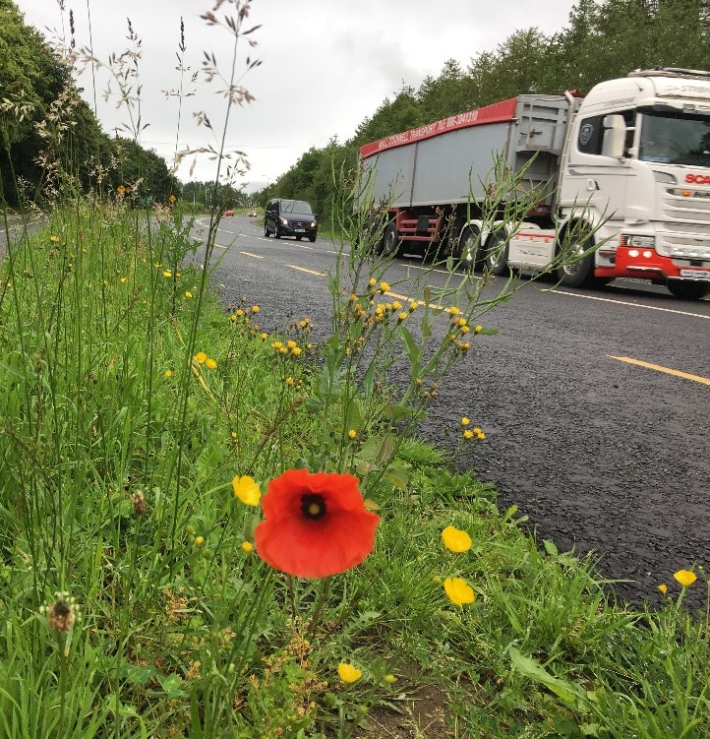
Nature Based Solutions
Nature Based Surface Water Management work with Nature not against it
Benefits include:
Flood risk Management
Improved water Quality
Biodiversity
Climate Adaptation & Mitigation

Slide 13
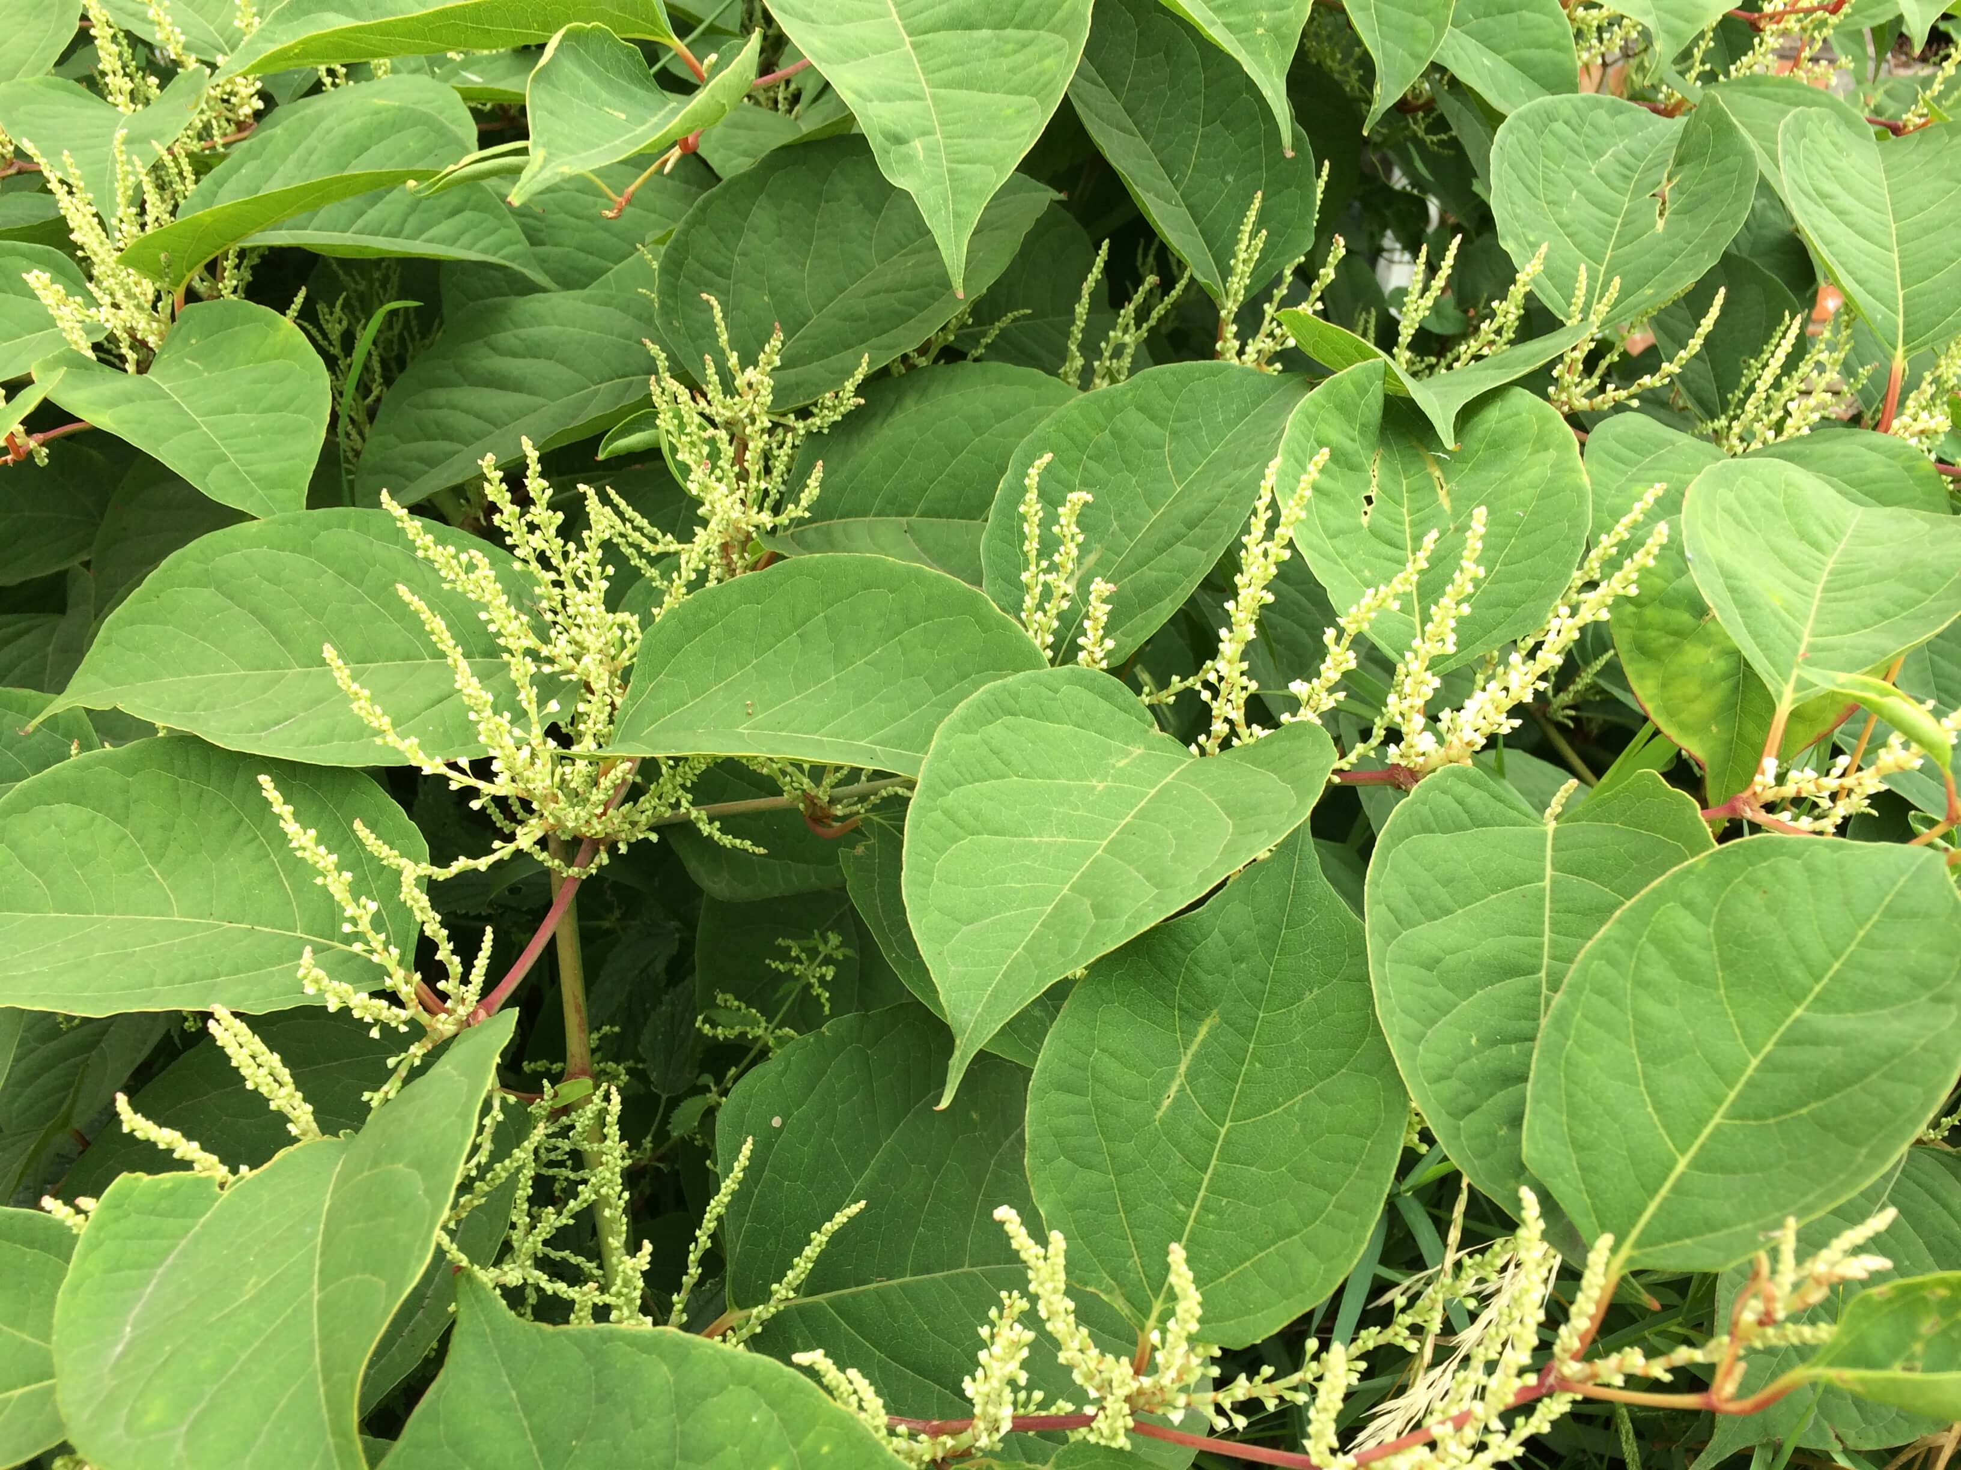
Invasive Species
More frequent extreme weather events (such as floods and droughts) stress native species and create opportunities for invasive species movement
Melting sea ice opens new shipping routes and pathways for invasive species spread
Increased carbon dioxide (CO²) in the atmosphere leads to higher CO² uptake in plants, which can increase herbicide resistance
Changes to climate (including temperature, humidity, and rainfall) can create favourable conditions for increased spread of invasives

Slide 14
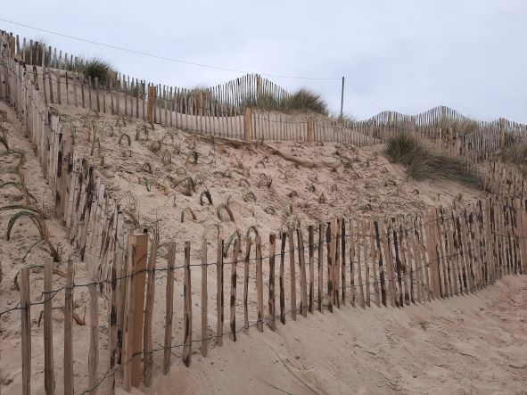
Coastal Biodiversity- Sand Dunes
Sand Dunes can be a big part of our fight against climate change and storm impacts/surge
Strength of the dunes comes from the plants that trap and bind the sands together
Habitat for flowering plants, lizards, toads and ground-nesting birds
Marram grass most common in Ireland
Biodiversity Action Plan Funding

Slide 15
Sustainable Development Goals
UN 17 interlinked Goals for a more sustainable future
SDG 13 Climate Action
SDG 14 Life below Water
SDG 15 Life on land

Slide 16
Thank you

