Slide 1
Landscape Biodiversity Seminar
Diarmuid Houston
Senior Planner

Slide 2
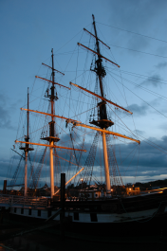
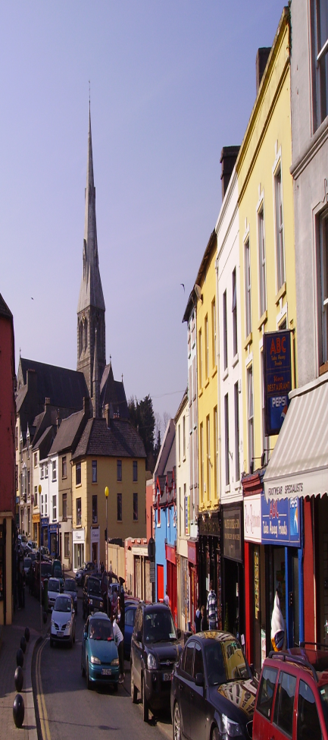
Wexford County Development Plan 2022 to 2028

Slide 3
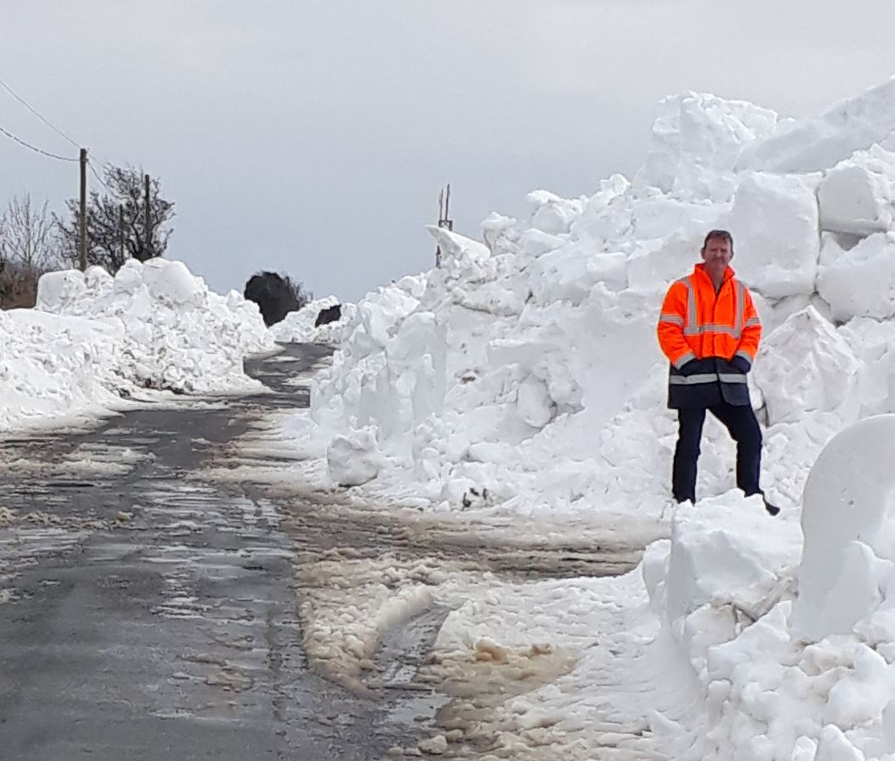
Our last chance
The plan is to cover the period 2022 to 2028 which is 6 years of the 8 years we have remaining to mitigate against climate change
Over the past few years Wexford has experienced drought, flooding, hurricane force winds and excessive snow fall. Year on year the Earth’s temperature is rising breaking all records.
We are close to a tipping point where these impacts will sharply worsen.
NATIONAL CLIMATE ACTION PLAN 2019

Slide 4
Now is the time for action
The Plan will have regard to all the Local and National Policies and will provide detailed actions to achieve this by;-
Promoting renewable energy working to make County Wexford a Carbon Neutral County
Improving and creating new biodiversity habitats
Reduce the use of fossil fuels
Create connected sustainable rural and urban communities

Slide 5
Chapter 2 Climate Change
Mitigation and Spatial Planning
Reducing greenhouse gas emissions, using sustainable, renewable energy sources and moving to a low carbon economy.
Promote sustainable transport options, encouraging the use of electric.
Promote the development of towns and villages.
Increase employment to reduce the amount of unsustainable commuting.
Facilitate sustainable agriculture.
Promote renewable energy.
Nearly Zero Energy Buildings (NZEB) by 31st December 2020. Support the development of the UN European Centre of Excellence in High Performance Buildings in Enniscorthy.

Slide 6
Vision
Vision for County Wexford
Be a self-sustaining, low carbon, climate resilient county where people want to live, work and play.
Offer high quality sustainable employment opportunities and high quality residential developments.
Have sustainable urban and rural environments supported by excellent physical and social infrastructure.
Continue to value its unique natural environment, built and cultural heritage, and which offers a range of high quality experiences to both residents and visitors.
Notes:
Climate Action
The Core Strategy Development Approach is focused on developing and strengthening the role of our towns and villages. There is a focus on increasing residential densities and employment in the main towns, creating ‘live-work towns’, thereby decreasing the distance that people have to travel from their home to work. The strategy is also focused around settlements with good public transport links, and improving public transport links in other settlements, highlighting the importance of integrating land and transportation to help reduce greenhouse gas emissions and facilitate the transition to a low carbon economy.

Slide 7
Objective CA11
To support measures to build resilience to climate change including adaptive capacity, awareness and providing for nature-based solutions and emergency planning and to raise awareness of the role of spatial planning in climate change mitigation and adaptation through the forward planning and development management functions of the Planning Authority.

Slide 8
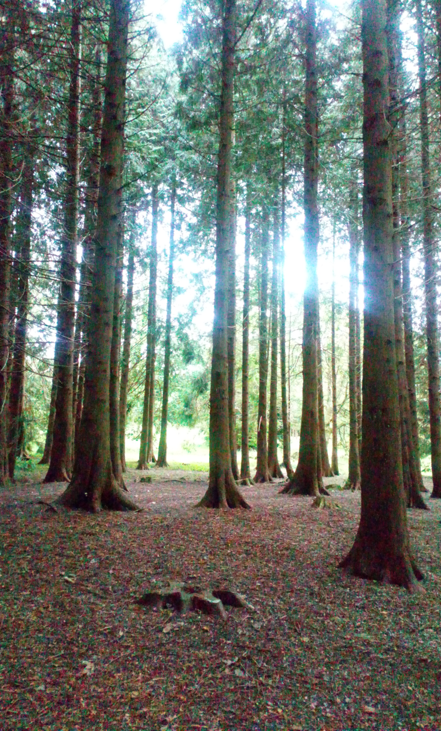
Housing Estates
Electric car charging
Adaptable Housing
Biodiversity areas
Innovative Play

Slide 9
5.7.2 Designing the Public Realm
Objective TV19
To require that new developments, streets, public spaces and other areas of public realm including parks are designed to reflect the design principles of Connectivity, Enclosure, Active Edge and Pedestrian Facilities/Activity and enhance the biodiversity of the town/village in which they are situated.

Slide 10
Rural Housing
New objectives to reduce carbon footprint
Lager sites for larger houses
Area of planting to promote pollinator plants and trees

Slide 11
Transportation
Climate Change and Transportation
Transportation is one of the most significant generators of greenhouse gasses and consumers of energy. In 2017, 19.8% of Ireland’s greenhouse gas emissions were attributable to transport sources.

Slide 12
Transportation
Objective TS20
To support the creation of new edge of town transportation hubs connected to the National Bus routes providing park and ride, park and cycle and park and walk transport interchanges for the four main settlements.
Objective TS21
To ensure that new transport infrastructure developed by the Council incorporates appropriate green infrastructure and functions as a biodiversity corridor and ensure that these elements are integrated into the proposals of other transport network providers.

Slide 14
Objective TS55
To encourage the use of road corridors, including national road corridors as green infrastructure networks and to encourage roads infrastructure design which maximises opportunities for biodiversity.
Objective TS70
To support the development of cycle tracks adjacent to the routes of new road schemes.

Slide 15
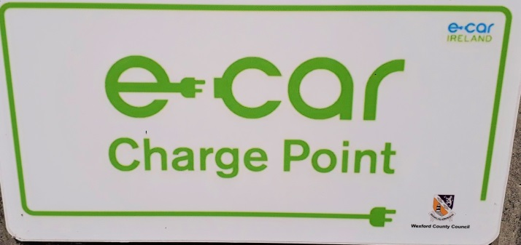
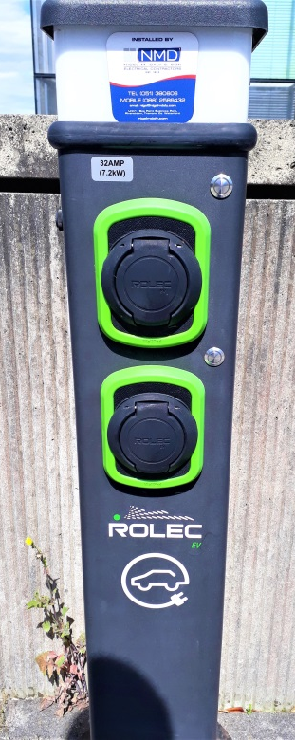
20% of all car parks to have charging points
New policies on parking in town centres
Proposals to provide edge of town parking and public transport hubs

Slide 16
Chapter 9 Infrastructure Strategy
Climate Action and Infrastructure Planning
Infrastructure developed above ground should avoid flood risk areas and areas at risk of coastal erosion.
Site selection, location, design and materials will need to have regard to and be resilient to the changing climate (high winds, temperature fluctuations, increased storminess and changes in rainfall).

Slide 17
Flood Risk and Surface Water
Fluvial
Tidal and Coastal
Surface Water
CFRAMs

Slide 18
9.11.9 Riparian Zones and Flood Risk Management
River corridors and their associated riparian zones are important for flood risk management and water protection. The riparian zone needs to be considered as an integrated part of a river, and any unnecessary interference with this zone can be damaging to flood attenuation and flood management features of the zone.
The design, layout and functions of the riparian zone is also discussed in detail in Chapter 11 Landscape and Green Infrastructure and this should be consulted when designing schemes adjoining watercourses, including public open spaces, recreational areas and activities and the location of dwellings and private gardens.

Slide 20
Chapter 11 Landscape and Green Infrastructure
Goal
The overall goal is to protect the inherent beauty of our landscape and to promote and enable appreciation and enjoyment of the County’s landscapes and to protect, restore and enhance the County’s green infrastructure and biodiversity for the benefit of all.

Slide 21
A well-designed network of Green Infrastructure will help to:
Provide high quality open spaces with associated health and social benefits for people through the provision of play areas, safe and attractive areas and routes for meeting, walking and cycling.
Provide opportunities and space for contact with nature which is considered essential for good health and wellbeing.
Allow communities to adapt to the impacts of climate change and flooding.
Act as a natural water management infrastructure including drainage and flood attenuation, filtration and pollution control.
Protect wildlife through the provision of buffer zones.
Incorporate nature-based solutions that contribute to the protection, restoration and enhancement of biodiversity and ecosystem services.

Slide 22
See objectives GI01 to GI09
Promote landscape connections
Retain and enhance riparian zones
Nature based SuDS

Slide 23
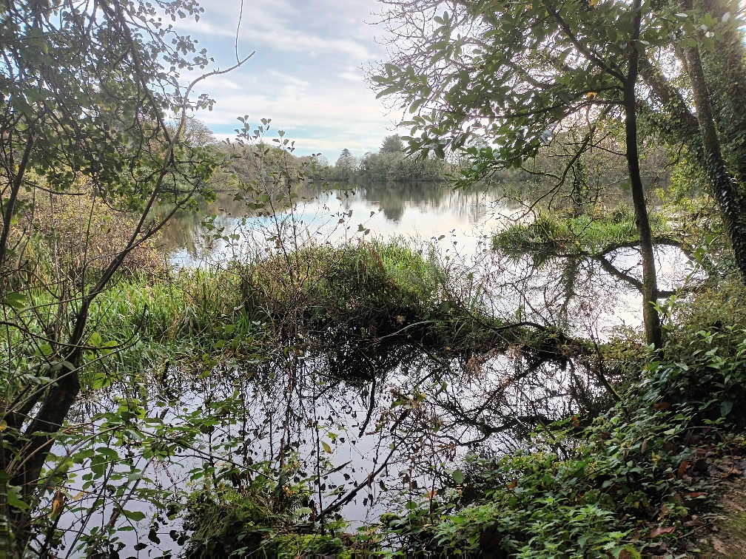

Slide 24
Chapter 14 recreation and open space
The Council, as a Planning Authority, has an important role to play in creating living environments that promote and facilitate active and passive recreation, physical activity and social inclusion
Objective ROS05
To ensure that open spaces and recreational facilities are multi-functional spaces incorporating biodiversity, SuDS and flood attenuation, where appropriate.

Slide 25
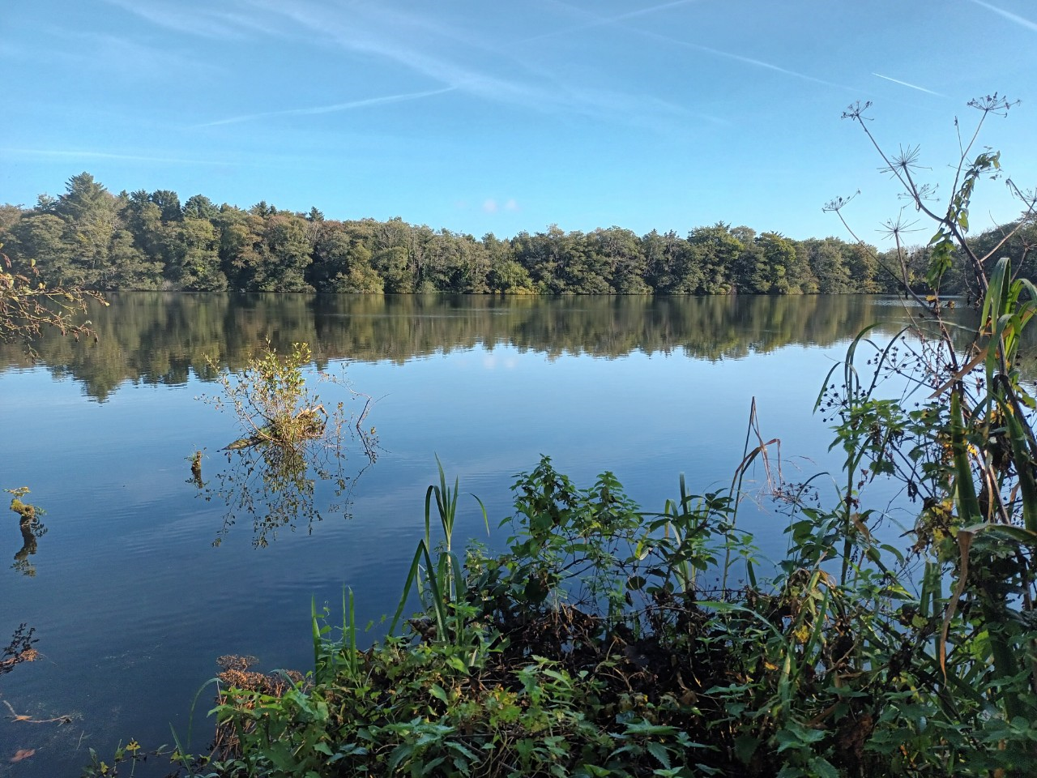
Objective ROS06
To support community groups and sporting organisations in the development of parks, spaces, allotments and community gardens, sporting facilities and play facilities subject to residential amenity and proper planning and sustainable development.

Slide 26
To support investment in the on-going maintenance and enhancement of existing public open space facilities, and support the provision of new public parks, green space corridors, pollinator projects, native planting and wild areas and rewilding projects and other public open spaces in tandem with planned population growth to create green, biodiversity rich and healthy settlements throughout the county.

Slide 27
volumes 2 to 13
Volume 2 Development Management
Volume 3 Settlement Plans
Volume 4 Statement of Compliance with Guidelines
Volume 5 Record of Protected Structures
Volume 6 Architectural Conservation Areas
Volume 7 Landscape Character Assessment
Volume 8 Retail Strategy
Volume 9 Housing Strategy
Volume 10 Energy Strategy
Volume 11 Strategic Flood Risk Assessment (SFRA)
Volume 12 Strategic Environmental Assessment (SEA)
Volume 13 Natura Impact Report (NIR/Stage 2 AA).

Slide 28
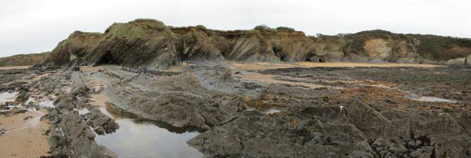
County Geological Sites and Recommended Geological Natural Heritage Areas

Slide 29
Next Stages
How do we deliver change
Town Plans
Biodiversity Plan
Heritage Plan
Think global act local
What do you think we should all do?

Slide 30
THANK YOU

