Slide 1
Biodiversity Changes in a Historical Landscape
Alan Ryan, Project Manager
Colclough Walled Garden
Tintern Abbey

Slide 2
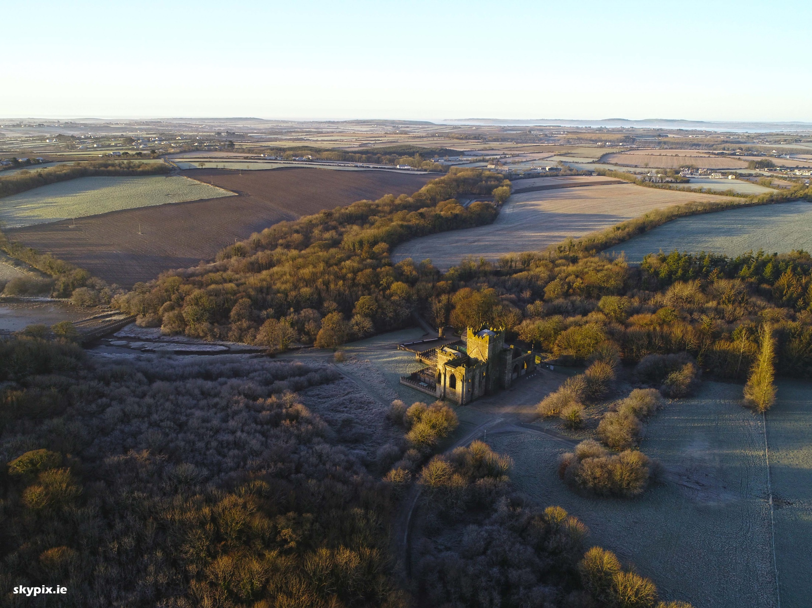

Slide 3
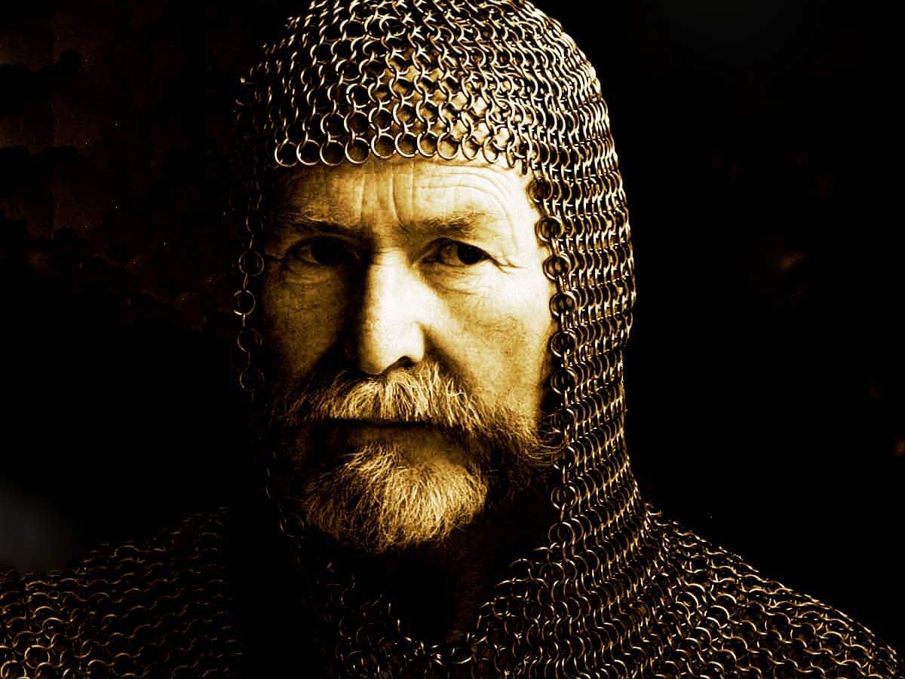

Slide 4
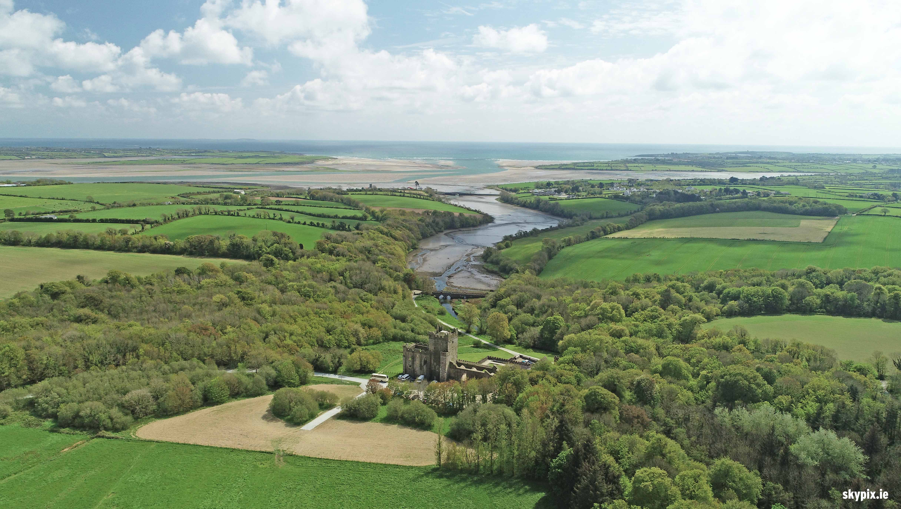

Slide 5
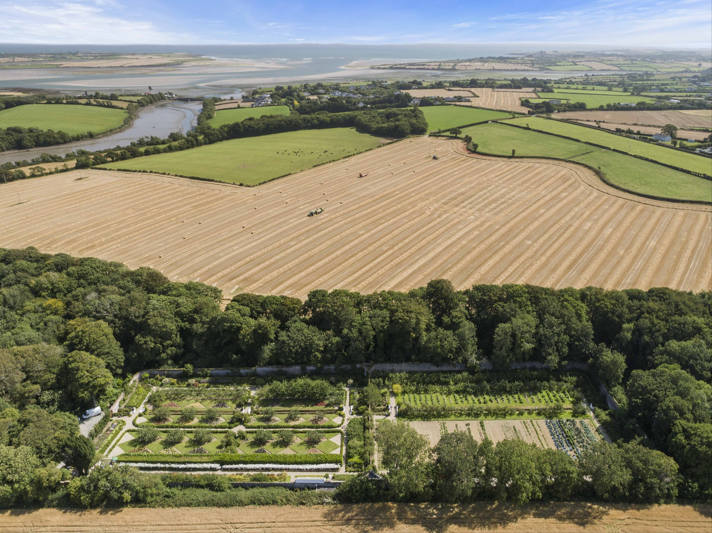

Slide 6
References
Topographia Hibernica (Topography of Ireland), by Gerald of Wales. Written around 1188
“Statistical Account or Parochial Survey of Ireland, Volume 3” edited by William Shaw Mason. Published in 1819
“Walks through Ireland”, J.B Trotter. Published in 1819
“The Beauties of Ireland” by James N Brewer. Published in 1825
A Topographical Dictionary of Ireland, by Samuel Lewis. Published in 1837
THANK YOU

