Slide 1
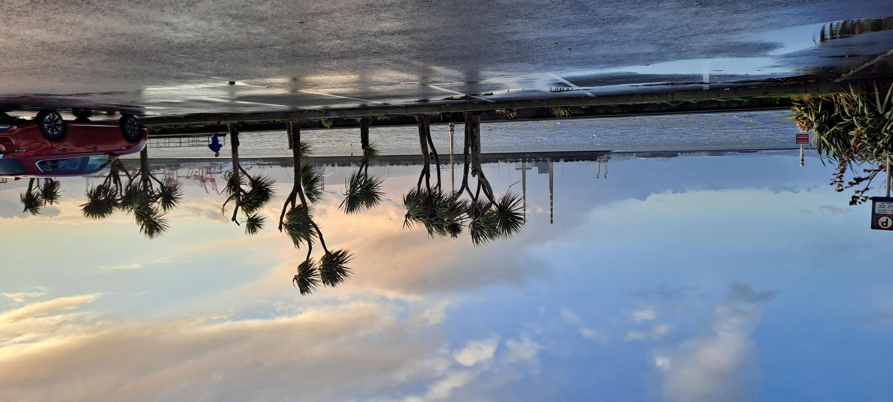
'Including Nature and Biodiversity in the design, construction and management of our urban (and rural) areas.
Wexford County Council
14 November 2022

Slide 2
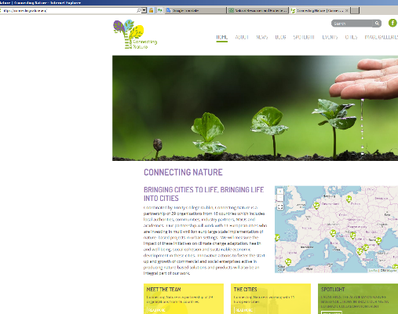
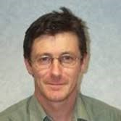
Landscape architecture – and the practical use of science
Tony Williams
Principal Landscape Architect
Transport Infrastructure Ireland
PhD Candidate.
School of Natural Science, Trinity College Dublin.
IFLA World Climate Change Working Group (IFLA CCWG)
European Voting Member.
https://www.iflaworld.com/climate-change-working-group

Slide 3
Promoting Biodiversity (as part of our normal activities)
Luas Cross City project as an example of integrating the natural world , and making a more Biodiverse ecosytem (more of everything in the urban / peri-urban and rural settings)
Engineering and planning the interventions is crucial to ensuring successful outcomes
Work on the details. How will it be done ? and who will do it ? Include this in contracts (but carefully)
The following is an example from Luas Cross City (Tramway Construction in Dublin)

Slide 4
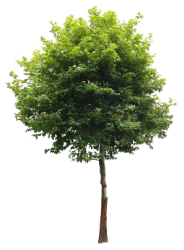
An example of multidisciplinary elements
Tree Pit design and Construction
Luas Cross City
Existing and Proposed Trees –
Strategy developed
Landscape Architects:
Tony Williams (TII ) Laura Flynn and Eimear Fox.
Fergal Parlon – (Brady,Shipman,Martin)
Utility Engineer:
Michelle Merne (TII)
Arborists:
Planning Stage-Ciarán Keating (for TII)
Enabling Works (for GMC) -Felim Sheridan
Infrastructure Works (for TII) –Felim Sheridan
Infrastructure Works (for SSJV) –John Morgan
Environmental Co-ordinator – Colin Wilson
And the design and site team (mostly engineers)
Notes:
The necessity to plan for the inclusion of work on the streetscape and the wide scope from tramway construction to retention and provision of utilities and services required a close collaboration and forward planning.
The team include
Landscape architects (lead Tony Wiliiams)
Utility Engineer (Lead) Michelle Merne
And lots of other engineers on the tramway generally (civil, structural, mechanical, electrical) and all have something to say about ‘Trees’
Arborists and Ecologies throughout the planning, design and construction phaes/.
Note that TII also secured the services of an arborist for the entire life cycle of the project and five years monitoring post-construction works 9for existing retained trees and newly planted)

Slide 5
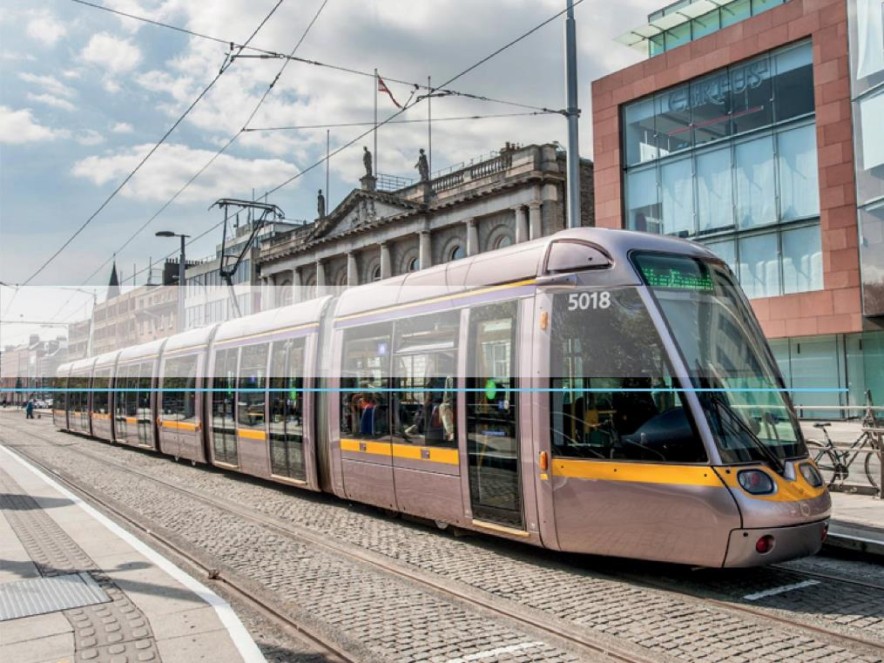
LUAS Cross City (LCC)
DAWSON STREET, Dublin, Ireland (Éire)
STREET ELEMENTS
Notes:
The essential elements of the task are the development of a clear detailed plan
Overall for the project (all elements, all paces)
for each section
And each square metre
Detailed planning is required and design is for each existing tree (thus the need for a project arborist both on the side of the contractor and the client !)
A tree management plan is drawn up and agreed with the local authority. This is then provided to the contractor with the option to accept ‘as their own’. This then becomes a contractual requirement and so focuses (not always positive) activities to the retention of trees and vegetation.
The retention of trees where possible, planning for the inclusion of new trees and vegetation and the overall improvements in root zones and aerobic conditions underground is therefore included as a key deliverable in the works.

Slide 6
Utilities and Tree Pits – Design in Unison
Notes:
The development of an underground design that incorporates
Existing utilities
Proposed utilities
Existing trees (design to incorporate utility space but also to retain the tree. Inclusion of fresh soil and a root zone that allows space for new root formation are included.
Newly planned trees (design of tree pit extents and construction type)

Slide 7
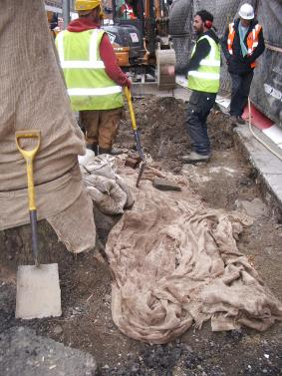
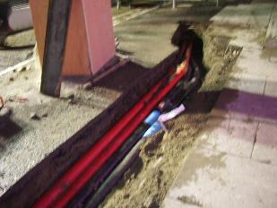
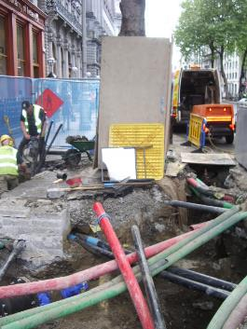
Notes:
Works on site must
Be overseen by the contractor’s arborist (and records kept)
Be overseen by the client's arborist / landscape architect
Follow the method statements provided
Be discussed with the site lead, works operatives on site
Be familiar with the expected weather
Be based on the overall risk assessment of the asset (the tree)

Slide 8
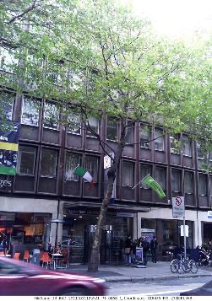
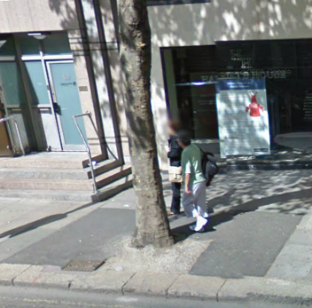
Existing Trees – Strategy
Not without its difficulties
  Challenge to adjust utility layouts in order to avoid impacting existing street trees
  Each trees footprint varies and needs to be designed for its unique position within the new streetscape and kerb lines
  Full aboricultural advice obtained to allow individual street tree details be developed.
  Trees removed only when necessary
  Requirement for aftercare and monitoiring
  Hand over to city and operator
METRO WEST
Dawson Street – Existing London Planes to be retained
LCC (BXD)
Trees - existing
Notes:
Text on the slide
Existing Trees – Strategy
Not without its difficulties
Challenge to adjust proposed utility layouts in order to avoid impacting existing street trees
Each trees footprint varies and needs to be designed for its unique position within the new streetscape and kerb lines
Full aboricultural advice obtained to allow individual street tree details be developed.
Trees removed only when necessary and using an arboricukltural impact assessment procedure outlining reasons for and mitigation of. The tree removal
Requirement for aftercare and monitoiring to be continuous
Hand over to city and operator

Slide 9
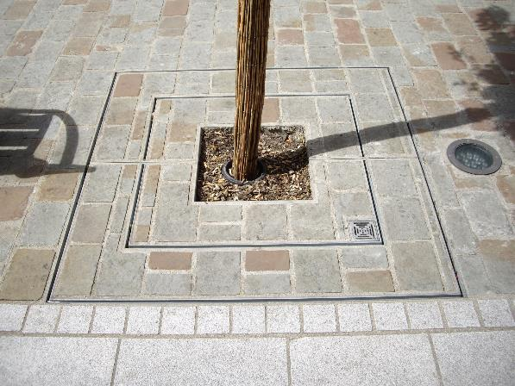
New Trees
  Challenge to adjust utility layouts in order to fit new street trees
  Tree grille proposed with infill to match surrounding paving
  Structural soils used as part of build up
  London Plane tree type used to match existing
  But not always.
  We are aiming to increase the range of species used
METRO WEST
LCC (BXD)
DAWSON STREET
Tree Planting - proposed
Notes:
New Trees
Challenge to adjust utility layouts in order to fit new street trees
Tree grille proposed with infill to match surrounding paving
Structural soils used as part of build up
London Plane tree type used to match existing
But not always.
We are aiming to increase the range of species used

Slide 10
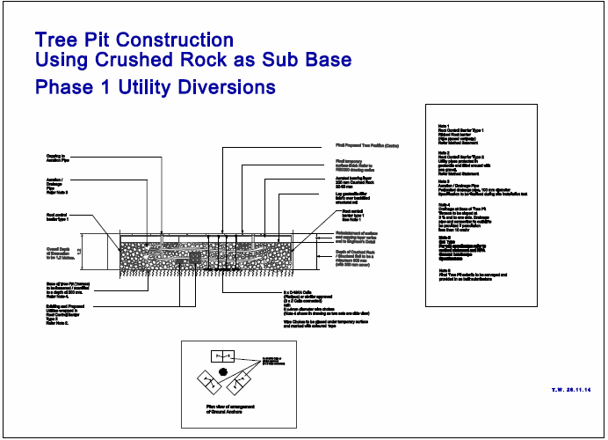
Luas Cross City
Urban Design Strategy
Tree Pit Construction
Contractor: GMC Utilities
Arborist : Felim Sheridan
Based on Stockholm Tree Pit Design – Orjan Stahl et al.
Notes:
Development of a methodology using a variety of root zone creation techniques. Refer to BS 8545 for advise also on the management of trees.
The use of
HDPE cells (90 % soil) 10 % structure
And
Stockholm system - Rock (100 /150 mm) sharp, compacted (30 % soil / 70 % structure)
Were tested.
The Stockholm system was favoured for constructability, (time) and cost. Tree pit size increased to compensate for loss of air / soil space (factor 0f 3 as a minimum if possible)

Slide 11
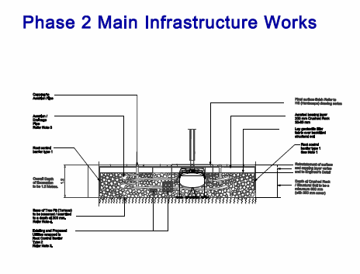
Luas Cross City
Urban Design Strategy
Tree Pit Construction
Contractor: Sisk Steconfer J.V.
Arborist : Felim Sheridan
Arborist : John Morgan
Ecologist : Colin Wilson
Landscape Architect : Fergal Parlon
Based on Stockholm Tree Pit Design – Orjan Stahl et al.
Notes:
Construction stages planned
For enabling works (tree pit infrastructure installed with utility works where design required, tree installed during main infrastructure construction works)
For construction stage (all works continuous)

Slide 12
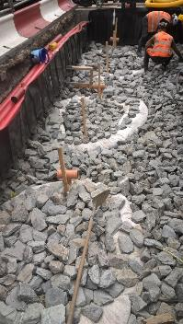
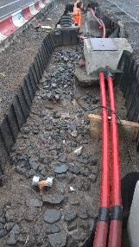
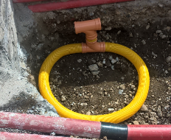
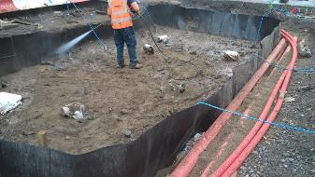
Luas Cross City
Urban Design Strategy
Tree Pit Construction
Utilities incorporated at Design Stage
Examples of O Connell Street Tree Pit Construction.
Pre Planting
Notes:
Tree Pit Construction used a ‘kit of parts)
Creation of the main structural root zone (Stockholm system). Settling of rock and washing in of (sieved) soil prepared to a specific mix.
Using locally available materials
Land drainage pipe and Wavin ® connections used to created ‘air channels’
Utilities included (Lighting in the photos) and surrounded with sand / gravel and wrapped in terram (deflection of roots)
Root directors around the tree pit from -300 mm to -900 mm.
Root directors absent from lower layer so allowing a root ‘escape’
Aeration to -1200 mm
Bottom of tree pit must drain(as a soakaway) at a minimum rate of 10 cm / hr or active drainage to be provided

Slide 13
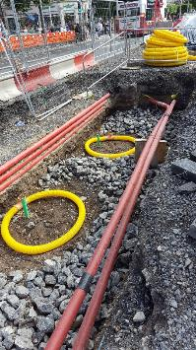
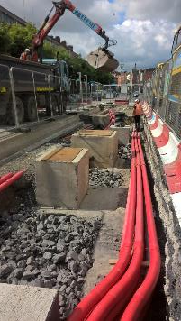
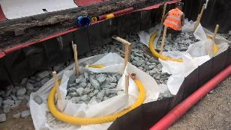
Luas Cross City
Urban Design Strategy
Tree Pit Construction
Utilities incorporated at Design Stage
Examples of O Connell Street Tree Pit Construction.
Pre Planting
Notes:
Top level reached.
Preparation for the creation of the top of the tree pit and connection to the hardscape design

Slide 14
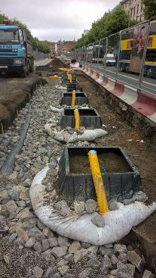
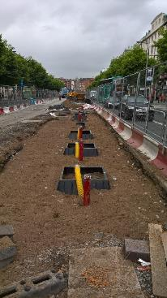
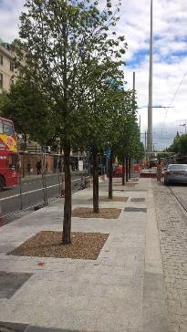
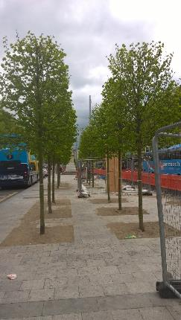
Luas Cross City
Urban Design Strategy
Tree Pit Construction
Construction Challenges
Ireland
During and post Construction
Notes:
Installation of the top tree pit layer using root directors and paving installed.
Opening for tree pit covers set in paving (to fulfil hardscape design)
The provision of a ‘root director’ which is 450 mm plus deep and directs roots below the paving zone.
The root director in combination with the root barriers (ribbed directional barriers and smooth root barriers for utility wrapping ensure
A root free zone under the paving (and also a utility zone free of roots…is the hope)
A design root zone which ensure good tree growth
Protected utilities

Slide 15
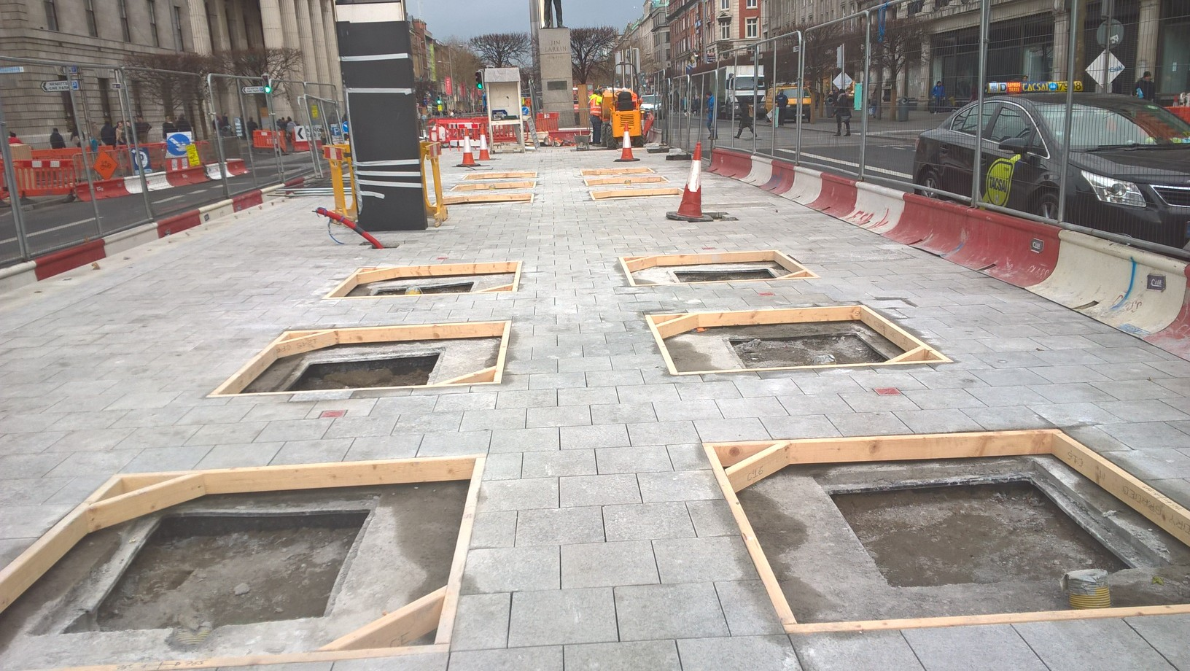
Luas Cross City
Urban Design Strategy
Tree Pit Construction
January 2017
Final surfacing complete
O Connell GPO Tramstop
Pre Planting
Notes:
Installation of the top tree pit layer using root directors and paving installed.
Opening for tree pit covers set in paving (to fulfil hardscape design)
The geometry of the hardscape design, the centres of the tree pits must be aligned
But
The underlying tree pit infrastructure is amended to suit the below ground conditions.
Note the differing locations of the ‘opes’ of the root directors. Soome leeway is allowable but the final trees must be in the correction positions
5 mm leeway above ground

Slide 16
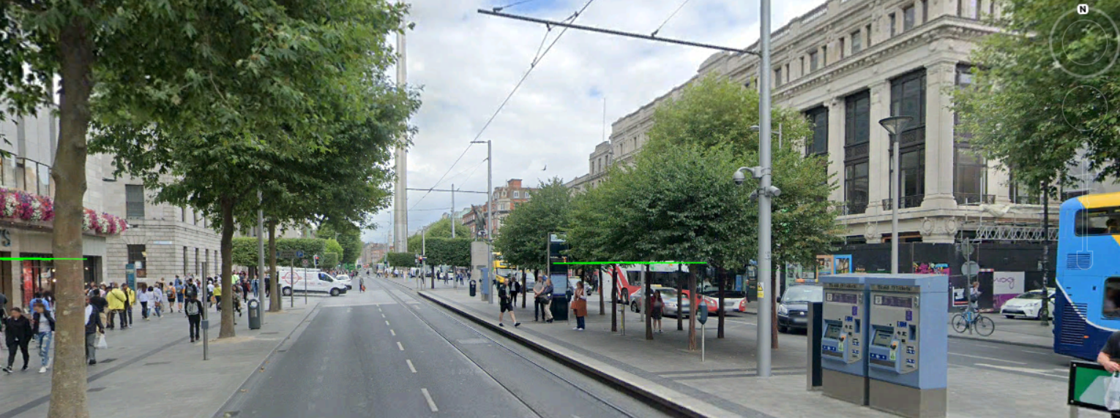
Luas Cross City
Urban Design Strategy
Tree Pit Construction
Notes:
The final installation used a previously managed tree from a registered nursery.
This allowed the tree canopy to be then managed for a
Lower ‘soffit’ height of 2.5 m (to allow people under)
Shape and health
The management strategy is to have the local authority maintain the trees if possible with TII and the operator as the ‘custodian’

Slide 17
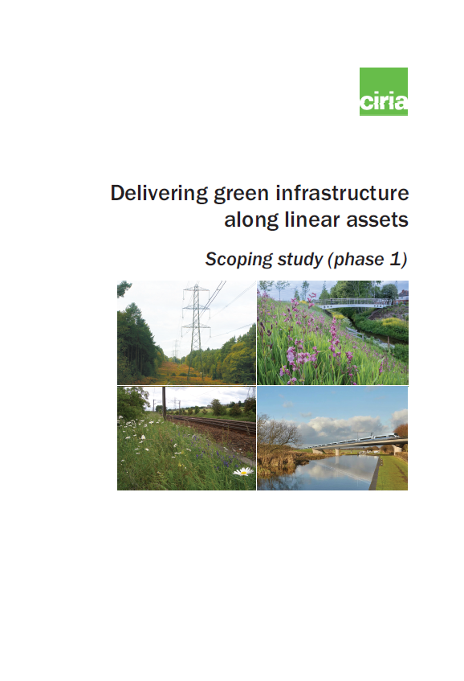
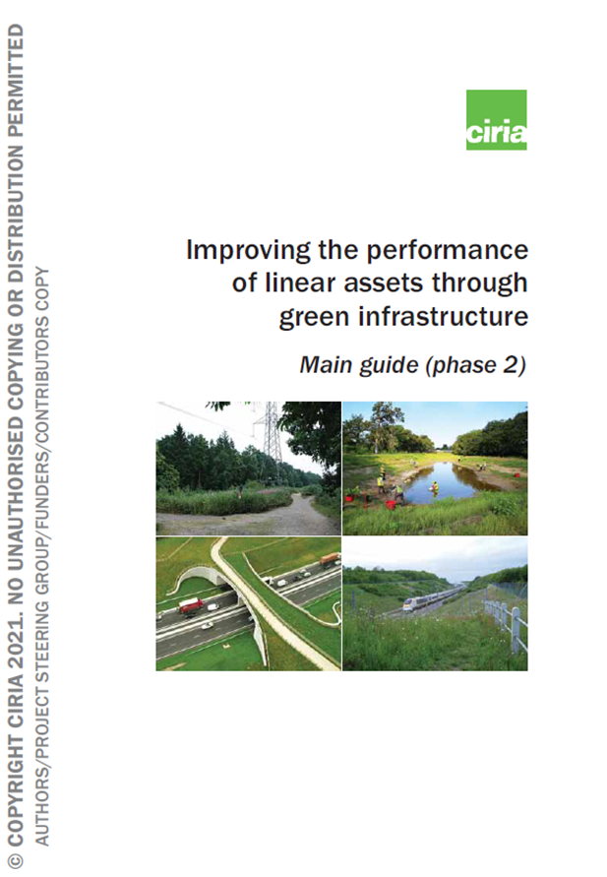
Continuing Research in TII
Blue Green Infrastructure and Nature-based Solutions
Current Research with CIRIA includes
Green Infrastructure for Linear Assets
Phase 1 scoping
Phase 2 Guidance published in 2022
Part 1 Delivering GI Assets along linear Infrastructure
Part 2 Improving the performance of linear assets through green infrastructure
Notes:
TII research in the past has included these projects.
The results are downloadable from the CIRIA website

Slide 18
Continuing Research in TII
Blue Green Infrastructure and Nature-based Solutions
Current Research with CIRIA includes
Green Infrastructure for Linear Assets
Phase 1 scoping
Phase 2 Guidance published in 2022
Part 1 Delivering GI Assets along linear Infrastructure
Part 2 Improving the performance of linear assets through green infrastructure
Notes:
CIRIA are continuing with
Community of Practice on Biodiversity
Phase 3 Asset Management for
BGI Guidance
2022 to 2024
TII are focusing also on the wider Euroipean Research network and the Conference of European Roads Directorates CEDR.

Slide 19
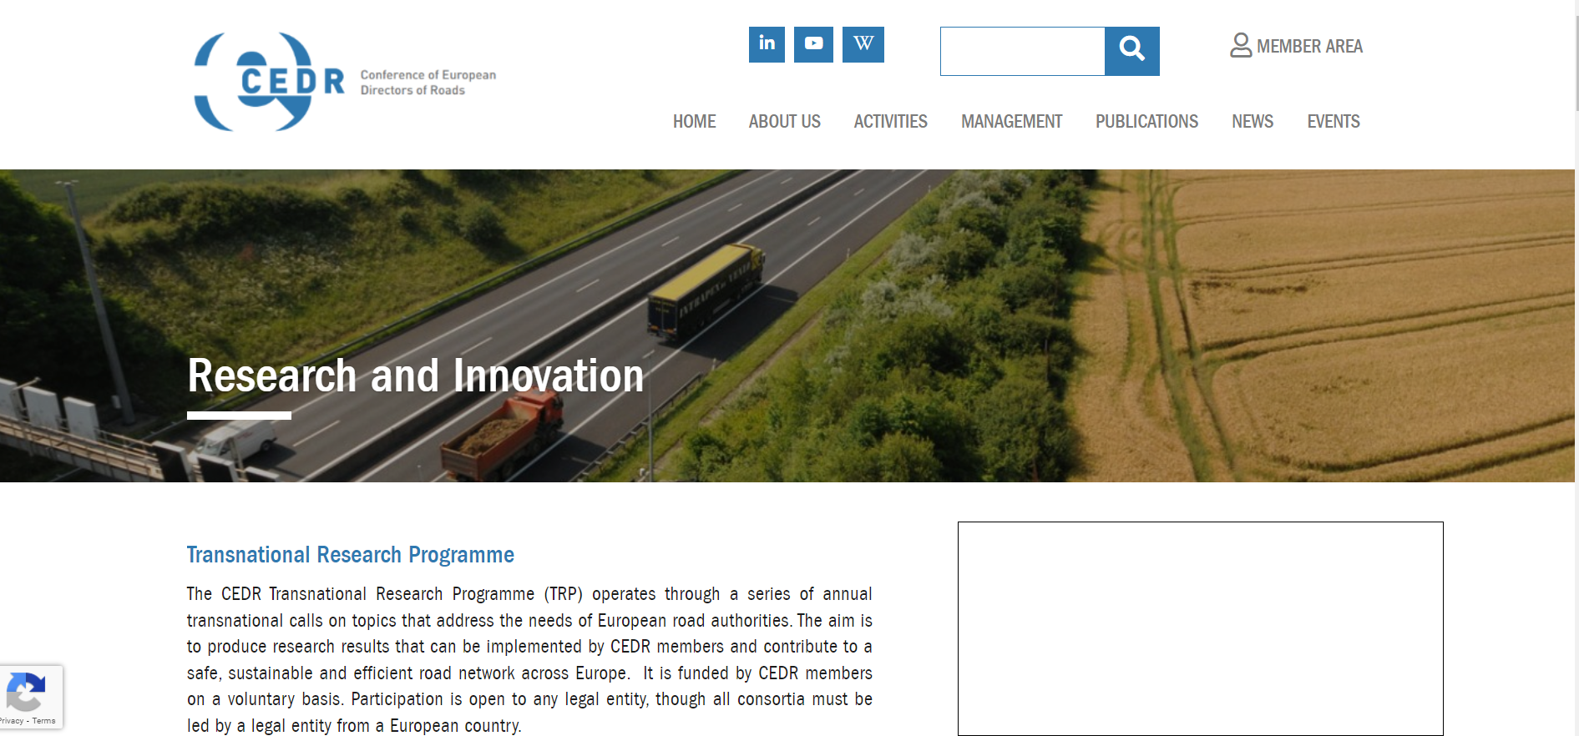
Conference on National Roads Authorities in Europe (CEDR)
  Ongoing Research on construction and mitigation strategies.
  TII as a funding partner and driver of innovation (e.g circular economy)
  https://www.cedr.eu/research-and-innovation
  research with European and partners worldwide

Slide 20
STEM (Faculty of Science, Technology, Engineering and Mathematics)
School of Botany
Current Research
From Landscape Architecture to Research Scientist
EU – Connecting Nature
Tony Williams
Supervisor : Prof. Marcus Collier
Trinity College Dublin
https://connectingnature.eu/
Notes:
Currently in the final writing phase of a PhD in Natural Science
Working Title : Impediments to the implementation of Nature-based Solutions in the provision of infrastructure.

Slide 21
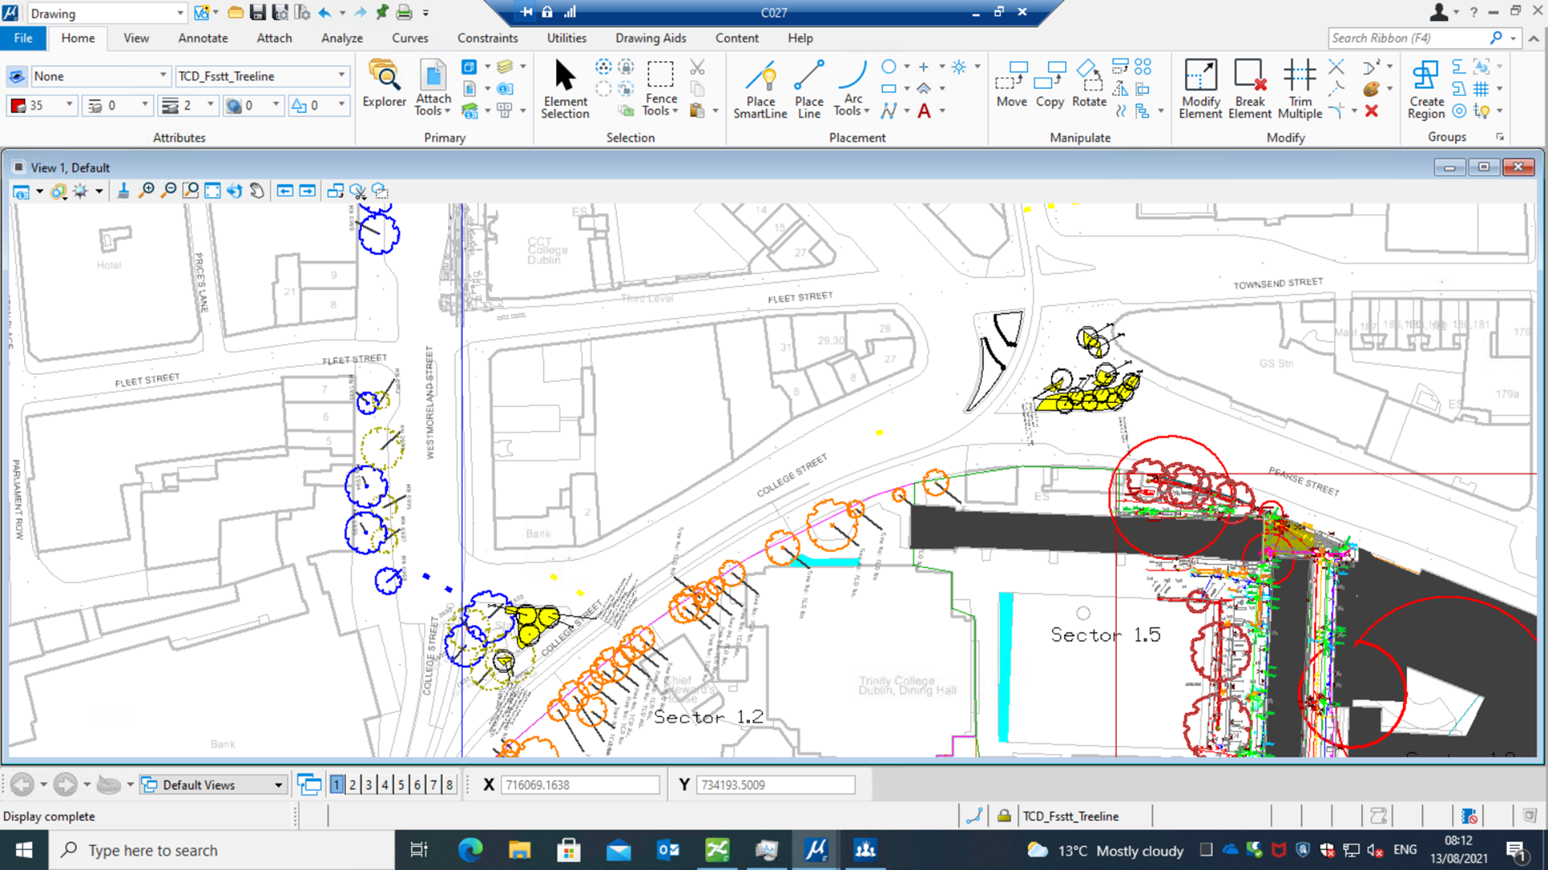
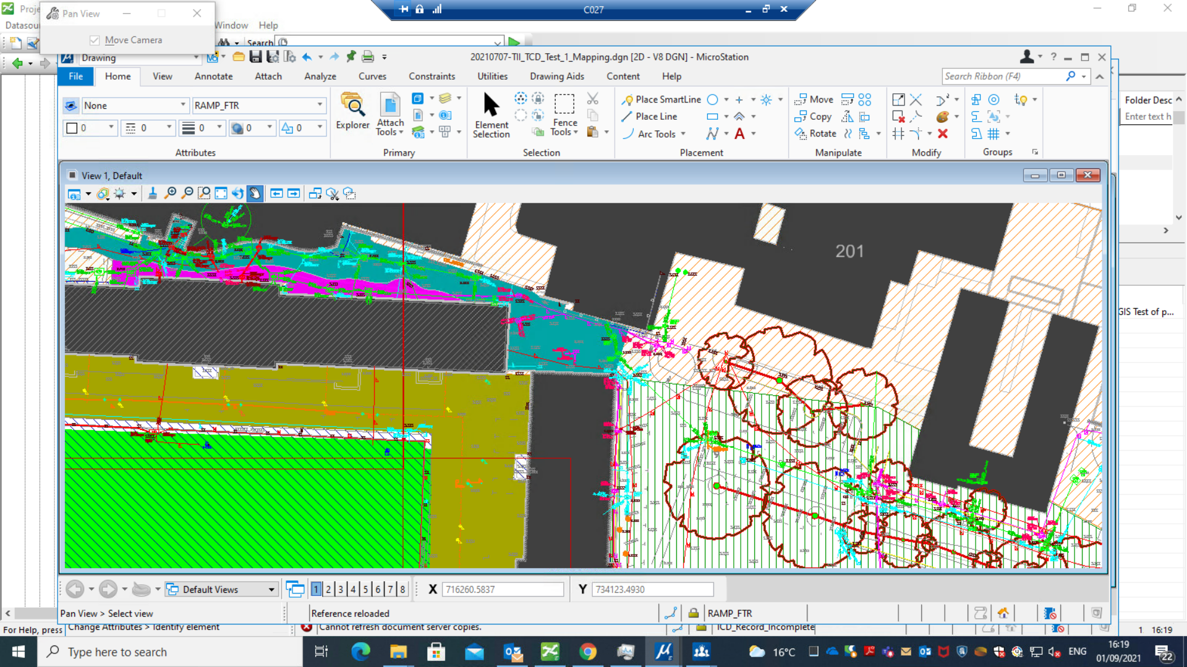
Field Sites
Ecological Fossitt Designations
Mapping and Data Assembly (Methodology development of the TCD Biodiversity Audit)
The assessment of the ecological ‘community’ (including humans)

Slide 22
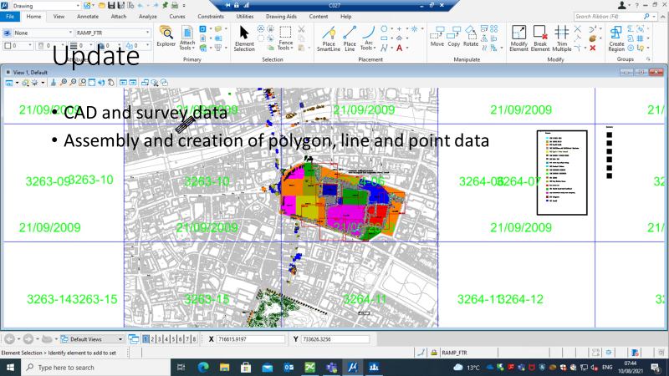
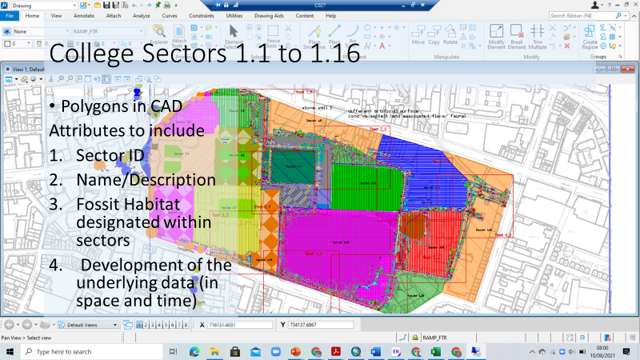
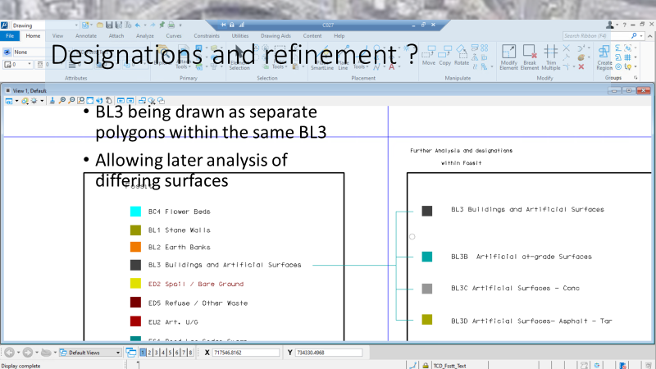
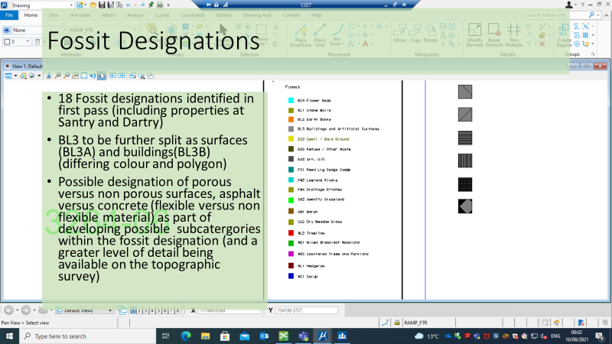
Field Sites
Ecological (Fossitt) Designations (Fine tuning the data collection)
Mapping and Data Assembly (Methodology development of the TCD Biodiversity Audit)

Slide 23
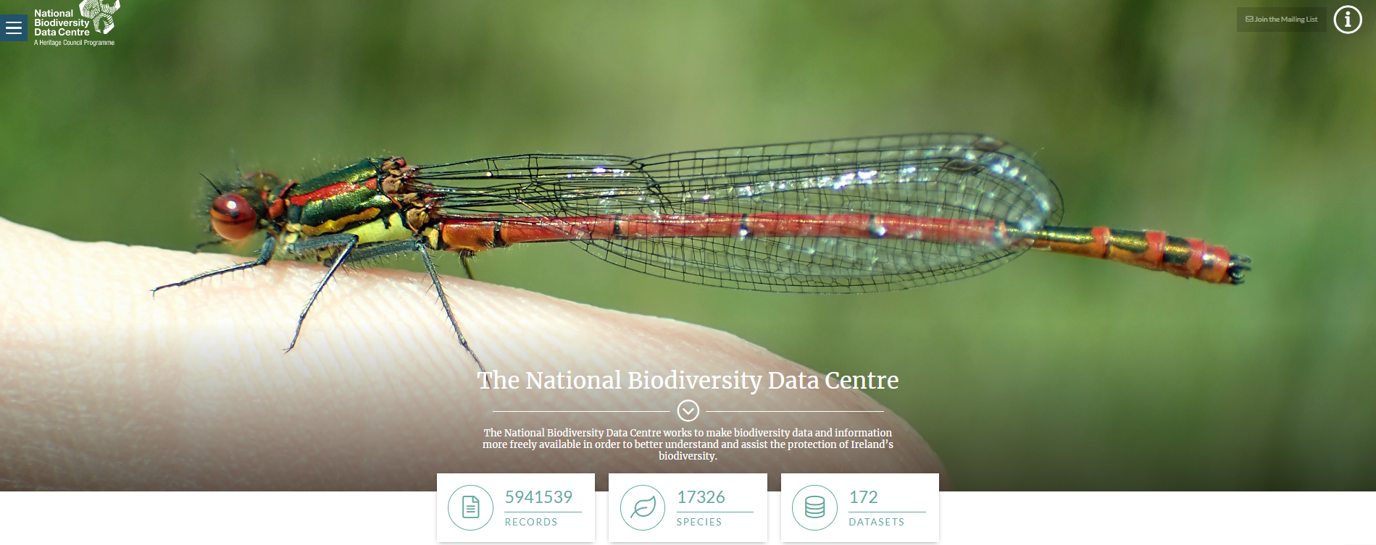
Collect, Analyse and use the data for your locality
https://biodiversityireland.ie/
https://biodiversityireland.ie/
https://biodiversityireland.ie/

Slide 24
Next Steps
Biodiversity audit (the Biodiversity Audit Centre are there to assist) https://biodiversityireland.ie/
Blue Green Infrastructure Plan (Fingal Co Co have a working template)
Linking the town and the rural areas (opprtunites to link agriculture, nature and economic and social activity)
Looking at social and economic gains also (The Heritage Council and the Collaborative Town Centre Health Check
https://www.heritagecouncil.ie/projects/town-centre-health-check-programme
Make some small changes e.g no weedkiller = more biodiversity

Slide 25
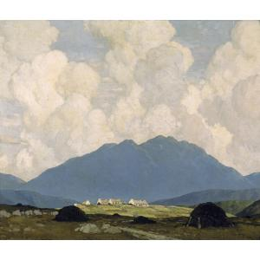
Go Raibh Maith Agat
Thank You
A Connemara Landscape
Paul Henry

