Slide 1

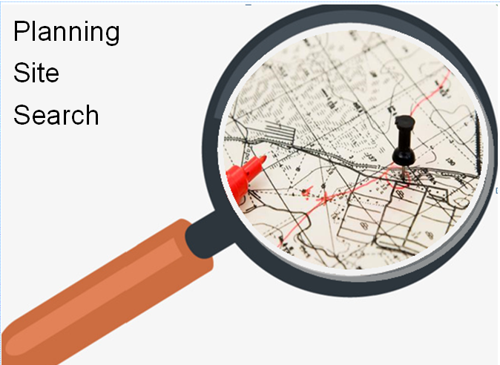

Slide 2
Planning Site Search - New Process
Locate url for Planning Site Search on Wexford Co Co website
Access Application
1. Search for location
2. Draw Boundary for Area of Interest
3. Enter Contact Details
4. Hit Submit
Open Planning Site Search html file received (as attachment via email).
Public will receive their map in circa 1 minute for a typical half acre site!

Slide 3
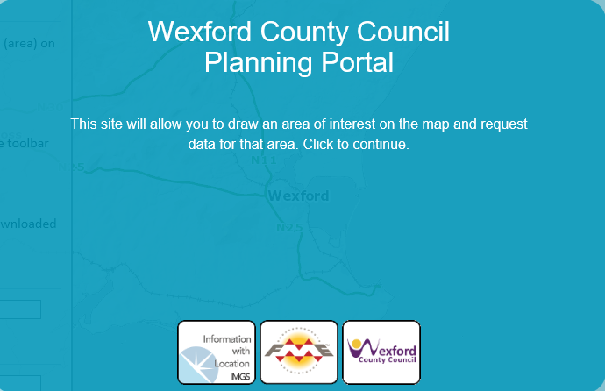

Slide 4
Planning Site Search Application
https://maps.wexford.ie/planningportal/

Slide 5
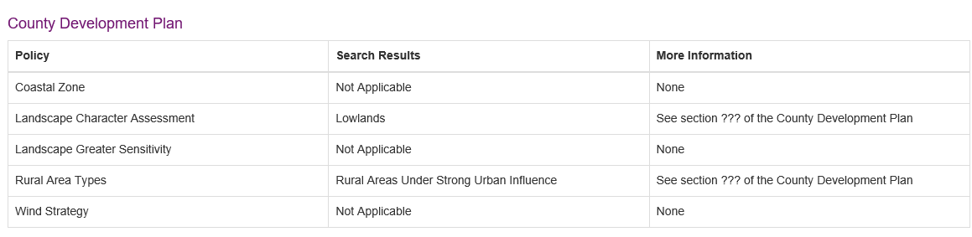
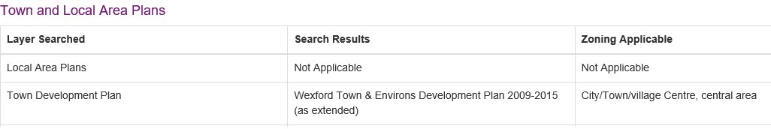
Future phases planned for report
County, Town & Local Area Plans

Slide 6
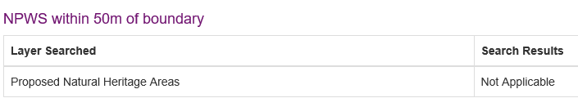
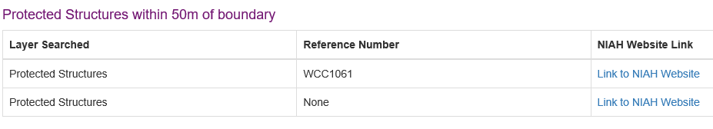
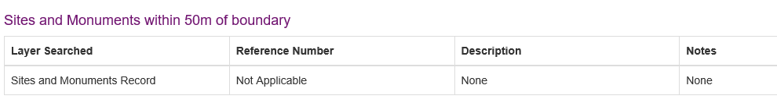
Future phases planned
NPWS, Protected Structures, Sites & Monuments

Slide 7
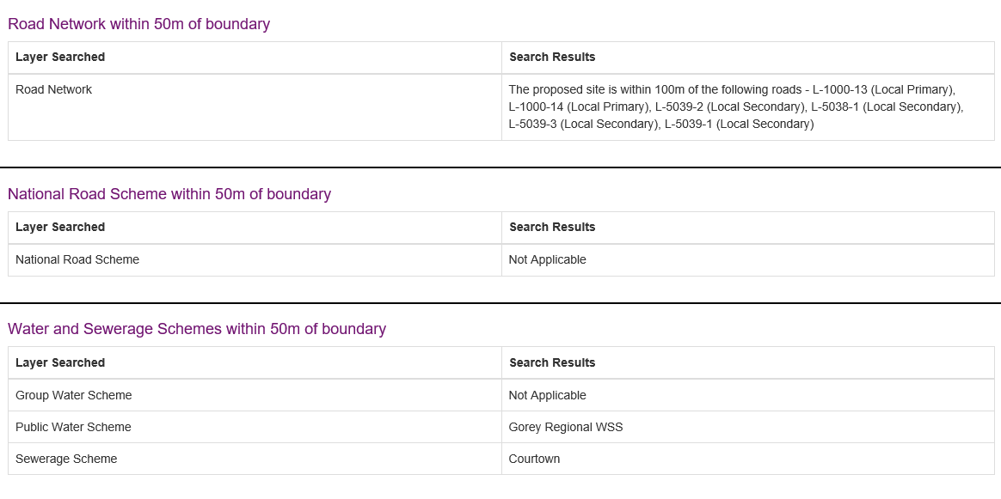
Future phases planned
Roads, Water & Sewerage Schemes

Slide 8
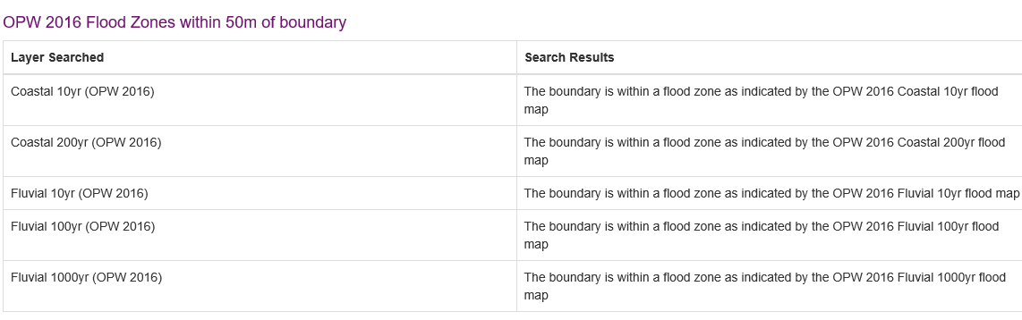
Future phases planned
Flood Schemes
Other proposed additions:
Aerial Maps 2019
Historical planning maps from pre 1985 with planning points

Slide 9
https://maps.wexford.ie/imaps/
Internet mapping system
Google search - wexford county council imaps
Frank Burke - GIS Section and Siobhan Doyle - Planning Section
Contact: giswexford@gmail.com

Slide 10
Thank You for listening
Frank Burke - GIS Section and Siobhan Doyle - Planning Section
Contact: giswexford@gmail.com

Slide 11
Non demo slides below

Slide 12
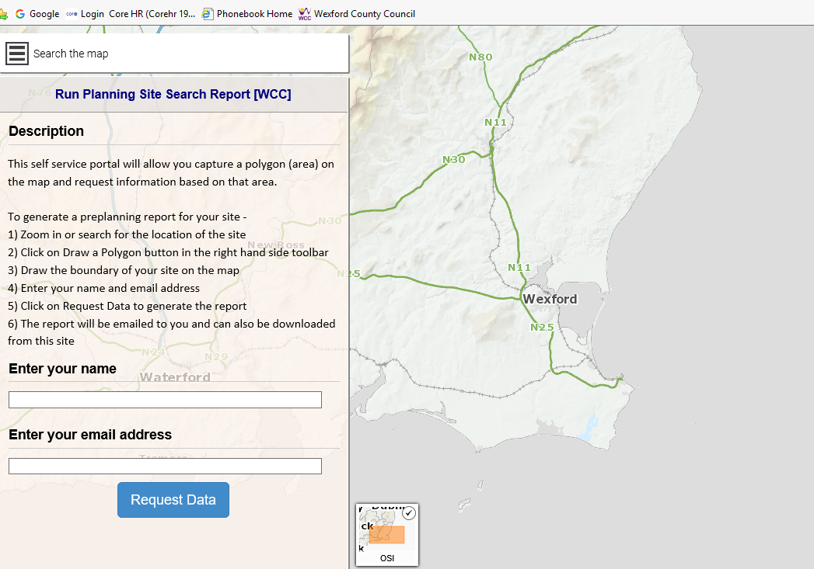
The home screen will look like this

Slide 13
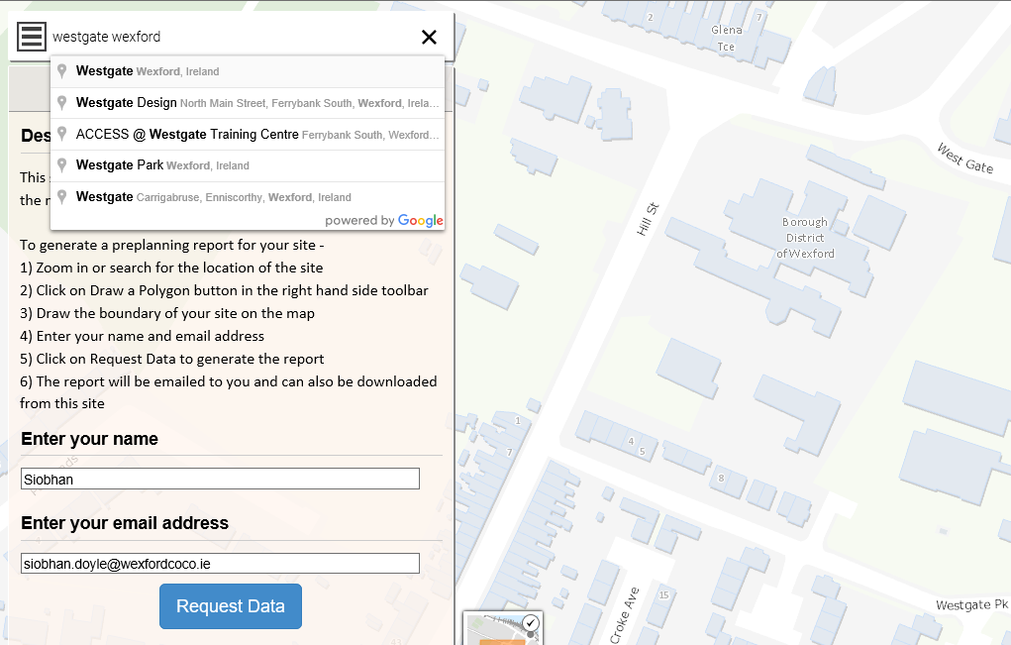
Type in an address or townland and click on one of the results

Slide 14
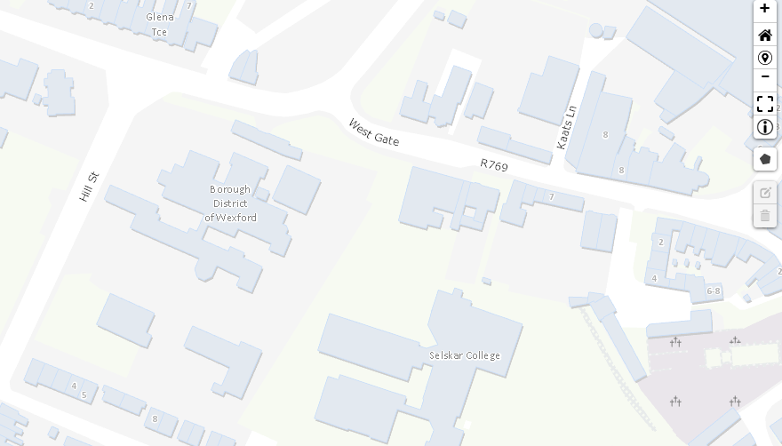
Or just zoom to site

Slide 15
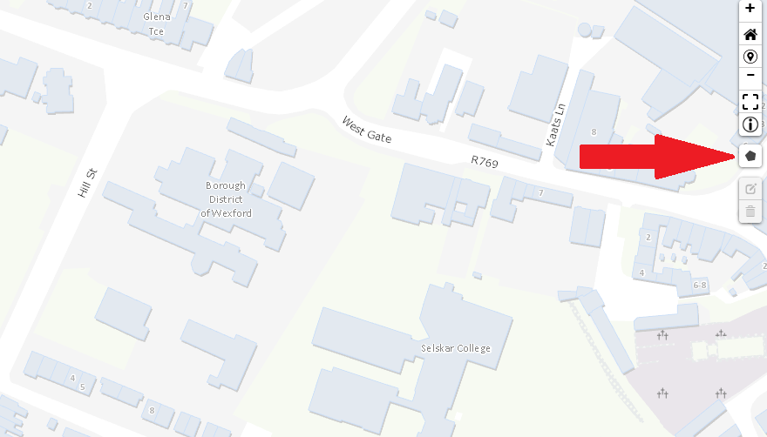
Click on the polygon button

Slide 16
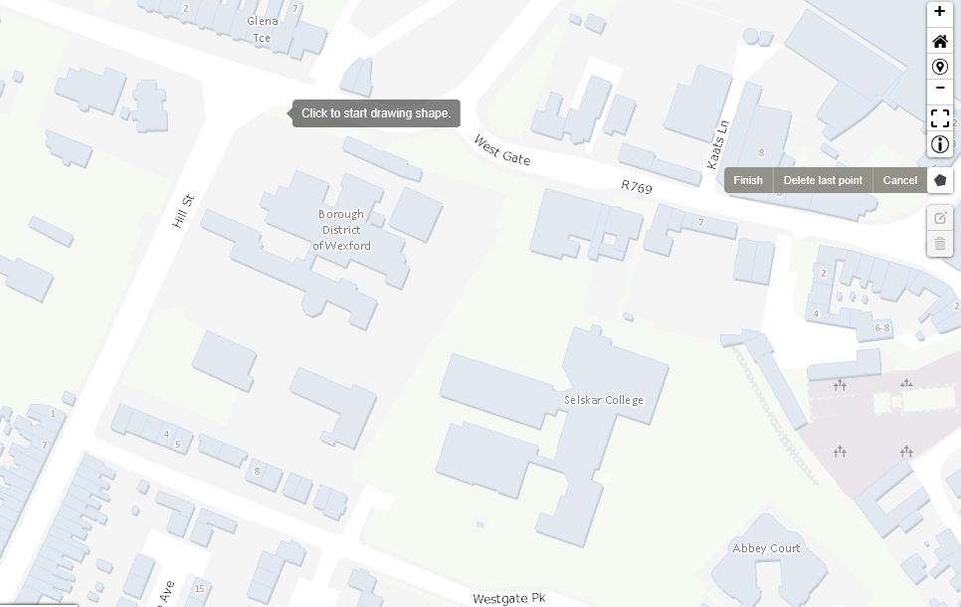
Click on a corner of the site to start drawing the polygon

Slide 17
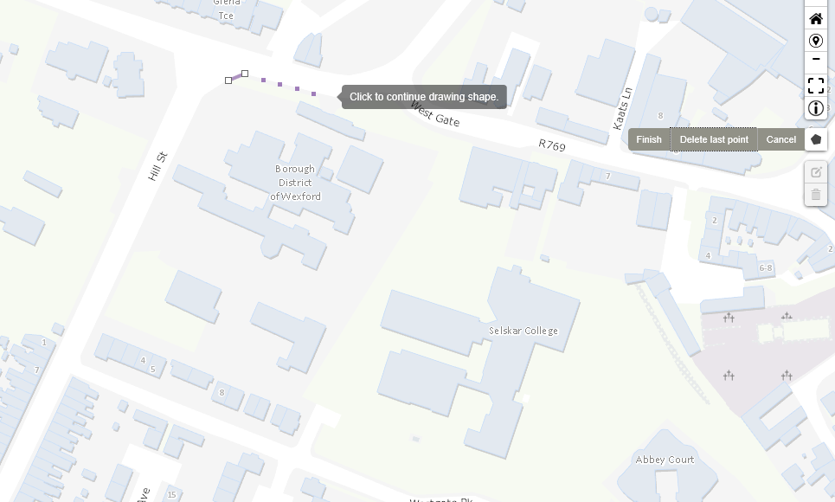
Click on a the next point of the site

Slide 18
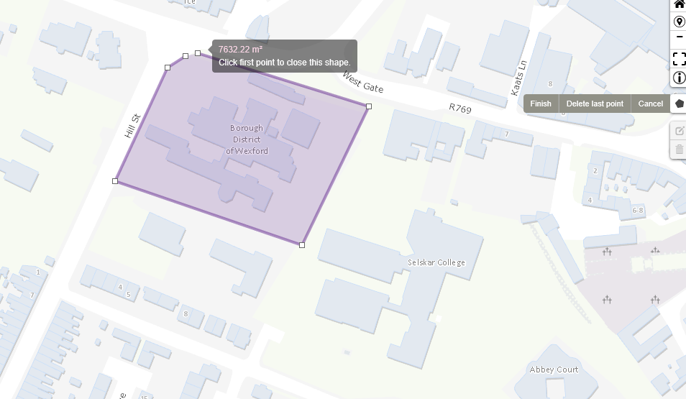
Continue clicking until you have captured the whole site and click on the first point to close the shape

Slide 19
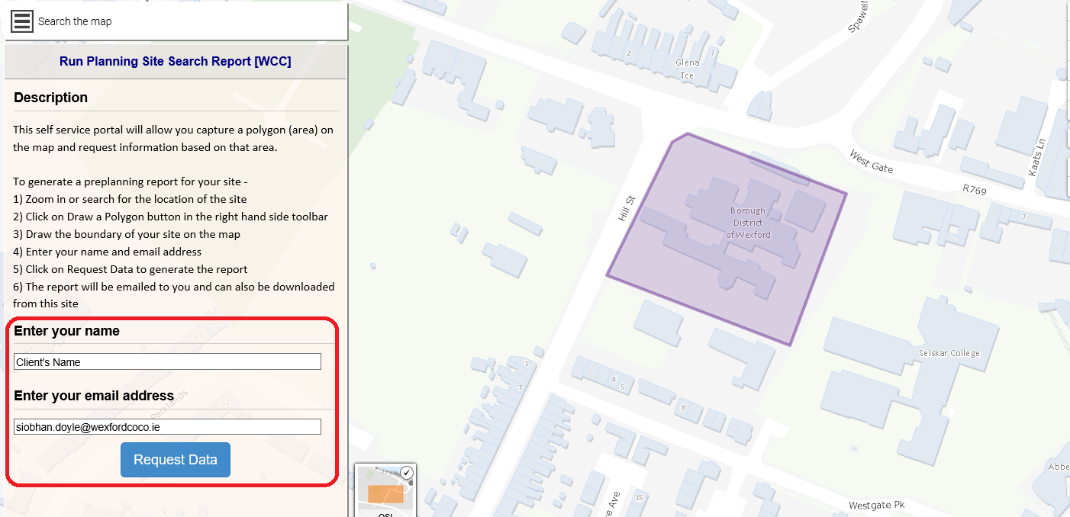
Type in your name (or client’s name) & email address and
Request Data

Slide 20
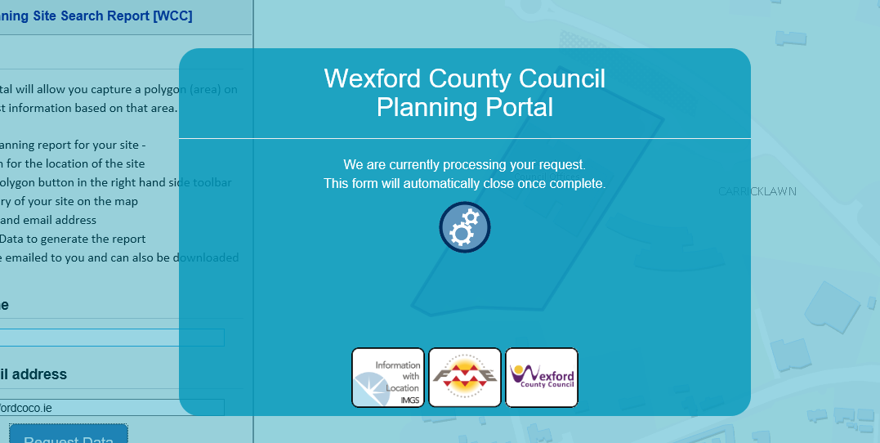
The following screen will appear – just wait a moment

Slide 21
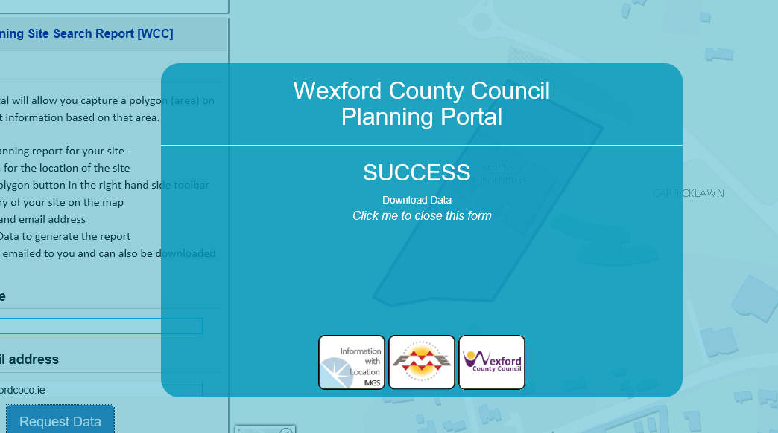
The following screen will appear signalling that
A report will have been sent to your email address

Slide 22
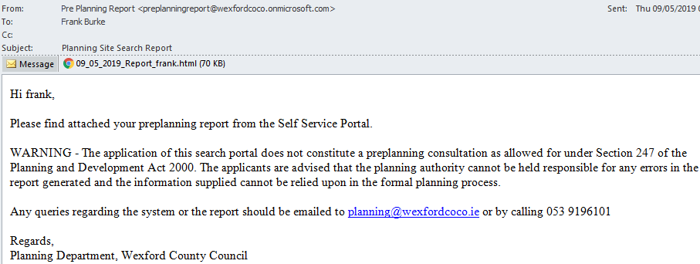
Go to your inbox and
There will be an email entitled Planning Site Search Report

Slide 23
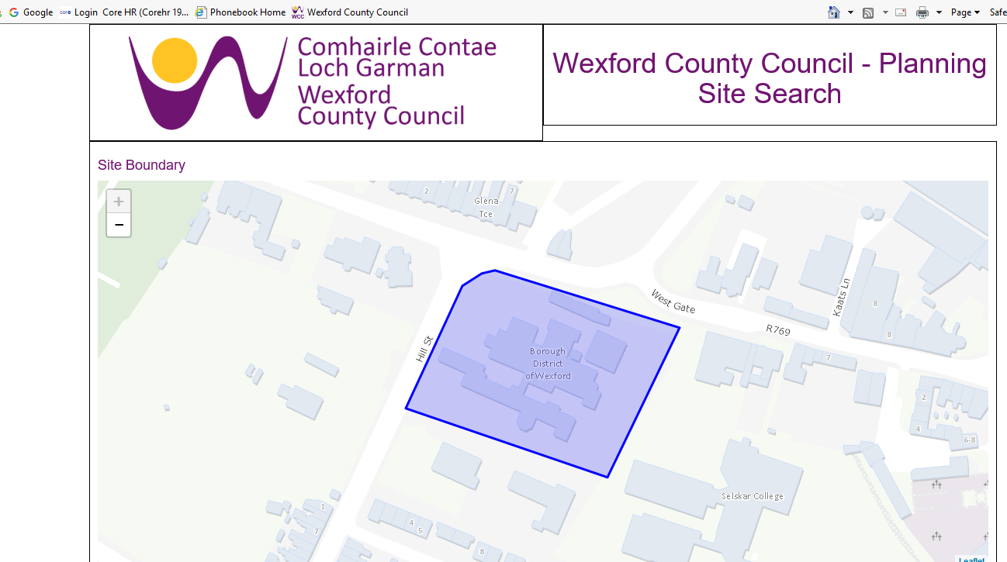
The outline of the site will appear first

Slide 24
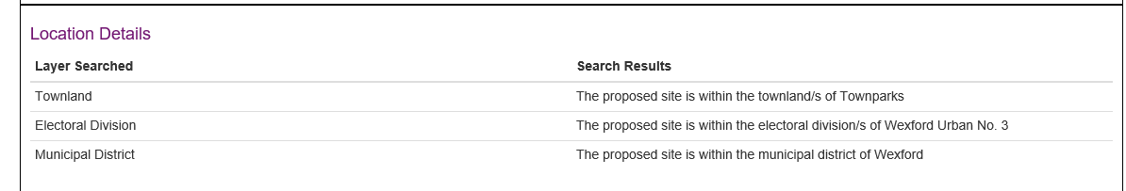
Scroll down to get the information
Townland, Electoral Division & Municipal District

Slide 25
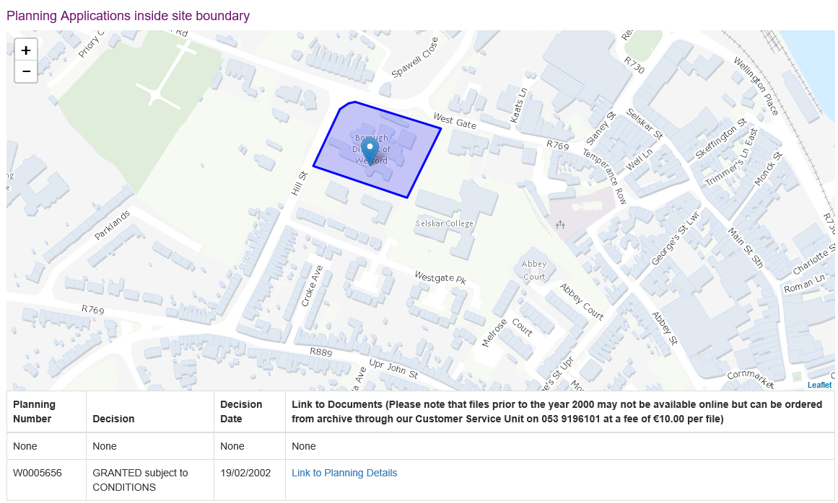
Planning Applications inside site boundary

Slide 26
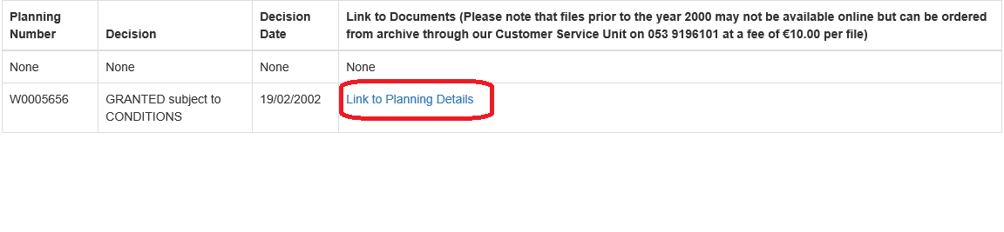
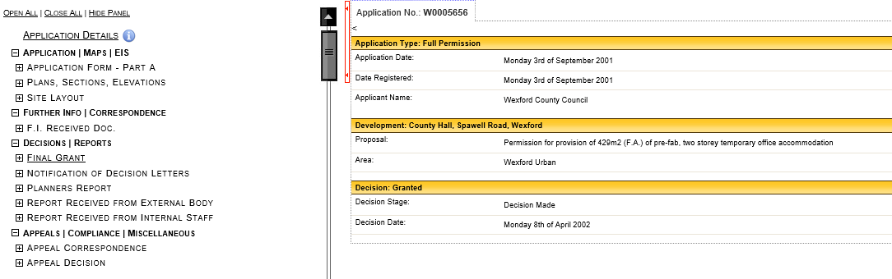
Click on the “Link to Planning Details” to access the documents

Slide 27
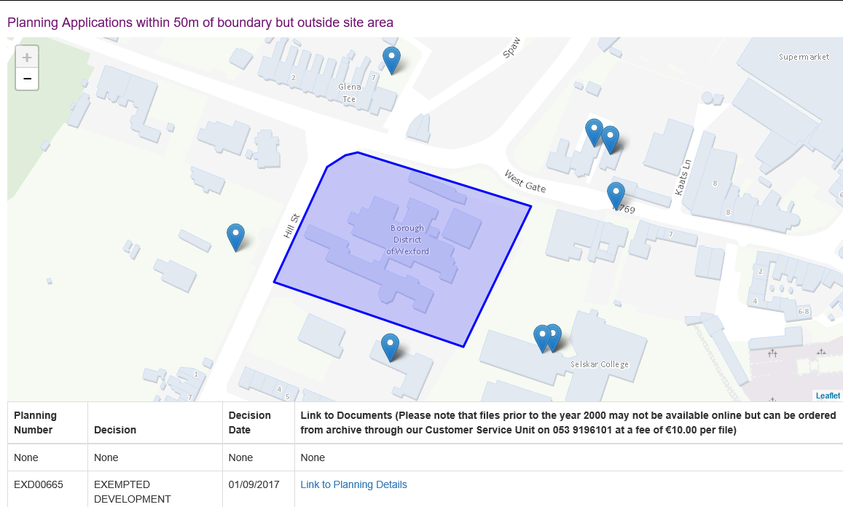
Planning Applications within 50m of boundary

