Slide 1


Welcome
Agent’s Day
September 2026

Slide 2
Overview of Key Planning Legislation Changes in 2026
Agent’s Day
September 2026

Slide 3

Agenda
Welcome Address - Eddie Taaffe, Chief Executive
Planning & Development Regulations, 2001 Update (Latest Exemptions) – Aisling Kelly, Senior Executive Planner
Zoning Variation Update – Deirdre Kirwan, Senior Planner
4. Summary of Upcoming Planning Changes – Diarmuid Houston, Senior Planner and James Lavin, Senior Executive Planner
- Planning & Development Regulations, 2026
- Sustainable Rural and Gaeltacht Housing, Draft National Planning Statement
6. Q& A Session
7. Closing Remarks – Elizabeth Hore, Director of Services

Slide 4
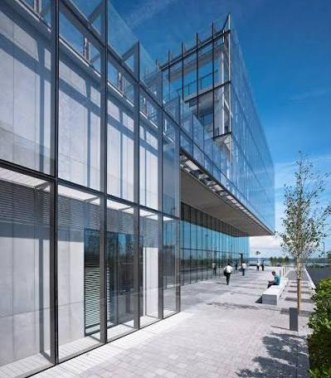

1.Welcome – Eddie Taaffe, Chief Executive, WCC
Planning and Development Act 2024
Signed by President on the 17 October 2024, the second largest piece of legislation in the history of the State and the cornerstone of the Planning System.
Commenced on a phased basis to ensure smooth transition from existing to new legislation.
Culmination of 18-month review and extensive Oireachtas scrutiny.

Slide 5
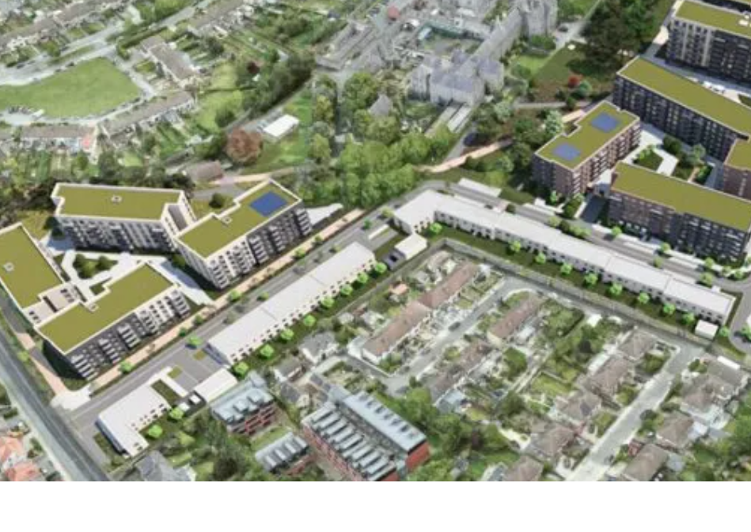

Planning and Development Act 2024 -
Intention of the Oireachtas is to provide clarity, consistency and certainty in the Planning system:
1) Policy clarity from the outset of the process, in a consistent manner and that is enabled to make timely decisions;
2) That operates to balance the common good with the right of others.

Slide 6
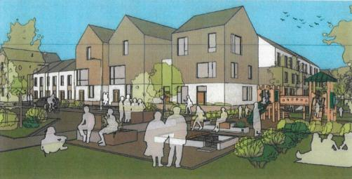
Key Commencement Elements
The restructuring of An Bord Pleanála to An Coimisiún Pleanála.
The introduction of statutory timelines for ACP – 18 to 48 weeks depending on type of development.
Strengthening of a plan led system with the introduction of 10 year County Development Plans and Urban Development Plans for Key Towns of Wexford, Gorey and new Key Town of Enniscorthy (pop. 10,000).
Reform measures to Judicial Review. Planning permission timeframe is protected while JR process is ongoing.

Slide 7
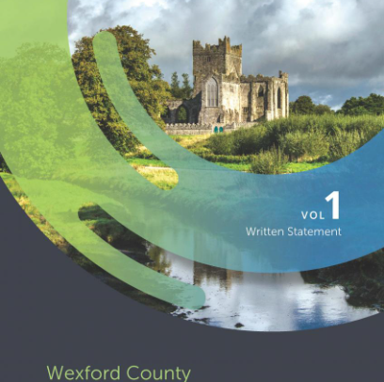
Variations to County Development Plan 2022-2028
Revised Housing Growth Requirements (HGR) arising out of revised NPF, increasing to 16,200 units delivered by 2034.
Enniscorthy and New Ross Variation approved July 2026 - 309ha residential and 197ha industrial.
Bunclody, Rosslare Harbour - 80ha; December 2026
Wexford – public consultation on draft Variation to commence 21st of October 2026.
Gorey - 2027

Slide 8
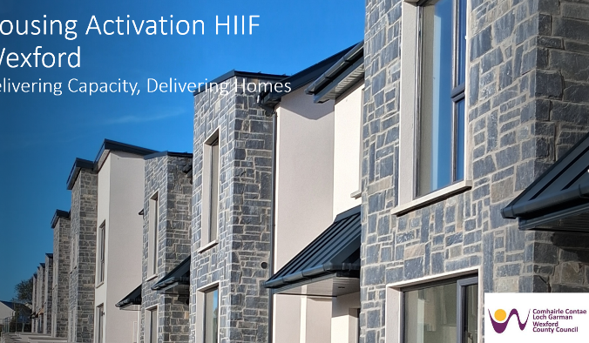
HIIF Programme Overview:
Call 1
€1 billion fund aimed at supporting direct investment in infrastructure needed to unlock housing delivery.
Call 1 of HIIF aimed at “shovel ready” Local Authority and Land Development Agency led projects
Wexford County Council secured the highest allocation, along with Meath, at €70m for five projects at Ballynagee, Ballytegan, St. Waleran’s, Turret Rocks and Milehouse to Moyne.
Circa. 11,000 units potentially activated on directly benefitting lands and indirectly on multiplier effect lands.

Slide 9
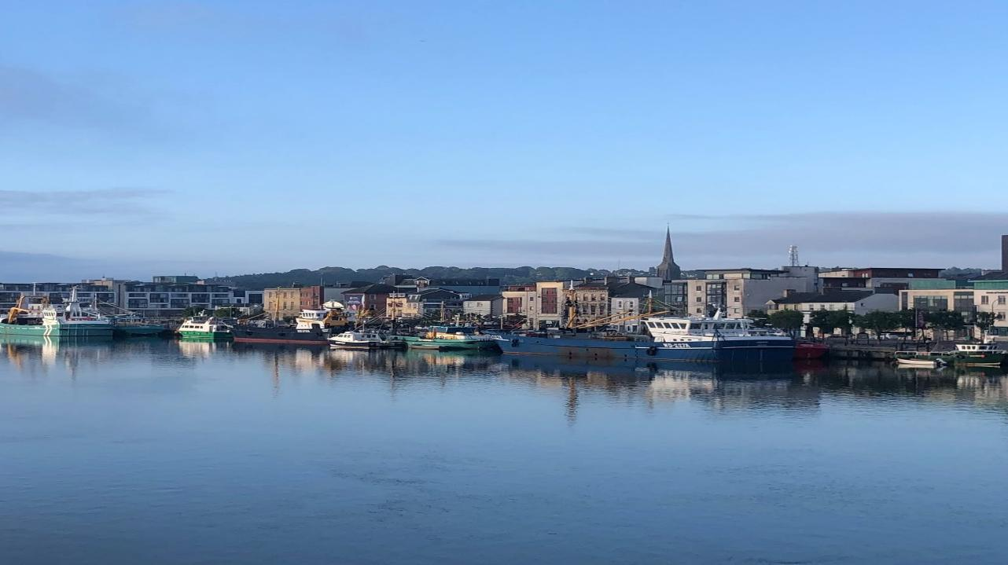

2. Planning & Development Regulations, 2001
(Latest Exemptions – Single Dwellings)

Slide 10
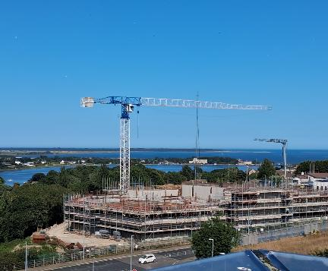
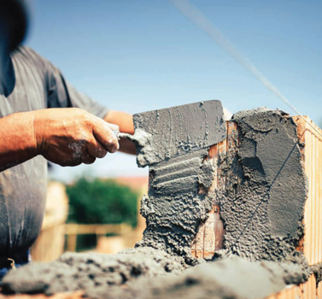
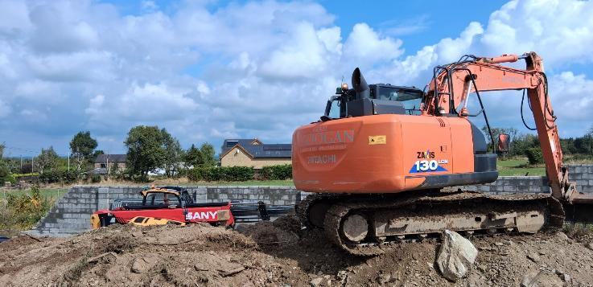

Overview
What has Changed?
  27 July 2026 - 7 new sets of regulations (New Statutory Instruments)
Objective
  To reduce the administrative burden on homeowners.
  To free up planning resources.
  To make better use of existing homes.

Slide 11
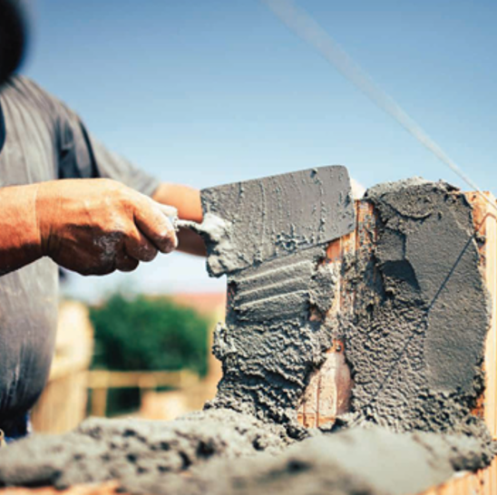

Bigger House Extensions
Statutory Instrument: | S.I. No. 338 of 2026
Class | Class 1
What’s Included | Extensions (extension to the rear/ conversion of any attached structure e.g. garage to the side/rear).
What’s Changed: | Exemption increased from 40m² to 45m²
Main Caveats | Floor area requirements still differ depending on a number of design factors. 1st floor extension – min. of 2m setback from any party boundary. Ground floor window – min of 1m from boundary it faces. Min of 25sqm private open space must be retained. ** See S.I. for full list of caveats.

Slide 12
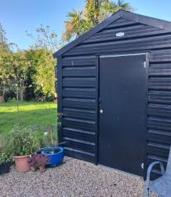

Bigger Auxiliary Structures
Statutory Instrument: | S.I. No. 338 of 2026
Class | Class 3
What’s Included | The construction, erection or placing within the curtilage of a house of any tent, awning, shade or other object, greenhouse, garage, store, shed or other similar structure.
What’s Changed: | Increased from 25m² to 30m²
Main Caveats | Must retain 25sqm private open space. External materials must conform with the main dwelling. Max height: pitched roof (4 metres)/ flat roof (3 metres). Use must be incidental to main dwelling. ** See S.I. for full list of caveats.

Slide 13
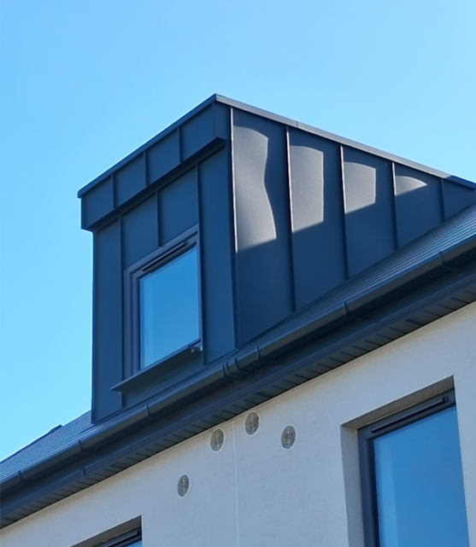

Dormers
Statutory Instrument: | S.I. No. 344 of 2026
Class | Class 1B
What’s Included | A dormer roof extension and insertion of a dormer window to the side or rear of the house.
What’s Changed: | Previously required planning permission
Main Caveats | The internal volume, either singularly or in combination with other dormer roof extensions shall not exceed 30 cubic metres. The dormer extension shall be no higher than the roof ridge and there shall be at least 20 centimetre eaves setback. ** See S.I. for full list of caveats.

Slide 14
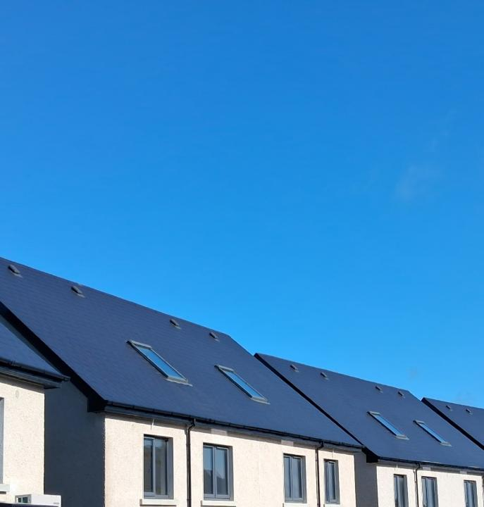

Roof Lights
Statutory Instrument | S.I. No. 344 of 2026
Class | Class 1C
What’s Included | The insertion of roof lights on the existing front roof plane of the dwelling.
What’s Changed | Previously required planning permission
Main Caveats | Maximum of two roof lights on the front roof plane. Maximum size - 100 cm (length) x 90 cm (width). ** See S.I. for full list of caveats.

Slide 15
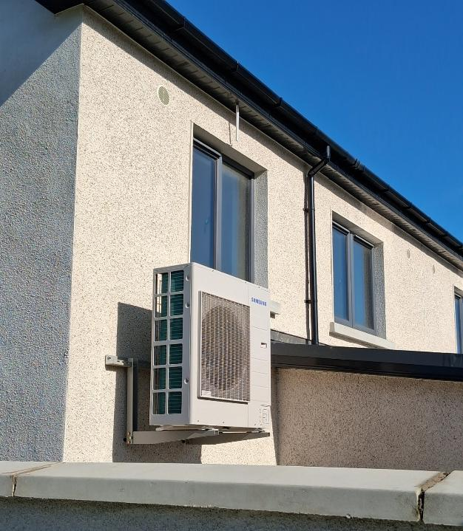

Heat Pumps
Statutory Instrument | S.I. No. 342 of 2026
Class | Class 2
What’s Included | The installation on or within the curtilage of a house of a ground heat pump system (horizontal and vertical) or an air source heat pump.
What’s Changed | Previously exempt to the rear. Now exempt anywhere in the curtilage provided it does not encroach onto the public road.
Main Caveats | Maximum of 1m ground level change. Total area (taken together with any other hear pumps) shall not exceed 2.5sqm. Shall not encroach public road. Maximum noise levels apply: 43db(A) - normal operation, or 5db(A) above the background noise, whichever is greater, as measured from the nearest neighbouring inhabited dwelling. * See S.I. for full list of caveats.

Slide 16
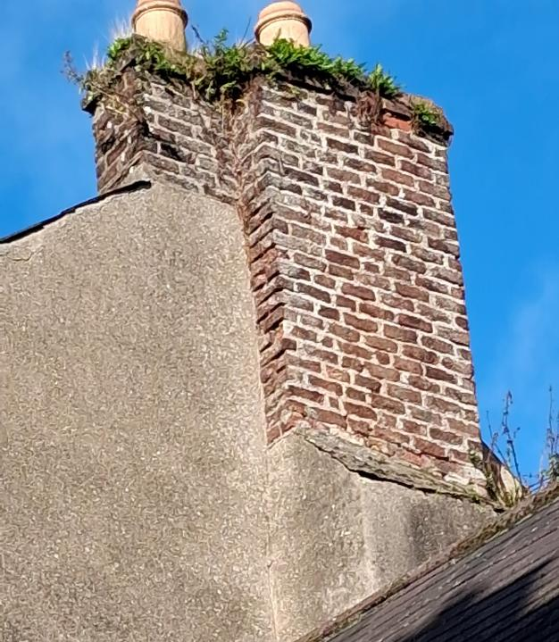

Chimneys
Statutory Instrument: | S.I. No. 343 of 2026
Class | Class 2A
What’s Included | The removal of a chimney from a house.
What’s Changed: | Previously required planning permission Must not form part of a joint chimney stack with a separate house. Roof finishes to match existing roof. Subject to compliance with Section 22 (protection of nests of wild birds) and Section 23 (breeding or resting places of protected wild animals including bats) of the Wildlife Act 1976, as amended. ** See S.I. for full list of caveats.

Slide 17
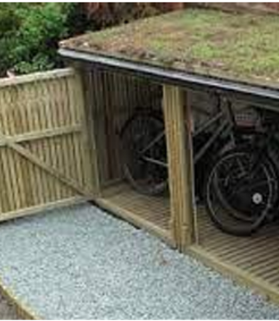

Cycle & Bin Stores
Statutory Instrument: | S.I. No. 341 of 2026
Class | Class 62
What’s Included | The construction, erection or placing of a structure within the curtilage of the house for the purpose of bicycle or bin storage.
Main Caveats | Maximum area of 3.5 square metres. Maximum height of 1.4 metres. Minimum setback of 0.6 metres from the front wall of the house to allow access, maintenance, daylight. Shall not reduce the front garden open space by more than 50%. ** See S.I. for full list of caveats.

Slide 18

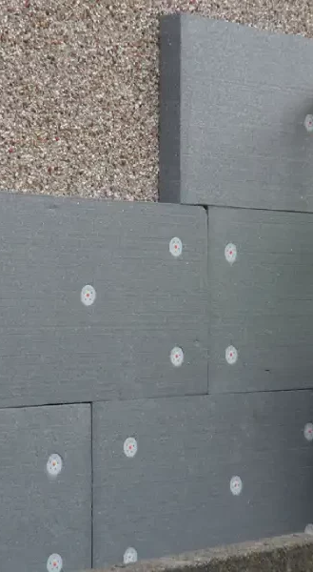
Statutory Instrument: | S.I. No. 341 of 2026
Class | Class 63
What’s Included | The addition of external wall insulation to a house and any necessary works to facilitate its installation.
What’s Changed: | Previously required planning permission
Main Caveats | Thickness shall not exceed 150mm. Shall not encroach a public road. Shall not materially affect the external appearance of the structure so as to render it out of character with the structure/ wider street. ** See S.I. for full list of caveats.

Slide 19

Subdivision of Dwelling into 2 Houses
Statutory Instrument: | S.I. No. 339 of 2026
Class | Class 1A
What’s Included | The subdivision of a house and the restoration of a house to its original form if subdivided under this Class.
What’s Changed: | Previously required planning permission
Main Caveats | Relevant period July 2026 to 31 Dec 2030. Subject to building control and fire regs. Each unit shall be min of 32sqm. Each unit must be self contained (no shared internal space other than access). No detached dwelling in the rear garden. Must notify Planning Authority no less than 14 days before. ** See S.I. for full list of caveats.

Slide 20
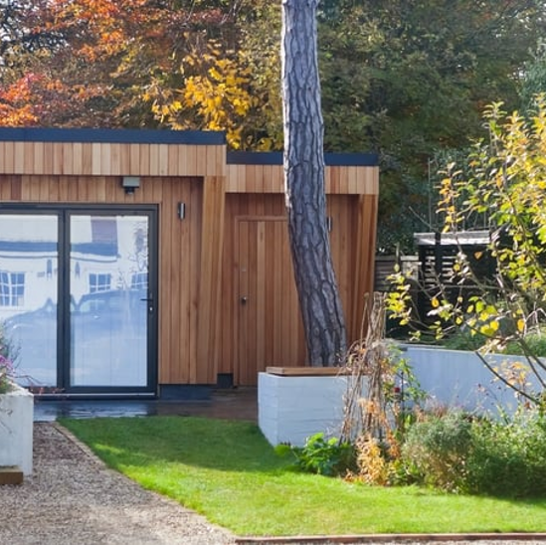
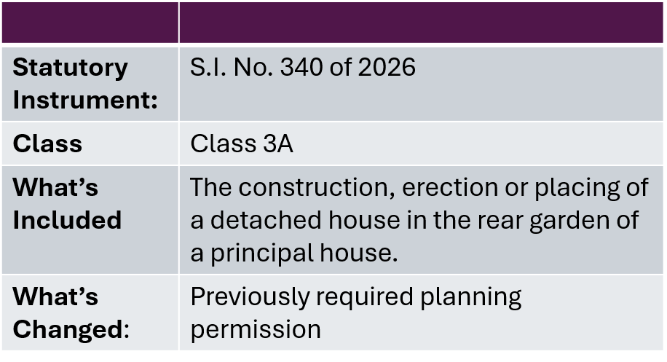


Detached Dwelling in the Rear Garden

Slide 21
Detached Dwelling in the Rear Garden Continued….
Relevant Period | Time Limited: 27th July 2026 to 31 December 2030
Caveats (General) | Must be ancillary to the main dwelling. Cannot be sold or subdivided separate to main dwelling. Subject to building control and fire regulations. Cannot be a temporary structure (e.g. caravan or mobile home) Principal dwelling cannot also be subdivided. Must notify the Planning Authority at least 14 days prior to commencement of works Must not be used for short-term letting. The principal dwelling house must be the sole or main residence of the property owner at the time the development is commenced. * See next slide for design caveats

Slide 22
Detached Dwelling in the Rear Garden Continued….
Caveats (Design) | Rear garden only. Maximum height - 3 metres (flat roof)/ 4 metres (pitched roof). Size Requirements: Minimum of 32sqm. Maximum of 45sqm (* figures include any structures previously erected under Class 3). Min. of 25sqm private open space to be retained. No new vehicular or pedestrian access from a road. Independent pedestrian and/or wheelchair access to the detached house shall be provided within the curtilage of the principal house. Urban Utility Connections: - No separate connection to utilities, including water or wastewater utilities. Rural Wastewater Connections: - Shall not encroach an approved percolation area. - Existing on-site waste-water treatment shall be of sufficient capacity. - No additional waste-water treatment units shall be installed. Dwelling to be a minimum of 0.6 metres from any wall or party boundary. All windows to be a minimum of 0.6 metres from the boundary they face. ** See S.I. for full list of caveats.

Slide 23

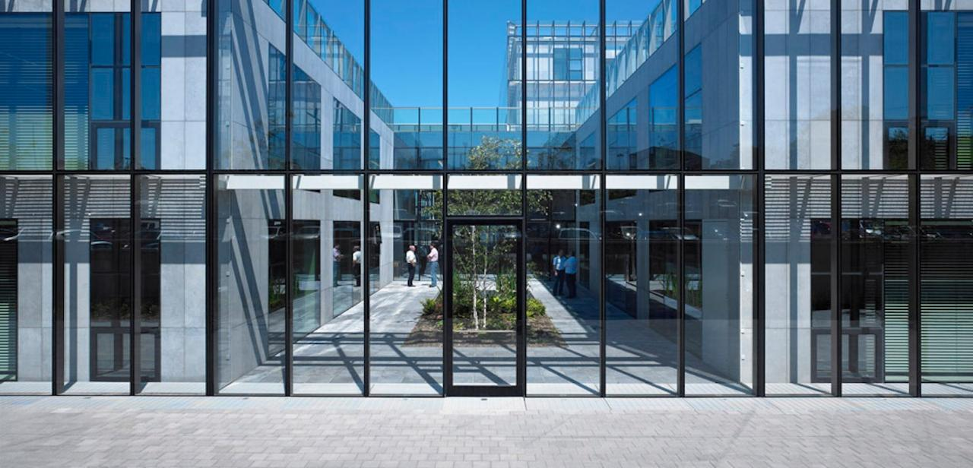
3. Forward Planning in Wexford
Deirdre Kirwan
Senior Planner
Planning for Growth · Providing Certainty · Enabling Delivery

Slide 24


Why Do We Zone Lands?
Plan for Growth
Right Homes
Right Place
Compact Growth
Certainty
Enterprise and Employment
Investment Opportunity
Funding
Protect Environment
Flood Risk
Biodiversity
Sustainability
Water and Wastewater
Roads, Transport
Schools
Utilities
Heritage Protection
Regeneration
Sense of Place
Character
Zoning is a tool for certainty, coordination and good place making.

Slide 25


A Thriving County Wexford...
163,919 Population
+9% Growth
69,000 People at Work
20% + since 2016
+5% Housing Stock since 2016
1622 units additional per year (HGR)
21,524 population of Wexford Town
2 Key Towns, Enniscorthy to be designated..

Slide 26

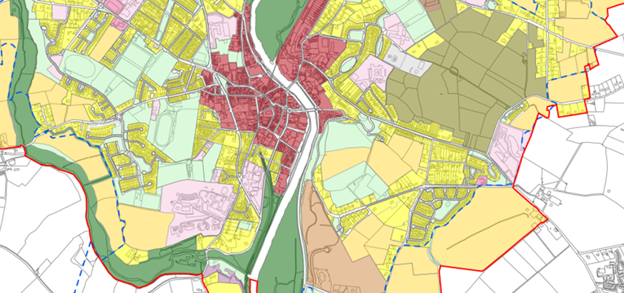
Responding to Growth in County Wexford
Land Use Zoning: Enniscorthy and New Ross
(Adopted July ‘26)
Land Use Zoning:
Rosslare Harbour and Bunclody
(In progress)
Land Use Zoning and Plan:
Wexford Town
(In progress)
Total of c.306ha of residential zoned lands across two main towns
197ha of industry lands
Total of c.80ha of residential zoned lands across two settlements.
Statutory Process in progress.
December Adoption.
Approx 250ha of proposed residential zoned lands and c.200 for employment.
Display next month.

Slide 27


Key Changes for Forward Planning
From preparing plans to preparing for delivery…
Longer Term Planning
10-year Development Plan
New Plan Hierarchy (UAPS, PAPS, CAPS, UDZS)
Stronger Alignment, National, Regional and Local
Emphasis on Delivery and Infrastructure led planning
A longer term, more strategic and more integrated plan-led system

Slide 28

Planning and Development Act 2024 (Part 3)
Planning & Development Act 2000 | Planning & Development Act 2024 | Key change / what it means
6-year Development Plan | 10-year Development Plan | Longer-term planning framework and greater certainty for landowners and infrastructure providers.
Development Plan + LAP structure | Development Plan + UAP / PAP / CAP structure | LAPs are replaced by a more targeted hierarchy of plans.
Local Area Plans (LAPs) | Urban Area Plans (UAPs) | UAPs provide detailed implementation of the Development Plan for identified urban settlements.
LAP could cover a wide variety of areas | Priority Area Plans (PAPs) | New targeted mechanism for a particular part of a settlement requiring development, renewal or regeneration.
Joint/coordinated planning possible but no equivalent dedicated plan type | Coordinated Area Plans (CAPs) | Dedicated mechanism for planning areas requiring coordination between planning authorities.
SDZ regime | Urban Development Zones (UDZs) | New separate strategic delivery mechanism; broadly the closest successor concept to an SDZ, with a development scheme and special DM consequences.

Slide 29
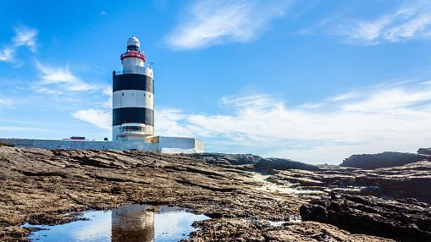
Looking Forward…
Gorey Plan & Zoning
New 10-year CDP Review
Coastal Planning
Housing Activation & Services
Rosslare Harbour Economy / ORE
2024 Act Rollout

Slide 30

4. Q & A Session www.gov.ie/planning

Slide 31
5. Closing
What Success Looks Like
- A streamlined planning system.
- More agile, efficient and unambiguous policy alignment that can balance all interests.
- Enhanced capacity to prioritise strategic investment in terms of housing, renewables and infrastructure.
- Retaining an open, transparent and participative planning system.
- ‘Plan led’ emphasis on outcomes.

Slide 32
Thank You

