Slide 1
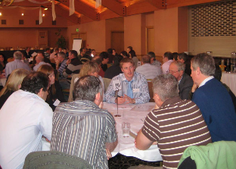


Agents Training
24th September 2026
Diarmuid Houston Senior Planner
James Lavin Senior Executive Planner

Slide 2

Planning & Development Act, 2024
Planning and Development Act, 2024
Planning and Development Regulations, 2026

Slide 3

Act Part 4
Regulations (to be confirmed )
Relates to Planning Applications
Commence on the 30th September 2026?
Donovan Phoebe - Slieve Bhuidhe and Ewes

Slide 4
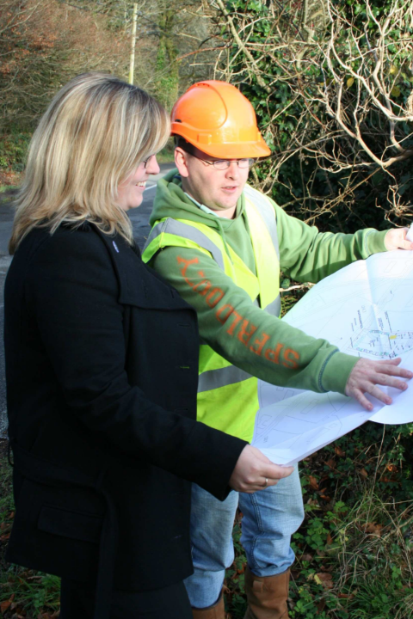
What do you need to know
New planning application forms
Validation changes
Preplanning for major developments
All housing and social housing exemption certificates

Slide 5

Social Housing
Part 7 (old part V)
Section 254 Housing Supply Exemption Certificates
If you apply for a development of
Less than 4 houses
Housing on land of less that 0.1 hectare or less
Shall apply for a certificate stating that this chapter shall not apply (exempt from social housing
Mijas
Carter Eamonn

Slide 6
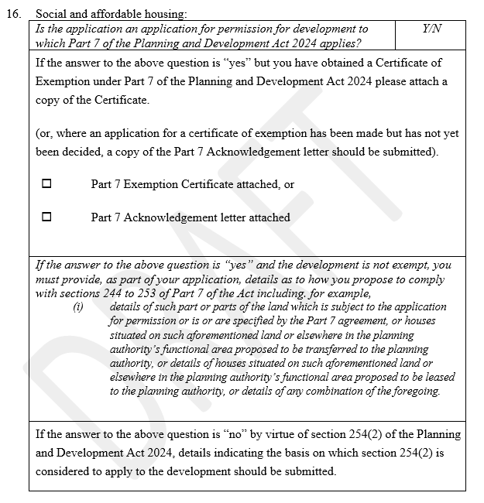
Planning application form
This is not new but is a validation issue strengthened in the regulations
This applies to all housing including single rural housing.
New standalone Regulation Housing Exemption Certificates will provide the application form

Slide 7

Preplanning Major Developments
Section 89 Pre-application consultation required for certain developments
10 or more houses
Student accommodation 200 bed spaces
Development (not residential) over 1000 sqm
Such development that may be prescribed

Slide 8
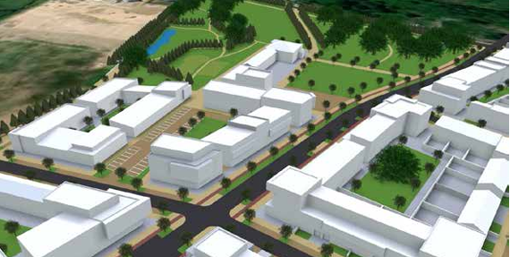
Preplanning
Major
4 weeks
If no meeting or no request to extend 4 weeks an application can be made
Separate process for Large scale residential development
“Standard Development”
As soon as is practicable

Slide 9
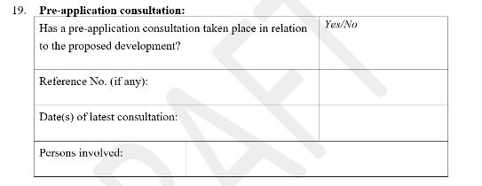
Section 95 (5)
…an application that is not in accordance with this section, section 89 (where applicable) or such regulations as are made for the purposes of this section shall be invalid

Slide 10


Slide 11

Outline Permission
96. (1) An application under section 95 may be made to a planning authority for permission (in this section referred to as “outline permission”) for development consisting of not more than 4 housing units (other than a housing unit that is a protected structure).

Slide 12
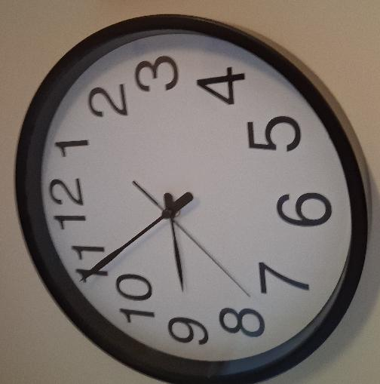
Time Frames
Normal Application 8 weeks but cannot determine an application until 6 weeks and 1 day (extra week added)
Renewable Energy Directive time frames start at 4 weeks to determine certain developments
8 weeks for exempted development not 4 weeks
Environmental impact Applications EIA and Appropriate Assessments
12 weeks then 8 weeks if further information is requested

Slide 13
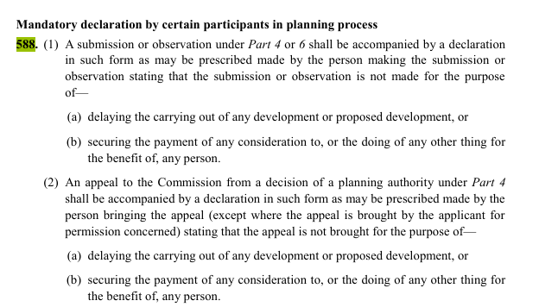
Public Submissions & Observations
Regulation 17
Prescribed form
Can withdraw submission
Declaration Section 588

Slide 14
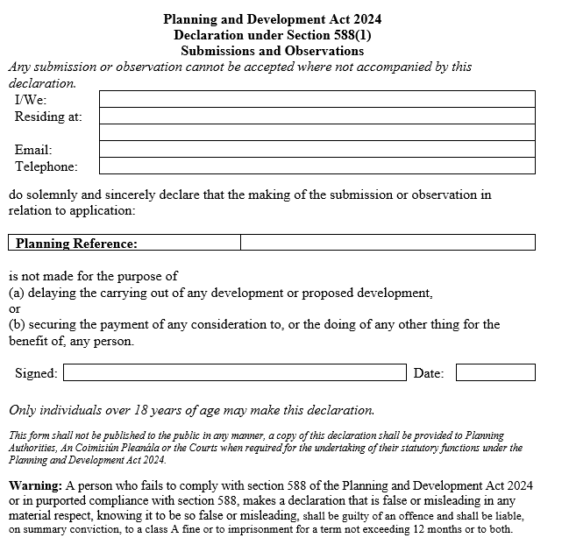
Submission and Observation
Declaration Form

Slide 15
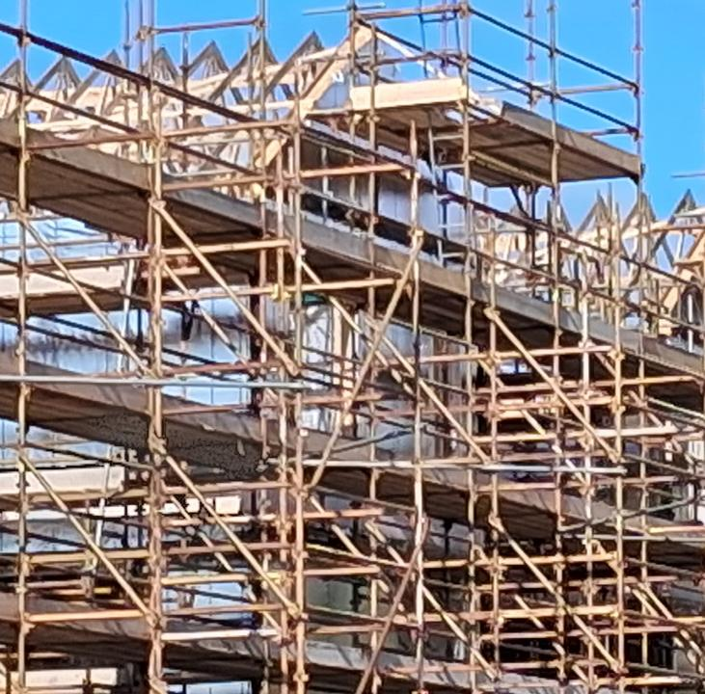

Material alteration of permission
Introduces a structured route for altering an existing permission or extending its duration.
Separates non-material alterations from material alteration requests.
• Material alterations bring a fuller procedural and decision-making framework decision-making framework.

Slide 16
Material alteration and Extension of permission
Is an alteration or extension of the duration of a permission requested under section 140 that:
• requires an appropriate assessment; or
• requires an environmental impact assessment; or
• is accompanied by an environmental impact assessment report or a Natura impact statement (or both); or
• is otherwise determined by the deciding authority to be material under section 140(7).

Slide 17

Material alteration and Extension of permission
Section 139
Person may apply for a consultation
Section 140
Request to alter terms of permission
Seek to Extend the duration of permission when it has commenced (not earlier than 1 year)
Planning Authority Determines if an application is required.
Regulations provide a process which is similar to that of a planning application and can be appealed

Slide 18

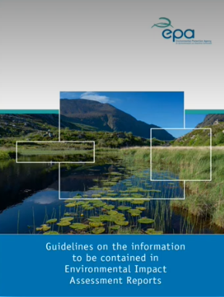
An Applicant can still apply for an Extension of Duration which is unaccompanied by and AA, EIA Or NIS , or any combination of these documents, until October 24th 2027.
If an application has an AA, EIS or NIS then they must apply through a material alteration application process.

Slide 19
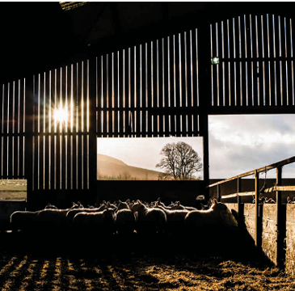
Part 2 Section 10
Exempted Development Certs
Note: New Act Exempted Development and Use Classes Regulations not expected this year
Section 10 Replaces Section 5 Declaration Exemption in 2000 Act
Declaration can be made by a “relevant person” relating to an act or operation carried out or proposed to be carried out on land owned by that person.
Occupier, others can apply but only with the consent of the owner
Or a company within the meaning of the Companies Act 2014
Or a prescribed person

Slide 20
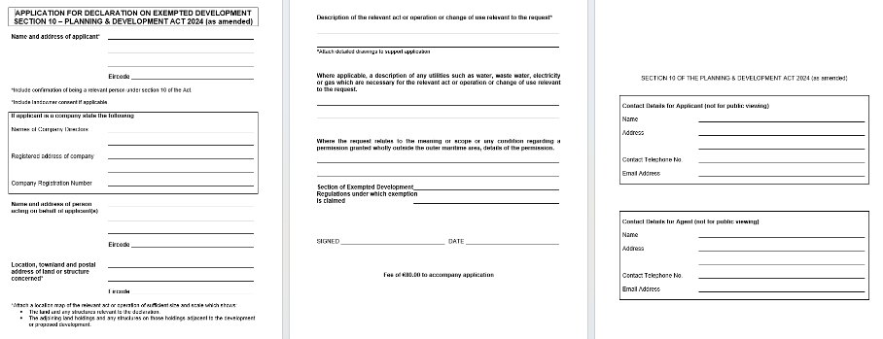
Where a relevant person requests a declaration notify the owner of the land or maritime site must notify the owner in writing
Can appeal Planning Authority decision but can also withdraw from appeal from the Commission
The changes will require additional checks by the Planning Authority on ownership and or company registration

Slide 21

Oystercatchers
Boolavogue Textile Studio

Slide 22

Short term lets
Material Change in use
Part 2 Section 7 (d) a change in use of a house or part of a house situated in a rent pressure zone (within the meaning of section 8) to a use for short-term letting (within the meaning of section 8) purposes
Childhood Delights
Sheridan Michael

Slide 23

Part 2 Section 8
“short-term letting” means the letting of a house or part of a house for any period not exceeding 14 days...
Currently, planning permission for short-term letting use is required in any location where:-
a house or apartment that is a person’s principal private residence (i.e. main home), is used for short-term letting for a cumulative period of more than 90 days per annum where the host is not present; or,
a house or apartment that is not a person’s principal private residence (i.e. is a second or subsequent property), is used for short-term letting for any period, and
the house or apartment that is being used for short-term letting, does not have planning permission for that use.

Slide 24
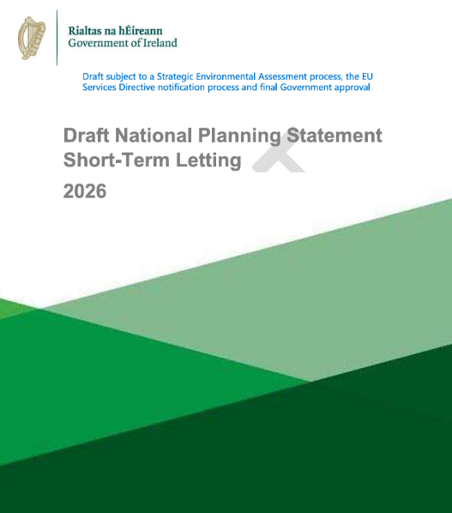
Draft
Short-term letting is defined as the letting of a house, apartment, or unit, or part of a house, apartment, or unit, for any period not exceeding 21 consecutive nights:
Residents, including homesharers, are allowed to let their entire principal private residence (house or apartment) (i.e. where it is not ordinarily lived in by the owner or leased as a long-term residential accommodation) on a short- term basis for a cumulative period of up to 90 days per calendar year where they are temporarily absent from their home;
Where the 90-day threshold is exceeded, change of use planning permission is required;
Where the house or apartment is not a 'principal private residence', the 90 day exemption does not apply and change of use planning permission is required for all short-term letting;
Homesharing (the letting Of a room or rooms in a person's principal private residence) is permissible on an unrestricted basis and is exempt from the requirement to apply for planning permission

Slide 25

Through the zoning objectives included in the statutory plan, the planning authority will indicate the acceptability or otherwise of tourist accommodation for particular types of zoning objectives and this will also inform the plan-led approach to purpose-built short-term letting as a form Of tourist accommodation.
25 largest cities and towns with a population above the identified threshold Of 20,000 persons in the latest Census Of Population (2022), there is a general presumption against the granting of planning permission for the use of residential properties for STL purposes, except in exceptional circumstances
Outside of the towns and cities over 20,000, the use of residential properties, including previously vacant and derelict buildings, for short-term letting purposes may be considered to be acceptable. However, there may be circumstances which may justify a proposal being refused permission by a planning authority on the basis Of provisions included within a statutory plan, made in accordance with policies, measures and guidance set out in this National Planning Statement

Slide 26

Rural Housing
Brother
Gale Martin

Slide 27
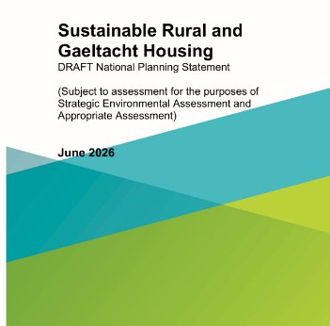
Sustainable Rural and Gaeltacht Housing DRAFT National Planning Statement
Avoiding prescriptive local policies to achieve clarity and consistency
In this regard, rural housing policies within development plans should not be prescriptive in including numerical requirements and arbitrary caps or limits on new single rural housing, for example relating to minimum site area, road frontage or landownership size requirements, limits on rural residential densities or on the number of dwellings that may be developed on a single landholding, along a stretch of road or within a rural area. Development plans should also avoid including prescriptive definitions of ‘farmers’ or ‘farms’, noting that a range of rural-based enterprises may be intrinsically linked to a rural area.
A Plan-led Approach to Housing in Rural Areas
Rural areas include: Rural settlements, defined by the CSO Built Up Areas (BUAs) 5 as having less than 1,500 people in the most recent Census year, are home to 350,461 people in Census 2022 (19%6 of the population of rural areas), and the surrounding rural countryside, which was home to 1,518,638 people in Census 2022 (81% of the population of rural areas).
A person living or working in a rural settlement under 1,500 population is considered to have a ‘rural generated housing need’

Slide 28
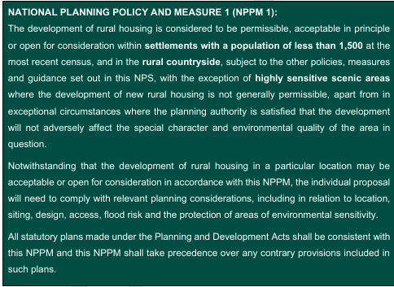

Slide 29
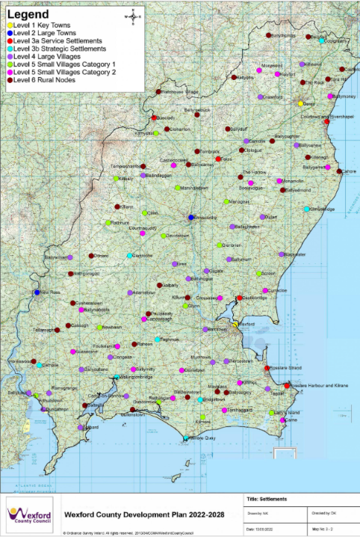
Rural Areas Under Urban Influence
Wider Rural Areas
Rural areas under urban influence: located within the metropolitan areas of cities10 and the commuter catchment of larger towns and centres of employment, where applicants must demonstrate a genuine ‘local economic or social need’ to live in a rural area.
Wider rural areas elsewhere: where a more flexible approach is applied to facilitate anyone wishing to build a house, subject to normal planning considerations including in respect of location, siting, design, access, flood risk and the protection of areas of environmental sensitivity and high amenity value.

Slide 30
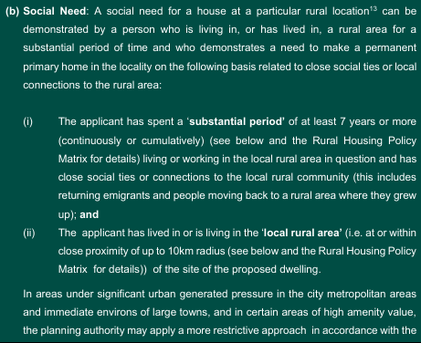
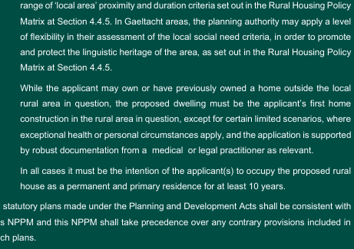
NATIONAL PLANNING POLICY AND MEASURE 2 (NPPM 2): set out the definition of ‘Rural Areas Under Urban Influence’ and that they shall be identified in accordance with the Central Statistics Office (CSO) urban/rural classifications for defining rural areas that are under ‘high and moderate urban influence’ at the most recent Census of population
NATIONAL PLANNING POLICY AND MEASURE 3 (NPPM3) states how the applicant can demonstrate either a local economic or a local social housing need, in accordance with this NPPM and the relevant policies and objectives of the adopted development plan.
Still must be the applicants first home construction in the rural area in question
Allows for medical need in certain limited scsnarios

Slide 31
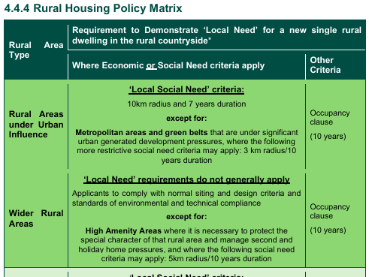

Slide 32
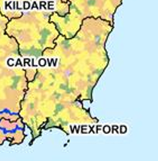
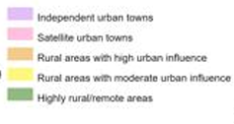
Maps need implementing at local level

Slide 33
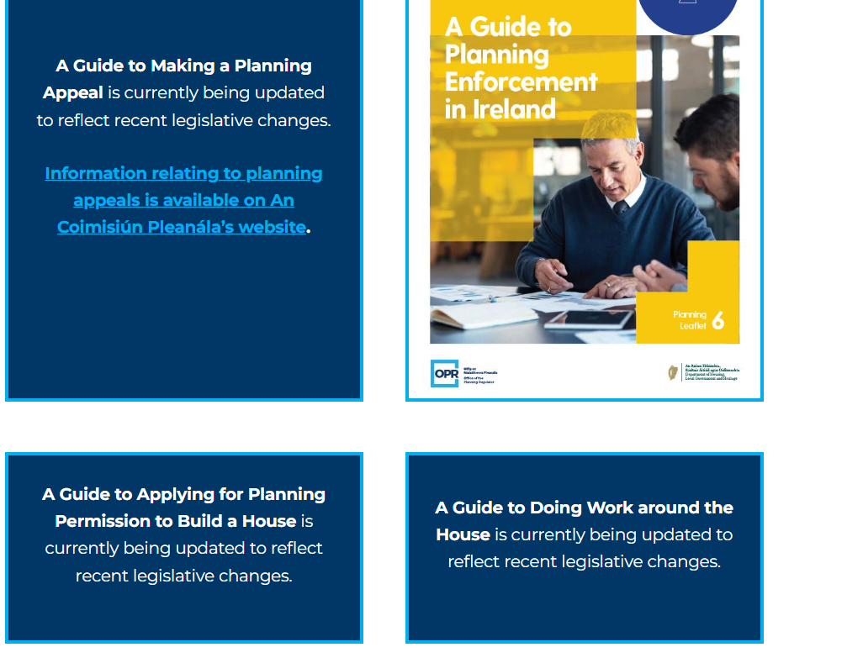

Slide 34
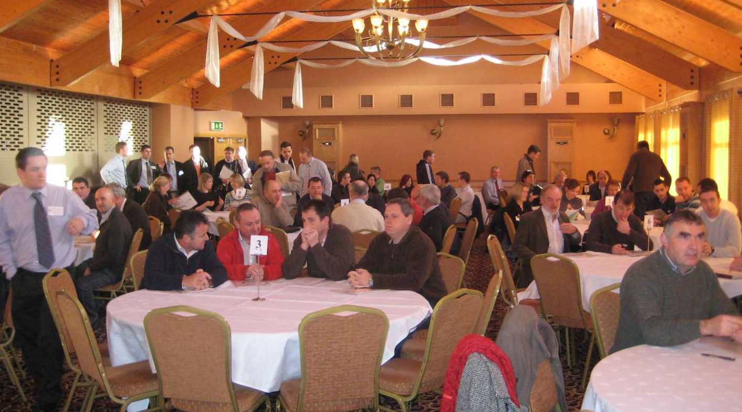
We need to keep doing this….next meeting November 2026?

Slide 35

Pikeman of Vinegar Hill Sunrise 1798
Kehoe John Gerard

