Slide 1





































Regeneration Unit Wexford County Council
Town Centre First / Vacant Homes.
Mick Mc Cormack (Town Regeneration Officer).
Agent Information Day
27th Nov 2024.

Slide 2



Wexford County Council Regeneration Unit?
Wexford County Council’s Regeneration Unit was formed in Nov 2023 (one year in existence), an amalgamation of Town Centre First (TCF) and Vacant Homes
Staff of 4 (made up of TRO, Vacant Homes Officer (Executive Engineer), Assistant Staff Officer and GSS)
With a more concentrated focus on Regeneration and vacancy activation through various Government programmes it was agreed to realign these roles into a new “regeneration unit.”
Our ambition as a section remains to make Wexford a better place to live, work, visit, play and do business.

Slide 3
Vacant Homes

Slide 4
Vacant Homes
Vision
The Vacant Homes vision is that “Ireland significantly reduces its quantity of Vacant Homes. Our mission is to assist, advise and collaborate with key stakeholders including government agencies and local communities to help create new homes from existing vacant dwellings. Apart from providing accommodation to people with a housing need, bringing vacant homes back into use helps rejuvenate areas in decline”

Slide 5

Croí Cónaithe - Scheme Outline
Refurbishment Grant – A max grant of €50,000 is available for the refurbishment of a vacant property.
Derelict property – A top up grant of €20,000 is available where the property is confirmed as derelict (i.e. structurally unsound and/or dangerous)
Applicants can live in as their private residence or rent out the property.
Information and application form can be found on Wexford County Councils website under the Regeneration Unit https://www.wexfordcoco.ie/regeneration-unit

Slide 6
Croi Conaithe – Scheme Outline
Property must have been built / substantially completed by Dec 2007. Can be located in Urban or Rural Areas and must be vacant for minimum 2 years.
Defined, but substantial amount of works that are covered under the Grant
A review will be carried out in late 2024 so it is important to get the message out to the public re availability of Grant
Again, we’re here to help, great opportunity to improve dereliction and bring Vacant and Derelict properties back into use in County Wexford.

Slide 7
Application Requirements
Named Individual(s) must own house (not company)
Applicant must provide Quotes for proposed works
The applicant must provide evidence that the property has be vacant for 2 years.
The applicant must provide Proof of Ownership
Local Property Tax must be paid on the property (or exemption submitted)
Applicant(s) must be tax compliant
A Structural Report must be submitted from a Chartered Building Surveyor or a Chartered Structural Engineer. if the Applicant wishes to access the €20,000 Top Up Grant.
Contractor must be tax compliant – All contractors must be VAT registered

Slide 8
Application Process
Wexford County Council will:
check the application form to ensure it is fully completed, has been signed and that the required supporting documents have been submitted;
assess the application in line with the conditions of the scheme;
where the application is in order and required supporting documentation is provided, arrange for suitable technical staff to visit the property to check the works applied for are in order and assess the projected costs as set out in the application form;
write to the applicant to let them know if the application has been approved and the level of grant which has been approved;
If you are availing of the Local Authority Purchase and Renovation Loan (LAPR) to purchase and renovate, or renovate only this property, you will be required, as a condition of that loan, to sign a Grant Payment Authority letter authorising payment of the Vacant Property Refurbishment Grant directly to the section of the local authority dealing with mortgage lending.

Slide 9
What happens when works are complete?
Wexford County Council will require evidence such as appropriately detailed invoice(s) for the completed works. Invoices must match the approved quotes, with some allowance for variations where applicable.
Electrical/gas installation certs required.
Compliance with all planning permission requirements.
In cases where approval in principle was granted, proof of ownership (Folio) must be provided before the grant can be paid.
House must be habitable if used a Primary Permanent Residence.
In respect of a property that is being made available to rent, evidence that the applicant has registered the tenancy with the Residential Tenancies Board (RTB) is required.
The VHO will conduct a final property visit to review that the work has been completed in-line with grant application and as vouched in the invoiced documentation provided.
Final documentation will then be sent to WCC Solicitors to arrange a secondary charge on the property as part of the clawback process. This requires signing by the applicant and nominated WCC Staff.
Payment approximately 4 weeks after signing of Charge Documents.

Slide 10
Issues that can cause delay from our experience
Missing documentation such as proof of ownership, LPT evidence or contractor quotes
Failure to meet eligibility criteria – no proof of Vacancy
Need for planning permission if substantial changes to the property are required.
Difficulty securing qualified contractors or tradespeople due to high demand in the construction sector.
Failure to provide receipts, invoices, or certificates of completion required for reimbursement.
Timeframe involved in paperwork/legalities connected to the Charge Documents
Invalid/Expired Tax Clearance Certs at Payment Stage.

Slide 11
CROÍ CÓNAITHE –
VACANT PROPERTY REFURBISHMENT GRANT
355
215
130
7
46
€2.5m
Number of Applications received
Approvals
Further Information Requested
Applications Declined or Withdrawn
No. of application with funding issued
Amount paid out to date
Source: Globe Giving

Slide 12
Ready to build scheme – Scheme outline
Serviced sites for new Homes. Local Authorities will make available serviced sites at reduced cost to support self-build home ownership.
The level of discount to the individual will depend on the level of servicing cost incurred by the Local Authority before the sale of the site but will not exceed €30,000.
Have direct access to adequate mains water supply and mains wastewater disposal infrastructure.
Local Authorities will manage the prioritisation, in line with the framework of priorities.

Slide 13
URDF Rd 3

Slide 14
URDF Round 3
URDF Round 3 to act as a dedicated revolving fund within each LA to address the financial barrier and risk faced by LA in seeking to tackle long term vacant and derelict building and sites in URDF Towns and Cities.
Wexford identified 217 vacant and derelict sites in 4 main Wexford Towns and applied for funding. 169 properties approved and allocated €6.7m in a revolving fund.
Essentially process is buy (CPO under derelict sites) - derisk – Sell.
Led by Planning enforcement team in conjunction with property section.
VACANCY IS NOT OK!! Active now on 62 of the identified properties as per graph.

Slide 15
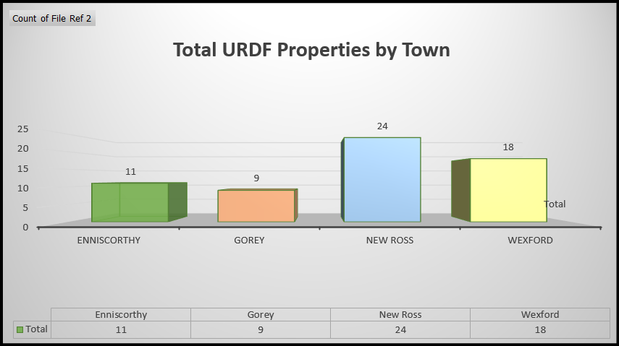

Slide 16
Town Centre First

Slide 17
What is Town Centre First (TCF)?
Aims to create towns that function as viable, vibrant and attractive locations. It’s a collaborative process creating Town Centres that people want to live, work, play and learn in.
Support towns to function as the service, social, cultural and recreational hub for the local community.
Government policy informed by data and best practice, and delivered by Local Authorities in partnership with communities.
TCF is bottom up, community led iniative, culminating in an evidence based Plan.

Slide 18
Wexford County Council and Town Centre First
We have fully embraced the Town Centre First process in Wexford and now have 7 TCF’s teams in place around County.
We have TCF Plans in place for New Ross and Enniscorthy and completing one for Courtown/Riverchapel along with developing a TCF strategy for Wexford Town which will be incorporated into the LAP. 4 active Town teams driving TCF agenda.
Have established TCF Teams in Bunclody, Taghmon and Castlebridge and carried out healthchecks, ambition is to have TCF Plans here in future.
Its about bringing life and vibrancy back into our town centres drawing on the experience , wishes and wants of the community.

Slide 19
Why is Town Centre First Important?
It is Ireland's First consistent approach to placemaking.
An evidence-based plan led methodology. Each TCF Plan is underpinned by a clear assessment of local strengths and challenges.
Communities are at the heart of the TCF process. Community collaboration; Town Teams that are representative of local communities are a key part of the TCF Collaborative process.
TCF Process
Consultation 2. Understanding the Place 3. Defining the Place 4. Enabling the Place.

Slide 20
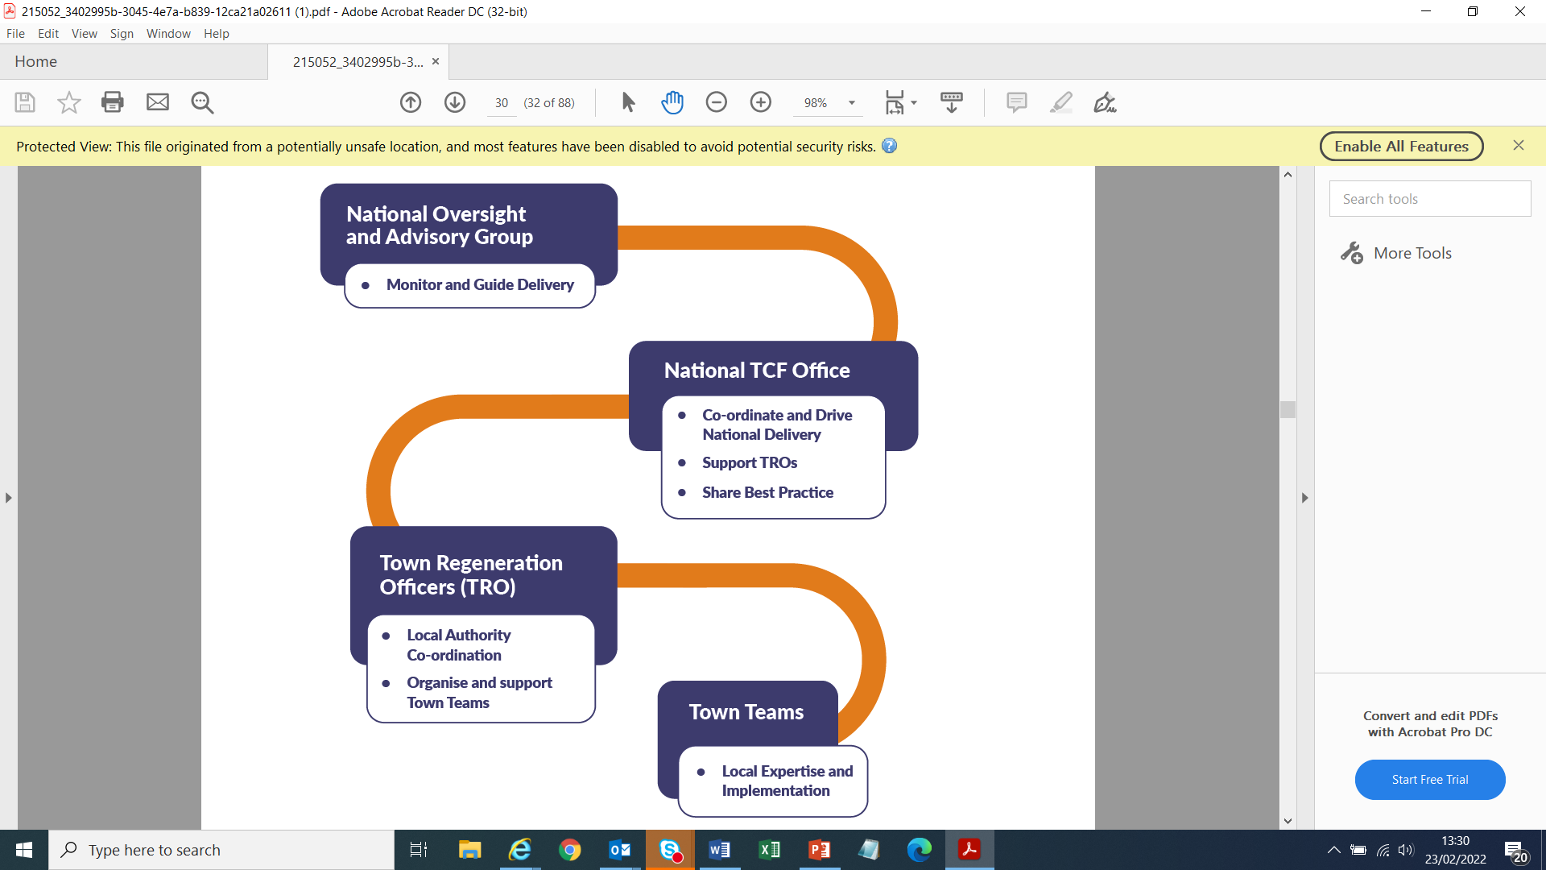
Key Roles/Players
National Oversight and Advisory Group
National TCF Office
Town Regeneration Officers
Town Teams

Slide 21
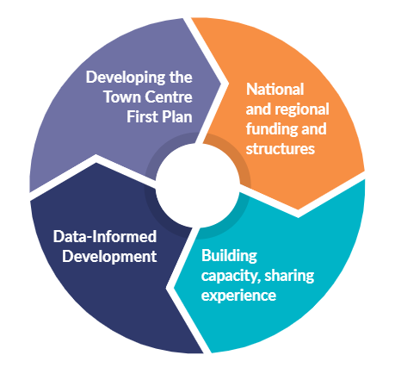
Key Elements of Town
Centre First Approach
Building capacity and sharing experience
Delivering a vision plan for each town
Putting in place the necessary national and regional structure
Data informed development

Slide 22






Challenges facing our Towns
Building Vacancy/ Dereliction – lack of vibrancy
Poor pedestrian/ cyclist access
How to increase employment in Town centres
Less desire to live in Town Centre
Lack of parking, access to green spaces
Out of Town/ Online shopping

Slide 23
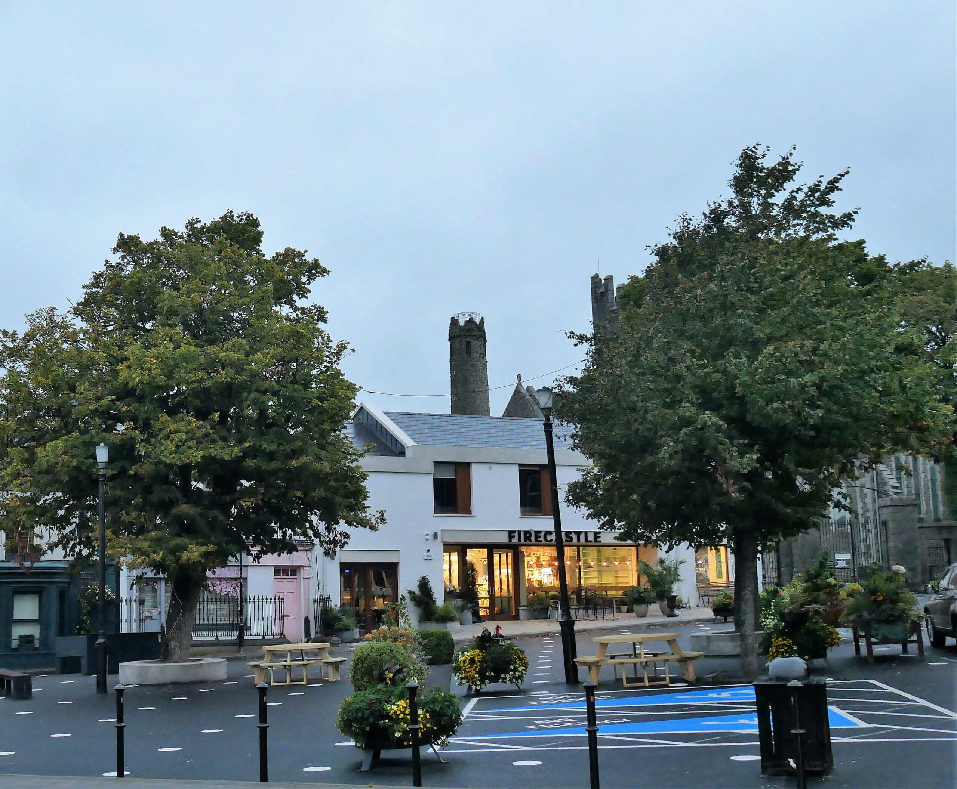
Opportunities
Climate Change Adaptation
Digital Transformation & Remote Working
Demographic Change & Housing Choice
Experience-led blend of retail
Regeneration of Public Spaces
Sustainable mobility-10 min Town
Realising the existing cultural and heritage assets of places
Empowered, inclusive and engaged Communities

Slide 24








Key Roles – Town Team
Local Experts - Comprised of Diverse Groups
Members of the Public & Local Residents
Community Organisations - sports organisations, cultural groups, voluntary groups
Team may also include Local Authority (LA) members, Public Partnership Network (PPN) members, public representatives etc.
Local development sector - Developers, Retailers, Landlords
Charities & Social enterprises, and Educational facilities
Business associations/Business Owners
An Garda Síochána

Slide 25
Role of the TRO
DEVELOPMENT & DELIVERY
ESTABLISH AND ASSIST TOWN TEAMS
COLLABORATE
EXPERTISE
Town Centre First Plans
Drive Town Centre First Objectives
VHO/Planning/Special Projects
LA Multi Disc. Team
National TCF Office
NOAG
Assist in Managing Delivery
Link between Town Teams and LA
CARLOW COUNTY COUNCIL WILL BE A LEADER IN CLIMATE ADAPTATION AND MITIGATION

Slide 26
TCF Plan Process
Engagement with local community about TCF
Brainstorming ideas/ projects for the Town
Review of Plan by Town Team and key stakeholders
Selection of priority projects
Planning Approval for project
Appointment of Consultants
Formation of Town Team
Analysis of Town issues and key data
Draft Plan produced including pipeline of projects
Adoption of plan by Town Team
Application for appropriate funding
Project Delivered

Slide 27
TCF Plan
Informed by:
National and Regional policy
Local Policy
Best Practice Guidelines
Case Studies and Pathfinders
Includes:
Analysis and Appraisal
Objectives
Strategy and Actions
Prepared and implemented by:
Town Centre Team
Town Regeneration Officers
Local Authority Multi-Disciplinary Team
Local Community
Business Groups

Slide 28
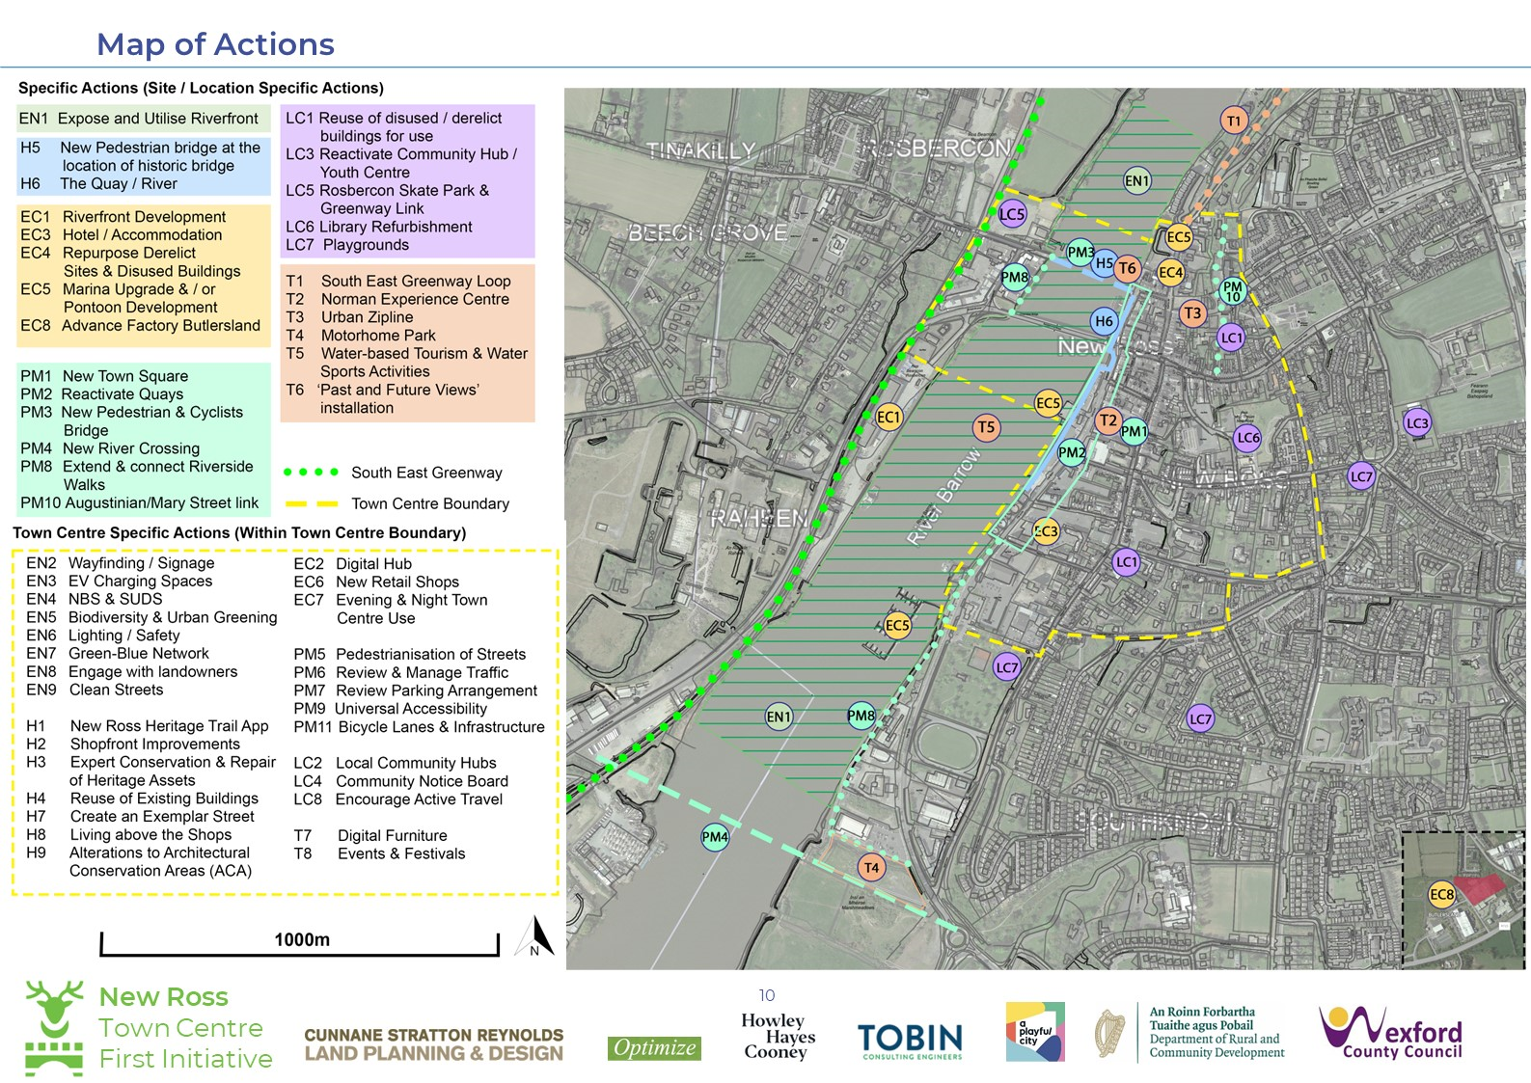

Slide 29
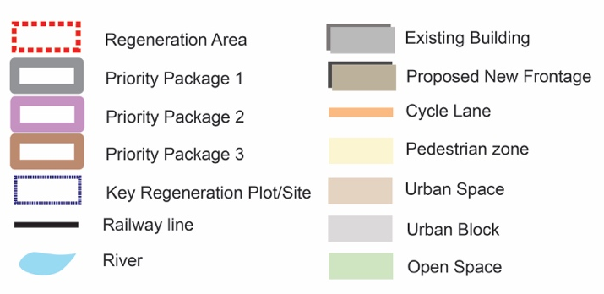
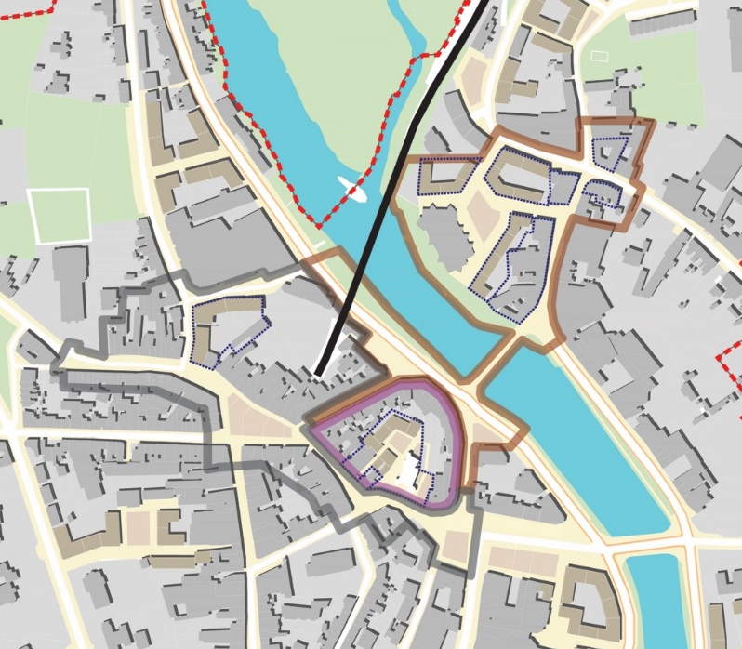
Packages
No. | Name | Regeneration elements
 |  | Public space improvement | Redevelopment and refurbishment
1 | Civic Spine | Main Street/Market Square/Castle Hill/Abbey Square | Murphy Flood site, refurbishment of stock.
2 | Castle Heritage Quarter | Surrounding streets and spaces - Castle Hill/Slaney Street/Slaney Place | Block Masterplan, Castle and Atheneum renewal and redevelopment. Redevelopment and refurbishment of street buildings.
3 | Templeshannon Hub and Link | All spaces in Templeshannon, Enniscorthy Bridge and connection to Slaney Street and Slaney Place. | Study and masterplan for backlands. Refurbushment of street buildings.
Notes:
29

Slide 30
Funding for Towns
Urban Regeneration and Development Fund (URDF)
Rural Regeneration and Development Fund (RRDF)
Town & Village Renewal Scheme
Housing for All
Crói Cónaithe Fund
European Regional Development Fund (ERDF) programme for Towns via the Regional Assemblies
Active Travel Fund
Climate adaptation/retrofitting
Built Heritage supports such as the Historic Towns Initiative (HTI)

Slide 31
2 Videos

Slide 32
Thank you

