Slide 1
Wexford County Council Climate Action Event 1st June 2023 Theme 3: Transport

Slide 2
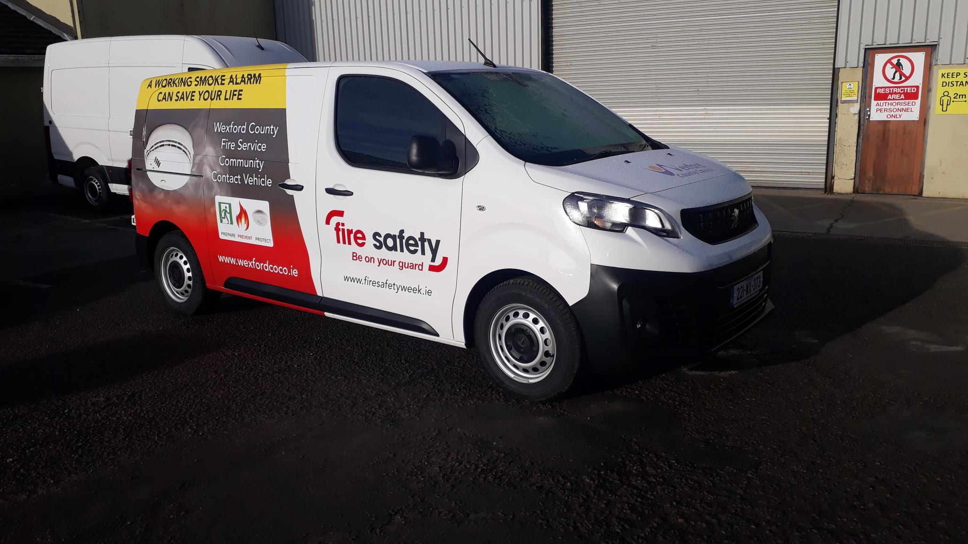
Wexford County Council Fleet
Comprising 288 Units
Made up of
Light Goods Vehicles
Heavy Goods Vehicles and
Specialised plant & machinery
Notes:
Not all Vehicles are suitable for transition to EVs

Slide 3
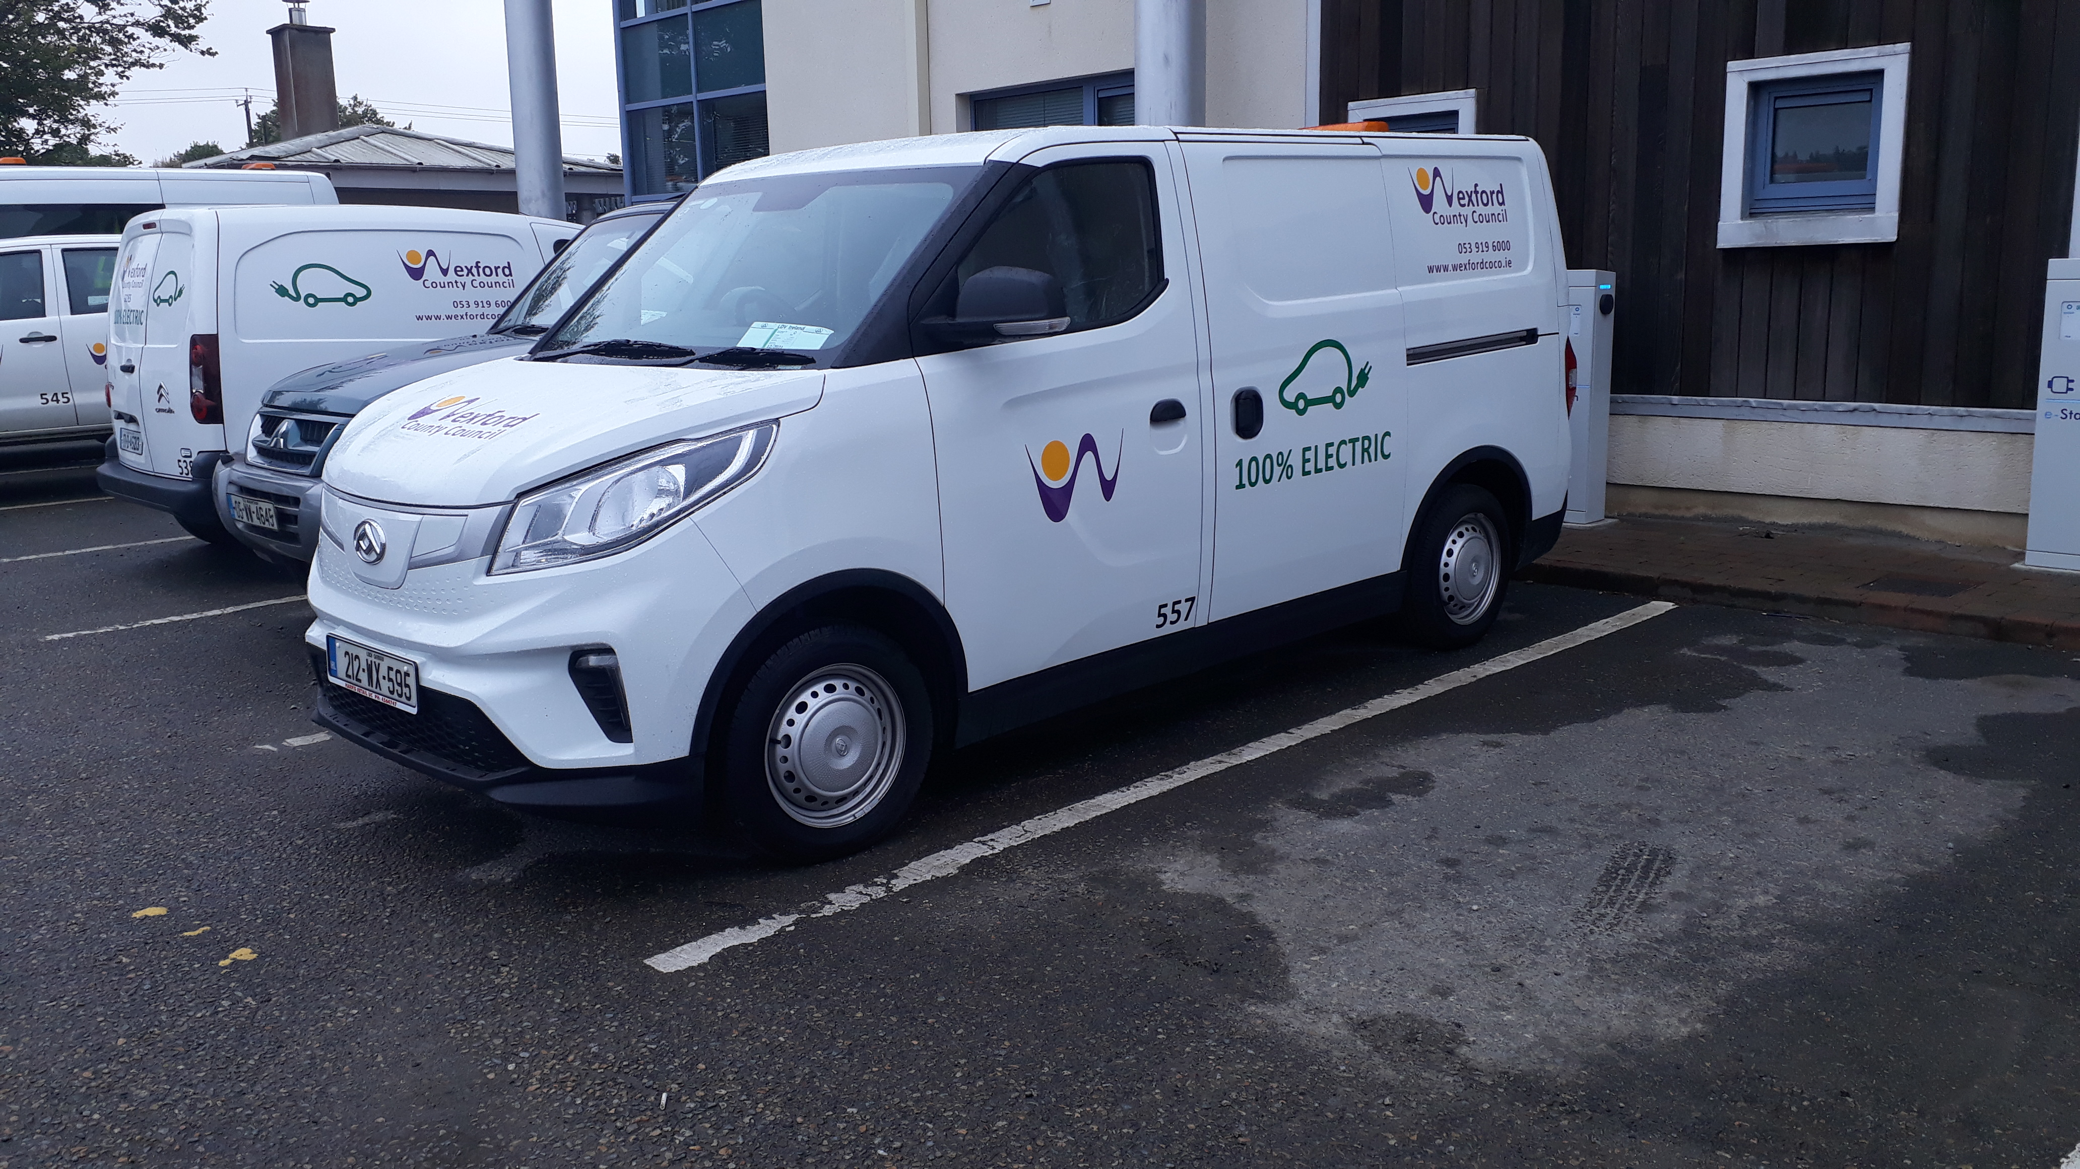
Transition to a Greener Fleet
Move WCC’s fleet away from 100% fossil fuelled model
Transition as many of the LGV fleet to EV’s as possible
Investigate using HVO (HydroTreated Vegetable Oil) as a direct replacement for Road Diesel as an interim
Notes:
Replace Light goods vehicles that are suitable to EVs
Much of the fleet is heavy goods vehicles or not suitable to change to EVs
Propose to Pilot the use of Hydrotreated vegetable Oil HVO) on Heavy Goods vehicles
HVO can be used as a direct replacement for Diesel

Slide 4
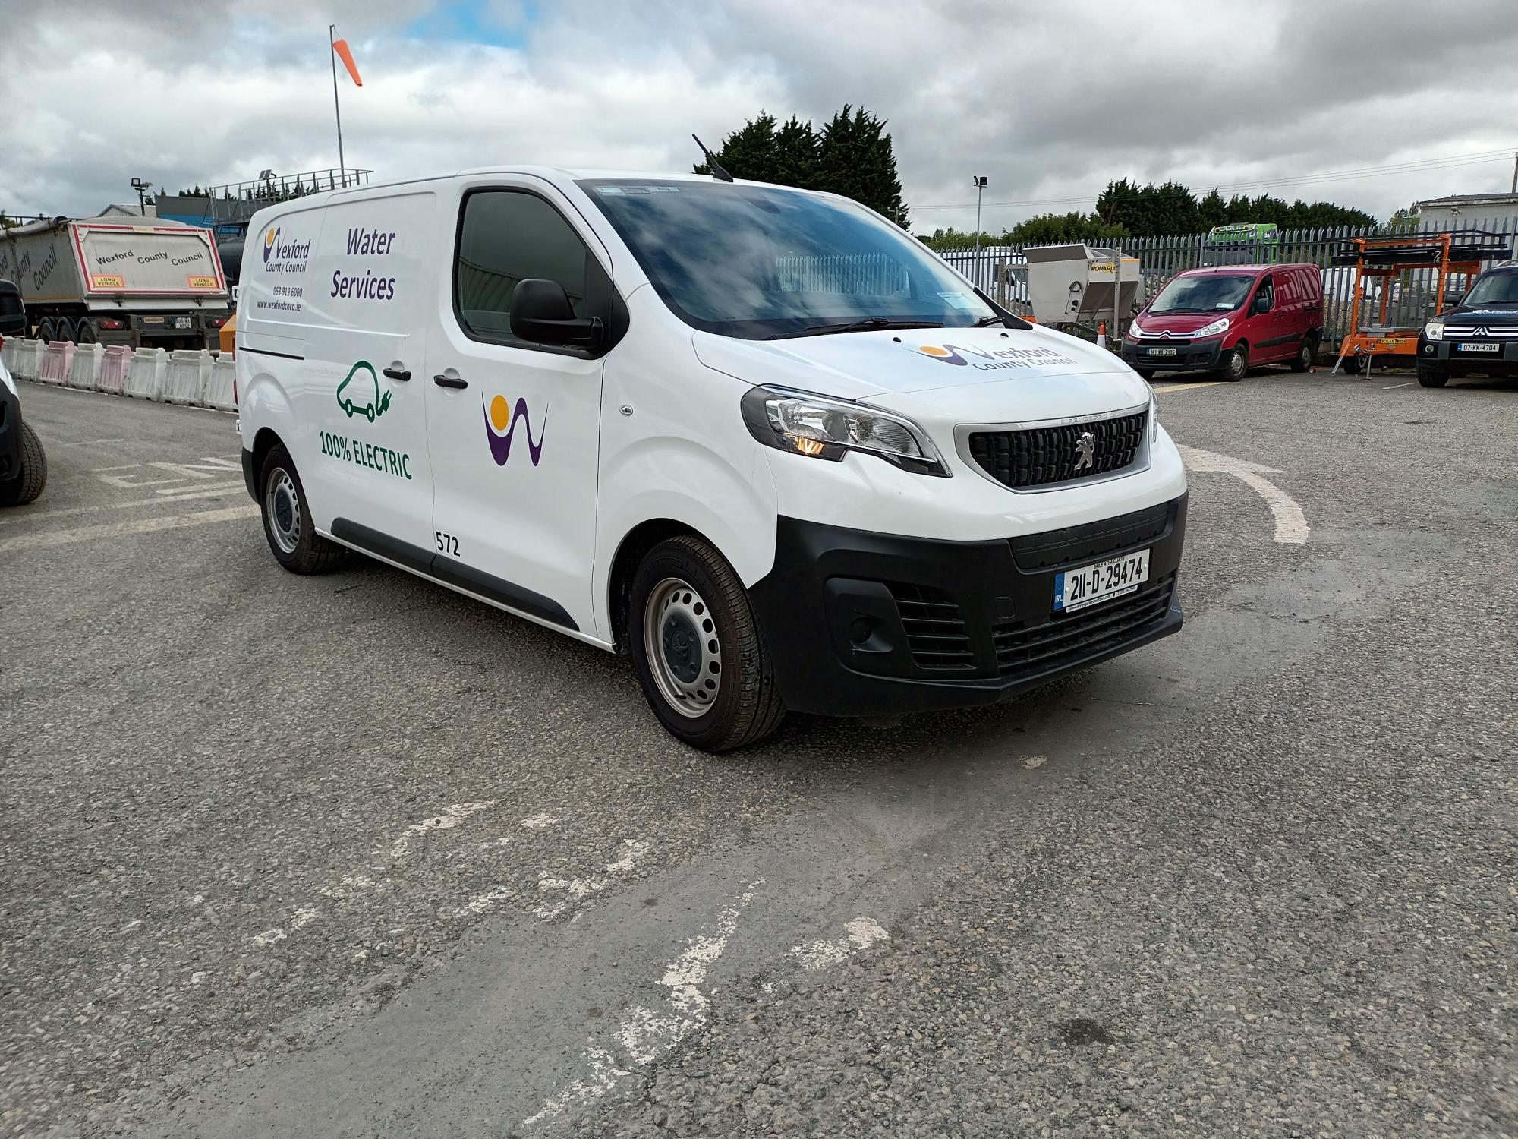
The Move to EV’s
4 EV commercial vans - 2019
EV’s now operating in the following sections:
Machinery Yard
Fire Service
Water Services
Environment Section (Community Warden)
Environment Section (Kilmore Quay Harbour)
County Hall
Wexford Borough
Notes:
Our journey started in 2019 when 4 commercial EVs were purchased
We are continuing to explore what vehicles in the various sections are suitable to transition to EVS
Replace the Diesel street sweeper in Wexford town to Electric sweeper

Slide 5
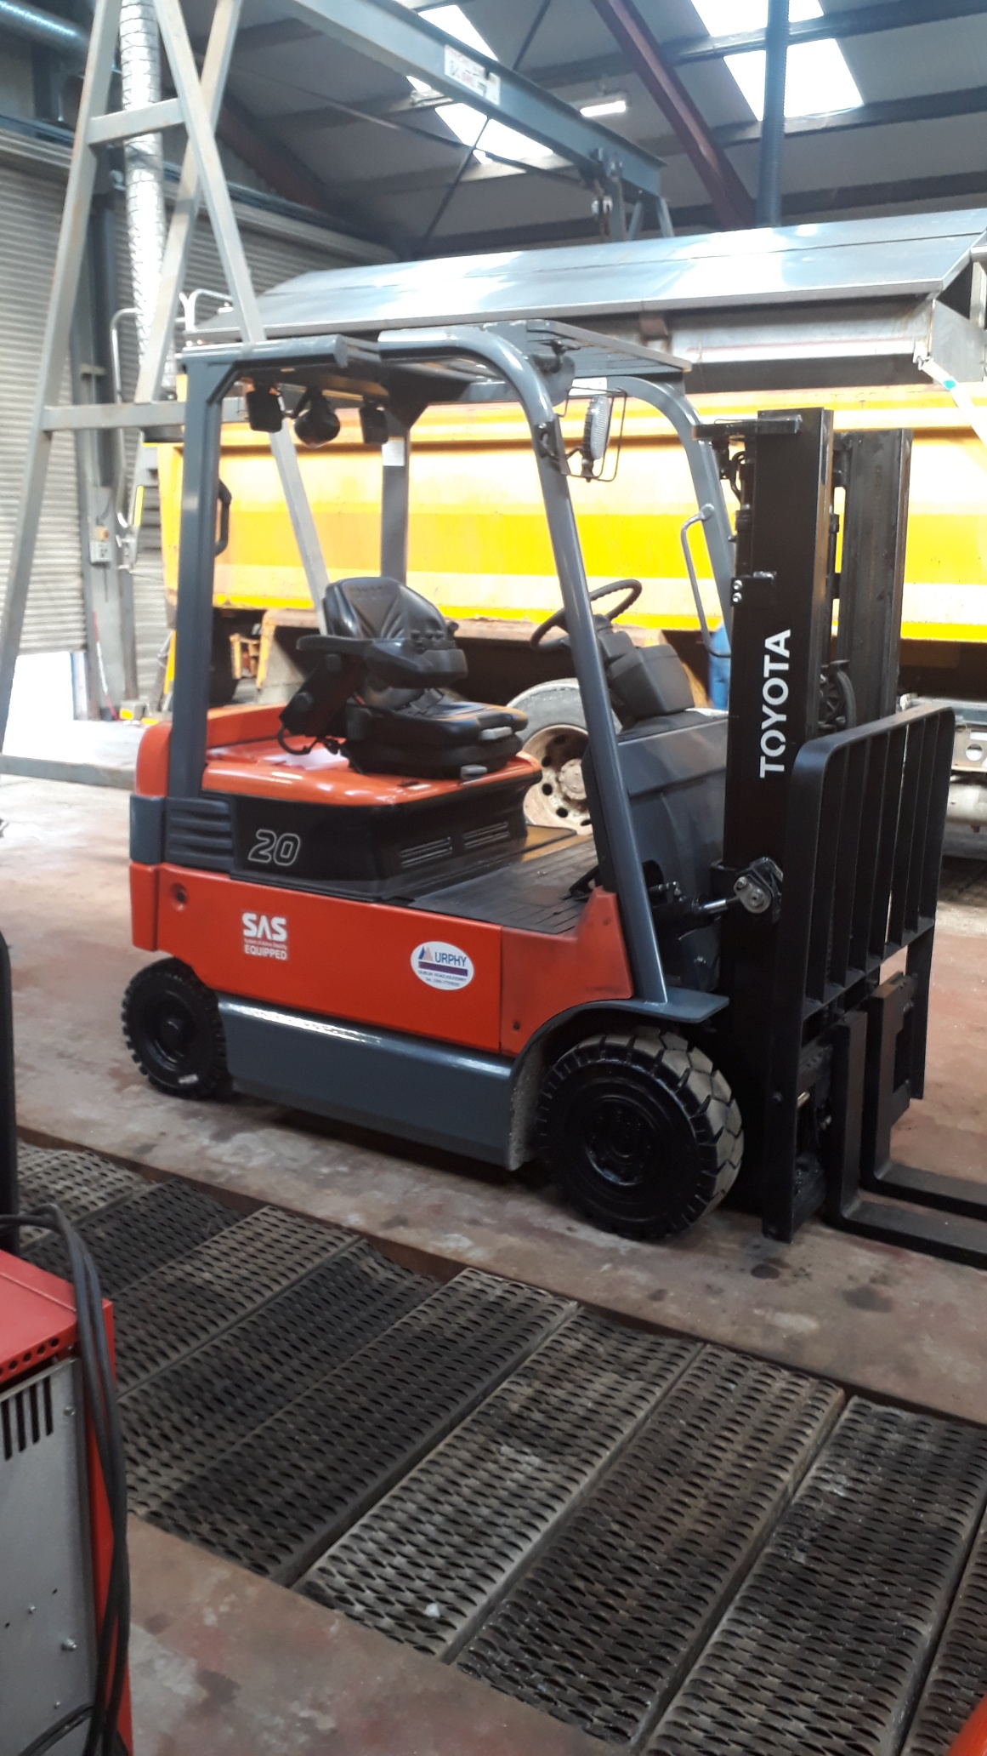
WCC EV fleet
11 EV vans
3 Electric Forklifts in CAS
1 Electric Sweeper – Wexford Town
Notes:
As a “rural” Local Authority, WCC a pace-setting LA in the transition to EV’s.
Potential to transition up to 30 to 40 units in WCC’s fleet to EVs which will help towards our CO2 reduction by 2030
Nearly 14% of the fleet over the next few years

Slide 6
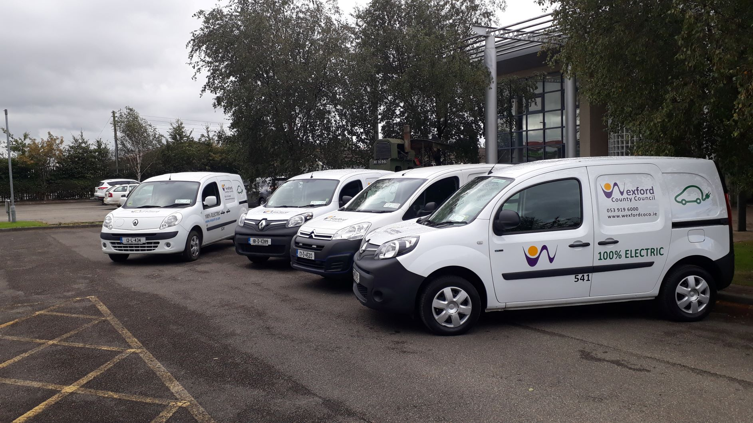
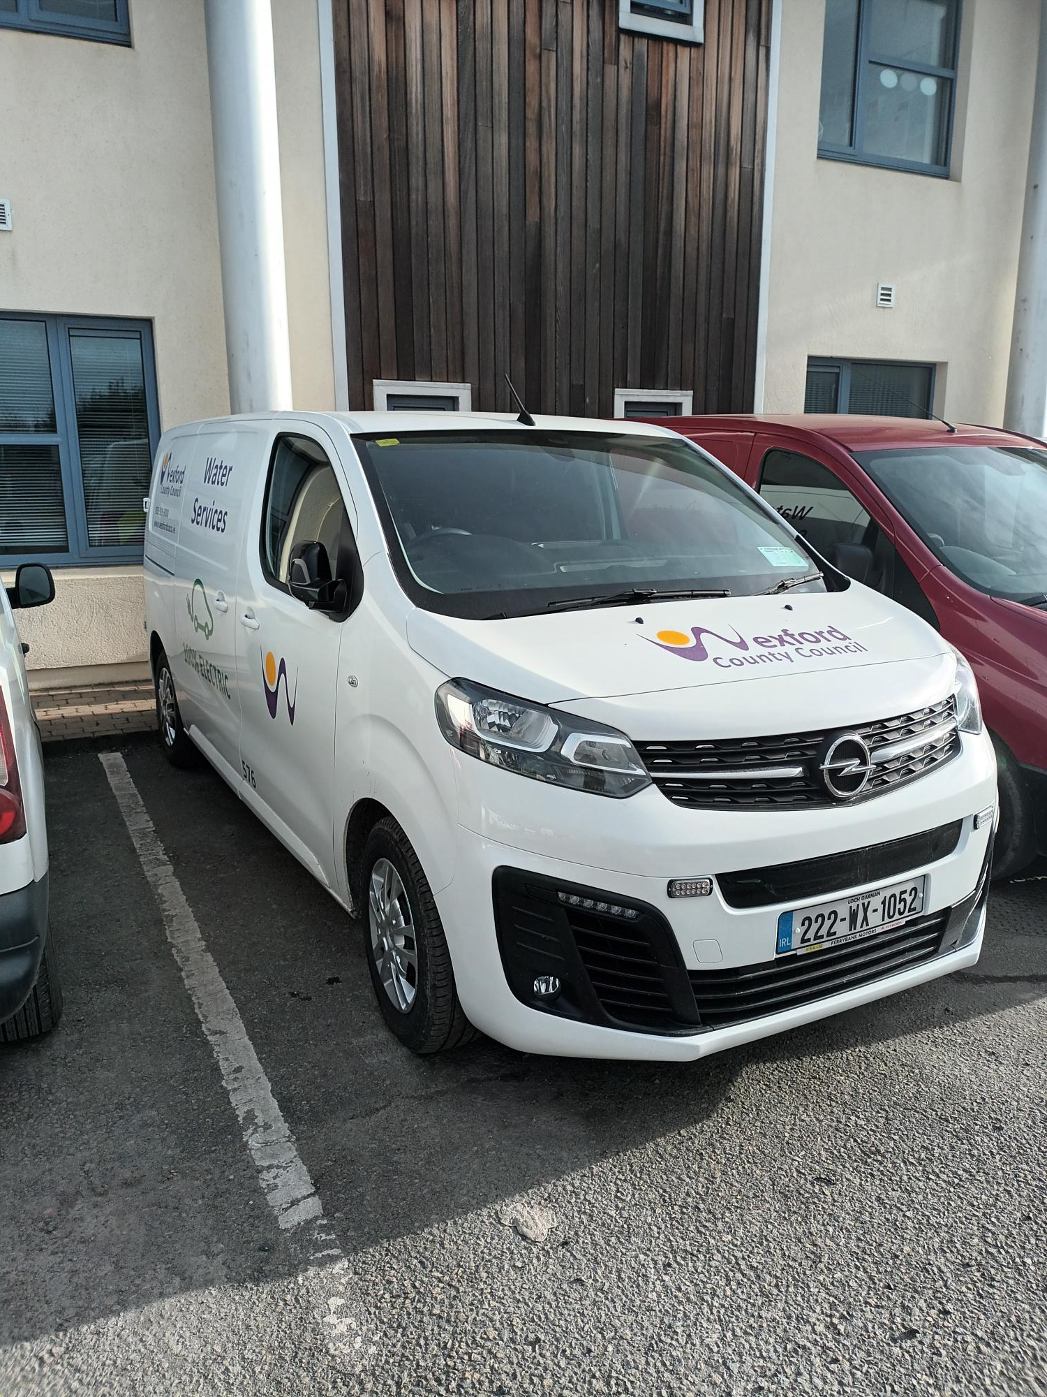
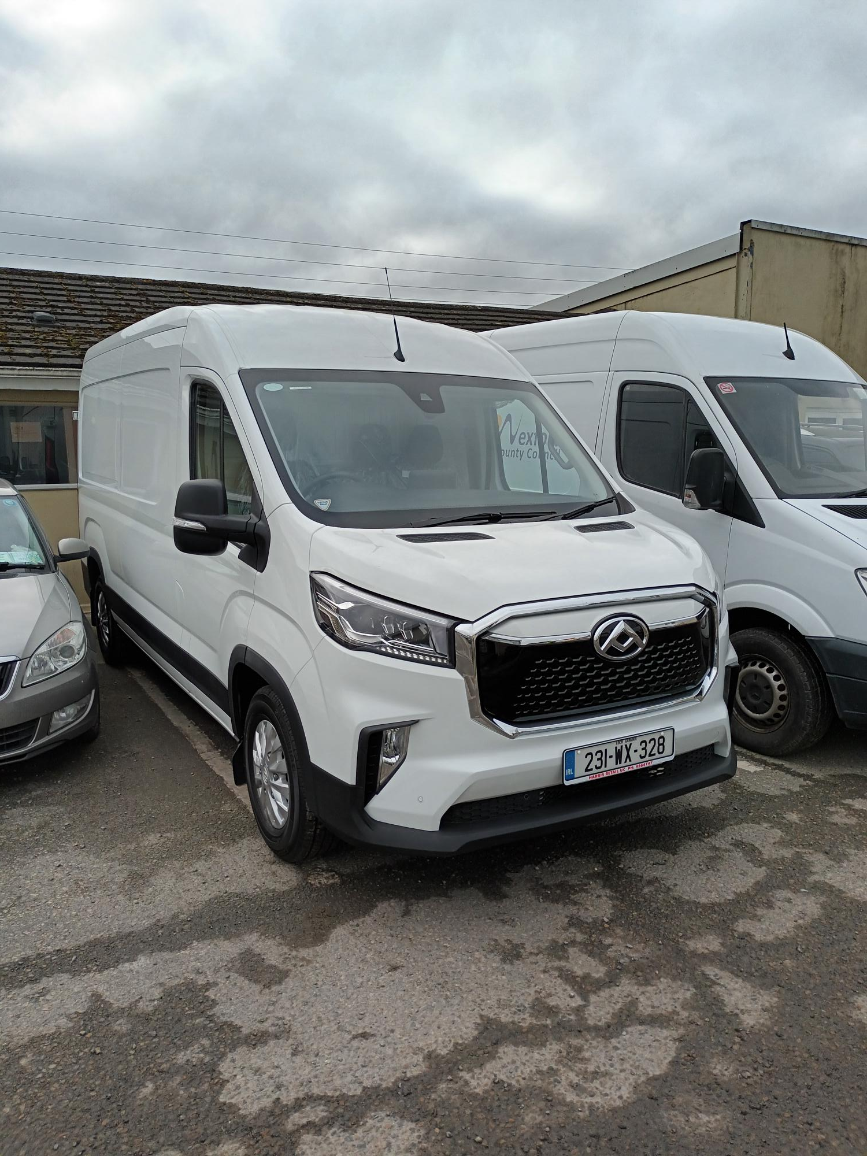
Examples of our EV Fleet

Slide 7
Active Travel
Pathfinder project for Wexford town
3 major spine roads in Wexford namely Roxborough Road, Newtown Road and Beechlawns /Clonard Road
4 Fulltime staff
€3.28 million Funding
Notes:
€3.28 million allocated for Active travel initiatives in Wexford for 2023
These initiatives are to make it safer and easier for people to get around on foot or by bike
1.5 million allocated to Newtown Road Pathfinder scheme
Safe Routes to School Programme will continue

Slide 8
Bolt Bikes
Launched May 2023
Notes:
floating E Bike sharing service
trial basis for one year
Wexford town
Launched in May 2023
Initially 50 bikes
parking controlled through GPS
designated and identifiable virtual parking bays
No need for bike parking infrastructure
flexibility on moving parking locations

Slide 9
Thank You

