Slide 1
Presentation for Wexford Climate Action
Thursday 1 ^{st} June, 2023

Slide 2
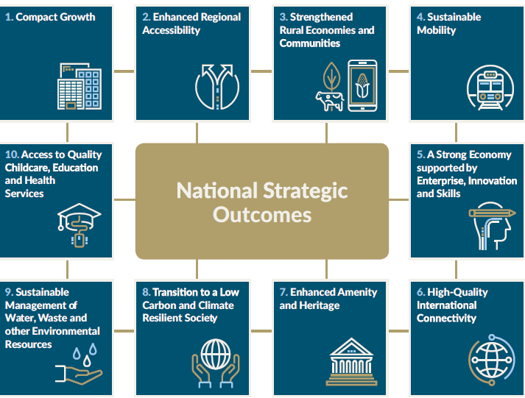
Policies in the Transport Sector - Project Ireland 2040 NSOs

Slide 4
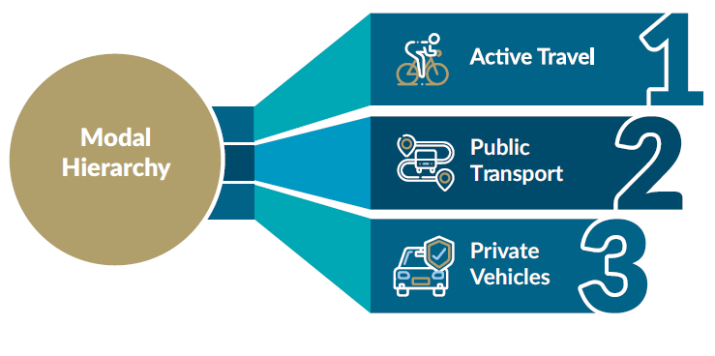
Policies in the Transport Sector – NIFTI Modal Hierarchy
Sets out a hierarchy of travel modes to be accommodated and encouraged when investments are made.

Slide 5
What is Active Travel?
Active Travel is travelling with a purpose - using your own energy. Generally this means walking or cycling as part of a purposeful journey.
Walking as part of a commute to work, cycling to the shop or scooting to school are all considered Active Travel, whereas walking or cycling for purely leisure purposes is not.
“According to Association for the study of Obesity in Ireland (ASOI) if the current trend continues by 2025, 33% of adults will be overweight, costing €2.1 billion to treat obesity related disease”.
Encouraging walking and cycling and public transport use over private car usage will improve health and will also improve local air quality.
The Climate Action Plan will also ask the public to consider their choices and to choose the sustainable mobility option first such as cycling or walking.

Slide 6
Who are we designing for? …… We are designing for everyone

Slide 7
When we design good infrastructure for cyclists it must be for people of all ages and abilities.
Full segregation from vehicular traffic is the goal where possible
If people feel safe and comfortable cycling, then more people will choose this option for travel

Slide 8
Active Travel Team Wexford
A dedicated Active Travel Team of 4 staff is now in place to actively progress National Transport Authority (NTA) approved Active Travel Infrastructure.
The team is currently project progressing 3 large schemes in Wexford Town; Roxborough R730; Beechlawn/ Clonard Avenue Cycle scheme which is at Preliminary design stage, Newtown Road Cycle Scheme which is at Detail Design Stage (Planning is in Place) and will proceed to construction in Aug 2023.
When completed 10.5 km of enhanced walking and cycling access will have been created. Future schemes will build linkages across these main axis points creating connections across town.
Safe routes to school – We are currently working with six schools as part of the Safe Routes to Schools scheme. This is a scheme to make the front of school environment and routes to school safe to encourage children and parents to walk or cycle to school.
Development of Wexford County Cycle Network – The Active Travel team is currently reviewing the proposed cycling routes prepared by Aecom Consultants.

Slide 9
Wexford County Cycle Connects Network
CycleConnects: Ireland’s Cycle Network aims to improve sustainable travel by providing the potential for more trips on a safe, accessible and convenient cycling network, connecting more people to more places.

Slide 10
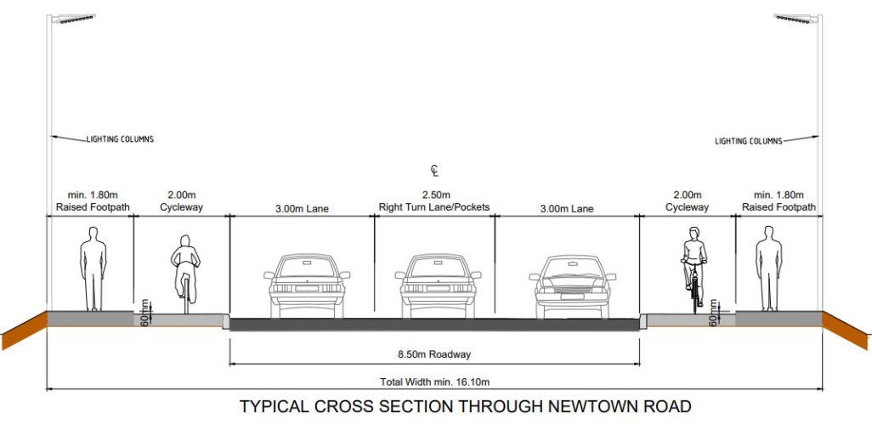
Typical Cross Section of Segregated Cycle Scheme proposed for Newtown Rd Wexford 2023.

Slide 11
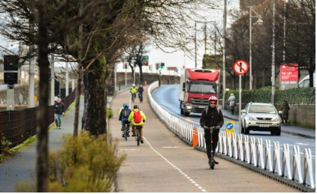
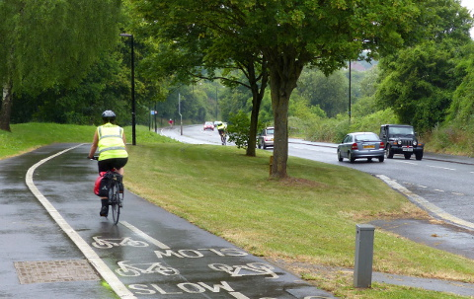
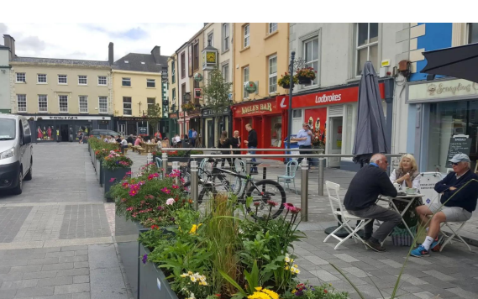
Opportunities for Improvements to Public Realm Places for people

Slide 12
Wexford traffic congestion
Enniscorthy

Slide 13
Wexford Town
Traffic congestion at the end of Grogan's Road

Slide 14
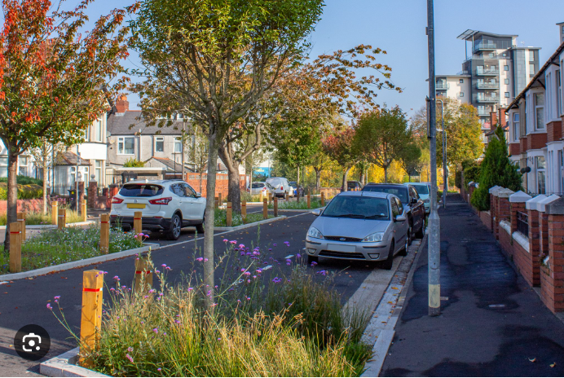
Active Travel street designs with SUDS
Road narrowing achieved through thoughtful planting plans. Lane width reduction reduces vehicular speeds.

Slide 15
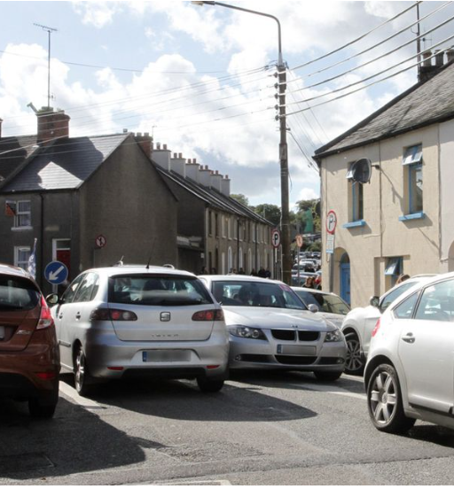
What kind of environment and streetscape would you like to live in?

Slide 16
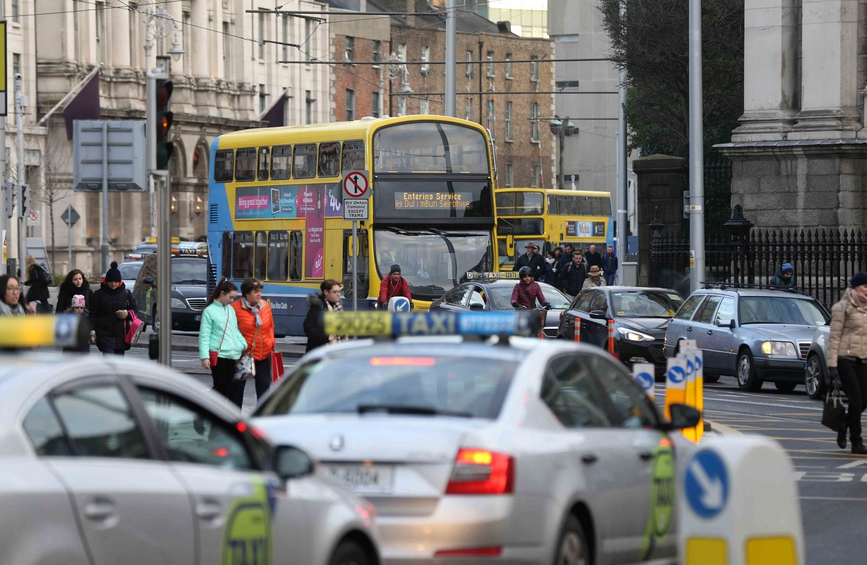
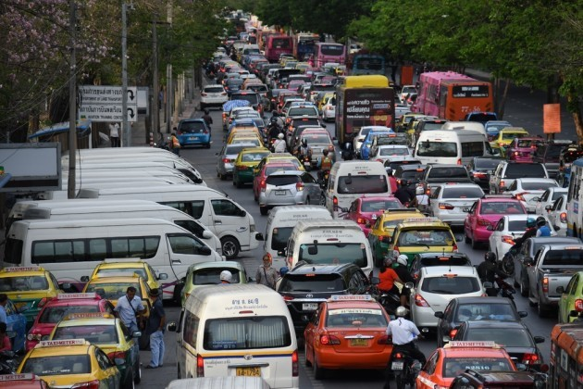
Space for people
Quality of Life
Physical Activity
Meeting people
Being healthy
Social coherence
Space for interaction when we are not in cars

Slide 17
Safe Routes to School (SRTS)Programme
To improve infrastructure outside and on the routes to school in order to improve safety for cyclists and pedestrians on key access routes to schools
Develop Safe Routes to School Programme in consultation with An Taisce and the Schools’ Board of Management.
Accelerate delivery of accessibility improvements in order to increase the number of children who walk, cycle or scoot to school.
27 Wexford schools applied. 6 of which are currently at design stage.
Improve safety at the school gate by providing ‘front of school’ intervention measures to improve safety, alleviate congestion and improve access.

Slide 18
SRTS Typical ‘Front of School’ Improvements

Slide 19
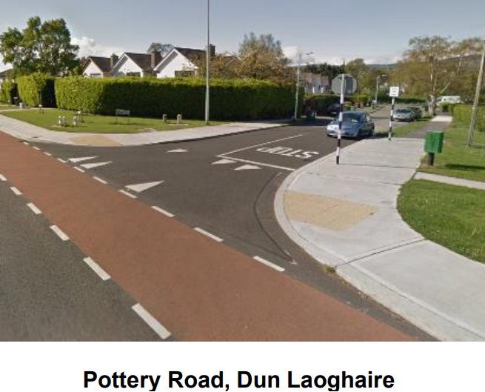
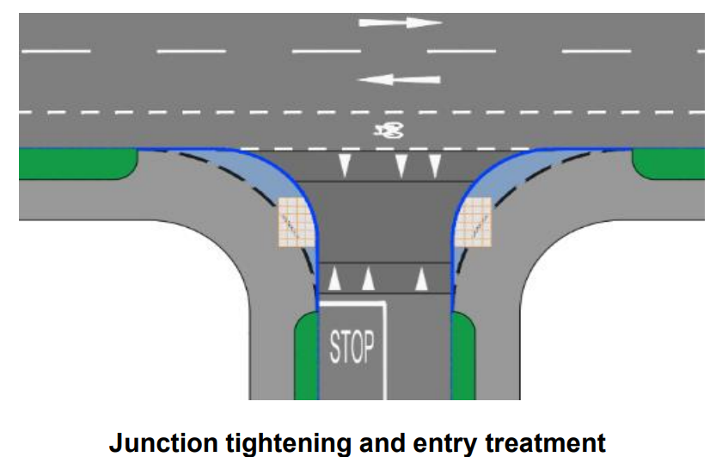
Junction Tightening/Pedestrian Crossing Schemes”.
The purpose of junction tightening is to improve the safety and comfort of vulnerable road users at existing priority junctions and pedestrian crossings.
In recent decades the growth in residential development has been centered primarily on access by road.

Slide 20
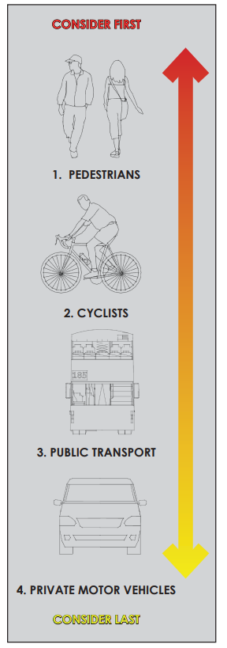
The Design Manual for Urban Roads and Streets (DMURS) proposes pedestrians be given the highest design consideration on urban roads and streets (Ref. DMURS 2.2.2):
Many junctions have been designed with the intention of facilitating ease of movement for turning vehicular traffic, at the expense of pedestrian convenience. These legacy junctions often feature:
1. large corner radii, facilitating swift vehicular turning movements and,
2. poor pedestrian crossing facilities including:
large distances across the mouth of the junction,
pedestrian crossings located away from desire lines, and
inadequate/non-existent dropped kerbs or tactile paving.
As a result Designers must place pedestrians at the top of the user hierarchy (Extract DMURS Figure 2.21).

Slide 21
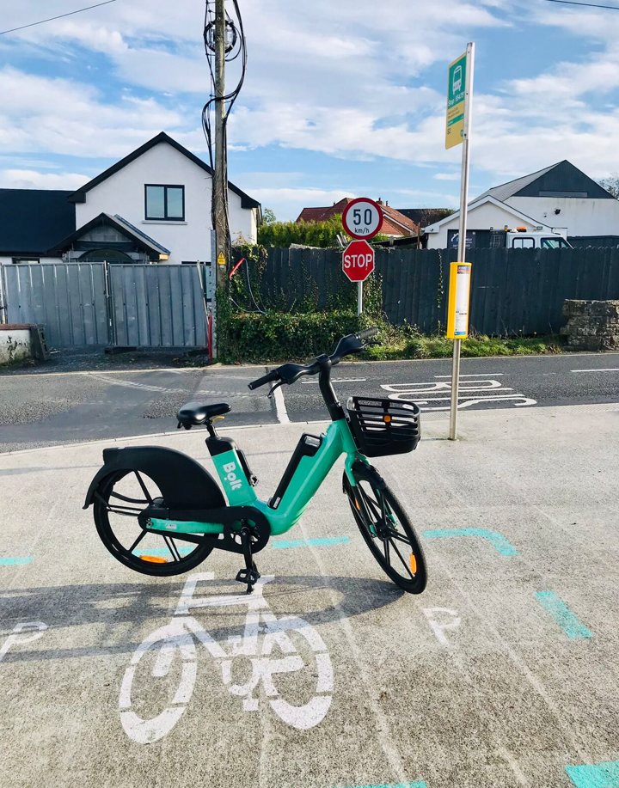
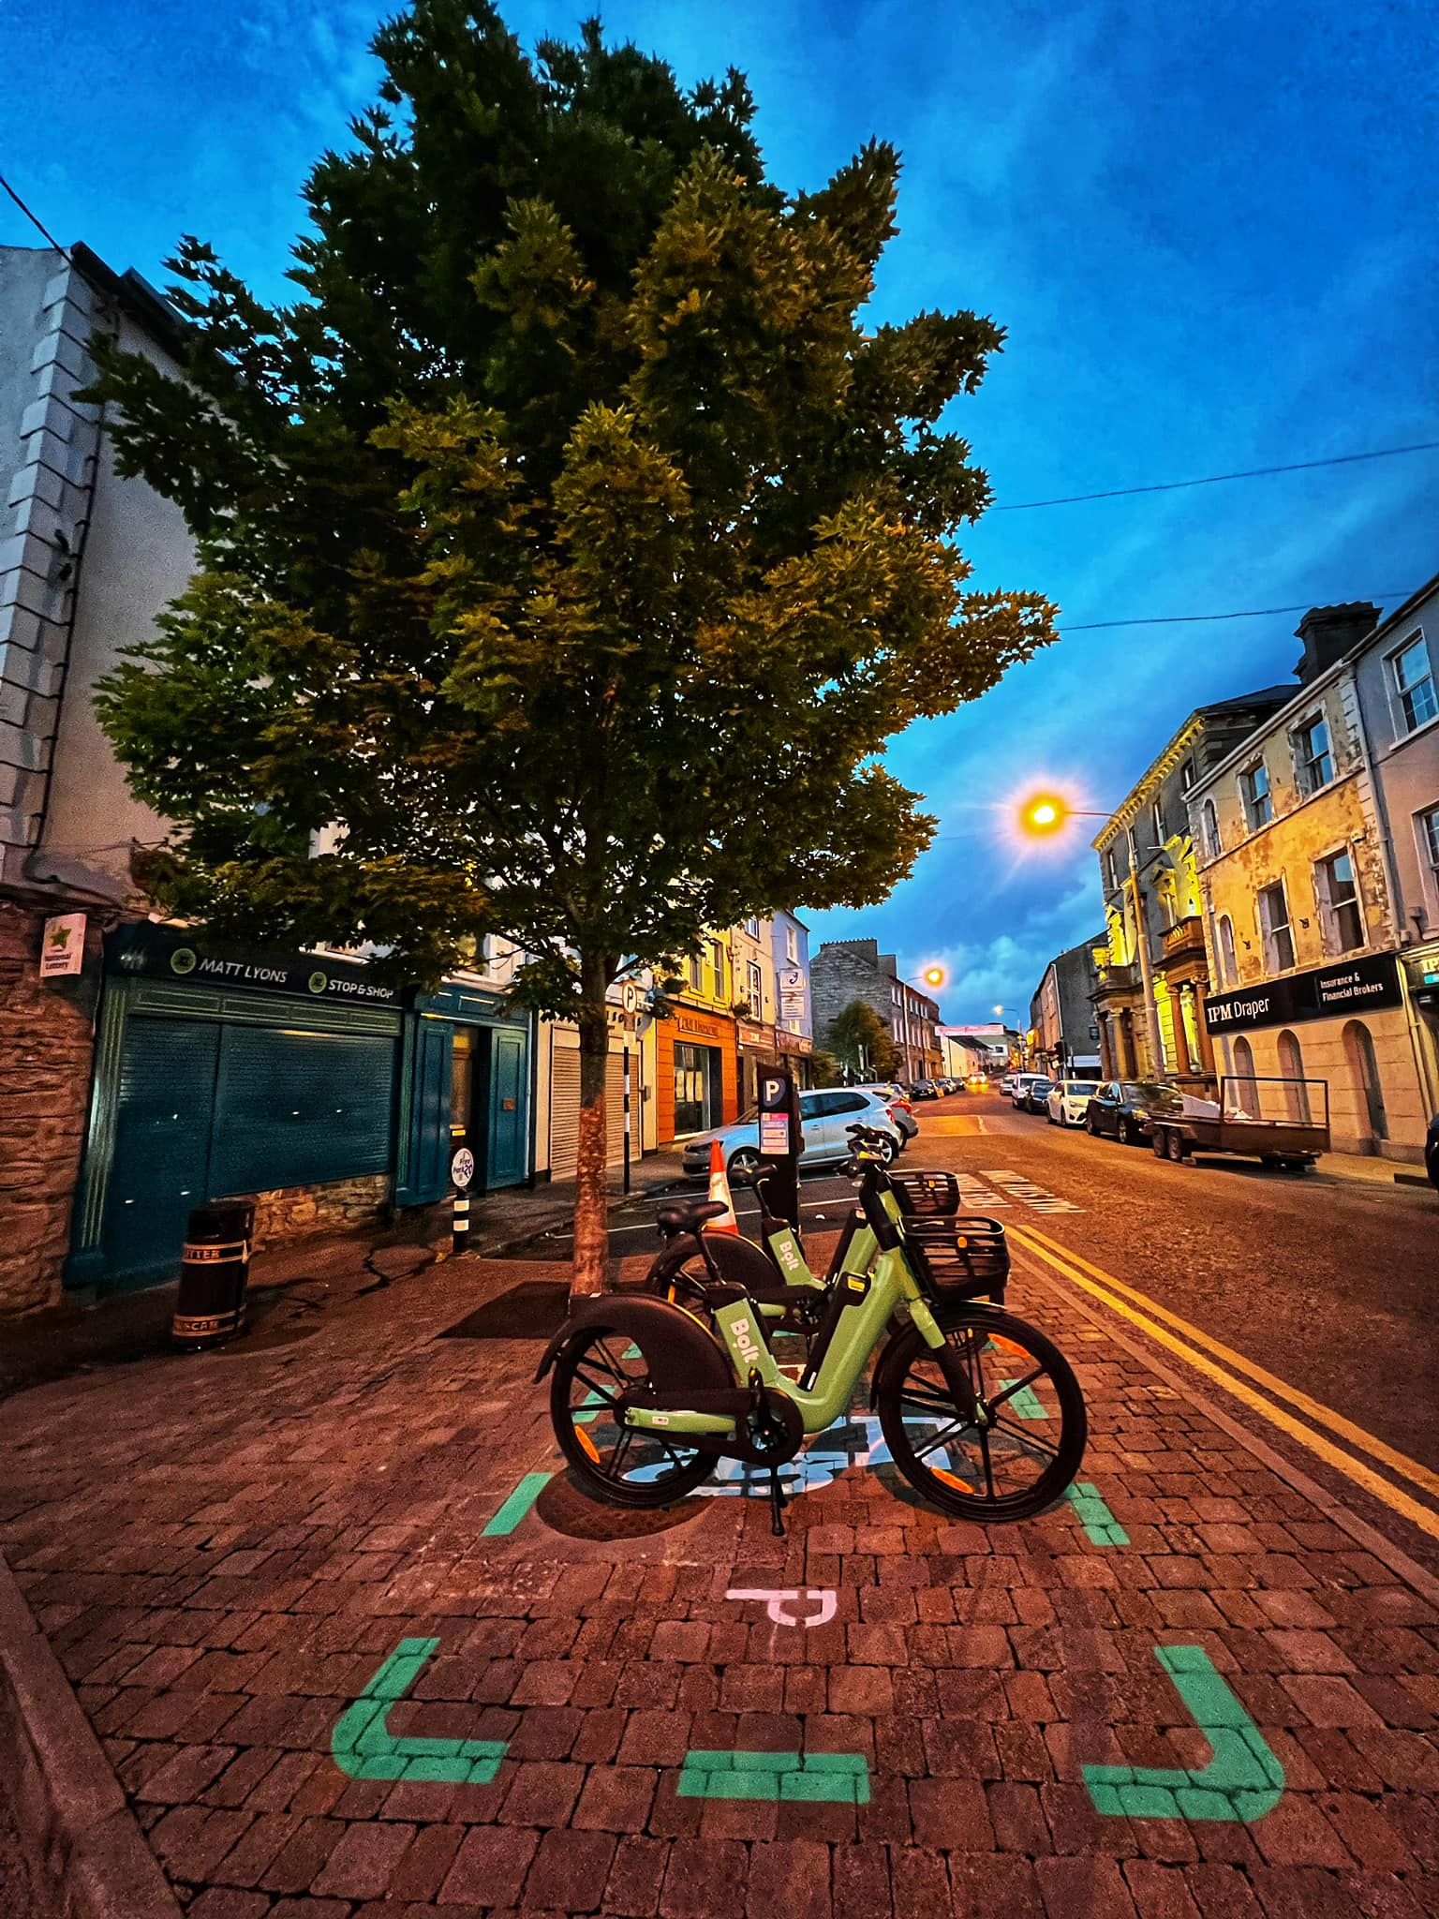
eBike Public Sharing Scheme is here!! Sign up today, we will show you how.

Slide 22
eBike Sharing Scheme
-Launched: 17th May 2023
-Fleet: 50 e-bikes
-Unique users: 504
-Rides: 1,048
-Average Duration: 16 min
-Average Distance: 2.8 KM
-Longest Order Distance: 18.5 KM
-Parking Locations: 28 with the ongoing rollout of additional locations weekly up to approx. 45

Slide 23
Thank you
activetravel@wexfordcoco.ie

