Slide 1
TFI Local Link Wexford
1st June 2023

Slide 2
TFI Local Link - Overview
www.locallinkwexford.ie
Maryb.oleary@locallink.ie
053 90118028

Slide 3
Introduction – what is Local Link
National Travel Survey 2019
Local Link and National plans
Achievements to date
What next?
Concluding points

Slide 4
TFI Local Link - Services
TFI Local Link bus services connect communities throughout rural Ireland as part of the Transport for Ireland Public Transport Network.
TFI Local Link operate two different types of service - Regular Rural Bus Services (RRS) which offer fixed routes between towns and villages that have a scheduled timetable; and Door-to-Door Bus Services (DRT) which collects and drops off pre booked passengers directly to their homes.

Slide 5
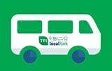
TFI Local Link - Overview
Responsibility for the Rural Transport Programme (RTP) was assigned to NTA 2012, rebranded to TFI Local Link
15 TCUs administer and manager TFI Local Link on behalf of the authority
Continued increase in passenger numbers, recovered extremely well as restrictions eased following pandemic
Continued investment and growth through Connecting Ireland Programme along with investments in ticketing systems & technologies
Passenger Numbers
2.8m
2.5m
2 m
2018
2019
2022

Slide 6
Passenger Numbers
TFI Local Link Patronage
Since the easing of travel restrictions which were implemented during the pandemic, passenger numbers returned to pre-pandemic figures almost immediately
During 2022, TFI Local Link services nationally carried a total of 2.8 million. 1.8 million passengers on RRS routes and 1 million on DRT services.
Weekly passenger numbers during Q 1 2023 ranged from 50K – 55K per week. Double the numbers carried same time 2022
Factors for the growth in public transport include:
Reduction in cost of fares – 20% cost of living, Young Adult card, TFI Leap and TFI Go cheaper fares
Connecting Ireland – developing new and enhanced routes across the TFI Local Link network
High numbers of Ukrainians based in rural Ireland

Slide 7
TFI Local Link Wexford - 2022
Over 60 DRT rural services
6 X 7 day RRS services
387 Rosslare to Wexford
388 Carrig on Bannow to Wexford
389 Riverchapel to Gorey
368 New Ross to Enniscorthy
369 Enniscorthy to Bunclody/Tullow
384 Wexford to Enniscorthy

Slide 8
Where do we live?
How do we travel?
Why do we travel?

Slide 9
Distribution of Ireland’s Population
Source CSO: 2016

Slide 10
Modal Share

Slide 11
How we travel across the country

Slide 12
Why do we travel

Slide 13
Where to?
Which plan to we follow?

Slide 14
Climate Action Plan
To connect people and places with sustainable mobility that is safe, green, accessible, and efficient.

Slide 15
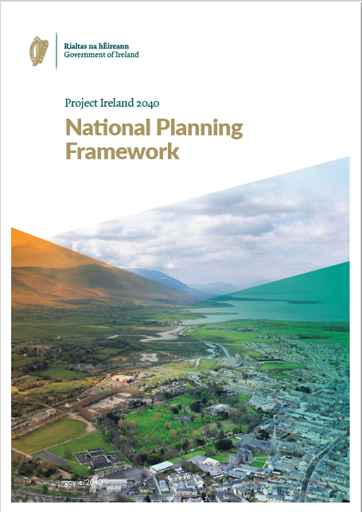
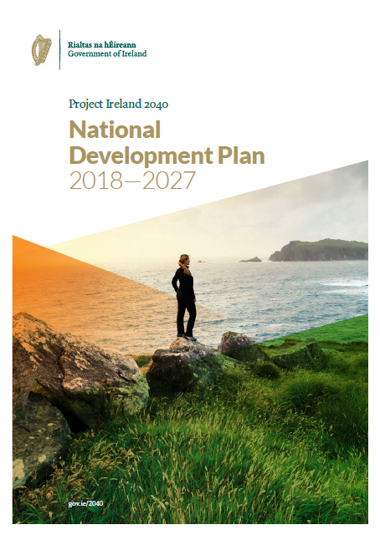
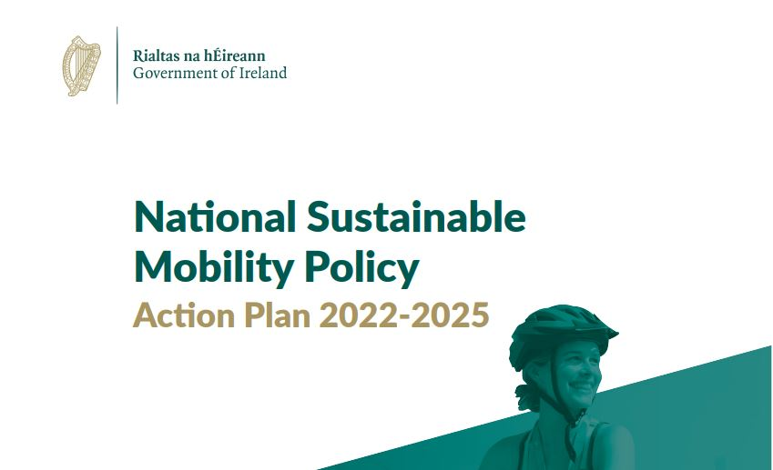
National Strategies

Slide 16
Our Rural Future – 2021-2025
Improved accessible for all
Piloting new initiatives in rural areas
Integrations with other public transport

Slide 17
National Development Plan
“A transport-led housing development approach will allow for the emergence of sustainable and well-connected communities where active travel is feasible and attractive for many localised journeys and good quality public transport is available to facilitate longer journeys into the major urban centres.”

Slide 18
Climate Action plan
“Our climate is changing rapidly and is transforming our world. Since 1850 there has been an increase of 1.1OC in average global temperature, and the increase since 1970 has been faster than in any other 50-year period over the last 2,000 years.”

Slide 19
What has been achieved to date

Slide 20
Connecting Ireland

Slide 21
Connecting Ireland – Rural Mobility

Slide 22
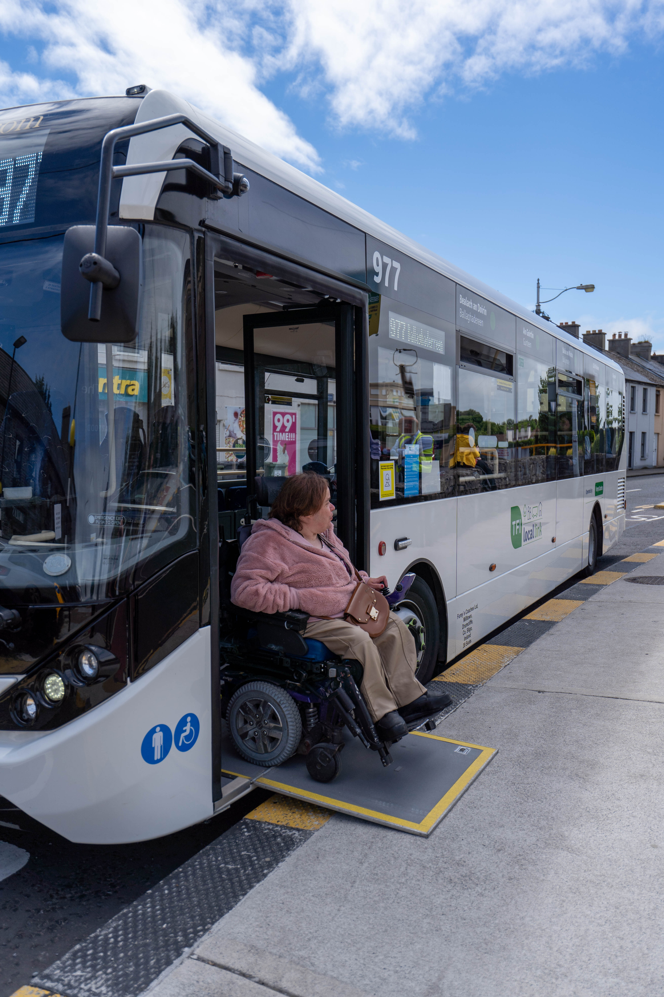
TFI Local Link Achievements 2022/23
During Pandemic Collect and Deliver Service
Continued increase in accessible kms, now >95%
Transport Services for Ukrainians located in rural Ireland
TFI Go
TFI Leap
Connecting Ireland
Community Car Scheme
Notes:
Accessibility video: https://www.youtube.com/watch?v=fx3V2ecmon4&t=2s

Slide 23
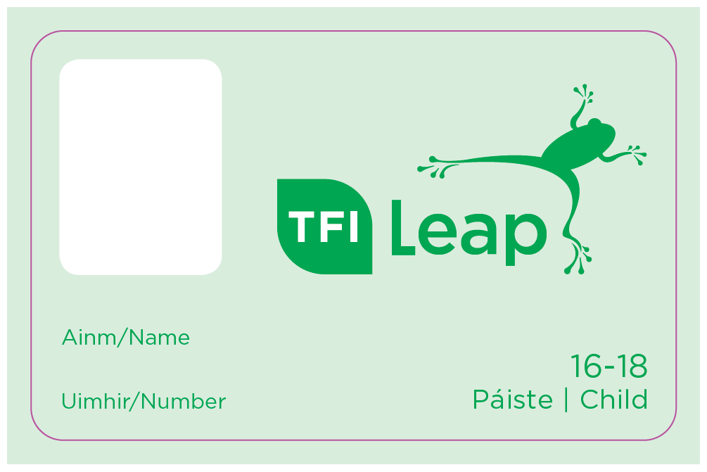
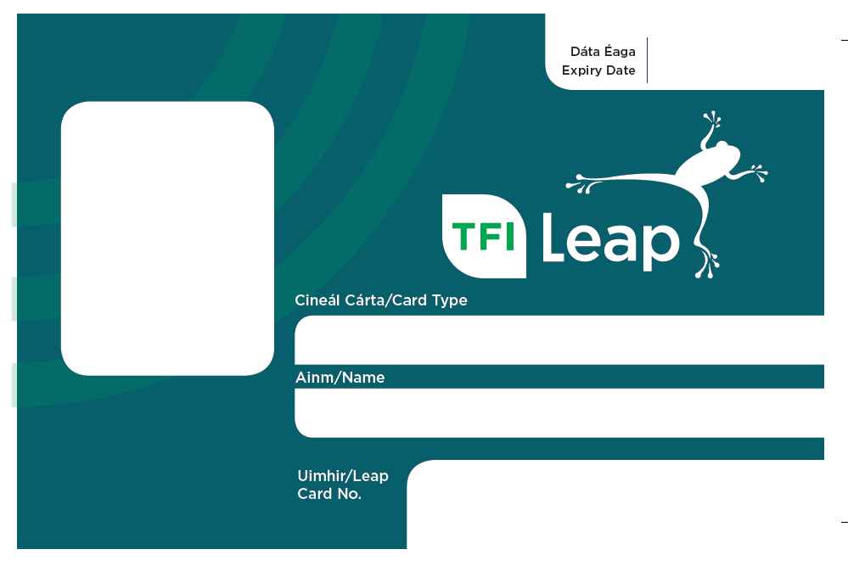
Ticketing Technologies
Ticketing Technologies 2022/23
TFI Local Link expanded its fare payment options to allow passengers to pay for travel with their TFI Leap Card or TFI Go App on RRS services.
TFI Leap and TFI Go offer up to a 30% discount

Slide 24
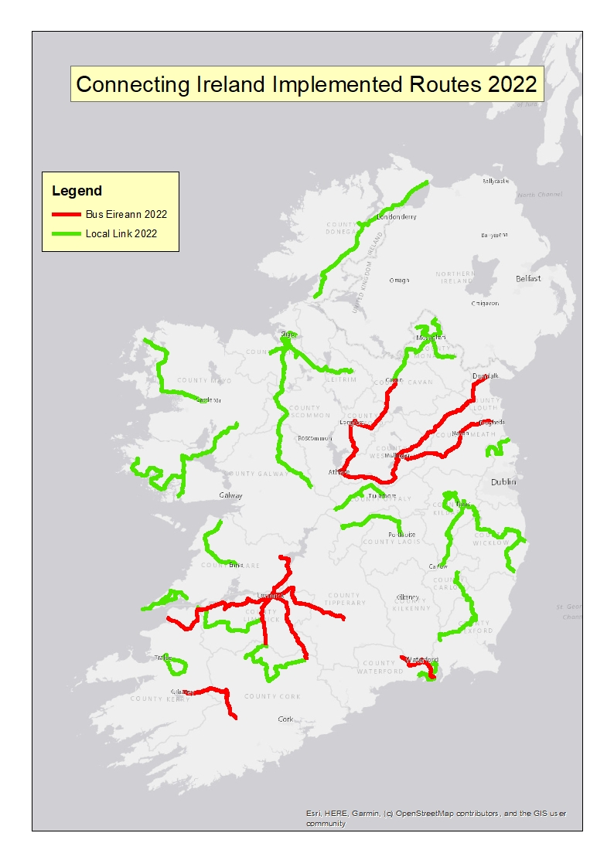
Connecting Ireland
Implemented to end 2022

Slide 25
What next?

Slide 26
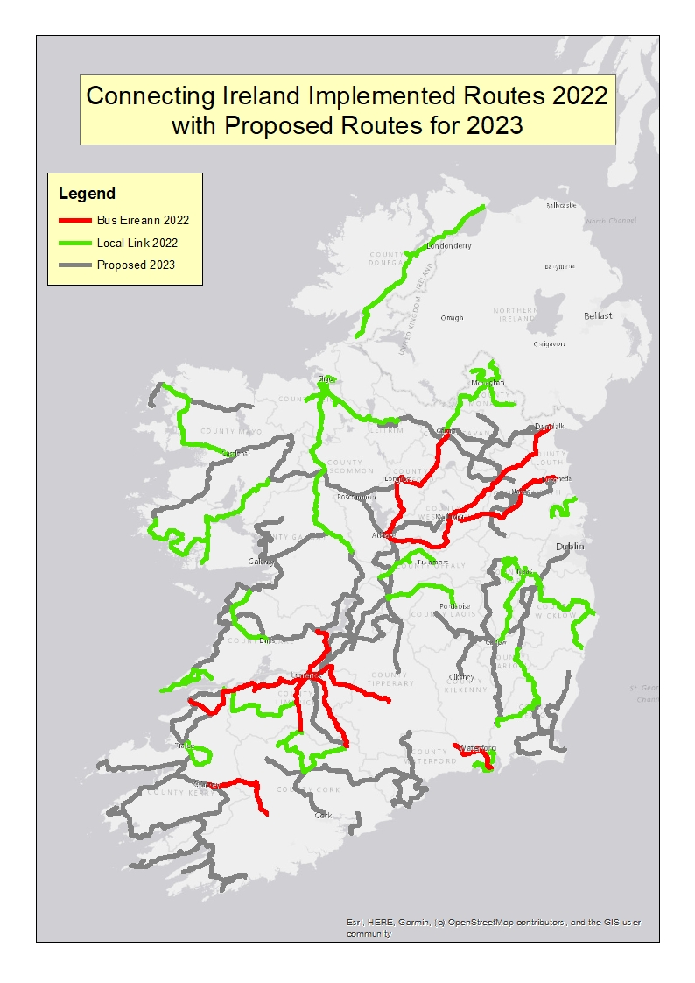
Connecting Ireland
Implemented to Date & 2023 Proposals

Slide 27
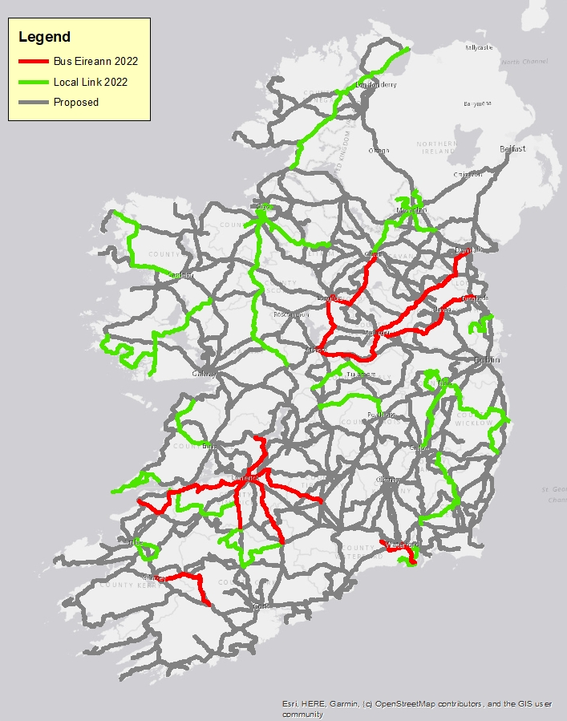
Connecting Ireland
Implemented to Date & Full Programme Plan

Slide 28
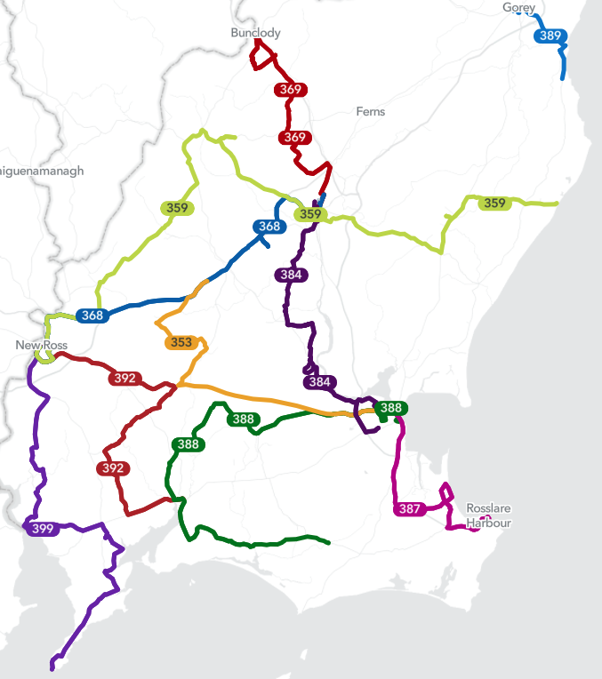
Regular Rural Services - Wexford
TFI Local Link Wexford Regular Rural Services
368 In operation
369 in operation
388 in operation
389 in operation
384 in operation
387 in operation
359 Q2/3
399 Q2/3
392 Q2/3
353 2024
Notes:
In response to the EU’s Clean Vehicles Directive and the Government’s Climate Action Plan, the Authority would like to increase the numbers of clean vehicles (electric vehicles (EV)) in the High Frequency Regular Rural Transport fleet. The Authority has made provision in the Request for tender documents for Operators to propose EVs in their tenders.

Slide 29
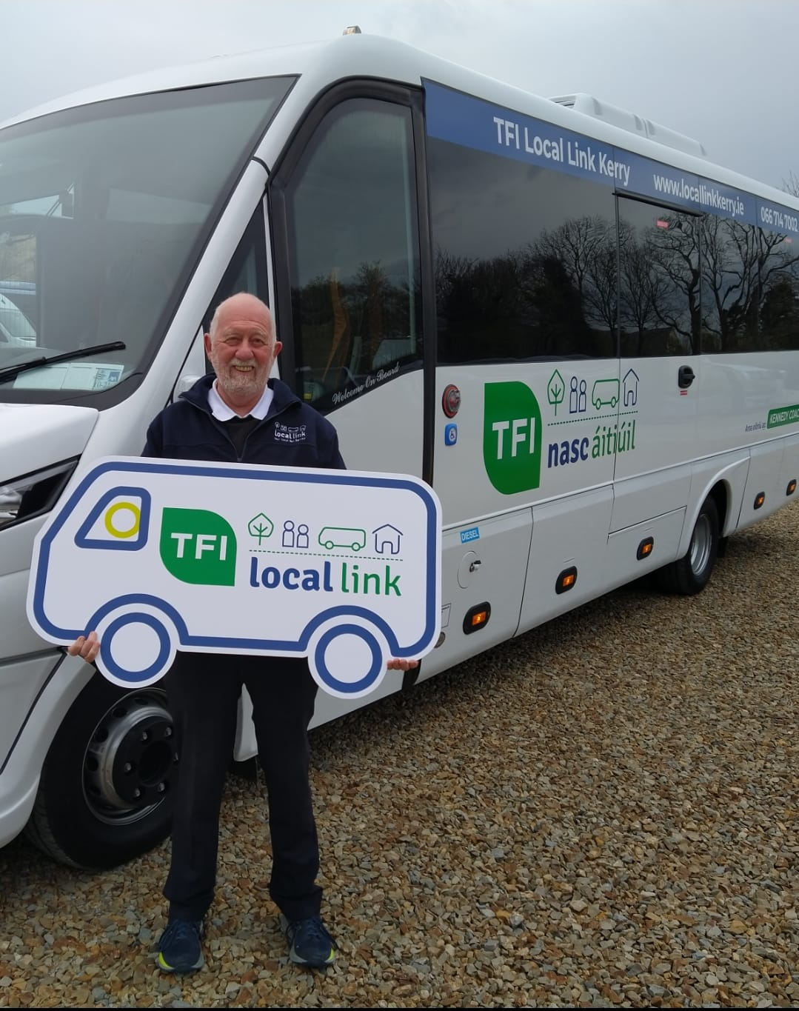
What’s next for TFI Local Link?
Clean Vehicles - Electric Vehicles
Pilot Contactless Payments
AVL Lite
Marketing and Promotions
Connecting Ireland Rural Mobility Plan
Continued improvements in accessibility
Notes:
In response to the EU’s Clean Vehicles Directive and the Government’s Climate Action Plan, the Authority would like to increase the numbers of clean vehicles (electric vehicles (EV)) in the High Frequency Regular Rural Transport fleet. The Authority has made provision in the Request for tender documents for Operators to propose EVs in their tenders.

Slide 30
Concluding points
Buses are the natural substitute for trips that cannot be completed in full by active travel
Cycle lock up’s in villages and travel connection hubs
DRT or community car options to take people to main stops
Maintain reduced fares
Through ticketing being developed
Electricity or alternative fuels for buses?
Bio-fuels
Solar panels on buses & improved battery storage
Electric charging points for PSV’s
Integration of a variety of modes of travel
Walk or cycle to the bus stop
Transit Orientated Development, (TOD)

