Slide 1
Wexford County Council Agent Information Day
Common mistakes with onsite application of the Technical Guidance Documents

Slide 2
What is Building Control looking for when carrying out an inspection?
Compliance with the Technical Guidance Documents
Adherence to drawings submitted through BCMS
Compliance with Granted Planning Permission

Slide 3
Construction of Block Footings
Main Issues Seen on-Site
Mortar joints of varying sizes
Inadequate bonding of blocks
Blocks being laid with inadequate support and not level

Slide 4
Construction of Block Footings
Main Issues Seen on-Site
Mortar joints of varying sizes
Inadequate bonding of blocks
Blocks being laid with inadequate support and not level
What Document are we Referencing?

Slide 5
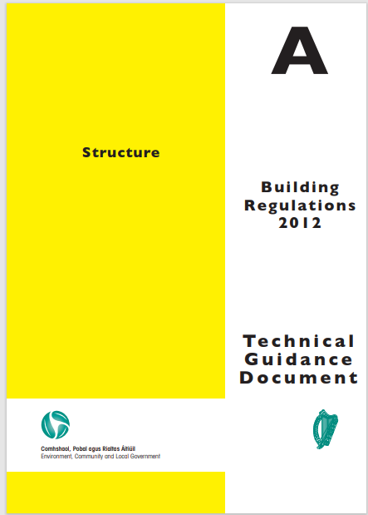
Construction of Block Footings
Main Issues Seen on-Site
Mortar joints of varying sizes
Inadequate bonding of blocks
Blocks being laid with inadequate support and not level
What Document are we Referencing?
Technical Guidance Document Part A
    Structure 2012

Slide 6
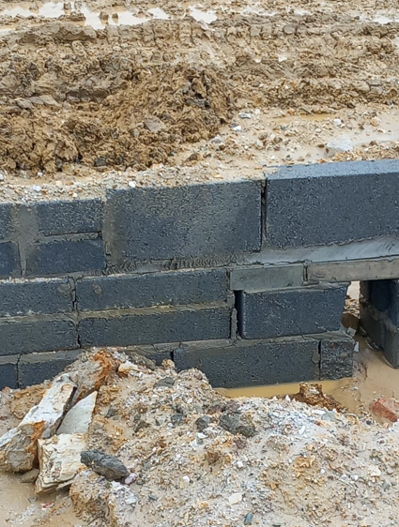
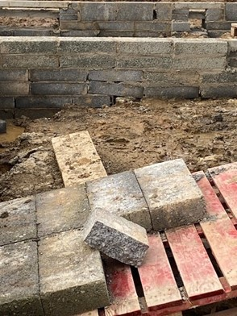
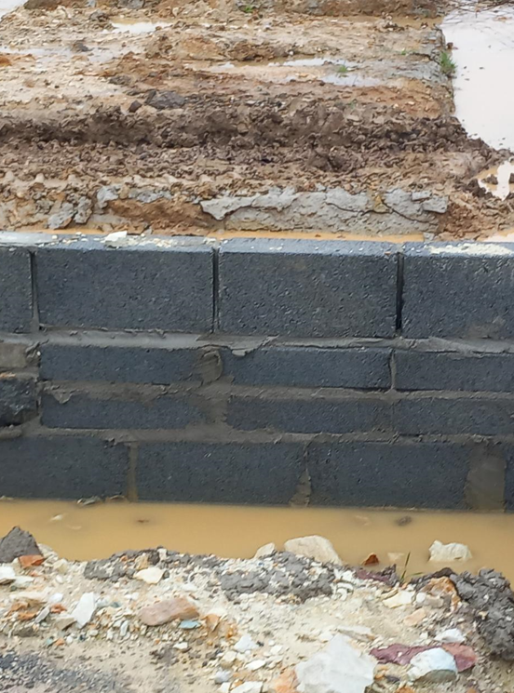
Examples
Defects in construction of block footings

Slide 7
What Does the Guidance Say?
1.1.3.5
Walls should be properly bonded and solidly put together with mortar and comply with the relevant requirements of I.S. EN 1996-2 and additional guidance given in S.R.325.
S.R. 325 Section 6.3.2
The average thickness of both horizontal and vertical mortar joints is decided by the coordination size of the masonry units and is normally taken to be 10mm.
S.R. 325 Section 6.4.1.1
The horizontal distance between vertical joints in successive masonry courses should normally be not less than one-quarter of the length of the units but in no case less than 75mm for blocks.
TGD Part A 2012 S.R. 325

Slide 8
Installation of Radon Barriers
Main Issues Seen on-Site
Incorrect T3 material used under the radon barrier
Tears in the radon barrier
Inappropriate materials used to seal the radon barrier
No sealing of the radon barrier at junctions

Slide 9
Installation of Radon Barriers
Main Issues Seen on-Site
Incorrect T3 material used under the radon barrier
Tears in the radon barrier
Inappropriate materials used to seal the radon barrier
No sealing of the radon barrier at junctions
What Document are we Referencing?

Slide 10
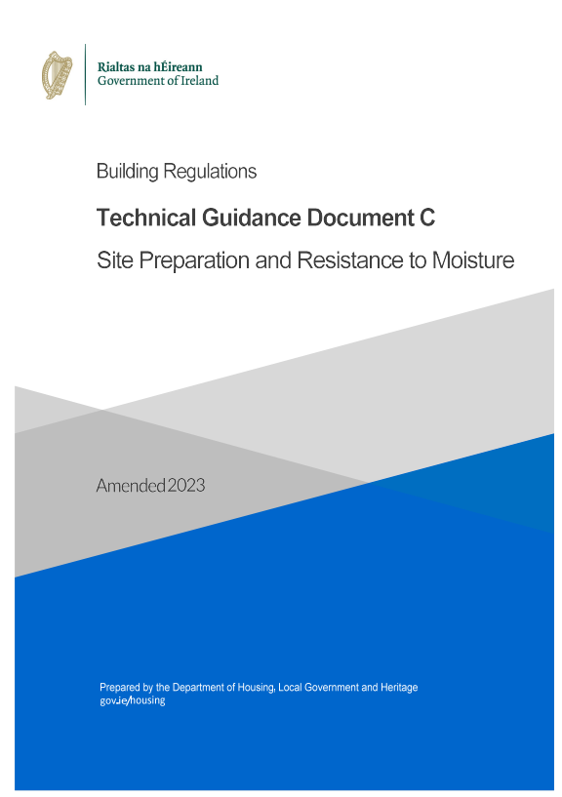
Installation of Radon Barriers
Main Issues Seen on-Site
Incorrect T3 material used under the radon barrier
Tears in the radon barrier
Inappropriate materials used to seal the radon barrier
No sealing of the radon barrier at junctions
What Document are we Referencing
Technical Guidance Document Part C
    Site Preparation and Resistance to Moisture 2023
Radon map | Environmental Protection Agency

Slide 11
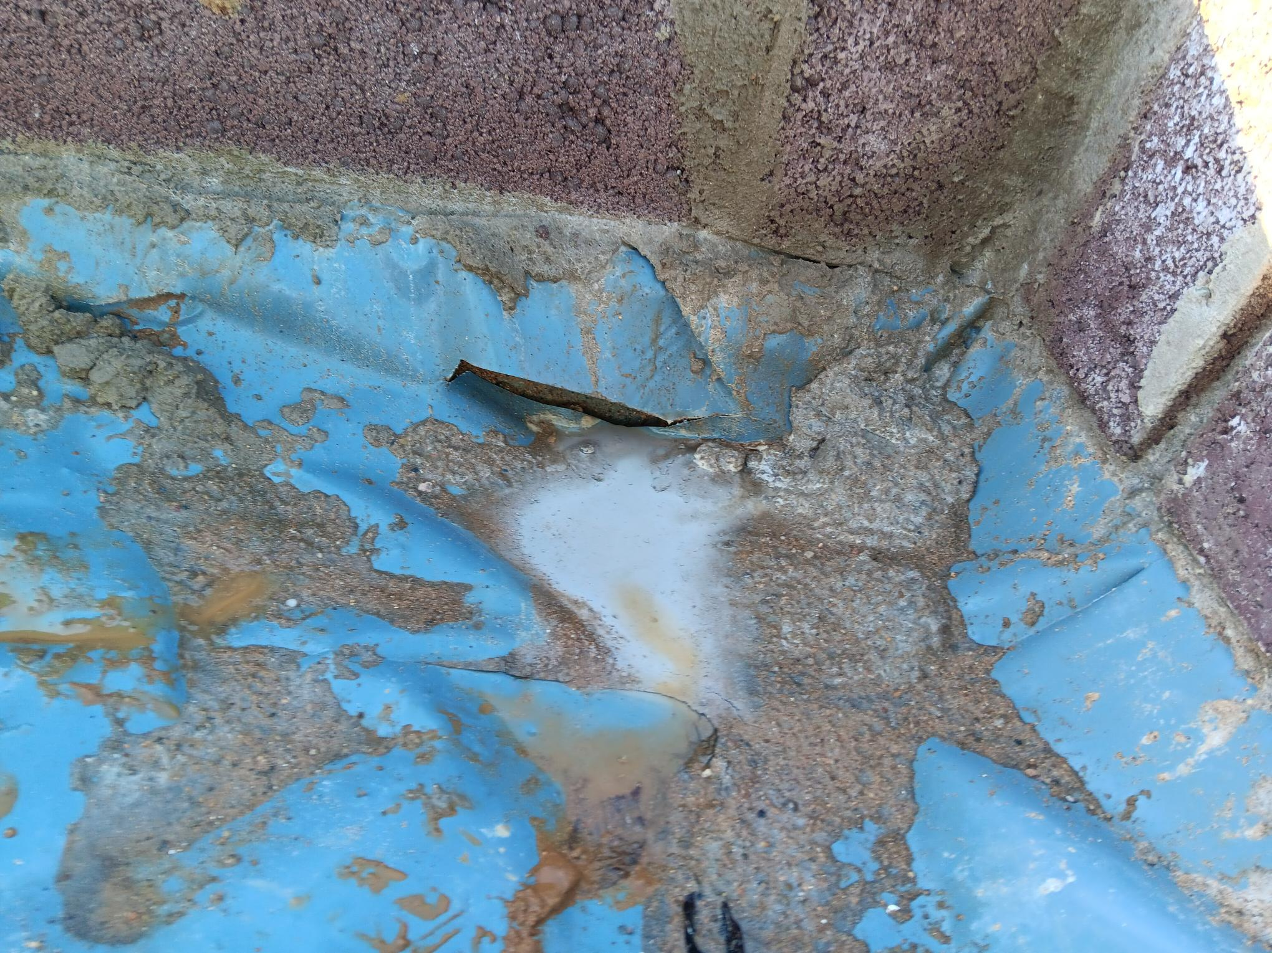
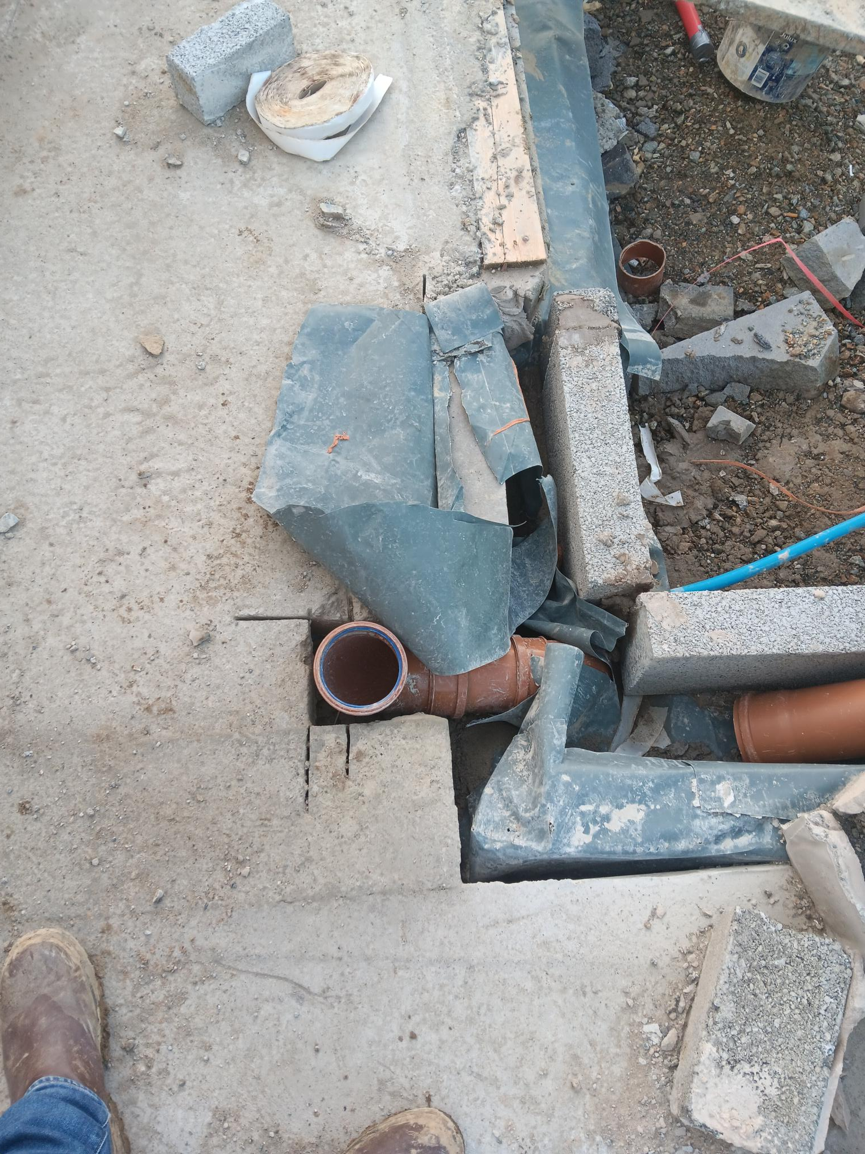
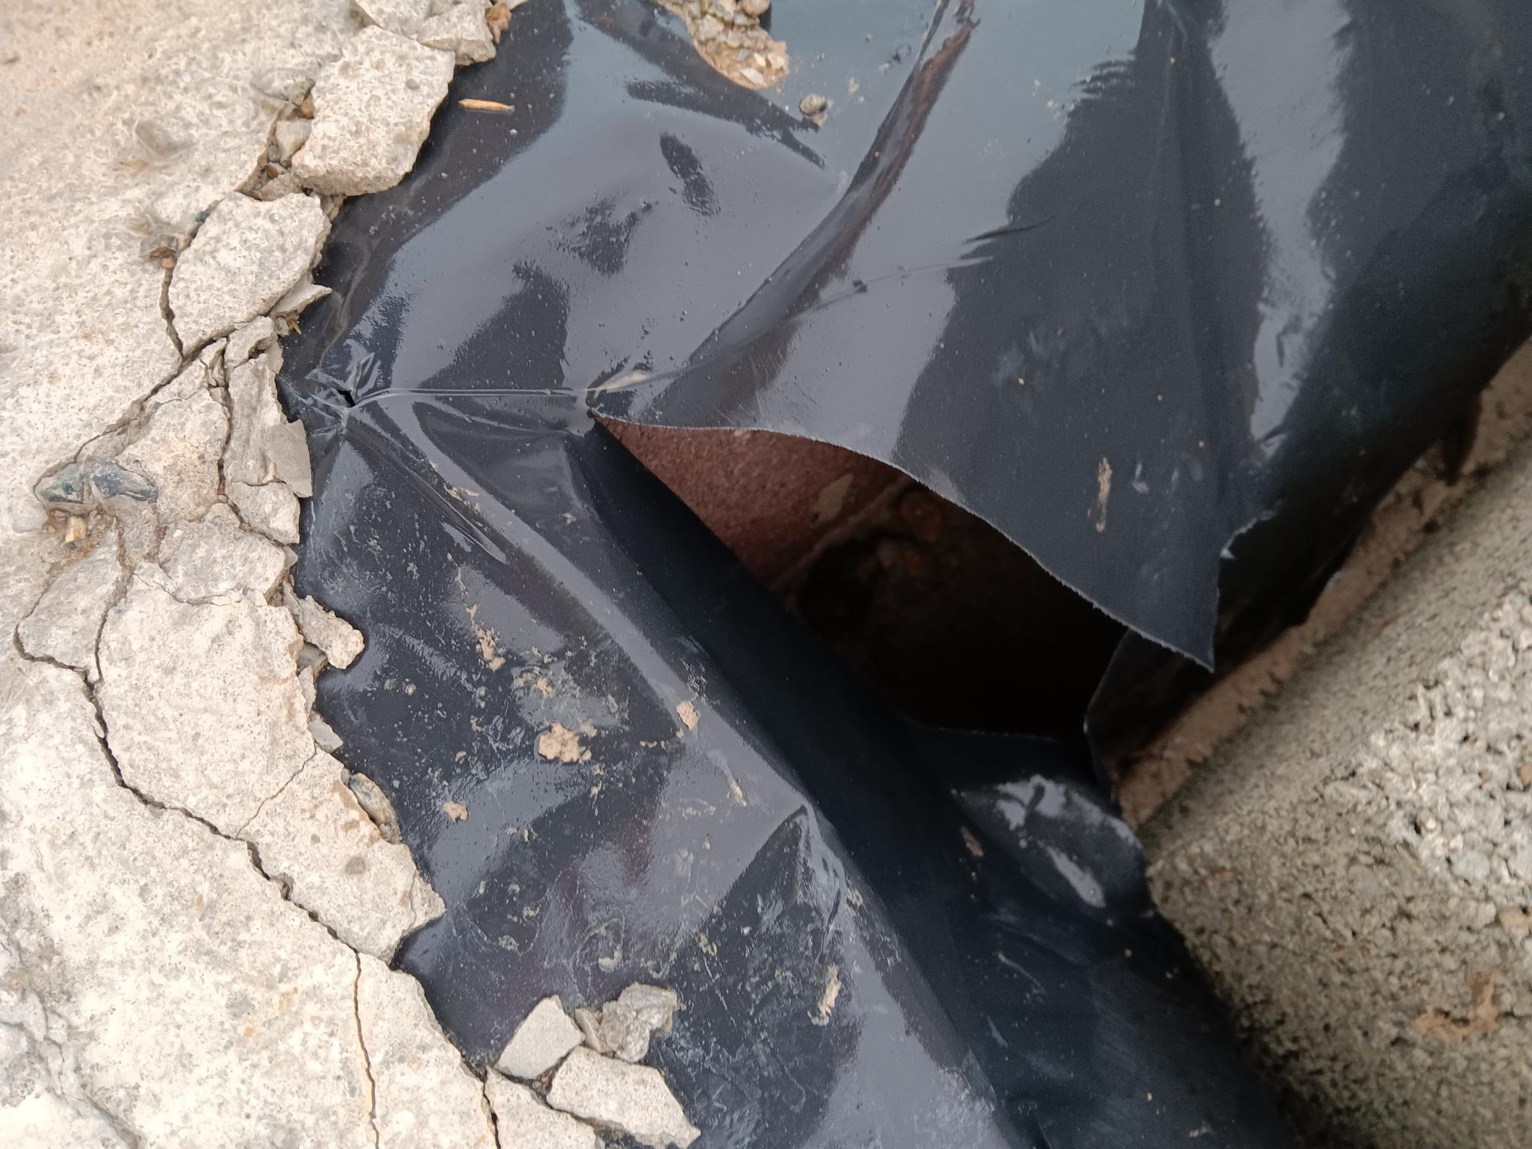
Example 1
Tears in the radon barrier.

Slide 12
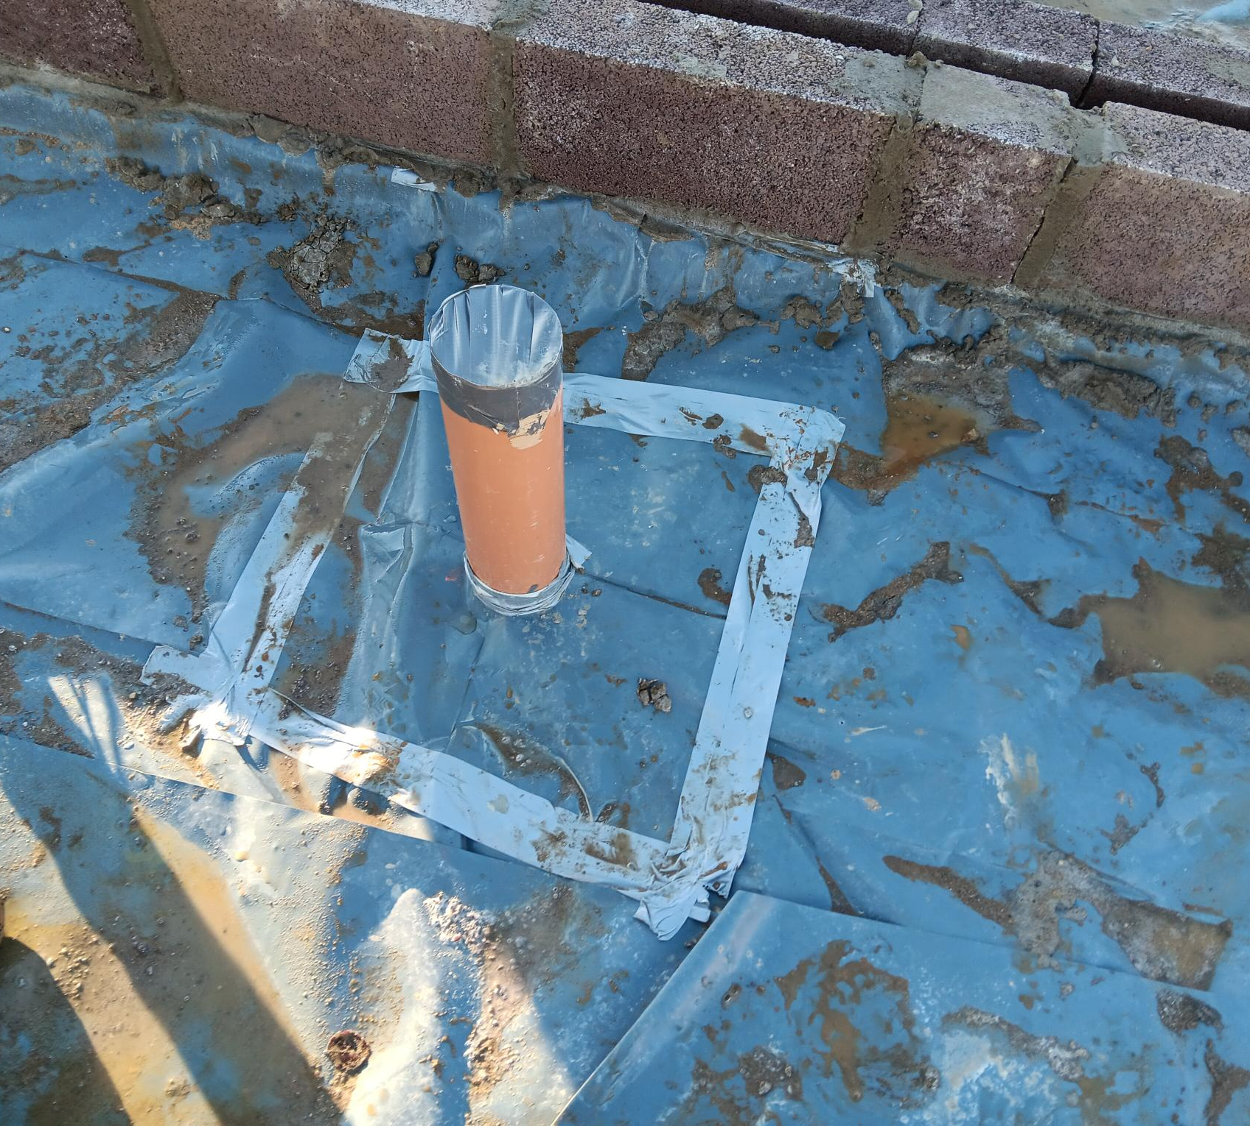
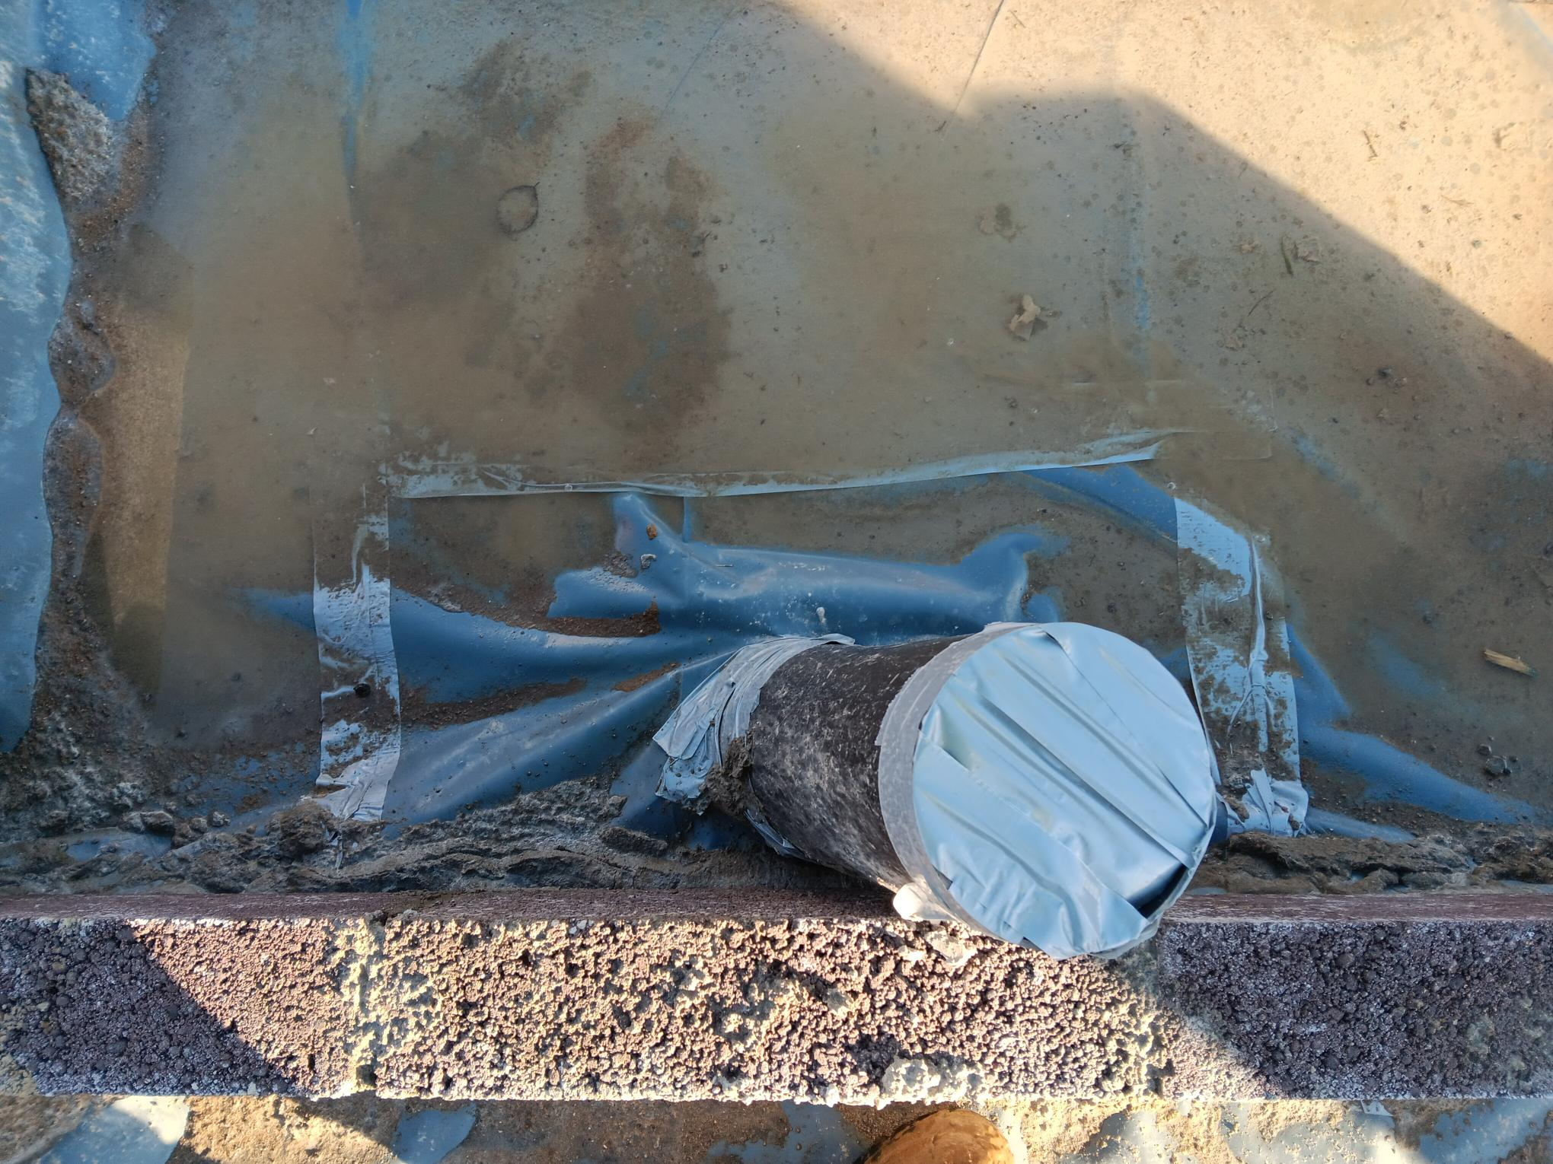
Example 2
Inappropriate materials used to seal the radon barrier.

Slide 13
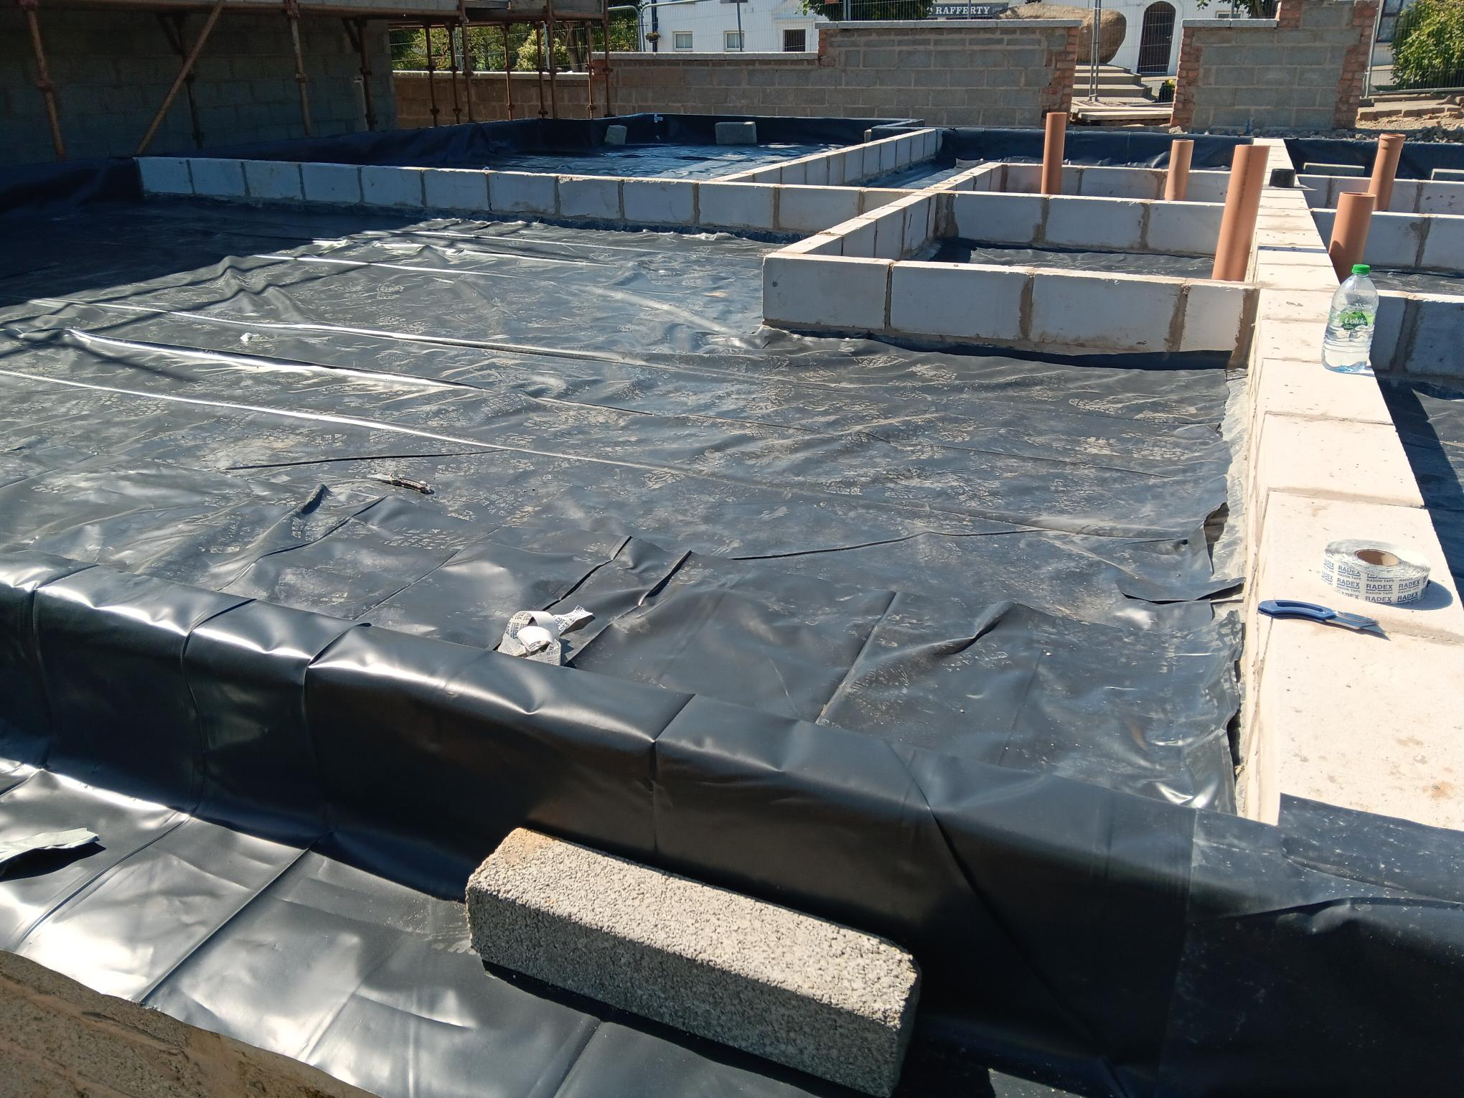
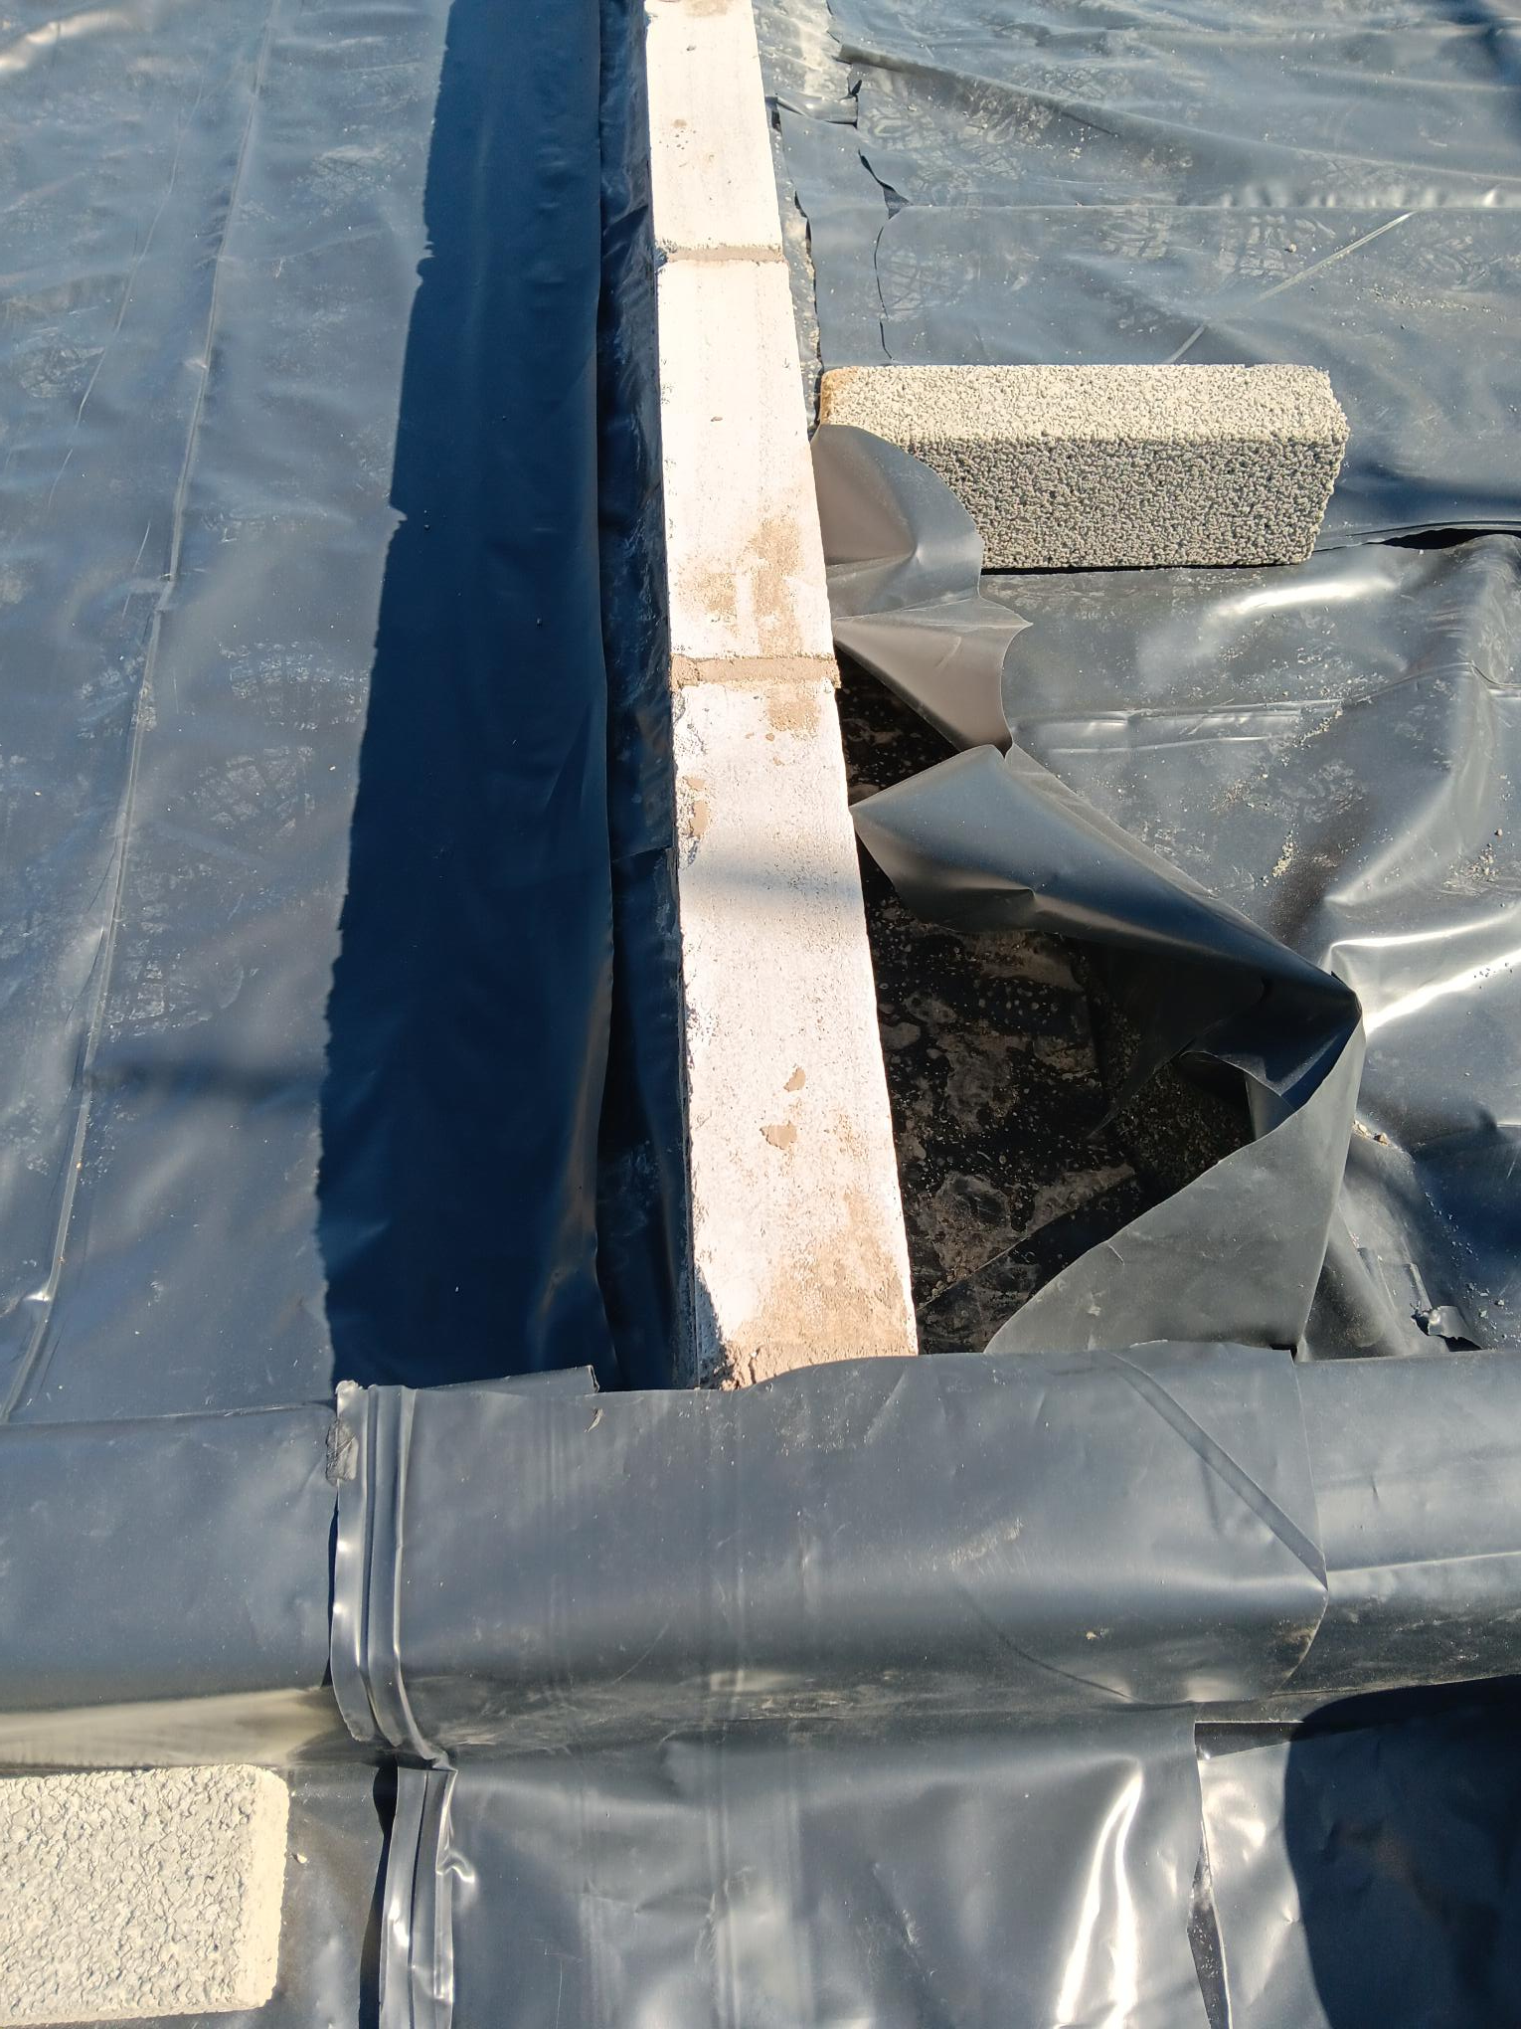
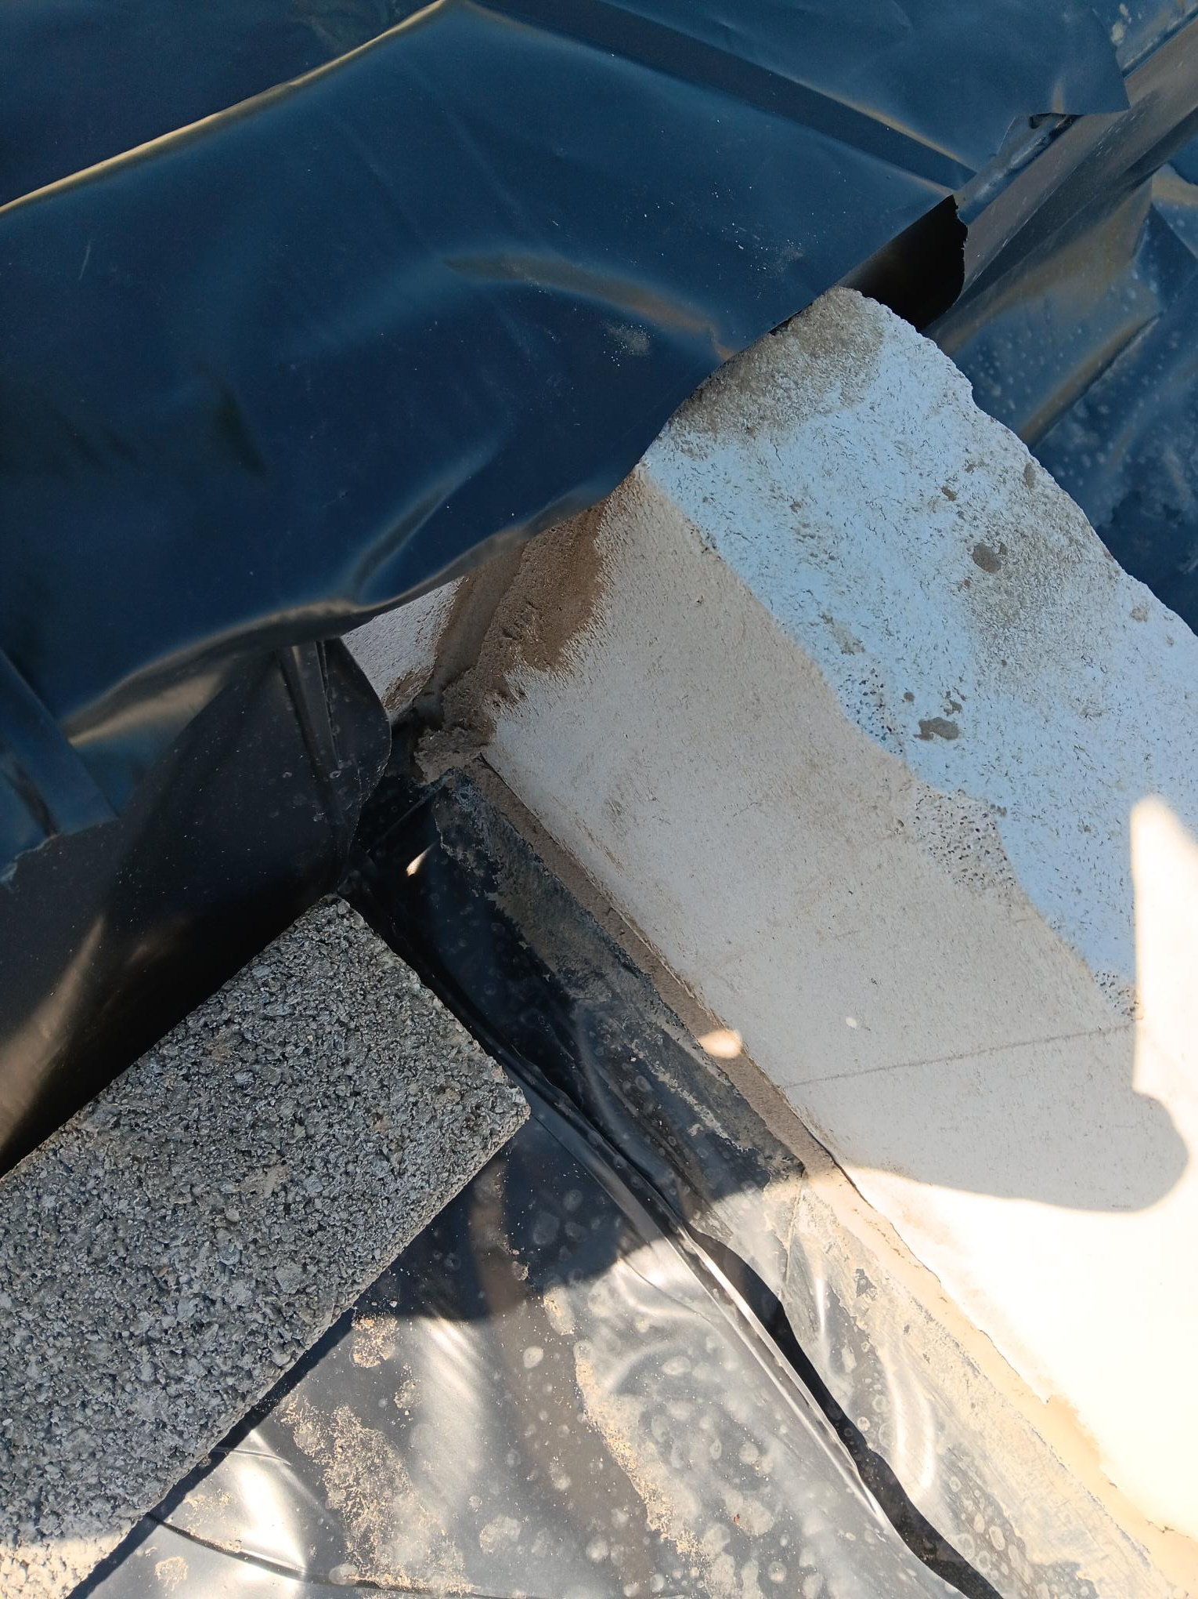
Example 3
No sealing of the radon barrier at junctions.

Slide 14
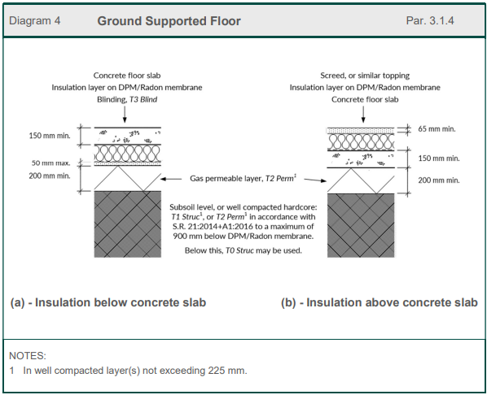
What Does the Guidance Say?
2:13
Particular care should be taken when installing the membrane. All joints and service penetrations must be fully sealed.
2:14
Every precaution must be taken to protect the membrane from damage, pre- and post- installation.
3:14
Outlines the characteristics of a ground supported floor to achieve pirma-facie compliance with TGD Part C and depicted in Diagram 4.
TGD Part C 2023

Slide 15
Masonry Wall Construction
Main Issues Seen on-Site
Insufficient wall ties around openings
Inadequate support of masonry blockwork over openings
Inadequate lateral support from floors

Slide 16
Masonry Wall Construction
Main Issues Seen on-Site
Insufficient wall ties around openings
Inadequate support of masonry blockwork over openings
Inadequate lateral support from floors
What Document are we Referencing?

Slide 17
Masonry Wall Construction
Main Issues Seen on-Site
Insufficient wall ties around openings
Inadequate support of masonry blockwork over openings
Inadequate lateral support from floors
What Document are we Referencing?
Technical Guidance Document Part A
    Structure 2012

Slide 18
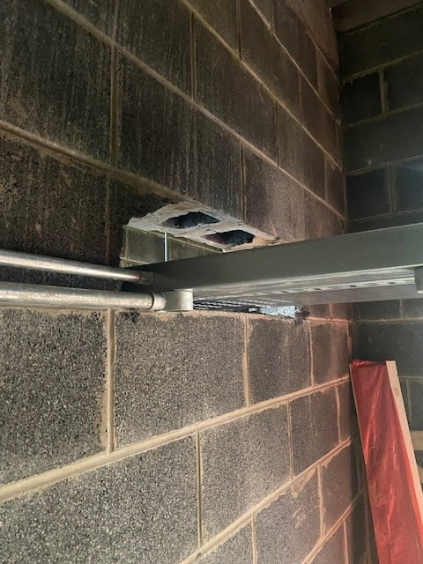
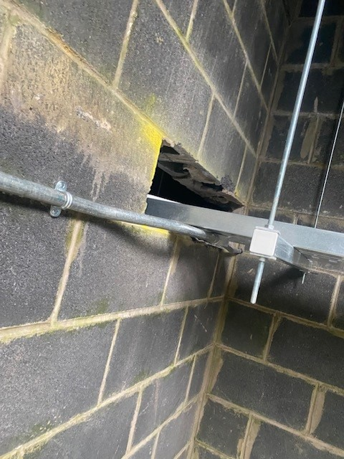
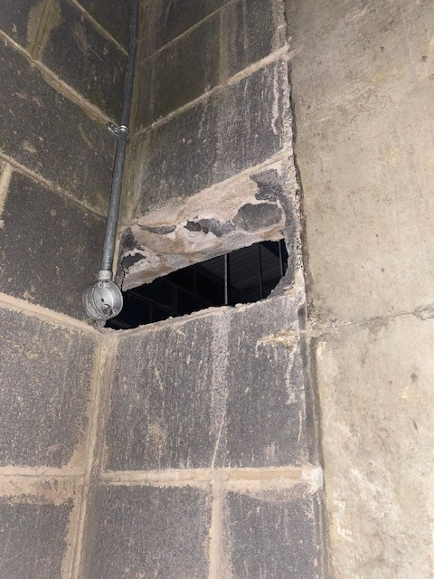
Example 1
Inadequate support for masonry blockwork over openings

Slide 19
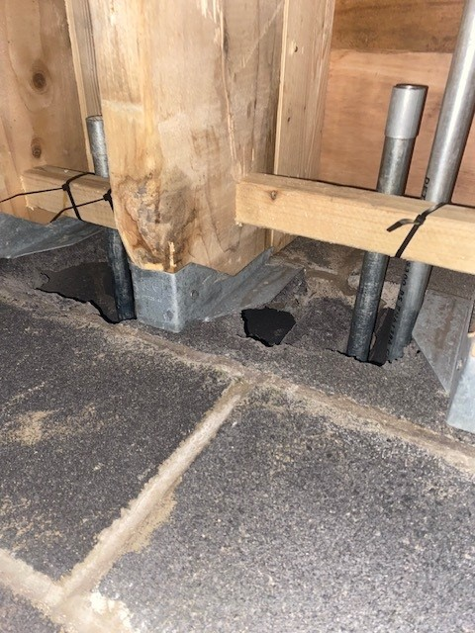
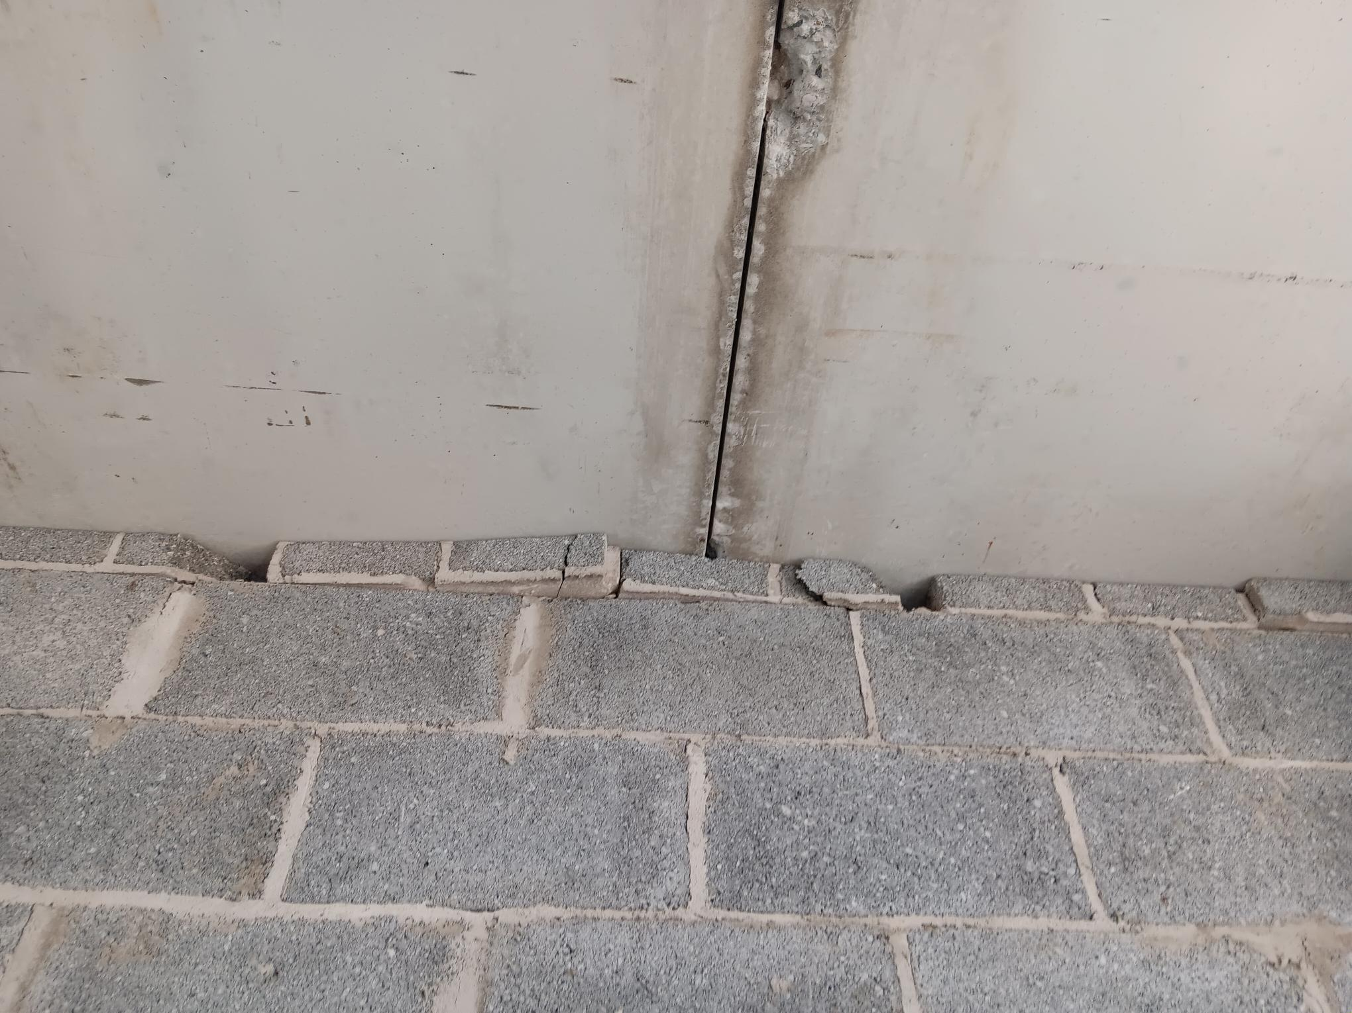
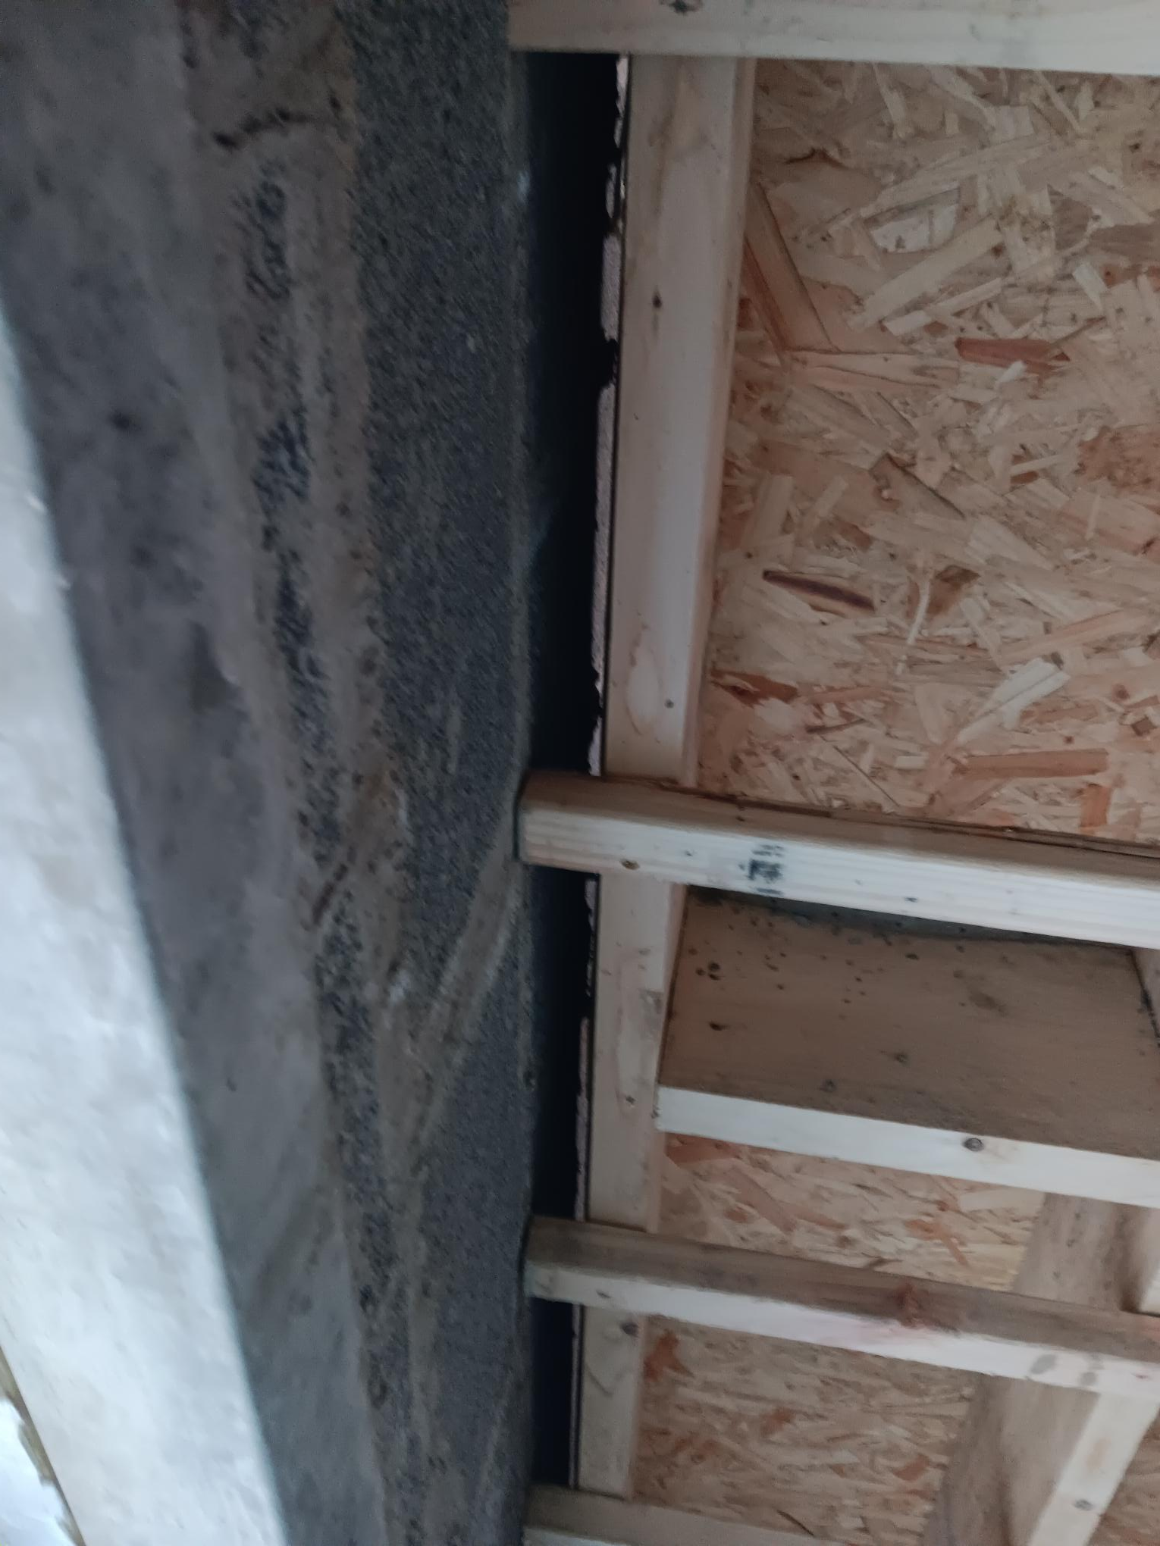
Example 2
Inadequate lateral support from floors

Slide 20
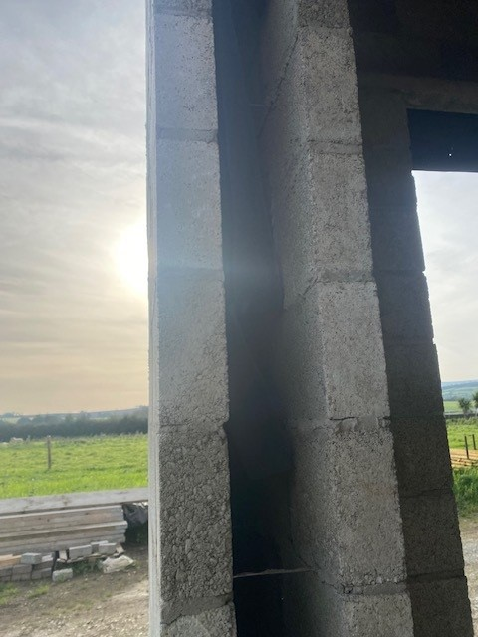
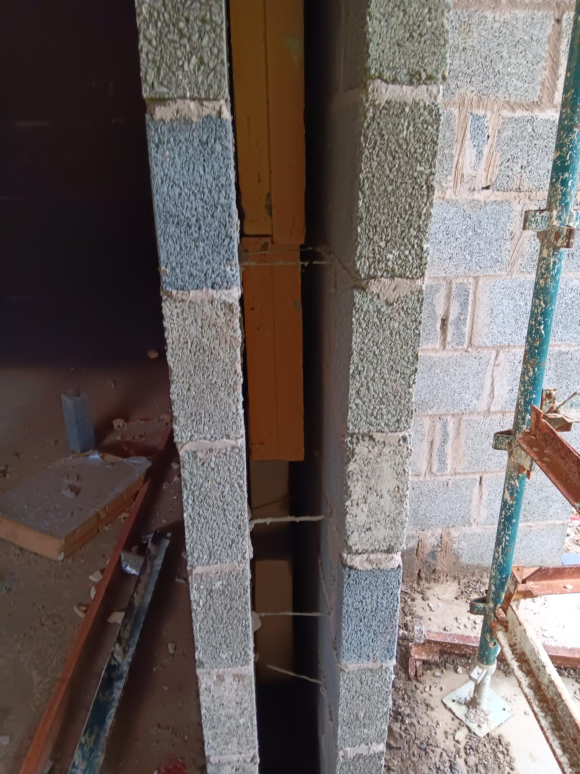
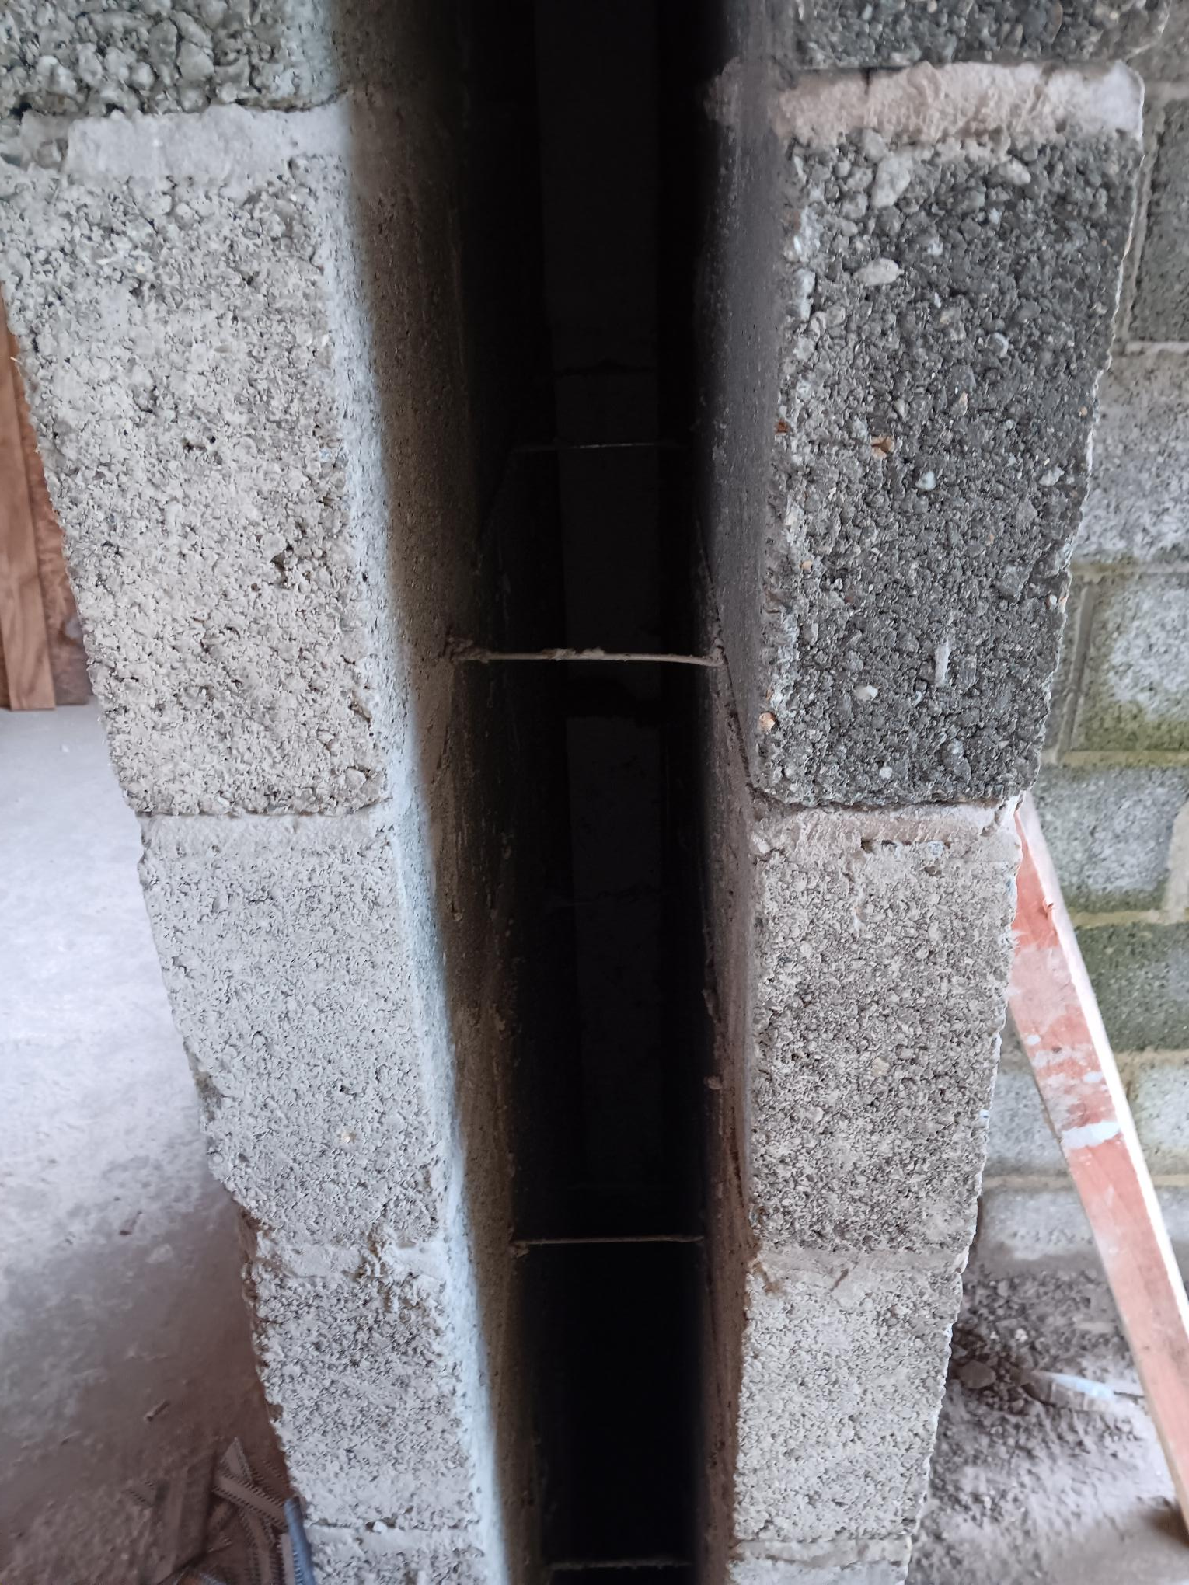
Example 3
Insufficient wall ties around openings

Slide 21
What Does the Guidance Say?
1.1.3.18
Construction over openings and recesses should be adequately supported and the ends of lintels and beams. All window and door lintels should have a minimum bearing length of 150mm.
1.1.3.24
Walls should be strapped to floors at first level at intervals not exceeding 2m as shown in Diagram 6 (a) and (b) by 30mm X 5mm galvanized mild steel or stainless-steel tension straps. Subsection (b) gives guidance on joist hangers.
1.1.3.27
The minimum quantity of wall ties provided should be: 4.9 wall ties per square meter for cavity widths of 100mm and 150mm. Extra wall ties are required at the jambs of openings and movement joints as shown in Diagram 9
TGD Part A 2012

Slide 22
Fire Stopping
Main Issues Seen on-Site
Fire bags not installed correctly
Penetrations/openings in party walls
Inappropriate materials being used for fire stopping
Fire collars/dampers not being utilised when penetrating a fire barrier

Slide 23
Fire Stopping
Main Issues Seen on-Site
Fire bags not installed correctly
Penetrations/openings in party walls
Inappropriate materials being used for fire stopping
Fire collars/dampers not being utilised when penetrating a fire barrier
What Document are we Referencing?

Slide 24
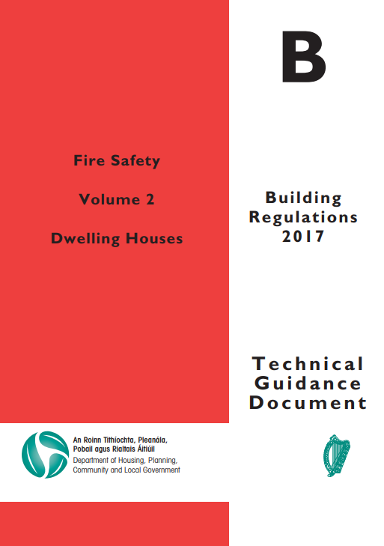
Fire Stopping
Main Issues Seen on-Site
Fire bags not installed correctly
Penetrations/openings in party walls
Inappropriate materials being used for fire stopping
Fire collars/dampers not being utilised when penetrating a fire barrier
What Document are we Referencing?
Technical Guidance Document Part B
    Fire Safety Volume 2 Dwelling House 2017

Slide 25
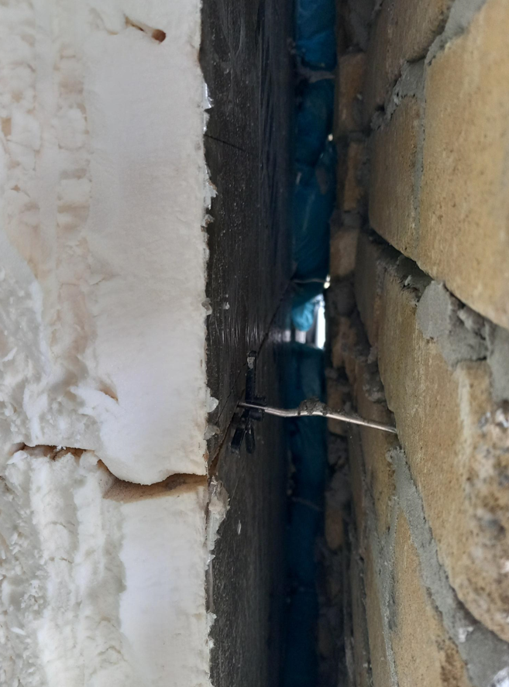
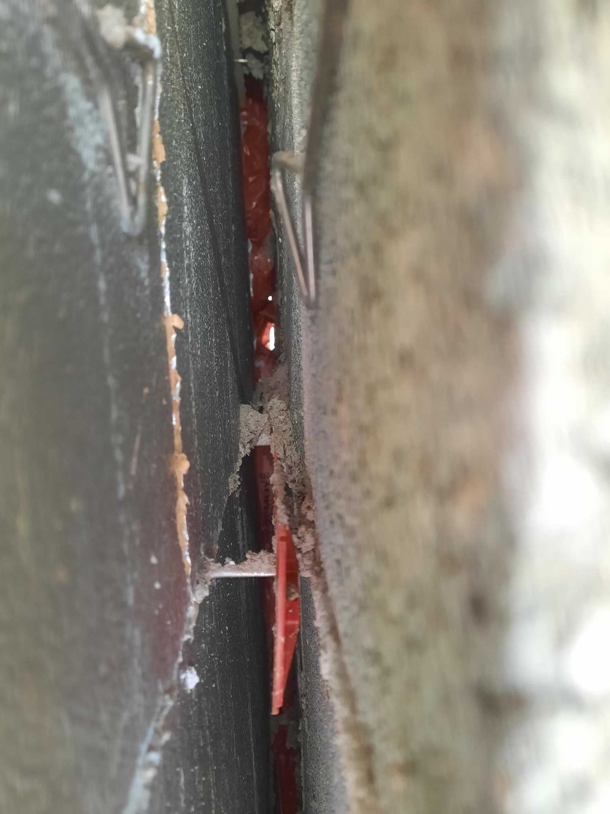
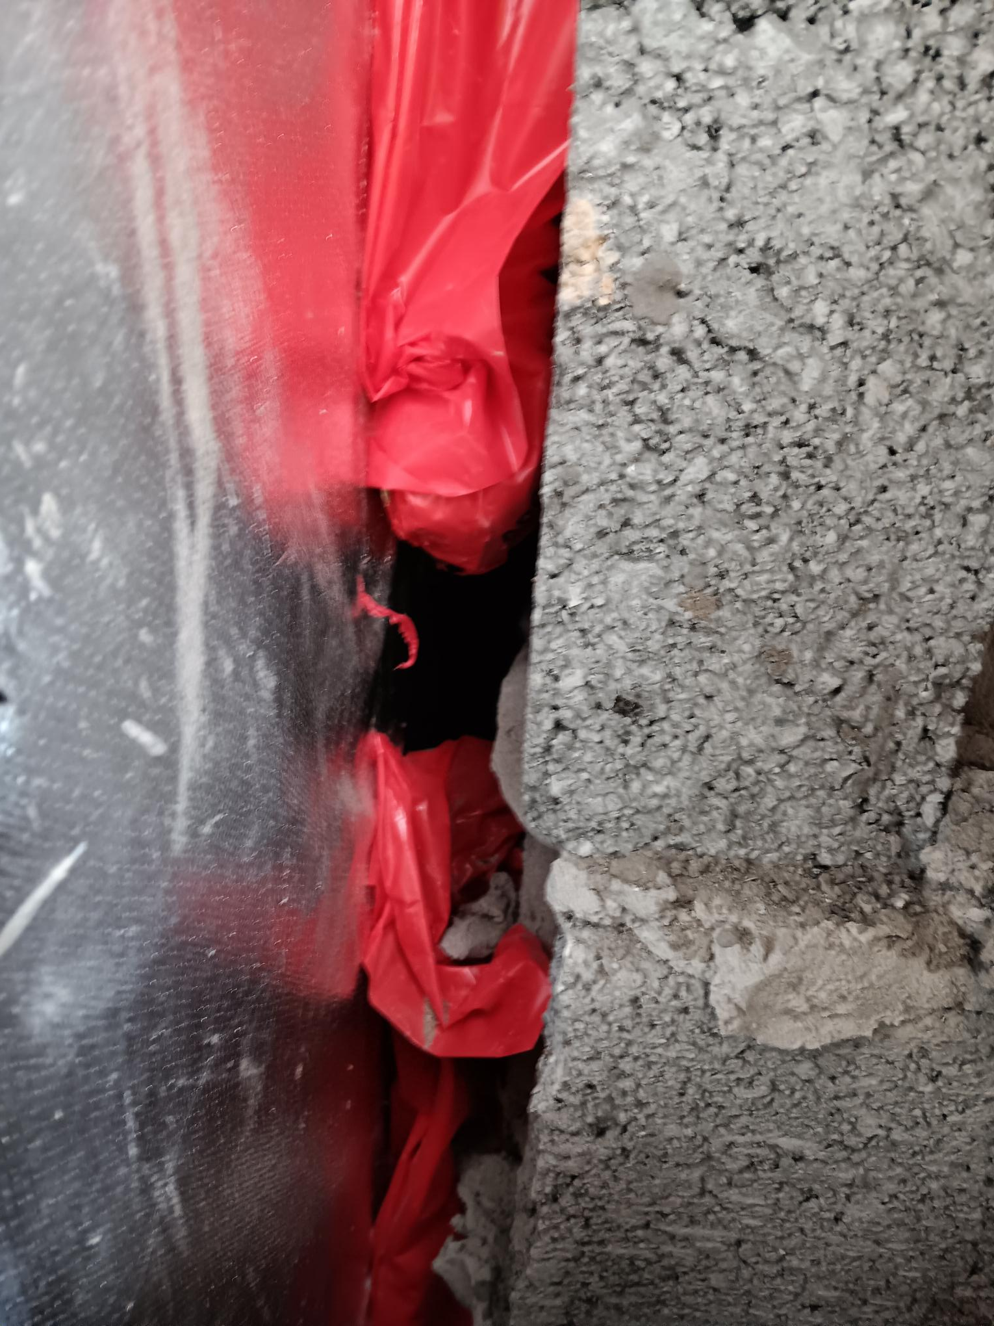
Example 1
Fire bags not installed correctly

Slide 26
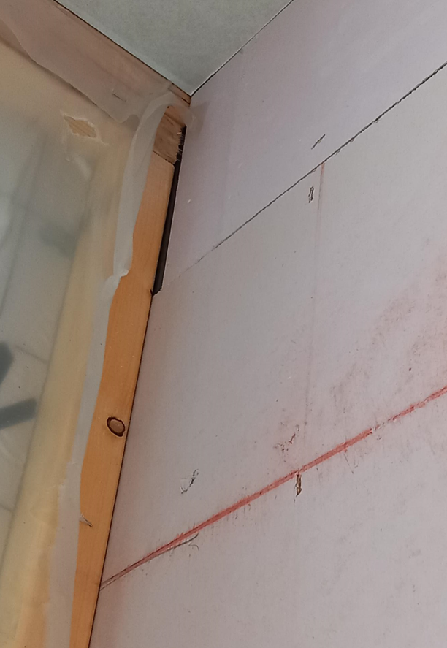
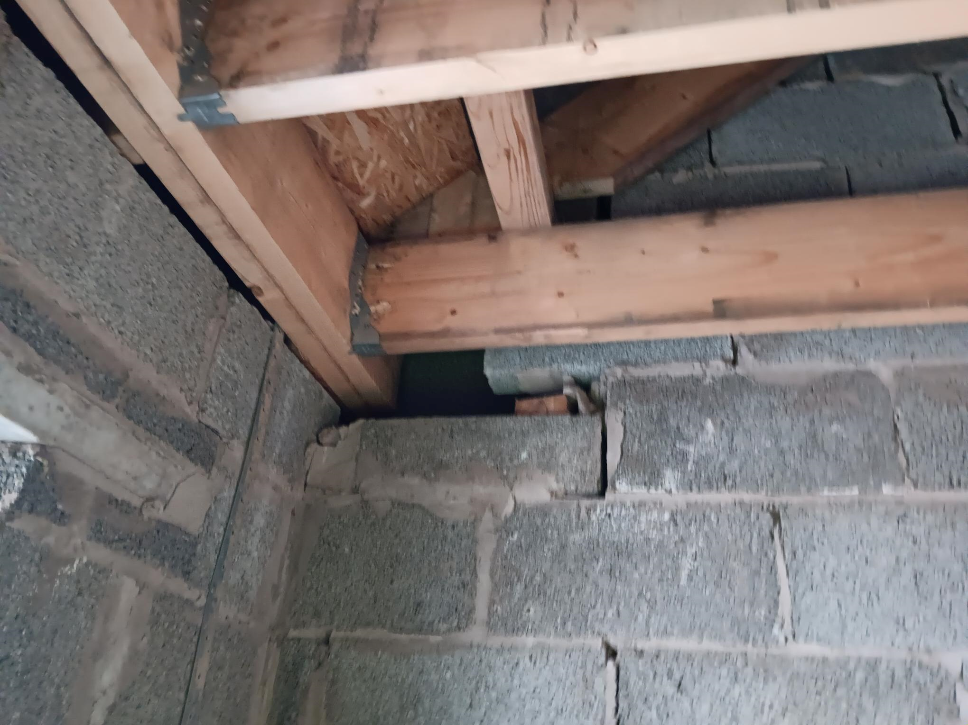
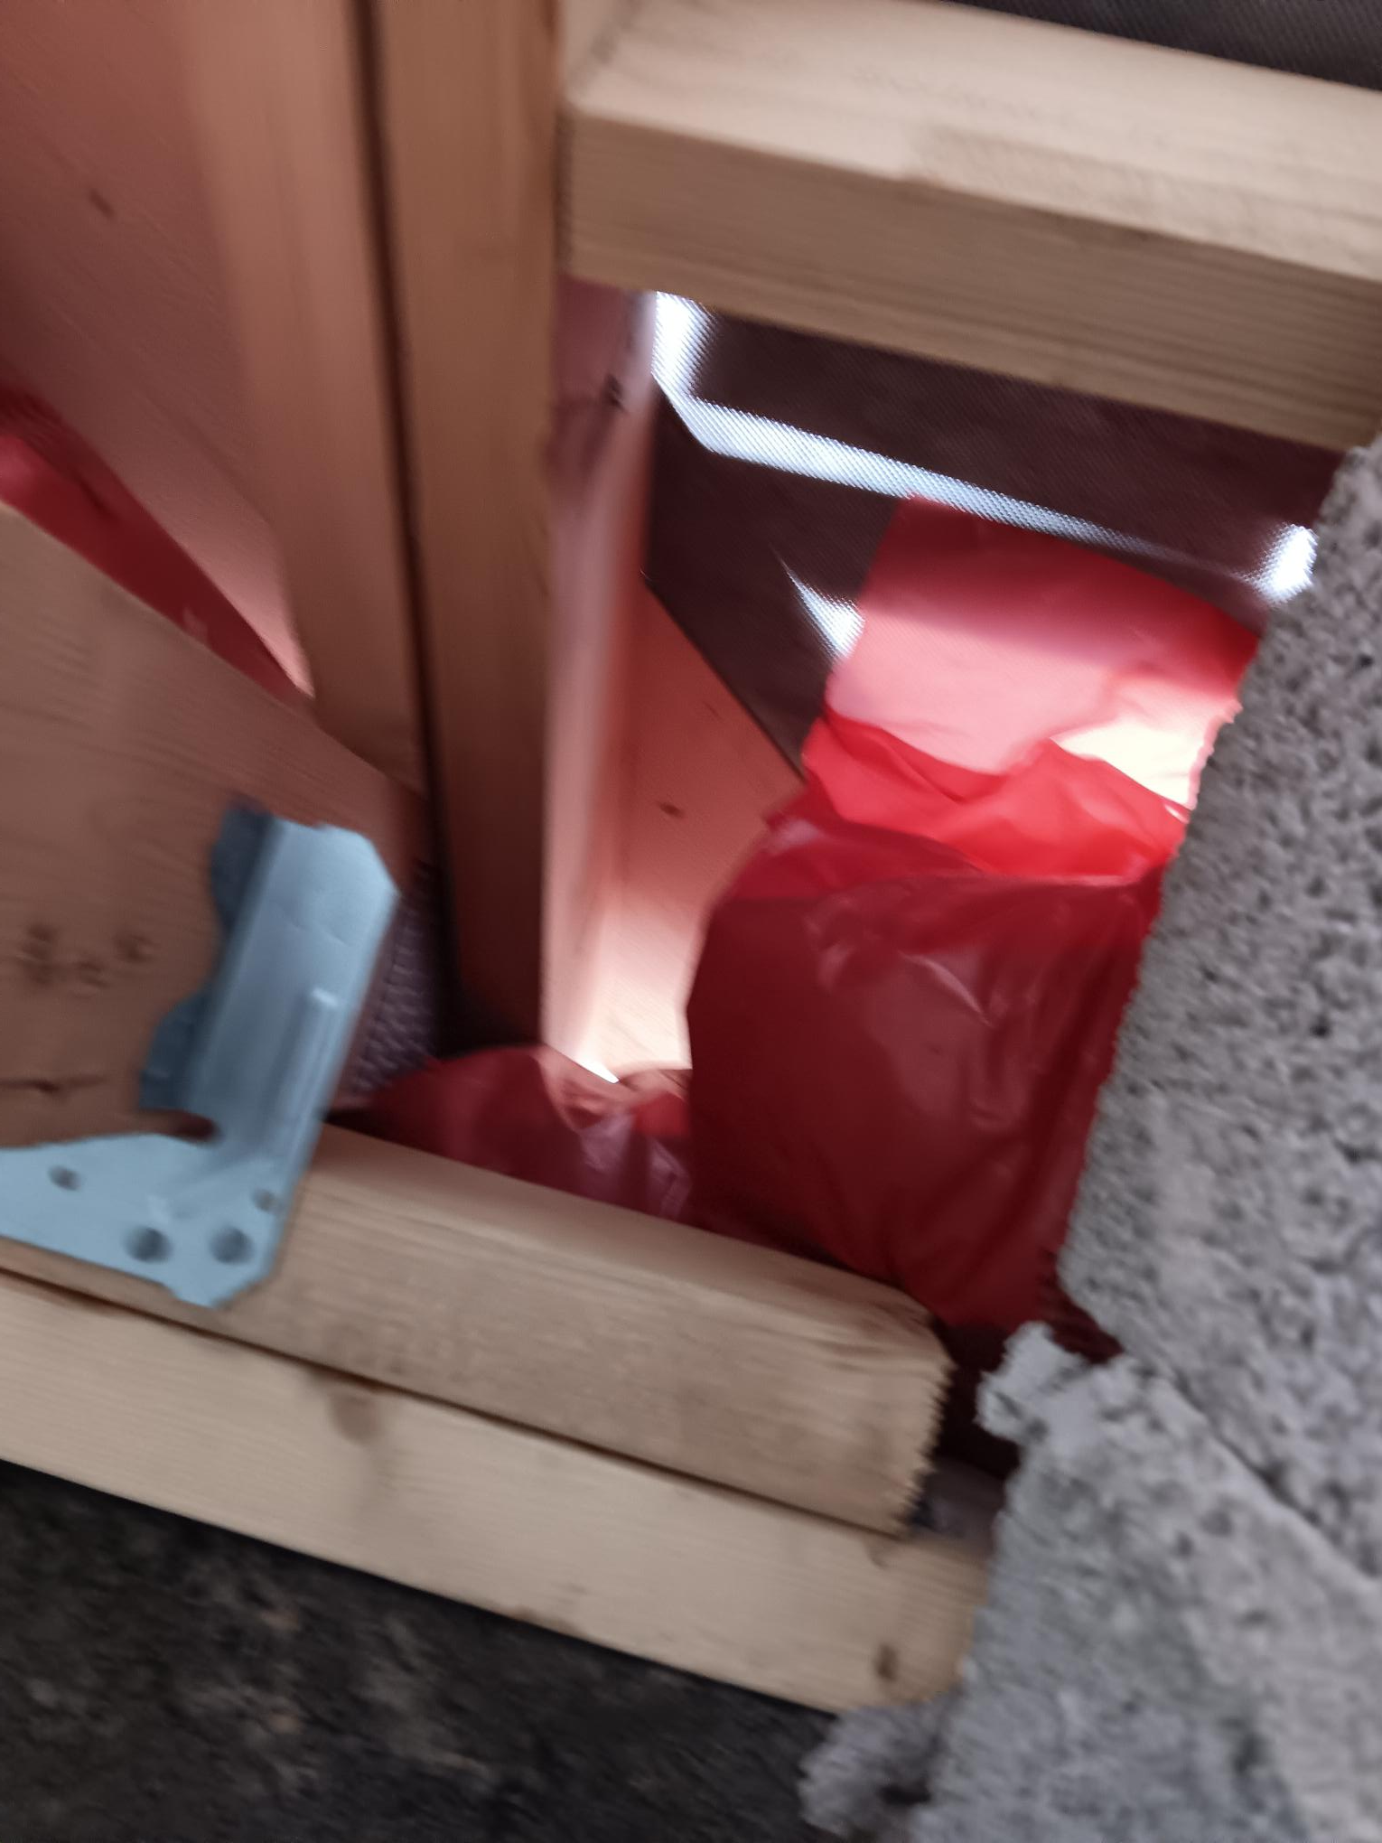
Example 2
Penetrations / openings in party walls

Slide 27
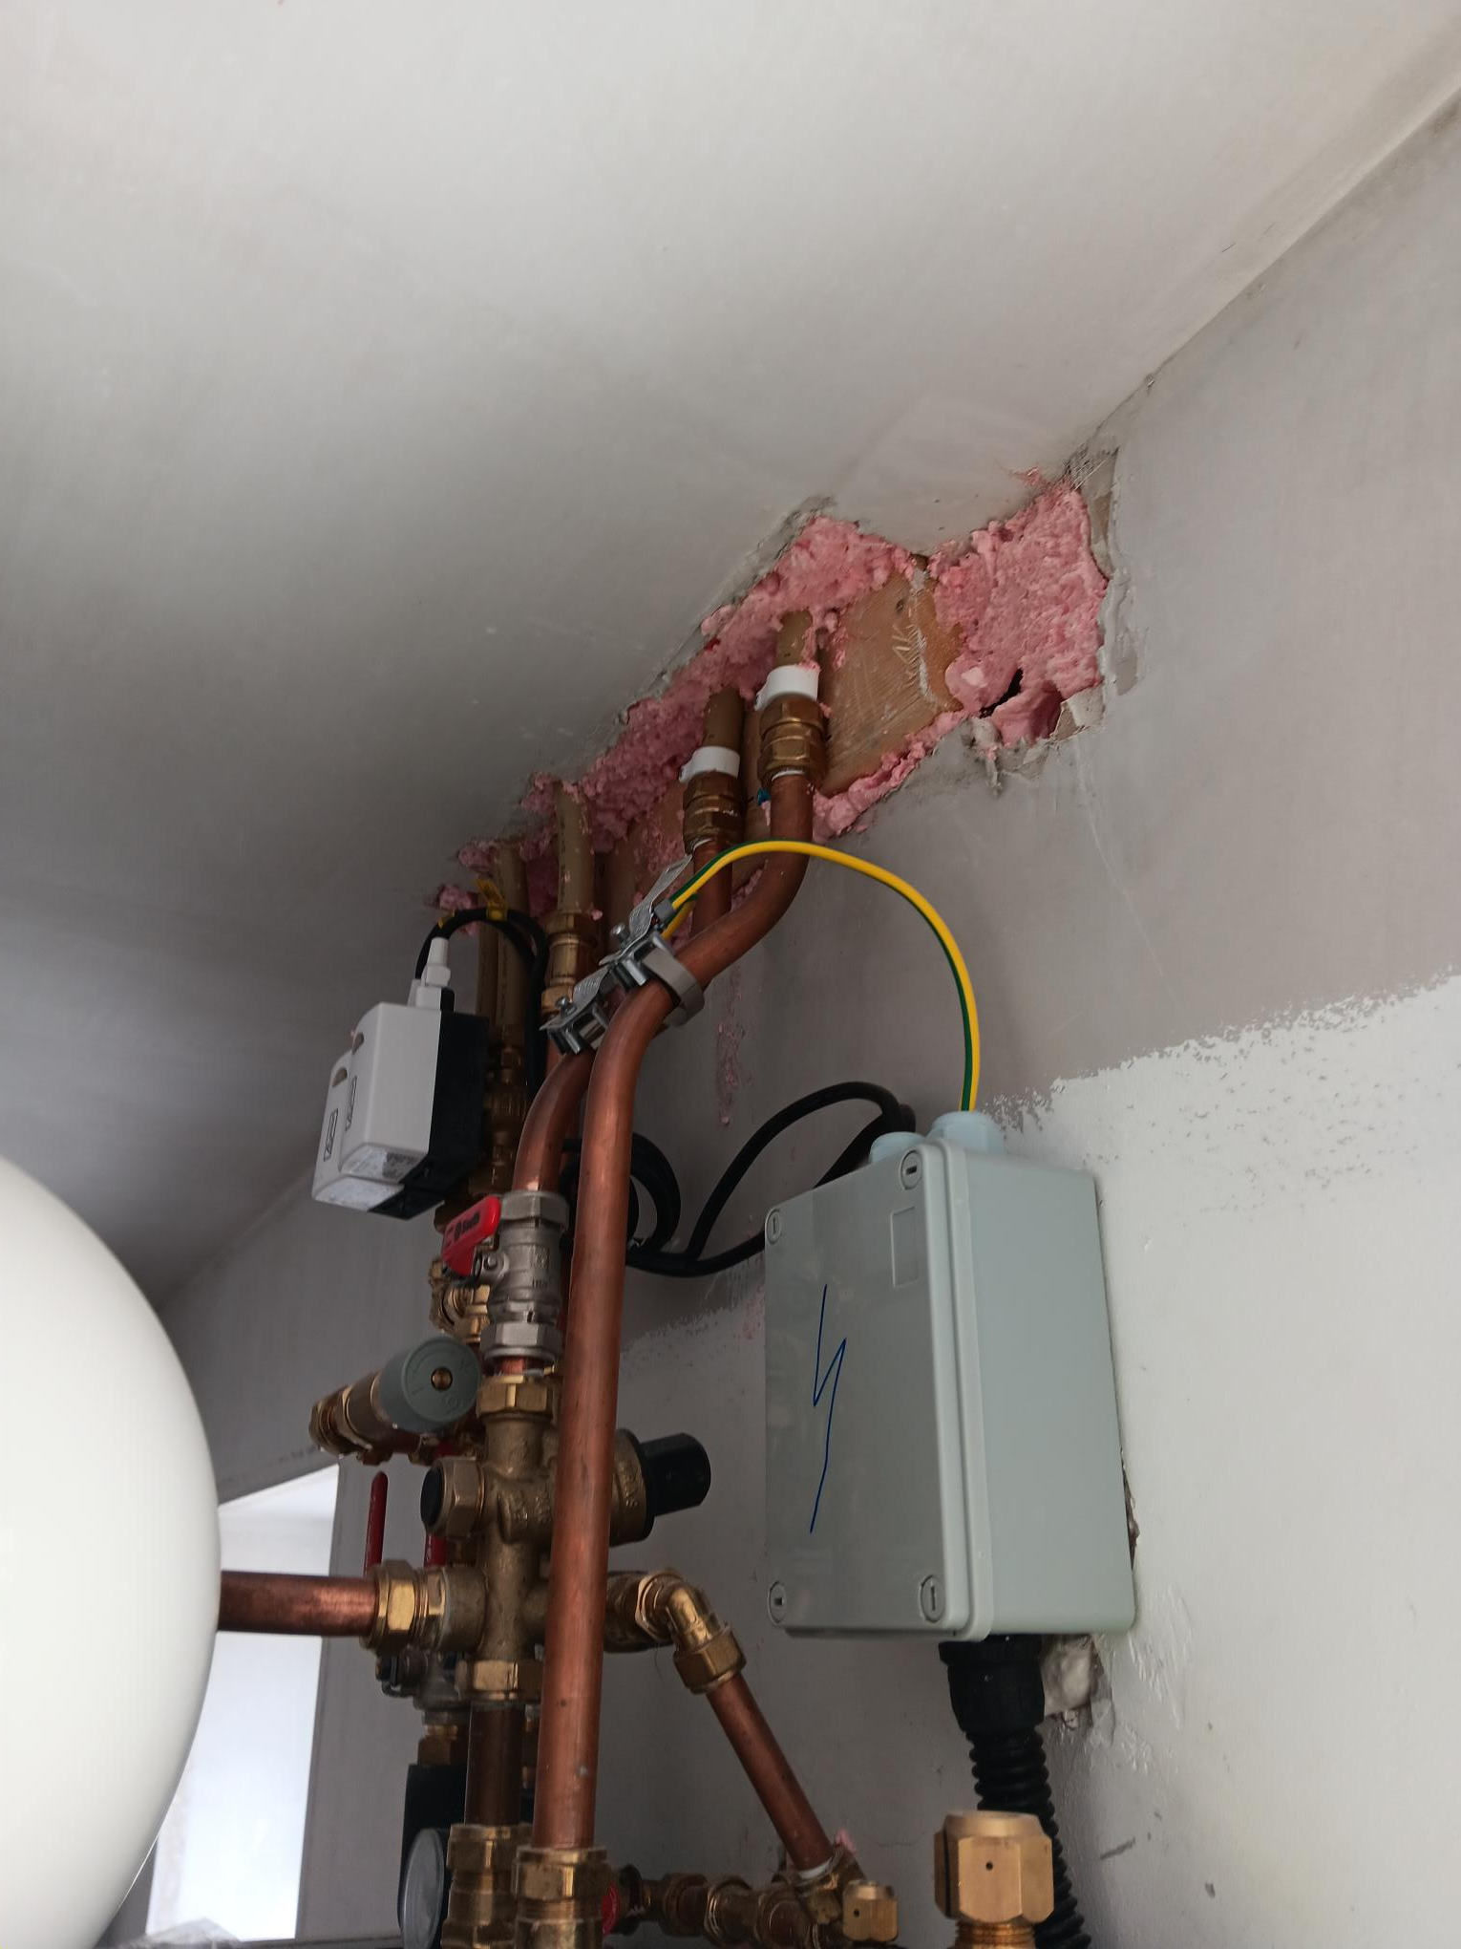
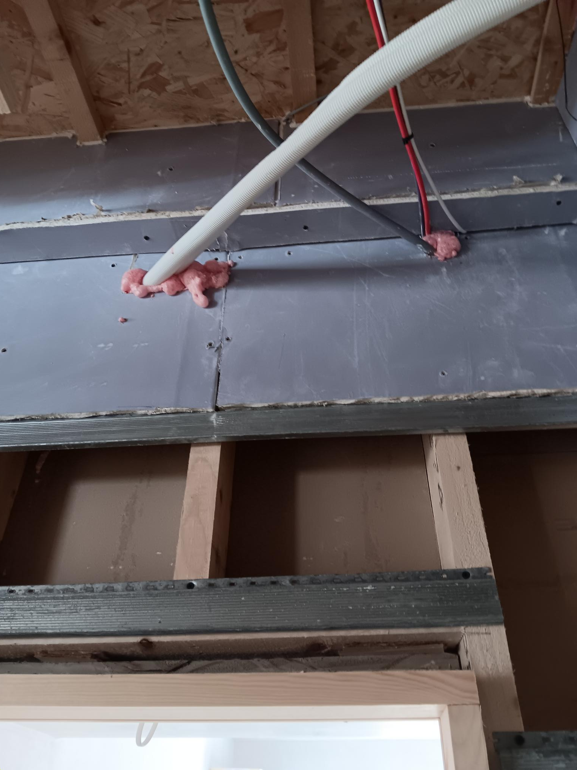
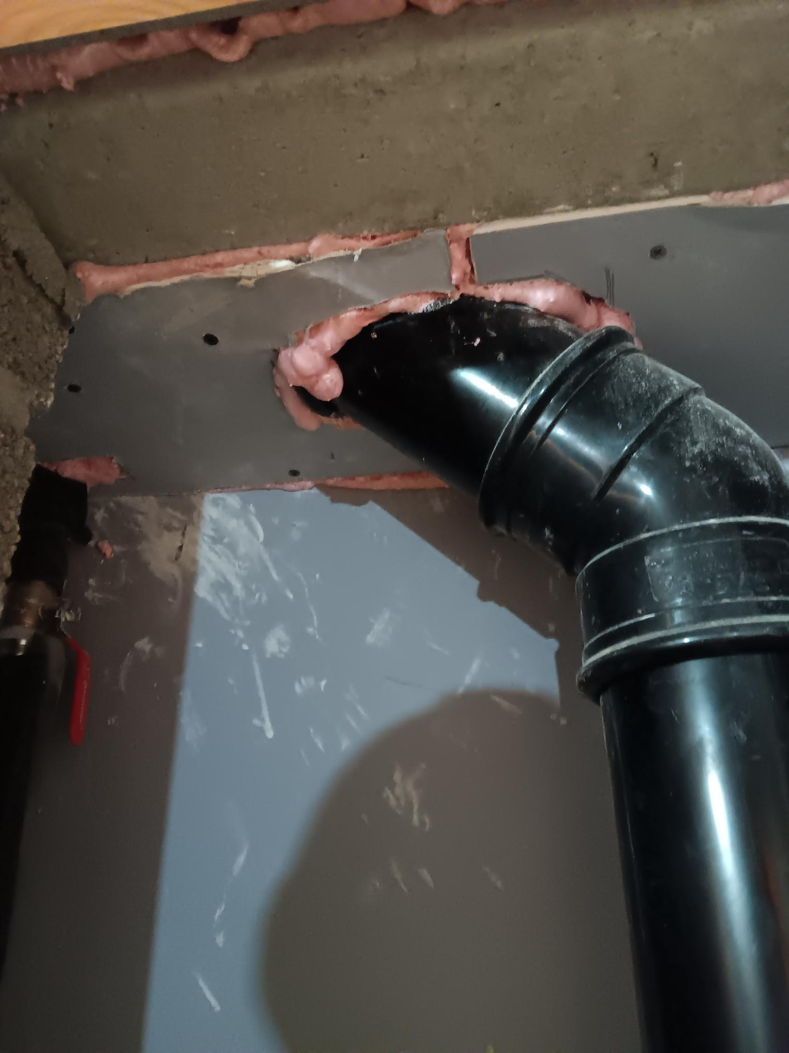
Example 3
Inappropriate materials being used for fire stopping

Slide 28
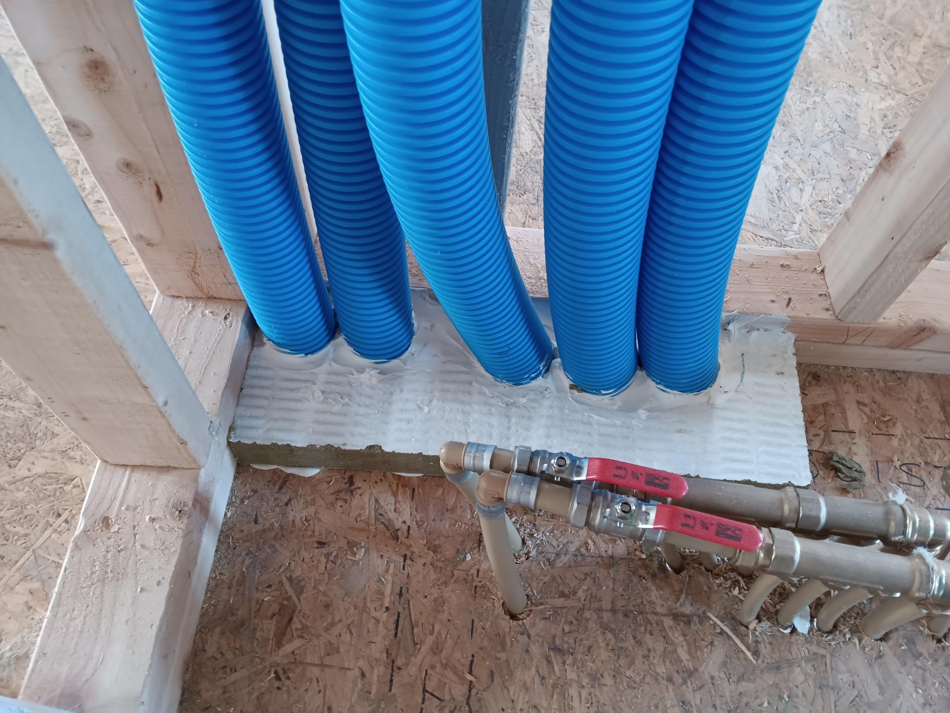
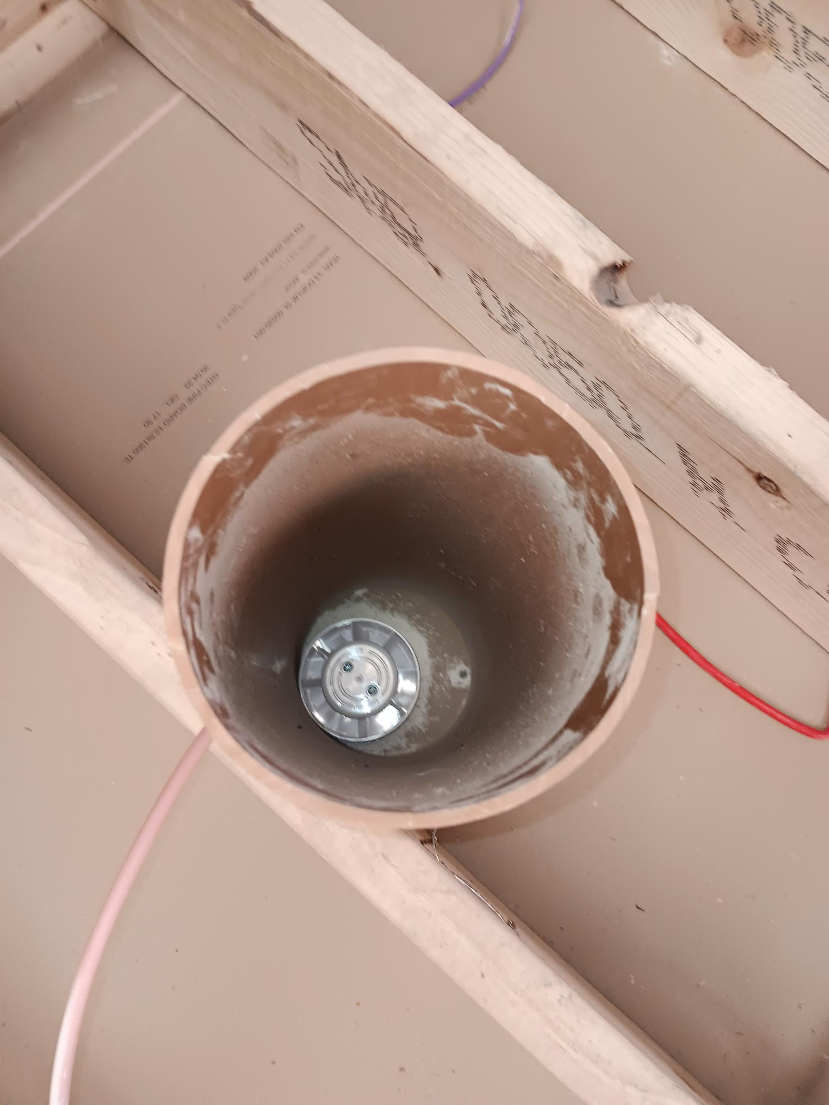
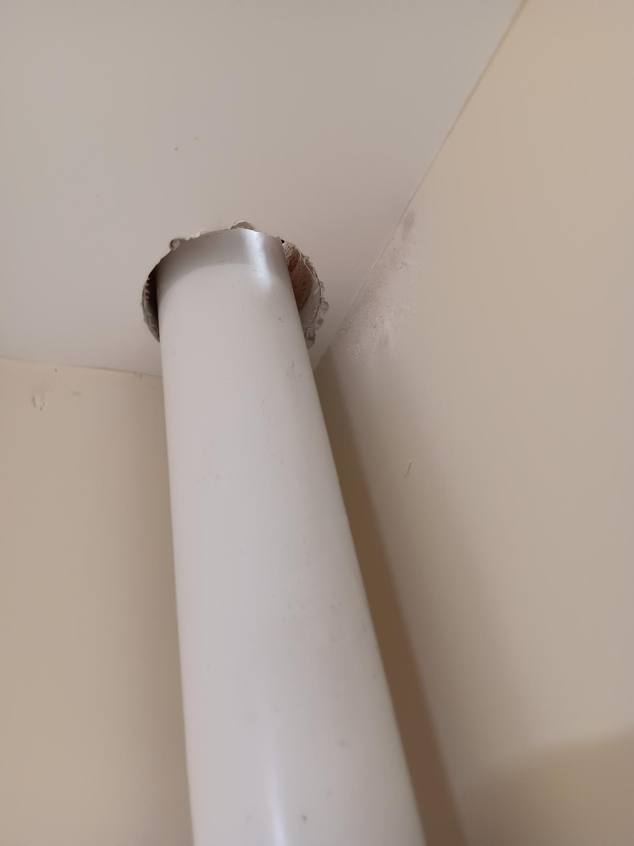
Example 4
Fire collars/dampers not being utilised when penetrating the fire barrier

Slide 29
What Does the Guidance Say?
3.5.4.5
Where a separating wall meets an external wall, the junction should be fitted with a cavity barrier in accordance with Diagram 12. The separating wall should also achieve a fire resistance in accordance with Table 1A of REI (60).
3.5.4.6
The gap between the wall and the underside of the roof should be as small as practicable (generally not greater than 50mm) and be filled with suitable fire stopping material over the full width of the wall. Ref Diagram 12.
3.7.2
Pipes which pass through a wall or floors which are required to be fire resisting, or cavity barrier, should meet the appropriate provisions in alternatives A (Proprietary seals), B (Pipes with a restricted Diameter) and C (Sleeving).
TGD Part B 2017

Slide 30
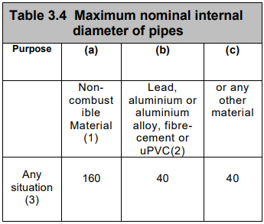
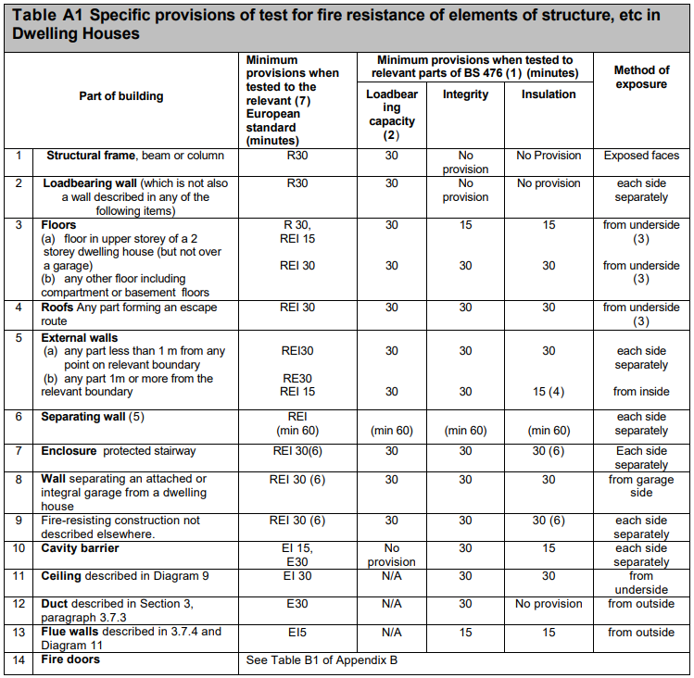
Additional Notes from Part B
The maximum diameter for pipes is outline in Table 3.4 of TGD Part B
European classification of the resistance has 3 classes (REI)
  (R) fire performance in respect of loadbearing capacity
  (E) fire performance in respect of integrity
  (I) fire performance in respect of insulation
3.7.7 Proprietary seals: other fire stopping materials are as follow where appropriate:
    Cement or Lime mortar
    Gypsum based plaster
    Cement or Gypsum based vermiculite/ perlite mixes
    Glass fibre, mineral wool, crushed rock, blast furnace slag or ceramic based products

Slide 31
Circular PL 07-2024
This relates to submissions coming into the Christmas period.
BCMS will be shut down on the 20th December 2024 until the 1st January 2025.
To avail of the of the Development Contributions waiver a Commencement Notice/ 7 Day Notice should be lodged before the 17th December 2024.

Slide 32
Thank you for your attention

