Slide 1

Wexford County Council Public Lighting LED Retrofit Programme
Tim Murphy BE CEng MIEI, Senior Executive Engineer
Roads Department, Wexford County Council

Slide 2
INTRODUCTION
In 2017 Wexford County Council operated and maintained 14,115 public lights. This has risen to 15,443 in 2022.
692 were LED
The remaining 13,423 were a mix of Son, Sox and
Metal Halides lights
The operation and maintenance cost amounted to €1,330,000
Energy Cost in 2017= €930,000
Maintenance Cost in 2017= €400,000

Slide 3
REASONS FOR RETROFIT PROGRAMME
The energy reduction that would be achieved from the programme would contribute towards the Council’s 2020 energy savings target of 33%.
Energy cost savings
Maintenance Cost savings
Upgrade of old lighting stock
Upgrade of older Sox lanterns that are now obsolete.

Slide 4
ENERGY REDUCTIONS
Public lighting is Wexford County Council’s largest consumer of energy at up to 60% of the total energy consumption of the council.
The retrofit programme achieved savings of up to 65%. This one programme once fully completed will have achieved the 33% energy reduction required under the 2020 energy savings target

Slide 5
ENERGY COST SAVINGS
The public lighting energy cost for 2018 was €930,000. This increased by up to 12% in 2019 bringing the energy bill to €1,054,000.
The reduction of 65% in the energy bill will amount to an annual saving of €677,000 per annum once the programme is complete

Slide 6
MAINTENANCE COSTS SAVINGS
The 2017 maintenance costs were running at €400,000 per annum. This was broken down as follows;
Routine Maintenance Costs- bulb replacement, bracket replacement act. | €250,000
Non routine maintenance costs – knock downs, cable faults, vandalism | €150,000

Slide 7
MAINTENANCE COSTS SAVINGS
Once the programme has been completed the routine maintenance bill will be reduced to no more than €50,000 per annum.
This will result in an annual saving on maintenance of €200,000.

Slide 8
UPGRADE OF OLD LIGHTING STOCK
There was never an asset replacement programme for public lighting. Many of the lamp standards were old and in need of replacement.
These lanterns needed to be replaced. It made sense to replace with Led lanterns rather than Son lanterns due to the energy and cost savings that could be achieved.

Slide 9
UPGRADE OF OLD LIGHTING STOCK
The retrofit programme ensures that Wexford County Council will have an asset replacement programme for public lighting going forward.

Slide 10
UPGRADE OF OLDER SOX LANTERNS
These lanterns are not being manufactured anymore. In fact the manufacture of the Sox bulb was discontinued from the end of 2019. It was imperative that all Sox lanterns were replaced by no later than the end of 2020.

Slide 11
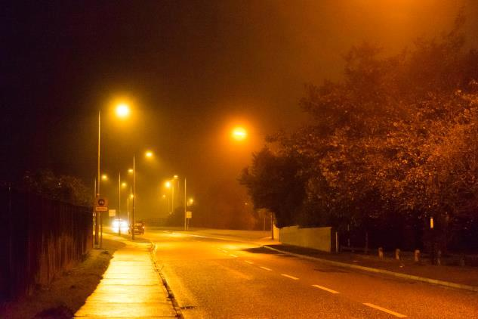
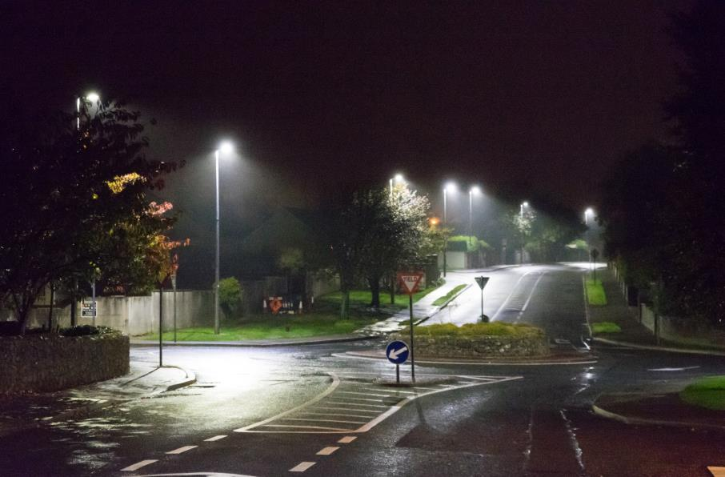
BEFORE
AFTER

Slide 12
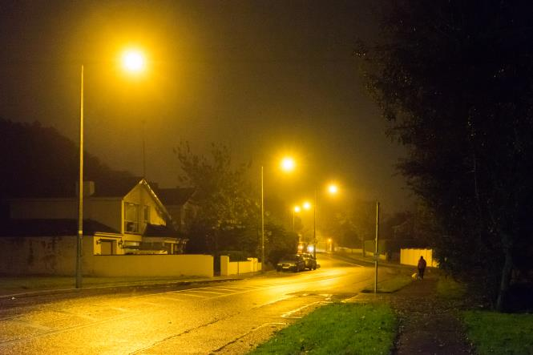
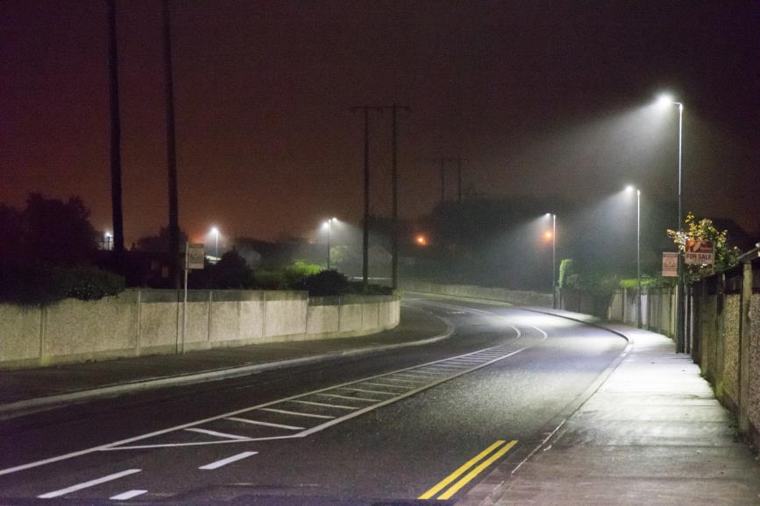
BEFORE
AFTER

Slide 13
PROGRAMME
The retrofit was be carried out over a 5 year programme.
2017 – 980 lanterns of the higher 250 W and 150W replace with 80W and 120W Led in Gorey, Enniscorthy and Wexford Towns.
2018 – 2,450 lanterns replaced in Wexford Town. All lanterns in Wexford Town are now Led.

Slide 14
PROGRAMME
2019 3,450 lanterns replaced.
2020/2021 The plan was to replace 5,700 lanterns. This was delayed due to Covid. It is expected to be completed by mid 2022.
The total cost of the programme will be in the region of €5,500,000.
The annual savings in energy and maintenance will be in excess of €850,000 per annum giving a payback of between 6 to 7 years.

Slide 15
PROGRAMME IN DETAIL
66% of existing lanterns were 70W Son and were replaced with 18W to 25W Led
The majority of the remainder were either 135W Sox or 150W Son and were replaced with 84W Led
The majority of the 25W Led lanterns were in housing estates. We were able to dim to 75% at midnight while still achieving required lighting levels.
The 84W Led will be dimmed to 75% from Midnight

Slide 16
PROGRAMME IN DETAIL
Before |  | After
Lamp Type | Billable Wattage | Lamp Type | Billable Wattage | Equivalent wattage taking 75% midnight to dawn dimming into account | % Energy Reduction
70W Son | 85W | 25W Led | 25W | 21.875W | 74%

Slide 17
PROGRAMME IN DETAIL
Before |  | After
Lamp Type | Billable Wattage | Lamp Type | Billable Wattage | Equivalent wattage taking 25% midnight to dawn dimming into account | % Energy Reduction
150W Son | 170W | 84W Led | 84W | 73.5W | 57%

Slide 18
CONCLUSION
The retrofit programme will deliver;
65% reduction in energy
60% reduction in operation and maintenance costs
6 to 7 year payback on investment

